Slide 1
3D Sound
for Video Games
from surround sound to spatialized audio
Lawrence Schwedler
DigiPen Institute of Technology
Audio Engineering Society Pacific Northwest Section
21 June 2017
Notes:
Tonight’s talk is about 3D sound for video games and the difference between surround sound and spatialized audio.
I’ll start with a brief look at the history of game audio technology, and then dive in to the complex question of how we perceive sound in three dimensions.
I’ll discuss some of the current techniques for simulating 3D sound for VR games using headphones, and wrap up with a look at how we might soon achieve a similar effect using loudspeakers.
After the break, you’ll have a chance to listen to 3D sound over loudspeakers, and also to experience a VR game that uses the techniques discussed to deliver spatialized audio over headphones.

Slide 2
Sources
Facebook Oculus Audio SDK - Introduction to Virtual Reality Audio
Google VR - Spatial Audio
Dr. Edgar Choueiri, 3-D Audio & Applied Acoustics Lab, Princeton University - BACHH™ 3D Sound
Notes:
The information presented here on human sound localization and methods for spatializing audio comes largely from two excellent websites:
Facebook Oculus “Introduction to Virtual Reality Audio” and
Google VR “Spatialized Audio”
For information regarding binaural audio over loudspeakers, I am deeply indebted to Dr. Edgar Choueiri and his 3-D Audio and Applied Acoustics Lab at Princeton University. Dr. Choueiri has been extremely generous in sharing with DigiPen his software, hardware, expertise, and his time.
I’d also like to thank JJ Johnston and Paul Hubert of Immersion Networks for sharing with us a glimpse of their work on spatialized audio. I have no doubt we’ll be hearing more from them in the days and weeks to come.
Finally, I’d like to thank my colleagues Matt Klassen, Greg Dixon, and Ian Shores, without whom this presentation would not have been possible.

Slide 3

Mono, Monaural, Monophonic
Mixed and routed through a single audio channel and perceived as coming from one position
Mono mix of Chopin Etude No. 10, Op. 3
Notes:
Let’s start with some definitions:
Mono, monaural, or monophonic audio is mixed and routed through a single audio channel and perceived as coming from one position.
Here’s a mono mix of Chopin’s Etude No. 10 Op. 3, arranged for viola and piano, performed by Brian Scott and Sachiko Stark, and recorded by Greg Dixon in our studio here at DigiPen.
[click to play example]

Slide 4
Stereo, Stereophonic
Recorded by two or more microphones and mixed and routed through two audio channels to two speakers
Stereo mix of Chopin Etude No. 10, Op. 3
Notes:
Stereo is recorded by two or more microphones and mixed and routed through two audio channels to two loudspeakers, giving a spatial effect to the sound.
Here’s a stereo mix of the same recording.
[click to play Chopin stereo example]

Slide 5
Stereo vs. Mono over Two Channels
  ProTools demo: Chopin Etude No. 10 Op. 3
Notes:
[Switch to Pro Tools to play Chopin Etude No. 10 Op. 3]
We’re familiar with how a mono signal, routed through two speakers at equal volume, sounds as if it’s coming from a single, “phantom” position between the two speakers.
Changing the amplitude balance of the two signals pulls the image to one side. This is a basic example of amplitude panning.

Slide 6
Binaural
“Having or relating to two ears”
Binaural hearing, along with frequency cues, lets humans and other animals determine the direction and origin of sounds.
Binaural recording is done with two microphones and transmitted separately to the two ears of the listener
Notes:
“Having or relating to two ears”
Binaural hearing, along with frequency cues, lets humans and other animals determine the direction and origin of sounds.
Binaural recording is done with two microphones and transmitted separately to the two ears of the listener, typically with headphones. The importance of this distinction will become apparent as we explore the psychoacoustics of 3D sound perception.

Slide 7
Surround Sound
Mixed and routed through multiple audio channels to multiple speakers surrounding the listener
Movie theater, home theater, 5.1, 7.1 surround sound
Notes:
Surround Sound is mixed and routed through multiple audio channels to multiple speakers surrounding the listener.
This is the experience you get in a movie theater or home theater using 5.1 or 7.1 surround sound.
Surround Sound is mixed in a studio with calibrated speakers, according to aesthetic judgements made by the mixing engineer, which may or may not be realistic.

Slide 8
Spatialized Audio
Audio processed to sound as if it is positioned at a specific point in three-dimensional space, simulating direction of origin and distance from the listener
Current VR systems use headphones to deliver binaural audio
Notes:
Spatialized audio is processed to sound as if it is positioned at a specific point in three-dimensional space, simulating direction of origin and distance from the listener.
Current VR systems use headphones to deliver binaural audio that fools us into hearing the direction of origin of virtual sound sources.

Slide 9
A Brief History of
Game Audio - 1970’s
Video arcades, early game consoles
Simple wave generators – sine, square, sawtooth
FM synthesis – combine simple waveforms into complex waveforms
Shape the amplitude envelopes with ADSR (attack, decay, sustain, release)
Notes:
The video arcade machines of the 1970’s utilized…
Simple wave generators – sine, square & sawtooth – to produce tones and electronic sound effects.
FM Synthesis allowed us to combine simple waveforms into complex waveforms
Shape the amplitude envelopes with ADSR (attack, decay, sustain, release)

Slide 10
A Brief History of
Game Audio -1980’s
Home consoles, PCs
Digital audio: 8-bit mono PCM
Amiga Original Chip Set, Sound Blaster PC sound card
Notes:
Digital audio in the form of 8-bit mono PCM appeared in the 1980’s via
the Amiga Original Chip Set, and later on the Sound Blaster PC sound card.

Slide 11
A Brief History of
Game Audio -1990’s
2nd gen home gaming consoles, PCs
Digital audio: 16-bit stereo PCM
SNES, Sound Blaster Pro PC sound card
Notes:
In the early 1990’s, 16-bit stereo came to home consoles such as
the SNES, and to PC gaming via the Sound Blaster Pro sound card.

Slide 12
A Brief History of
Game Audio - 2001
modern game consoles like the Xbox
Multichannel surround sound, 5.1
Vector Based Amplitude Panning
Lateral panning for direction, volume attenuation for distance
No psychoacoustic cues
Notes:
By 2001, gaming consoles such as the Xbox supported 5.1 surround sound – multichannel, CD-quality audio routed to multiple speakers surrounding the listener.
Advances in 3D graphics for game led to increased expectations for more realistic game audio. Vector-based amplitude panning allowed sound designers to pan and attenuate sounds according to the 3D coordinates of their virtual sources in the game.
VBAP uses lateral panning and volume attenuation for distance.
However, it does not produce the psychoacoustic cues we use to perceive 3D sound.

Slide 13
A Brief History of
Game Audio
Oculus Rift, HTC Vive, Playstation VR
A head-mounted display (HMD) that tracks head motion
Spatialized audio over headphones that simulates three-dimensions of sound
Notes:
Since the development of 5.1 surround sound, not much has changed in 3D sound for games – until recently.
Virtual reality systems such as Oculus Rift, HTC Vive, and Playstation VR have replaced the video monitor and surround sound speakers with
a head-mounted display, the ability to track head motion, and
Spatialized audio over headphones that simulates three dimensions of sound.
Let’s take a look at how we hear in three dimensions with two ears.

Slide 14
Localization: How We Hear in Three Dimensions with Two Ears
Differences in timing, amplitude, and frequency determine direction of origin
Reflections, reverberation, and other cues determine distance
Occlusion causes low-pass filtering
Learned cues
Psychoacoustics, inference, visual and learned cues combine to help us localize sound
Notes:
Our brain compares the signal entering our two ear canals, analyzing differences in timing, amplitude, and frequency to determine a sound’s direction of origin.
Reflections, reverberation, and other cues tell us how far away it is.
Sounds coming from behind a wall or other large object appear to lose some high-frequencies.
Experience teaches us that birds are usually above rather than below.
We use psychoacoustics, inference, visual cues, and learned cues to determine where a sound is coming from and how far away it is.

Slide 15
How We Localize
Lateral Direction
Our brain measures:
differences in the arrival time
differences in the volume level
image from of Google VR - Spatial Audio
Notes:
Our brain measures differences in the arrival time and volume level at each ear to localize sounds laterally (left-to-right.)

Slide 16
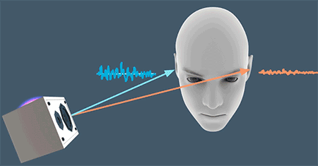
Interaural Time Difference
  ITD: the delay between a sound’s arrival in both ears
image from Google VR - Spatial Audio
Notes:
Interaural time difference, or ITD, is the delay between the sound’s arrival in both ears.

Slide 17
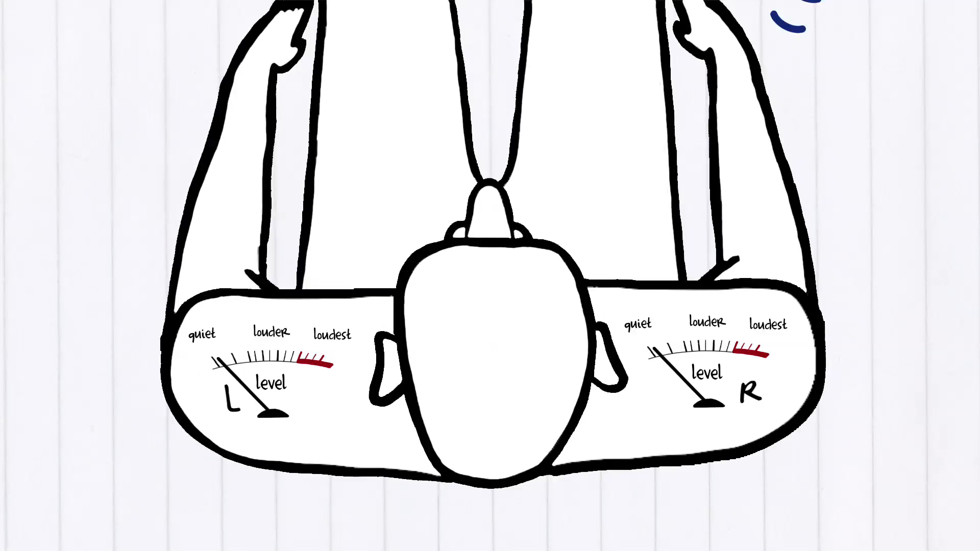
Interaural Level Difference
ILD: the difference in the volume level at each ear
image courtesy of Dr. Edgar Choueiri, 3-D Audio & Applied Acoustics Lab, Princeton University
Notes:
Interaural level difference, or ILD, is the difference in the volume level at each ear.

Slide 18
ITD, ILD, and Frequency
below 500-800 Hz – mostly ITD
~800-1500 Hz – ITD and ILD
above 1500 Hz – mostly ILD
Notes:
ITD and ILD are frequency dependent. Which technique we use depends heavily on the frequency content of the sound.
1. For wave lengths longer than the distance between our ears (below 800 Hz) we can distinguish the difference in arrival times at each ear, but have difficulty perceiving differences in level. For wave lengths much shorter than the inter aural distance (above 1500 Hz) we depend on level differences caused by head shadowing.

Slide 19
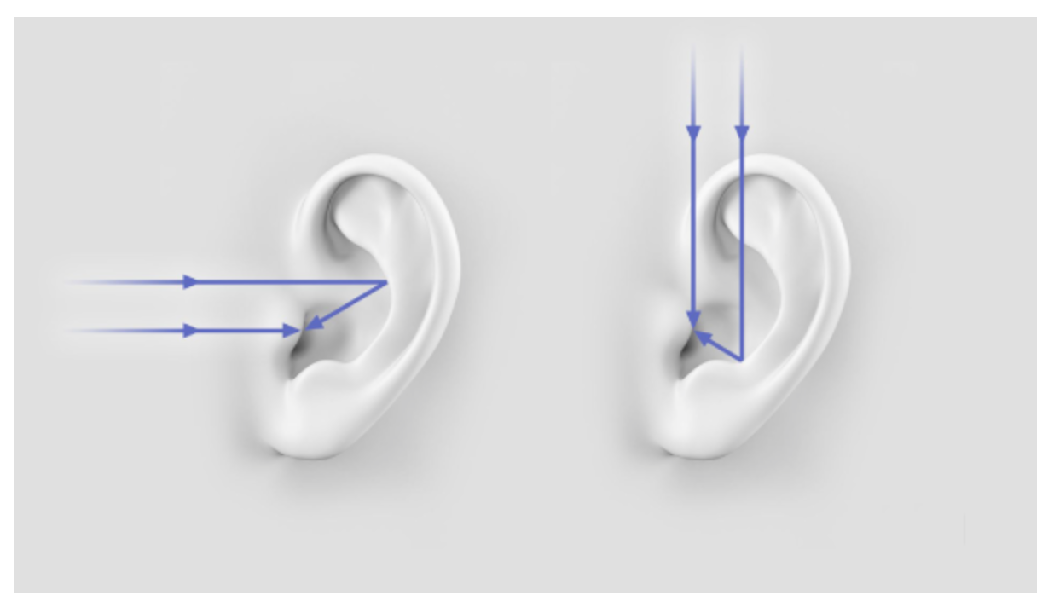
Localizing
Front-to-Back & Elevation
Sounds are filtered and reflected according to direction of origin
image from Google VR - Spatial Audio
Notes:
Sound interacts with our outer ears, head, neck, and torso,
1. all of which filter and reflect the sound according to its direction of origin.

Slide 20
Our Personal Filter
ITD + ILD + spectral modifications = direction selective filter
The brain infers direction of origin according to this filter
The filter can be represented by a head related transfer function
Notes:
[click]
ITD, ILD, and spectral modifications combine to create a unique direction selective filter.
Our brain infers the direction of origin according to this personal filter.
The filter can be represented by a head related transfer function.

Slide 21
HRTF
An HRTF is based on measurements of a human subject inside an anechoic chamber
The HRTF reproduces the ITD, ILD, and spectral cues
A generic reference set of HRTFs may be adequate for simulation
Notes:
An HRTF is based on measurements of a human subject inside an anechoic chamber, using a microphone placed in each ear.
The HRTF reproduces the ITD, ILD, and spectral cues that the brain uses to determine where a sound is coming from.
While your personal HRTF will yield the most accurate results, a generic reference set of HRTFs may be adequate for simulation, especially when reinforced with visual cues and head tracking.

Slide 22
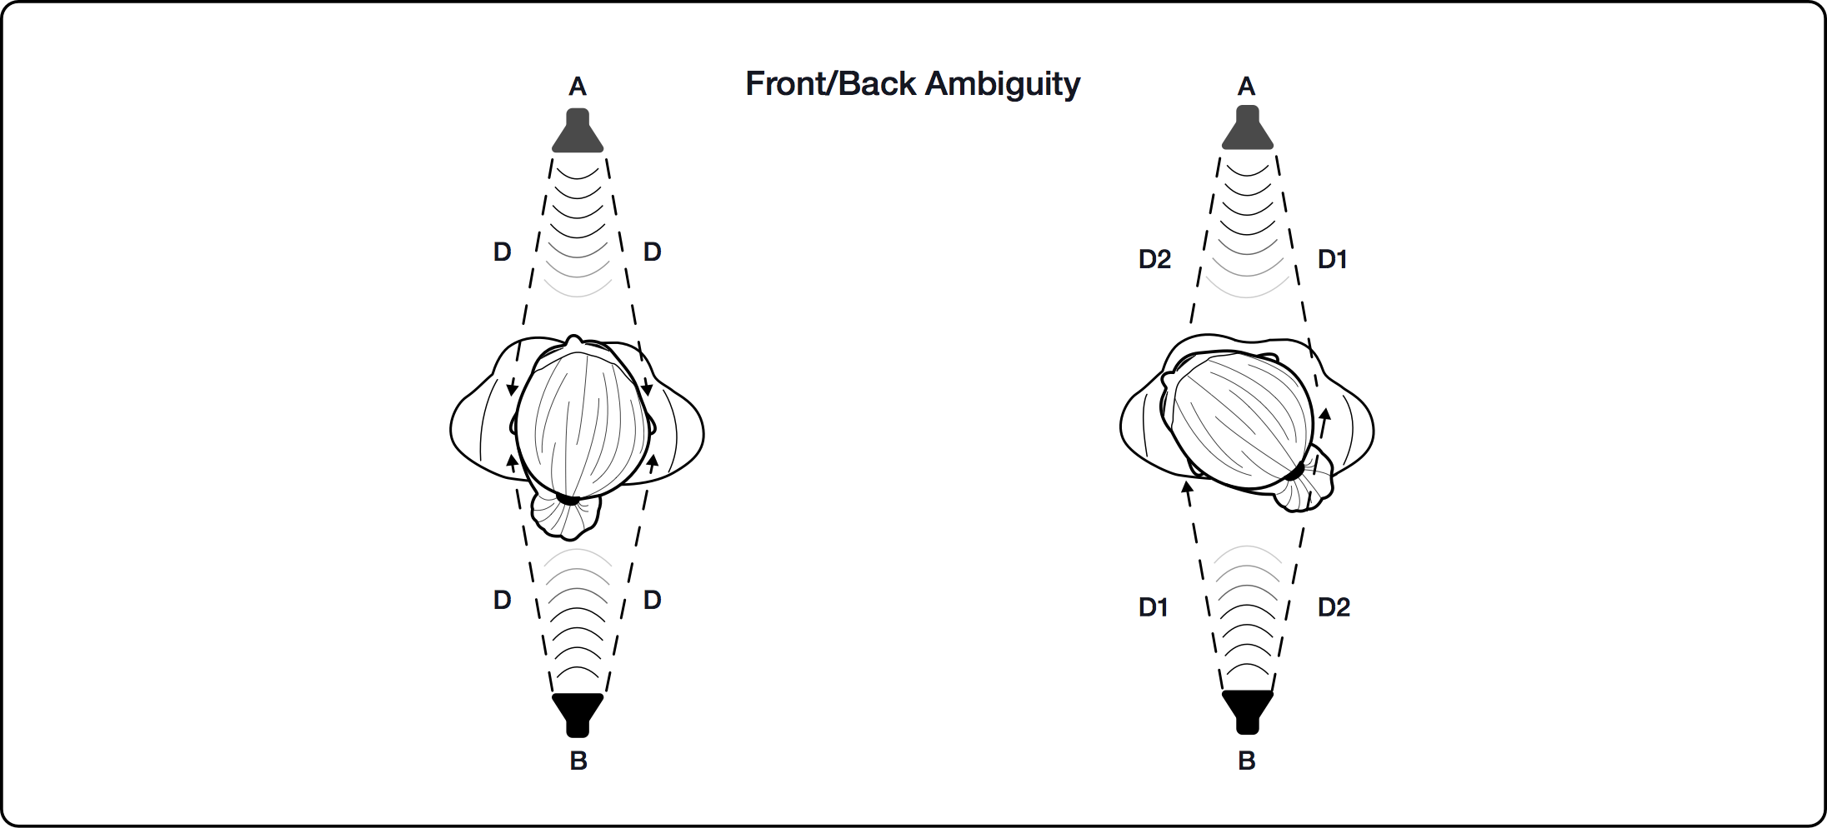
Head Motion Helps With Ambiguity
image from Facebook Oculus Audio SDK - Introduction to Virtual Reality Audio
Notes:
Head motion helps with ambiguity. To assist in localizing sounds coming from behind, we move our head side-to-side.
1. This re-orients our ears to a position where we can more readily distinguish ILD & ITD.

Slide 23
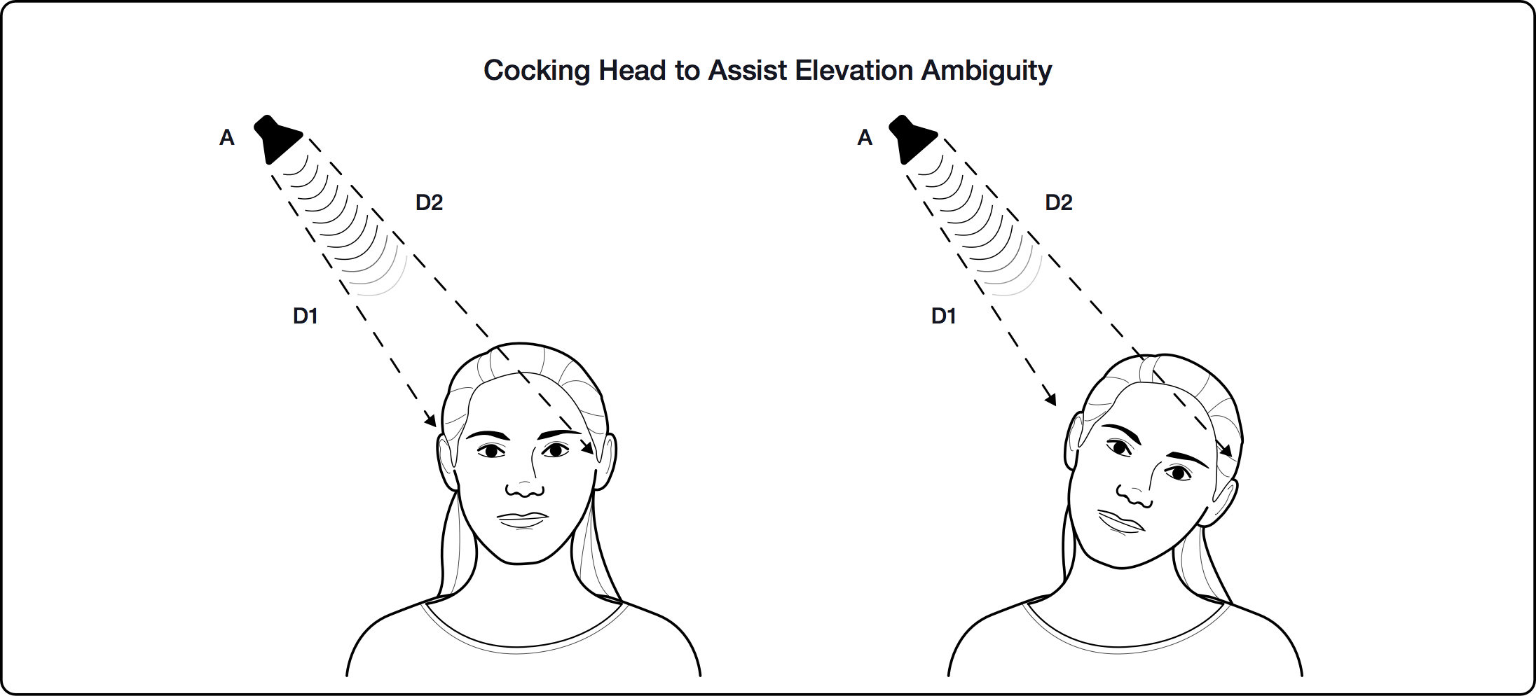
Head Motion Helps With Ambiguity
image from Facebook Oculus Audio SDK - Introduction to Virtual Reality Audio
Notes:
To assist in localizing sounds coming from above or below, we our cock our head.
1. Again, this re-orients our ears to a position where we can more readily distinguish ILD & ITD.

Slide 24
How We Determine Distance
Loudness (for familiar sounds)
Initial time delay: the interval between the direct sound and its first reflection
Ratio of direct sound to reverberation (wet/dry mix)
Motion parallax
Notes:
We use a variety of cues to determine distance.
Of course, close sounds are louder than sounds further away, but this only works for familiar noises.
The Initial Time Delay – the interval between the direct sound and its first reflection – helps us to distinguish distance.
The ratio of direct sound (dry) to reverberant sound (wet) helps us hear distance.
Motion parallax also helps distinguish near and far: experience teaches us that a sound that travels very quickly from left to right ear is probably very close; (if not, it must be moving extremely fast.)

Slide 25
Spatialized Audio
Spatialization is the reverse of localization
Apply an HRTF to a sound source to recreate the ITD, ILD, and spectral cues
Notes:
Now that we’ve seen how we localize sound, let’s talk about how we might use this information to make something sound as if it’s coming from a particular point in 3D space.
Spatialization is the reverse of localization. It’s the process of making a sound appear as if it’s coming from a particular point is space by replicating how sound waves interact with the environment and with our ears, head, and upper body.
We apply an HRTF to a sound source to recreate the ITD, ILD, and spectral cues that cause our brain to infer the sound’s direction of origin.

Slide 26
Head Tracking
By moving our head, we reposition our ears in space to perceive changes in time arrival, level, and frequency cues
VR software uses rotation information to rotate the sound field in the opposite direction of head movement
Notes:
Virtual reality video requires head tracking to sustain the illusion of three-dimensional objects in space.
Virtual reality audio also requires head tracking to sustain the illusion of sound coming from three dimensions.
By moving our head, we reposition our ears in space to perceive changes in time arrival, level, and frequency cues. Head motion helps us localize sounds.
VR software uses rotation information to rotate the sound field in the opposite direction of head movement.

Slide 27
Head Tracking Is Essential
Head tracking is at least as important as HRTF in creating the illusion of 3D sound for VR audio
That’s because of the inherent lack of precision in our ability to resolve some binaural cues, and our dependence on head motion to do so
Notes:
[click] Head tracking is at least as important as HRTF in creating the illusion of 3D sound for VR audio.
That’s because of the inherent lack of precision in our ability to resolve some binaural cues, and our dependence on head motion to do so.

Slide 28
Distance Modeling
Loudness
Initial time delay
Reflections and late reverberations
Motion parallax
Notes:
Recall the four main cues we have for determining distance:
[click] Loudness, [click] initial time delay, [click] reflections and late reverberations, and [click] motion parallax
Loudness is easy to model, with simple attenuation based on the distance from the source to the listener.
Initial time delay is more expensive, requiring computation of early reflections based on environmental geometry.
Accurate modeling of reflections and late reverberations is very expensive computationally. For VR audio, application of artificial reverb (“wet/dry” mix) is a cheap alternative.
Motion parallax is a natural product of the velocity of a sound source, requiring no extra computation or processing.

Slide 29
Ambisonics
A full-sphere surround sound technique
A three-dimensional extension of M/S (mid/side) stereo recording technique, adding additional difference channels for height and depth
Unlike other multichannel surround formats, its transmission channels do not carry speaker signals
Instead, they contain a speaker-independent representation of the sound field which is decoded to the target speaker setup
Notes:
Another technique currently in use for spatializing VR audio is ambisonics. This is a cursory look at ambisonics and how it’s currently being used in conjunction with HRTF to spatialize audio for VR.
Ambisonics is a full-sphere surround sound technique, developed in the U.K. in the 1970’s, covering sound sources from above and below as well as left-to-right.
In effect, it is a three-dimensional extension of the mid/side stereo recording technique, adding additional difference channels for height and depth.
Unlike other multichannel surround formats, its transmission channels do not carry speaker signals.
Instead, they contain a speaker-independent representation of the sound field which is decoded to the target speaker setup.

Slide 30
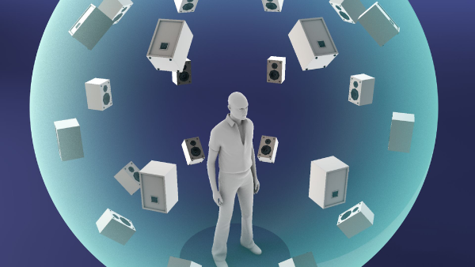
Ambisonics
Ambisonics depends on a loudspeaker array for playback
image from Google VR - Spatial Audio
Notes:
Ambisonics depends on a loudspeaker array for playback.

Slide 31
Ambisonics
Some VR systems use ambisonics to surround the listener with a high number of virtual loudspeakers
image from Google VR - Spatial Audio
Notes:
Some VR systems use ambisonics to surround the listener with a high number of virtual loudspeakers.

Slide 32
Ambisonics
Each virtual loudspeaker is associated with an HRTF to fool the listener into thinking the sound is located at that point in the virtual speaker array
image from Google VR - Spatial Audio
Notes:
Each virtual loudspeaker is associated with an HRTF to fool the listener into thinking the sound is located at that point in the virtual speaker array

Slide 33
Ambisonics
Virtual sound sources may be mixed through an ambisonics bus to a fixed virtual speaker array
This allows for more virtual point sources than the system might otherwise be capable of rendering as individual HRTFs
Ambisonic recordings of real-world ambiences can also be effective in a virtual environment
Notes:
Virtual sound sources may be mixed through an ambisonics bus to a fixed virtual speaker array, rather than applying an HRTF to each individual point source.
This allows for more virtual point sources than the system might otherwise be capable of rendering as individual HRTFs.
Ambisonic recordings of real-world ambiences can also be effective in a virtual environment

Slide 34
Headphones vs. Speakers
Binaural audio is sound that is transmitted separately to the two ears of the listener.
The brain must compare two discrete signals in order to analyze differences in arrival time and signal level
Headphones ensure that each signal reaches its destination without also reaching the other ear
Notes:
Remember that binaural audio is sound that is transmitted separately to the two ears of the listener.
The brain must compare two discrete signals in order to analyze differences in arrival time and signal level.
Headphones ensure that each signal reaches its destination without also reaching the other ear, and so they are an essential component all current VR systems.

Slide 35
Headphones vs. Speakers
There is another way, however…
Notes:
There is another way, however.
Let’s take a look at a method for binaural audio through two loudspeakers.
After the break, I hope some of you will try the VR game we have set up for you.
If you do, you may come to appreciate why many of us working with VR are eager for a solution that uses speakers rather than headphones.

Slide 36
BACHH™ 3D Sound
Audio technology developed by Dr. Edgar Choueiri at Princeton University’s 3D Audio and Applied Acoustics Lab.
Based on BACHH™ filters: optimized crosstalk cancellation (XTC) filters that allow binaural audio through two loudspeakers
Notes:
BACHH 3D Sound is audio technology developed by Dr. Edgar Choueiri at Princeton University’s 3D Audio and Applied Acoustics Lab.
The technology is based on BACHH filters: optimized crosstalk cancellation (XTC) filters that allow binaural audio through two loudspeakers.

Slide 37
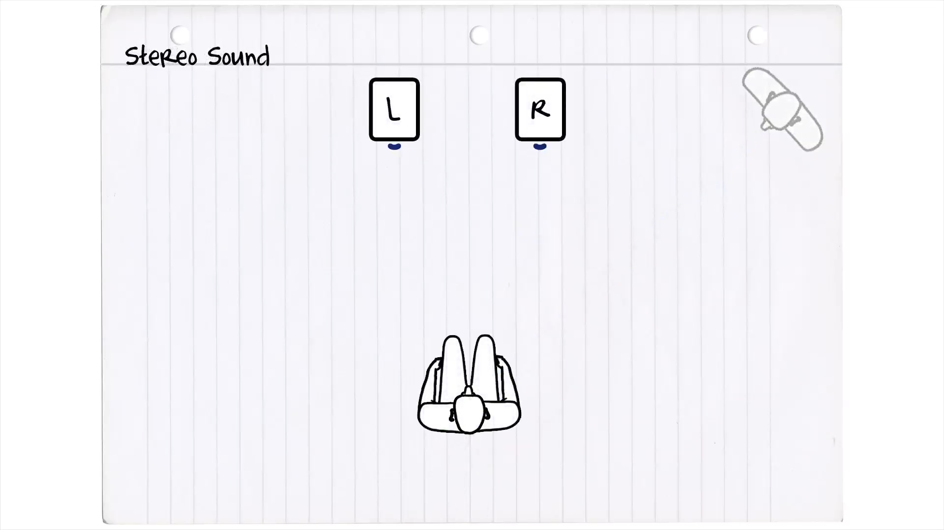
image courtesy of Dr. Edgar Choueiri, 3-D Audio & Applied Acoustics Lab, Princeton University
Notes:
As you can see, both left and right binaural signals from two loudspeakers reach both of the listener’s ears. This “crosstalk” obscures the binaural cues we require in order to determine the sound’s direction of origin.
If we could place a mattress between the speakers, we could keep the left signal from reaching the right ear, and the right signal from reaching the left ear.

Slide 38
Or, we could use crosstalk cancellation filters designed to minimize spectral coloration to the input signal
Notes:
Or we could use crosstalk cancellation filters designed to minimize spectral coloration to the input signal.

Slide 39
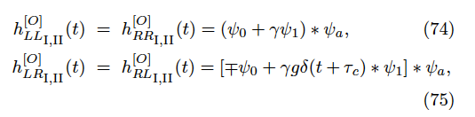
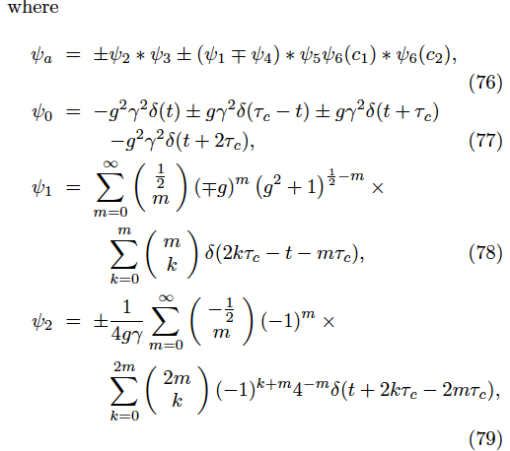
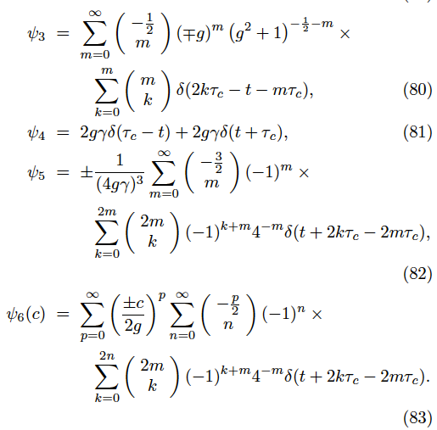
10 equations and 2 loudspeakers
Notes:
I won’t try to explain the math behind the filters, because I don’t understand it.

Slide 40
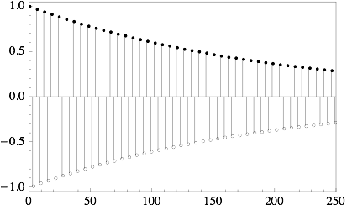
but the gist of it is…
Notes:
But the gist of it is a solution involving sending rapidly alternating signals of diminishing amplitude, 180 degrees out of phase, to cancel that portion of the signal reaching the wrong ear.
For any sound coming from the right speaker, the same sound needs to come from the left speaker 180 degrees out of phase and delayed by the ITD (interaural time difference), canceling the signal so that it doesn’t reach the left ear.
However, that new signal introduces its own crosstalk, which now needs to be cancelled in the right ear. This would seem to create a nearly infinite loop, but because of the effects of head shadowing, the phase-inverted impulses diminish in amplitude over a very short period time.

Slide 41
Optimal Crosstalk Cancellation for Binaural Audio with Two Loudspeakers
Edgar Y. Choueiri
Princeton University
choueiri@princeton.edu
http://www.princeton.edu/3D3A/Publications/BACCHPaperV4d.pdf
Notes:
For more detailed info, here’s the link to Dr. Choueiri’s paper explaining the math and physics.

Slide 42
and now, a demonstration
may we have a volunteer?
Notes:
In the meantime, let’s hear what it sounds like!
May we have a volunteer?

Slide 44
3D Sound
for Video Games
from surround sound to spatialized audio
Lawrence Schwedler
DigiPen Institute of Technology
Audio Engineering Society Pacific Northwest Section
21 June 2017

