Slide 1
Room Acoustics - Measurements
J.D. Johnston – Himself Bob Smith – SoundSmith Labs Dan Mortensen – Dansound Rick Chinn - Uneeda Audio
Notes:
AES Presentation first slide

Slide 2
Equipment List
Monitors to be used for mixing
Audio Interface
Inexpensive measurement mic and stand
Measurement SW
Tape measure and string

Slide 3
Objective
Locate monitors where they will be used
Locate measurement microphone at listening position
Obtain acoustic measurements for each monitor
Determine acoustic problems, often nearby reflective surfaces

Slide 4
Steps 1/3
Locate monitors and measurement microphone
Send excitation signal to a monitor at approximately 85 to 90 dBA as observed at the listening position
Record and calculate impulse response (usually simultaneous with previous step)
Generate Energy Time Curve
Analyze ETC for reflections after direct impulse.

Slide 5
Steps 2/3
Calculate distance of reflection from time if necessary
Add this distance to distance between monitor and mic
Use a tape measure or a piece of string the total length calculated
Fasten one end at the center of the monitor, the other at the measurement tip of the measurement mic.
Find a surface the string can touch while keeping the string taught.

Slide 6
Steps 3/3
Treat the problem at that surface accordingly.
Repeat steps until desired results are achieved.
Repeat steps for other monitor, though many acoustic problems may have been reduced to a satisfactory level already from steps with first monitor.

Slide 7
Excitation Signals
Log Sine Sweep (Crest Factor = 3 dB)
– highest signal to noise for measurement
– highest annoyance factor to others
Periodic Noise (Crest Factor = 9 dB)
– lower signal to noise than Log Sine Sweep
– much lower annoyance factor to others
MLS (Crest Factor = 0 theoretical, 6 ~ 9 dB practical)
– potentially higher measurement distortion in
non-linear systems

Slide 8
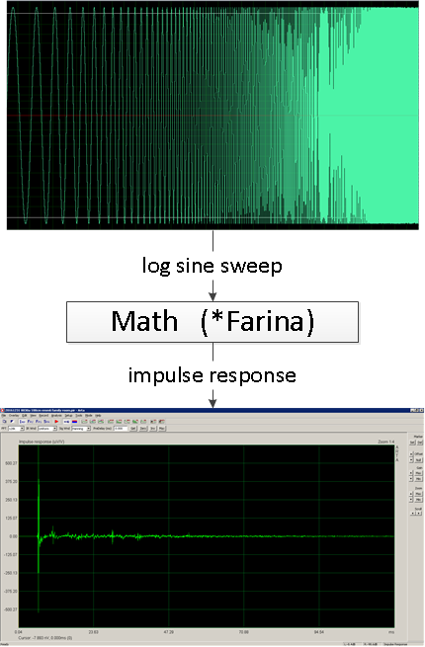
Obtaining Impulse Response

Slide 9
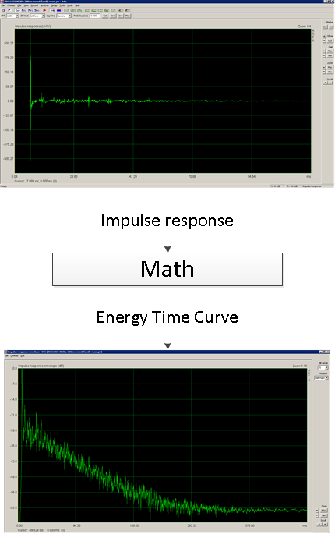
Generate ETC

Slide 10
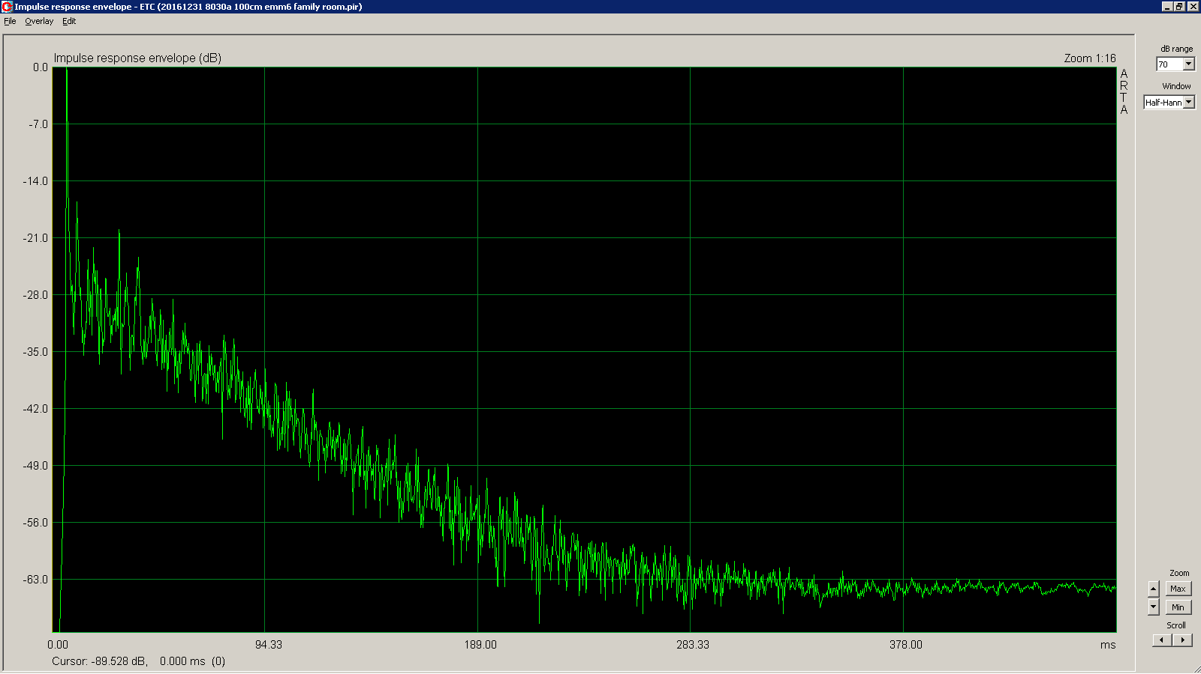
ETC

Slide 11
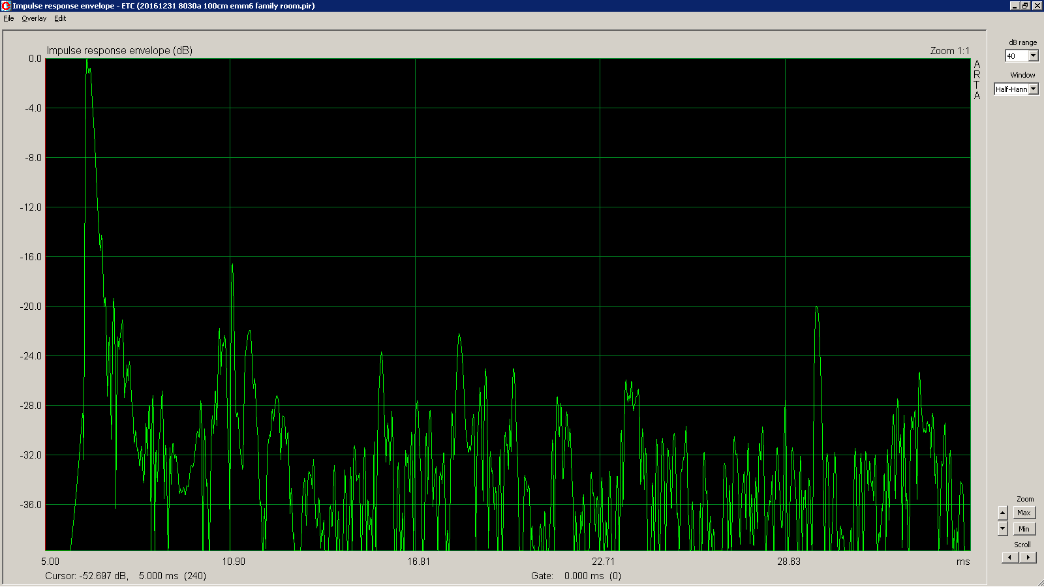
ETC - zoom

Slide 12
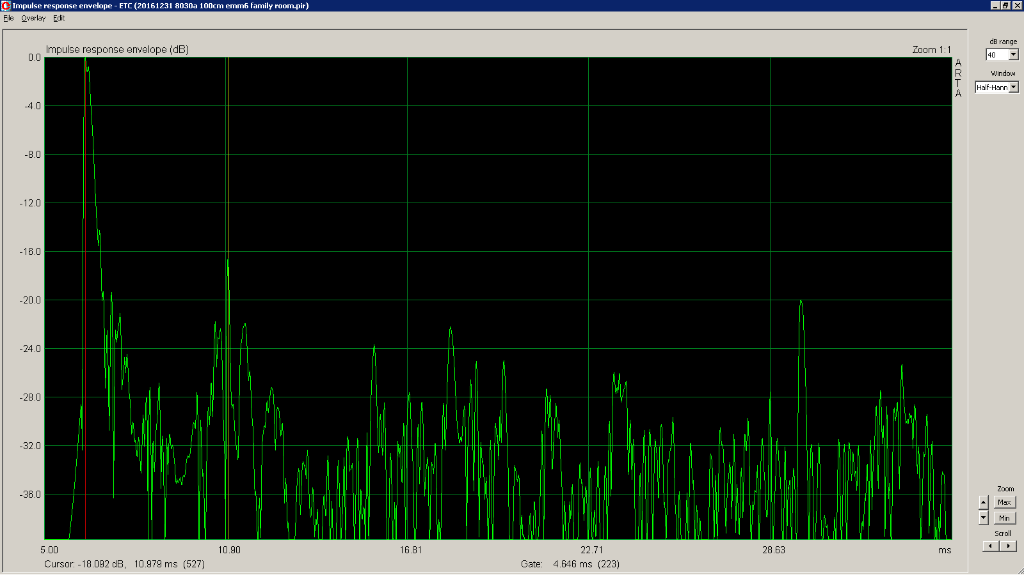
ETC – time measurement

Slide 13
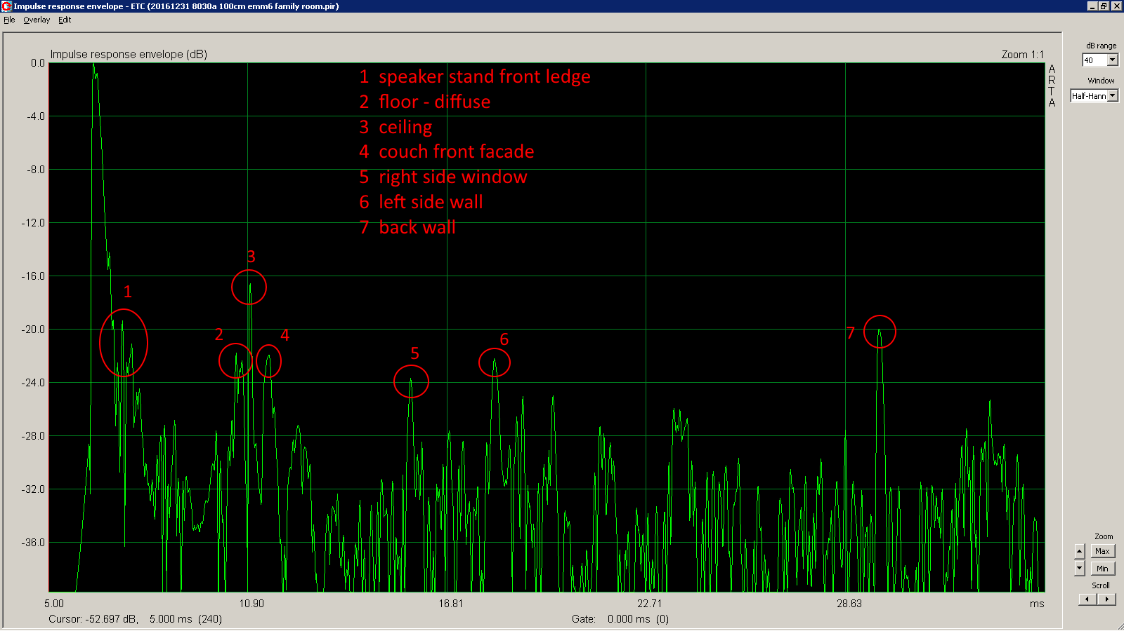
ETC - annotated

Slide 14
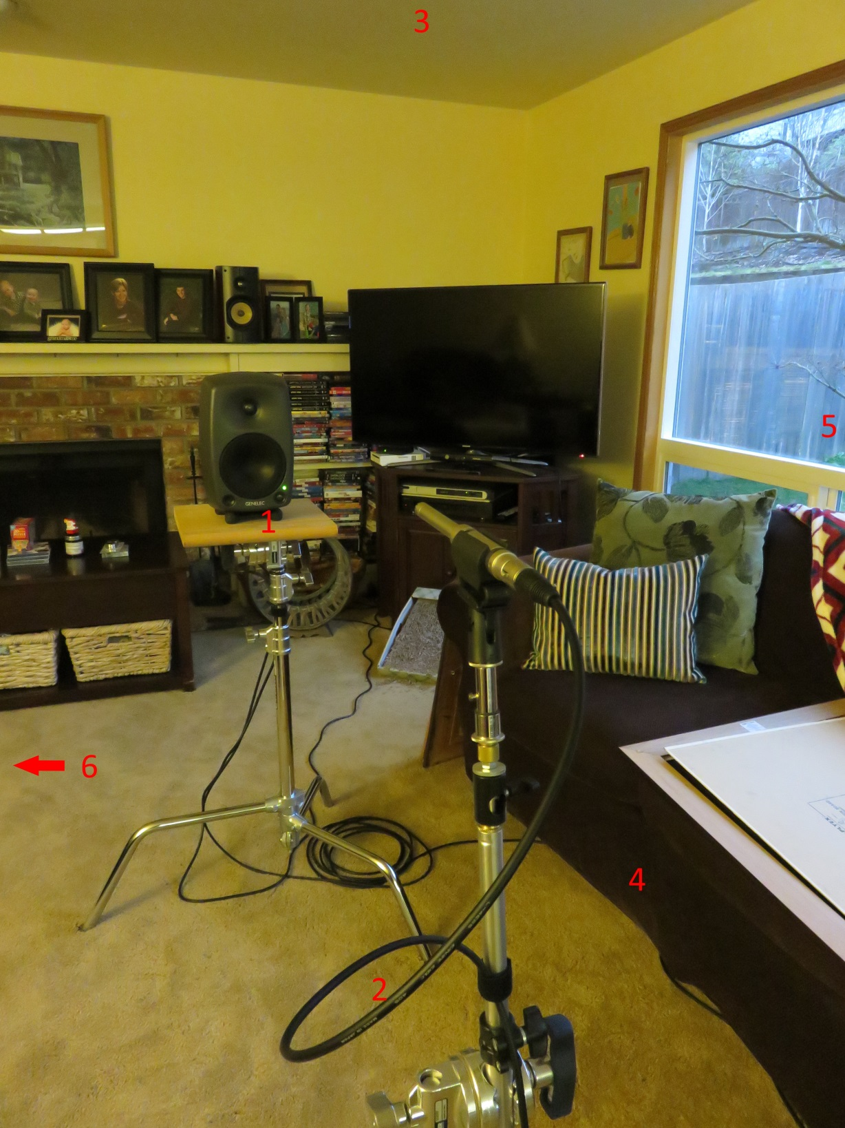
picture frame removed before measurement
Notes:
Picture frame on couch removed before measurement acquired

Slide 15
Convert time to distance
reflection distance = reflection time * speed of sound
total distance = reflection distance + speaker to microphone distance

Slide 16
20161231 | Room Acoustic Measurements
T | 67 | °F | room temperature
D | 100 | cm | distance speaker to mic
C | 1126.1 | ft/s | speed of sound ft/s
C | 343.2 | m/s | speed of sound m/s
t | 2.913 | mS | time speaker to mic
ETC time | d1 | d1 + D | surface | d1 + D | d1 + D
measured | cm | cm |  | inches | feet
0.854 | 29.31 | 129.31 | speaker stand front ledge | 50.91 | 4.24
4.200 | 144.16 | 244.16 | floor (diffuse) | 96.13 | 8.01
4.380 | 150.34 | 250.34 | floor (diffuse) | 98.56 | 8.21
4.646 | 159.47 | 259.47 | ceiling | 102.15 | 8.51
5.167 | 177.35 | 277.35 | couch façade | 109.19 | 9.10
9.375 | 321.79 | 421.79 | right side window | 166.06 | 13.84
11.875 | 407.60 | 507.60 | left side wall | 199.84 | 16.65
23.292 | 799.47 | 899.47 | back wall | 354.12 | 29.51

Slide 17
ETC – 100 cm listening position

Slide 18
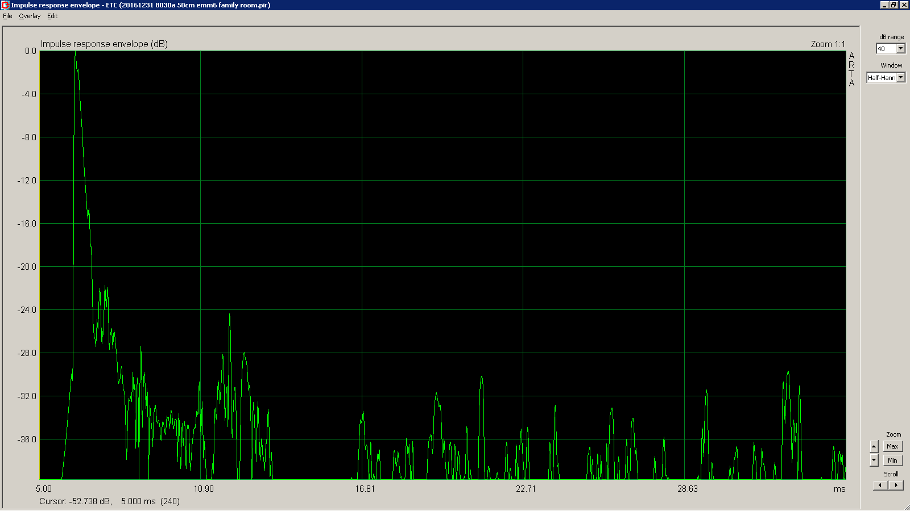
ETC – 50 cm listening position

Slide 19
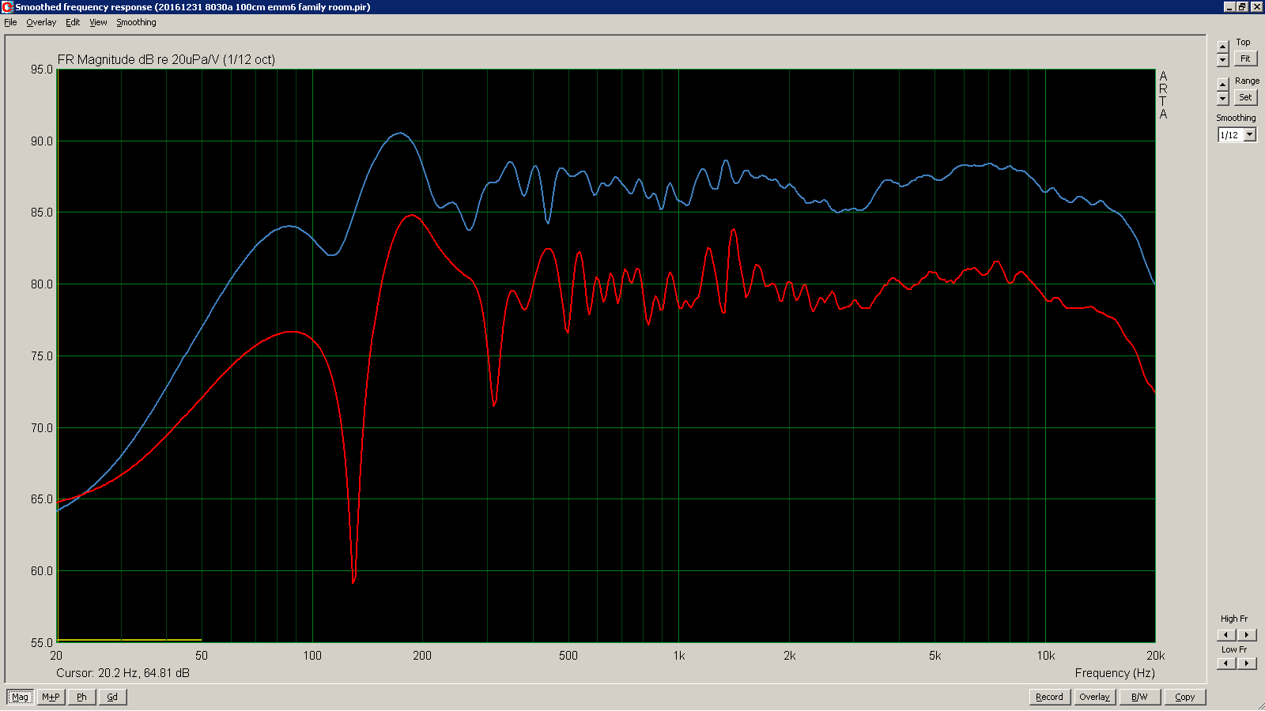
FR 50 cm - 100 cm comparison

Slide 20
Measurement SW
Room EQ Wizard (PC, Mac, Linux, any Java)
http://www.roomeqwizard.com/
Holm Impulse (PC only)
http://www.holmacoustics.com/holmimpulse.php
ARTA (PC only)
http://www.artalabs.hr/download.htm
Fuzzmeasure (Mac Only)
http://supermegaultragroovy.com/products/fuzzmeasure/

Slide 21
Measurement HW
Inexpensive Omni Measurement Mic
http://www.parts-express.com/dayton-audio-emm-6-electret-measurement-microphone--390-801

Slide 22
Example Fire Test Data
Auralex Fire Test Data
http://www.auralex.com/tools/testing-data/fire-testing-data/

Slide 23
Resources - examples
http://www.roomeqwizard.com/
http://www.atsacoustics.com/cat--DIY-Acoustic-Materials--102.html
http://www.gikacoustics.com/acoustic-primer/
http://realtraps.com/articles.htm
http://www.acousticfrontiers.com/room-acoustic-measurements-101/

Slide 24
Vendors – examples
http://www.auralex.comm/
http://www.atsacoustics.com/
http://www.acoustimac.com/oc7032
http://realtraps.com/
http://www.gikacoustics.com/
https://acousticalsolutions.com/
http://www.ultimatesupport.com/products/ultimate-acoustics.html

Slide 25
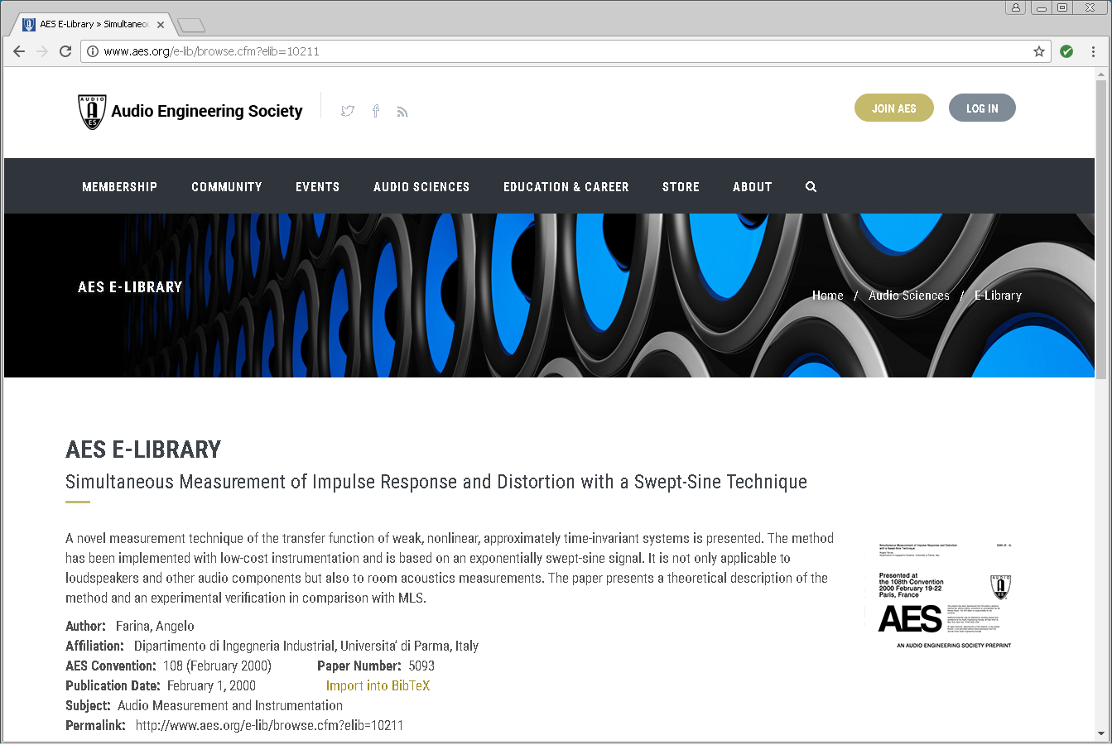
Farina – Impulse Response measurement
Notes:
Farina paper

Slide 26
