Slide 1
You want me to mix this in ***HERE????***
J.D. Johnston – Himself Bob Smith – Acousticus Measurebus

Slide 2
The goals of this introduction:
What does a small, untreated room, do?
How can we detect the worst reflections in a bad room (where one does not have legal authority to use a bulldozer) without spending over $200 dollars, assuming you have a laptop?
Where do these reflections come from?
What can we do about them?
What can’t we do much about?

Slide 3
WARNING!!! MOST IMPORTANT ISSUE:
We are going to talk about using foam and other Sound absorbing materials.
All materials must be ASTM rated for FIREPROOFING.

Slide 4
Remember the Great White Station Nightclub Fire! NO MORE. EVER!

Slide 5
NO MORE!

Slide 6
So, what do small rooms usually have?
Hard walls that are parallel.
Short dimensions, or sometimes (hallways) short in two dimensions, and absurdly long in the other.
Walls, ceilings, and floor that reflect sound.
These reflections cause problems.

Slide 7
What kind of problems?
Flutter echoes
Bass modes
Early wall, ceiling and floor reflections
Potential asymmetry (I’m assuming stereo in this case)
Stereo setups need to be symmetric. This reinforces any nasty modes the room has, most often.
And of course noise. That’s one thing that you can’t do much about. If the room is that noisy, it’s time to have a heartfelt discussion with the venue.

Slide 8
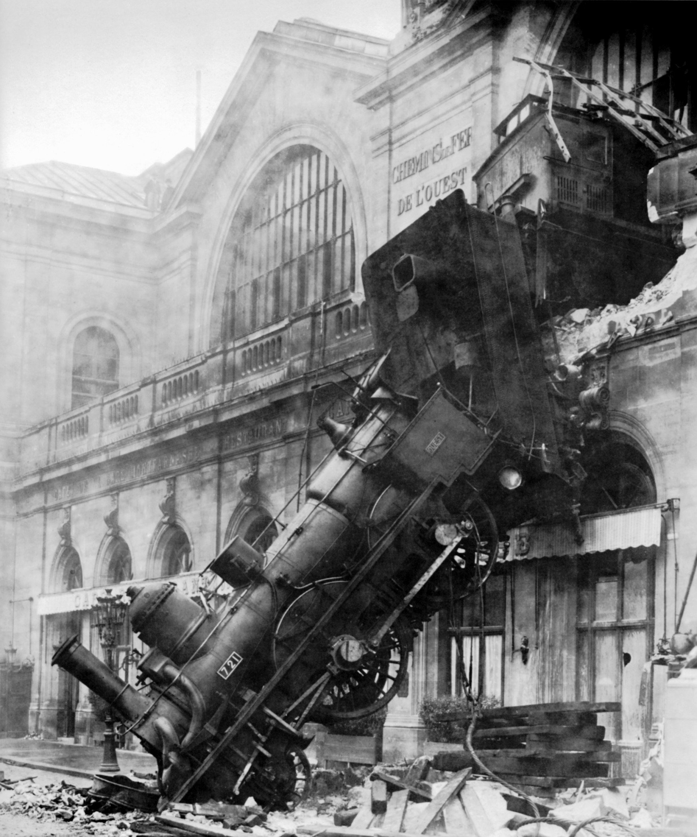
Bob runs a test of our in-room setup here
Notes:
Wake up bobs

Slide 9
What can you do about this?
Careful placement (when possible)
Use of inexpensive tools to recognize the worst reflections
Ways to treat what your tools show you.

Slide 10
First steps:
Try to set up your listening position so it’s symmetric. Too much asymmetry (side walls different distances) will be really hard to mitigate. Of course, symmetry makes frequency response worse.
Clap your hands. Listen for flutter or an obvious echoes or reflections. Those obvious reflections will be the first thing you work on absorbing.
Listen some more. Will this actually suffice, or do you need to do more?
Sometimes this will get you where you need. But usually not.

Slide 11
Ok, now the physics, or at least a summary of the physics.
Reflections are a kind of filter, much like what most people call a ‘digital filter’.
In addition to providing frequency shaping, they can destroy stereo imaging.
Low frequency room modes will come about via reflections from whole walls.
High frequency reflections can occur from walls, windows, tables, ceilings, floors, you-name-it.
You need to fix the worst problems in order to be able to do a good mix/recording/monitoring.
No, electronic means will not fix room modes and high frequency reflections. While you can cut peaks, you can’t “fill” big dips in the room response.

Slide 12
Show frequency response again

Slide 13
A note on soundfields.
People commonly use an omni mike to capture the “frequency response” of a room.
No, that’s not the frequency response of the room!
That’s only one of 4 variables at that *exact point* in the room.
Yes, you’re missing two things
The response at any other point in the room
The volume velocity of the air at the point of measurement.
Yes, this means you’ve got ¼ of one of many points, in terms of information.

Slide 14
More physics:
If you’re at a dip in the room response (in pressure, i.e. omni microphone terms) you are at a peak in the volume velocity in the room.
Yes, that dip means there is a peak in the room somewhere else,
It also means that despite the lack of pressure at that point, there is lots of energy in the sound at that point, just not in a way you can hear at low frequencies (but you can at frequencies above 100Hz!)
Adding more energy to a room that stores too much energy is just about as pointless as you might imagine.

Slide 15
Ok, so what to do?
First, figure out where the worst reflection comes from
Absorb it.
Then, figure out where the (next) worst reflection comes from
Absorb it.
Then, figure out where the (next) worst reflection comes from
Absorb it.
Repeat until the situation is tolerable.

Slide 16
Right, so how do you do that?
First, if you can HEAR it, you really, really need to absorb it. So any place you hear flutter, or slap echoes, or anything of that sort, there’s where you start.
For the reflections that you can’t identify from just listening, then you want to use some form of room analysis
but not to add electronic correction, until the last step
Use the impulse response you get from the room to find out where the reflection comes from.
Then, yes, you guessed it, you absorb it.
Sometimes you can use a figure 8 microphone, off-axis, to point to the source of a reflection. Usually, you can use a piece of string.

Slide 17
Treating the surface (with ASTM certified material)
First, consider how absorption works.
Fiberglass, porous foam, and the like all work on air movement, that is to say, volume velocity.
Walls and reflective surfaces are specifically PRESSURE locations, not velocity locations, unless the wall is moving, at least.
If it is then perhaps we’re in the wrong discussion.
If you put the material against the wall, you’ll be absorbing frequencies of wavelength ¼ the material thickness and shorter.
For 3” material, that means you get substantial absorption at about 1100Hz or so.
For 3” material that’s 9” away from the wall, more like 262Hz or so.
So, put your material in a frame, and don’t apply it directly to a surface, unless all you are concerned about is higher frequencies.
Yes, you get some absorption at frequencies lower than the above, but the fall off is quite rapid.

Slide 18
Ceilings and floors
Ceilings can make it hard to support or hang absorbing material.
It’s worth a try if and only if you can do it safely. When the speaker-ceiling and speaker-floor distance are the same, however, this does become quite important.
Again, having some air behind the absorbing material is helpful. This is great if you can actually do it.
Most “acoustic tile” doesn’t do much of anything.
Floors? Well, you have to walk on floors. If that’s the only reflection you have, you’re not doing too badly, with most speakers that have a bit of “beaming” at mid and high frequencies.

Slide 19
Early reflections
Change timbre
Ruin stereo imaging
Can put actual zeros in the transfer function at high frequencies.
Early, here, means under 5-10 milliseconds.
That’s side and back walls, ceiling and floor, in a small room.
These are the first things to go after.

Slide 20
Those later reflections
The very late reflections create the primary bass modes of the space you’re working in. They can be hard to absorb at low frequencies.
As long as you reduce the high-frequency reflections from those places, you’ll suffer most from bass modes.
Spaced absorption again is the way to go. Some people use specially fabricated bass traps, which can work in the right setting.
Having long lengths (in the direction of the mode) of absorption away from walls a bit helps as well.
For this you need to know the direction.

Slide 21
Direction of bass mode volume velocity
When you’ve detected either a peak or a dip in the bass region with your omni microphone, you have several options:
You can look and try to figure it out.
You can listen with your ears in place of the mike. Listen especially for out-of-phase sensations in some directions. If you find that, that’s the direction of the major mode that’s pestering you.
You can take a figure-8 mike, and play continuous pink noise, or narrowband noise in the frequency band you care about.
You rotate the mike in horizontal and vertical axis until you see the lowest measurement at the problem frequency.
The zero in the figure 8 pattern is now pointing toward the source of the offending reflections.
Do this again with a different angle that shows a null, and you will find that one direction will be common to both measurements. This is the direction in which you need to look for reflections.
You can relate peaks and nulls to room dimensions, especially if they repeat at regular intervals in frequency. More on that if you want, after the talk.

Slide 22
Absorption vs. diffusion
Your problem in makeshift venue is almost always a lack of both
Making the room dead eliminates the need for diffusion.
Remember, diffusion does NOT absorb sound, it scatters it, and scatters different frequencies differently.
Diffusion is almost impossible at low frequencies. Absorption is your only real hope there.

