Slide 1
Audio, Radio, Acoustics, Signal Processing?
James D. Johnston
Retired Audio Geek

Slide 2
What a long, strange trip it’s been!

Slide 3
When I started life in Audio
That would be 3 times:
In Jr. High School
At CMU
At Bell Labs
Each time, I was discouraged by teachers, professors, or management, on the basis that audio was full of nonsense, and we didn’t understand things very well, either.
None the less, Bell Labs has a long legacy of work in hearing and audio.

Slide 4
What did I learn at CMU about audio?
Leased wideband lines are terrible
Leased wideband lines are terrible
Oh, did I mention? Leased wideband lines are terrible.
Yes, I hung out at the campus radio station.
No, it’s not TPC to blame, it’s physics.
Yes, folks, that was one of the facts that caused MP3.

Slide 5
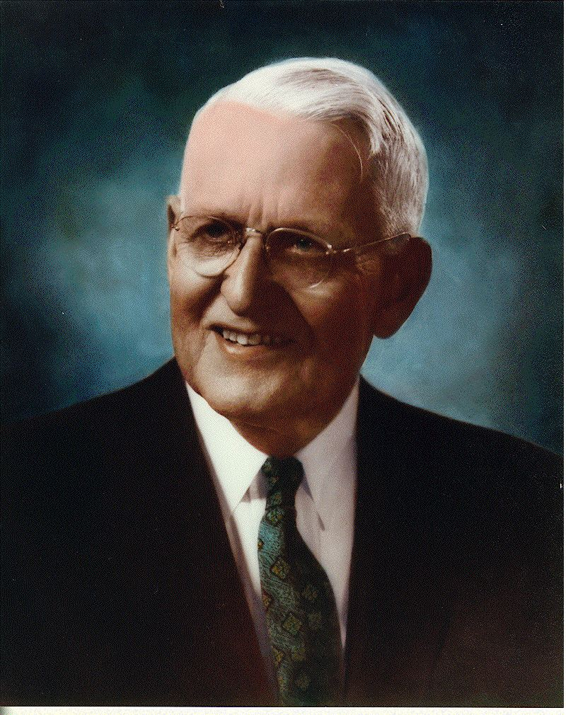
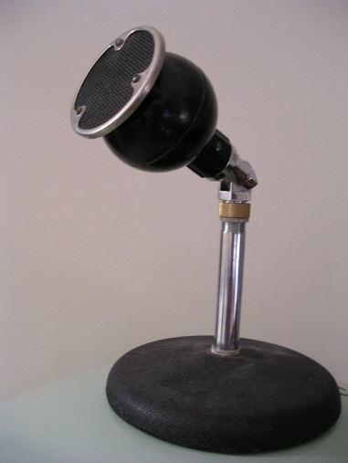
The Bell Labs Legacy
Harvey Fletcher worked at Bell Labs in the pre-WW2 days.
His work underpins a great deal of the modern understanding of hearing.
Stevens, Zwicker and others built and expanded on his work.
He established the understanding of the ear as a frequency-sensitive organ.
He used this,
among other
things:

Slide 6
Frequency Sensitivity
Fletcher showed, by way of masking experiments, that the ear was a frequency selective device. This has a few important effects.
The first, and foremost, is that Signal to Noise Ratio is kind of pointless, unless you know it in some variety of frequency-sensitive sense.
Everything, give or take, needs to take the frequency selectivity into account.

Slide 7
How’s that?
Let’s consider two signals:
Signal 1 has an SNR of 6.0 dB – The signal consists of narrowband noise between 950 and 1050 Hz. The noise is a tone at 1kHz, 6dB lower in energy than the narrowband noise.
Signal 2 has an SNR of 60 dB – The signal consists of a 20kHz sine wave. The noise consists of a 1.5kHz sine wave 60dB lower.

Slide 8
Which one can you hear?
Let’s have a show of hands. Which situation will allow you to determine signal vs. signal + noise in a properly constructed double-blind test in a quiet room?
Signal 1 – Please show hands
Signal 2 – Again, please show hands
Try it yourself! Download octave, make the signals, and do the test on yourself.

Slide 9
The Message?
Very basic, older tests show that SNR, which is a superset of THD, is, to take a line from the Hitchhiker’s Guide to the Universe:
Mostly Harmless
Yes, it is useful at extremes. Between extremes, well, not so much.

Slide 10
So, how does this lead to conflict?
Most measurements available from literature give THD or SNR. Almost nowhere do we see noise spectra or anything of the sort, even for one signal at one frequency, let alone many.
So, we hear the classic argument
THE THD IS GREAT, WHAT’S YOUR PROBLEM
vs
No, It sounds like (bleep)

Slide 11
There we have it already, a start of the conflict that remains today in Audio. That was a long, long time ago! (and we didn’t even discuss the people who preferred steel vs. thorn needles on their Victrola)

Slide 12
Loudness vs. Sound Pressure, Intensity, and so on
Loudness is an internal, perceptual level. It is the SENSATION LEVEL
SPL is Sound Pressure Level. This carries part of the information of the power in the atmosphere
Intensity is the sound power in the atmosphere at a given point, only part of which is converted by HRTF’s to the pressure at the eardrum.

Slide 13
Which Brings Me to Another Point or Two.
First, what you like to listen to is PREFERENCE, not “accuracy”. You listen to what you prefer to hear, not what is measurably more accurate, unless of course, you prefer a good measurement. Preference is inviolate!
Preference can amount from many, many things, in many, many ways.

Slide 14
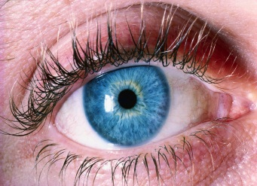
A modern view of perception
Peripheral
Processing
Kilobits
Bits
Lateral
inhibition
Feature
Analysis
Object Analysis
Cognitive-level understanding
Frequency filtering, loudness analysis
Megabits
Many
Megabits
OBSERVE THE MASSIVE FEEDBACK AND THE LOSS OF DATA AT EACH STEP

Slide 15
How does this cause conflict?
First, it clearly shows the need for “blind testing” in fact “double-blind testing”.
No, that doesn’t mean you wear a blindfold
It does mean that you have to detect the differences you’re listening for WITHOUT HINTS FROM OTHER SENSES
No, you can’t ignore them.
It’s not delusion, hallucination, or stupidity, it’s how your brain works.
If it’s not a DBT, you have no idea what you were responding to, beyond “something.”

Slide 16
And that’s bad?
Not always.
If you like chartreuse wires, that’s preference. Repeat after me again “preference is inviolate”.
There are undoubtedly things beyond the sound of something that you care about, like
Reliability
WAF
(endless list)
It all depends on what you want to do with your listening experience.

Slide 17
Your preference is not my preference, it is your preference.
When describing an aesthetic experience, opinions are just that, opinions, preferences, what-have you.
They do not extend beyond your own PREFERENCE
They may not match someone else’s.
They certainly may not have much to do with the sound emitted during the experience.

Slide 18
When is preference bad?
When you’re trying to determine what the auditory system, just the auditory system, and only the auditory system is providing to the rest of the process.
The systems are so very flexible that only if you have a FALSIFIABLE result can you proceed with a scientific investigation
Anecdotes start the process, but there has to be more than anecdotes to investigate scientifically.

Slide 19
And there we have it
Another cause of the divide between the engineers and scientists, and perhaps the nastiest one of all.
The SNR experiences teach the artistic side to ignore the engineer
The lack of DBT’s and testability teach the engineers to ignore the artist.

Slide 20
And that, ladies and gentlemen IS A REALLY BAD THING!

Slide 21
Ok, now onward.
After college, as I said, I went to Bell Labs, and was discouraged officially from working on audio. There were a few things to consider here, though.
I worked for Dave Goodman
He worked for Jim Flanagan
He worked for Max Matthews

Slide 22
Bell Labs vs. Audio
Thanks to a variety of legal and tariff issues, Bell Labs was not supposed to work on audio systems. Research was OK, but not things like loudspeakers, stereos, etc.
That didn’t keep the people at Bell Labs from being interested.

Slide 23
My first summer at Bell Labs
I designed and built an ADPCM coder that did from 2 to 8 bit ADPCM, using analog multipliers, integrators, and so on. It could cycle at 8kHz. Barely.
I sat in Max’s Lab, next to another young college student type who went by the name of Bitsy Cohen at the time.
I forget what she was working on, you’ll have to ask her.
At the end of the summer, I said something to the effect of: If I had faster ADC and DAC, I could make one of these that would code music.

Slide 24
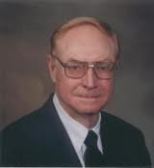
Jim Flanagan
Jim Flanagan, who hired me into Bell Labs, should be known for a lot of things:
The artificial Larynx
ADPCM coding (the CELP in your cell phone comes from that family of codecs)
Being a very, very good manager in terms of supporting people who want to invent new things.
He was also interested in music coding, saying something like: Well, you know, it is a transmission problem, and we do that sort of thing.

Slide 25
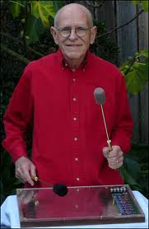
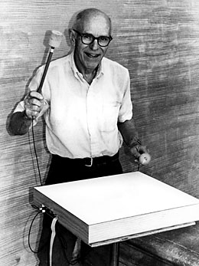
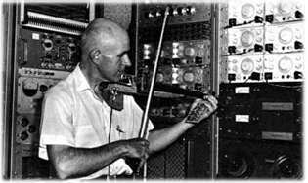
So, how would he get support?
In two words: Max Matthews

Slide 26
I suspect I don’t have to explain
Max, as I suspect everyone knows, was very, very much interested in computer music.
He was Jim’s boss.

Slide 27
So, the next summer…
I was hired back to build another analog ADPCM codec:
2-12 bits this time
6khz to 32kHz sampling rate
High Dynamic range
Soldered point to point perfboard:
AT 12 bits, dynamic range of 110dB (re 10V RMS)
DBX 202’s gave us true exponential step size control

Slide 28
So..
To make a long story short, I stuck at Bell Labs, learning signal processing from Dave, Jim, Larry Rabiner, Nikil Jayant, and lots of other people.
1979 – the “Two band sub-band commentary grade codec”.
56 kb/s
Two-band ADPCM/APCM
G722, much later, was the same, but with adaptive predictors
The first perceptual lesson

Slide 29
The Lesson
This codec sounded great.
We put classical through it
We put rock through it.
We put pipe organ through it
We put male vocal through it
And then we put female vocal (acapella) through it.
No, it didn’t sound great any more.
This was my first introduction to “upward spread of masking”

Slide 30
Array Microphones
Along about this time, Jim Flanagan decided to build an array microphone for the Murray Hill auditorium.
I don’t have any photos of the first mike and hardware, but had 49 elements, and used CCD’s for delay.
I know way too much about it, I designed the circuit boards for the CCD’s (8 channels per board, digitally addressable for delay setting), and Paula Bottone stuffed them, fixed the soldier spillovers (from the board manufacture), and we tried it out.

Slide 31
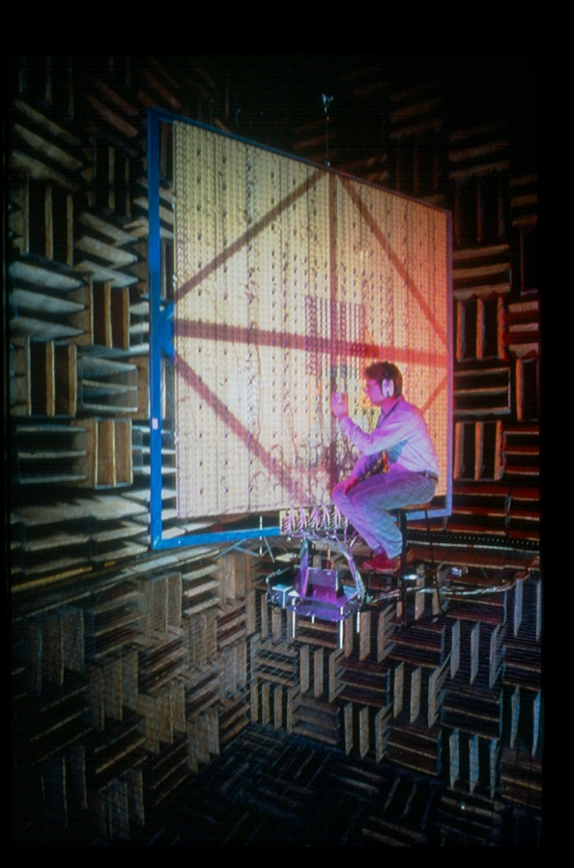
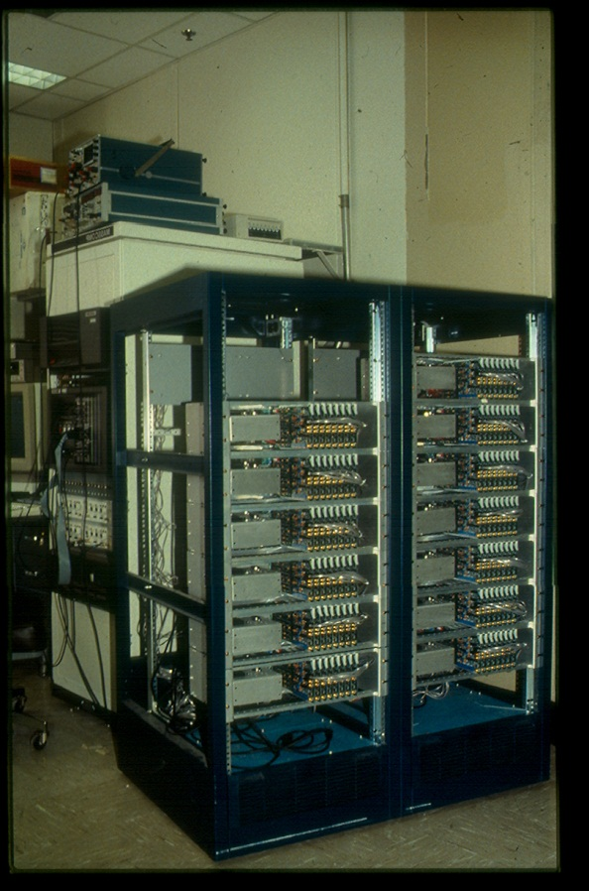
This is what it turned into:
Here we see Gary Elko looking at the more modern, higher-order, octave spaced array.
And the beamforming hardware

Slide 32
What next?
Well, next was a digital earphone.
It had 4 bits
You got the performance you expect from 4 bits.
It used a 6th order acoustic filter stuck on the output side of the electret, which was split into sections, hence the 4 bits of resolution.
I haven’t seen much like that since.

Slide 33
But back to coding:
Implementing a real perceptual coder had to wait, there wasn’t enough memory on the high-speed minicomputers. They did have a pretty good memory space, it was a full 32 kB.
And then the Alliant FX8 arrived…

Slide 34
The Alliant ran a Unix variant
I was the only Unix user in the department (thanks to needing lots of circuit design tools written by Joe Condon, Steve Bourne, and others)
It had lots of memory, 64 megabytes, if I recall correctly. LOTS of memory…
Here, jj, you test this thing.

Slide 35
Which, after a story for another day, brings us to this
The 13 dB miracle
You will hear 3 tracks in random order.
Original
13dB SNR white noise
13dB SNR perceptually injected noise
Ok, which is which?

Slide 36
Once again
SNR IS MOSTLY HARMLESS!

Slide 37
Now, if I only had a nickel for every time somebody said: “Yes, Mr. Johnston, but what is the SNR of that codec?”

Slide 38
From there:
PXFM
MP3
PAC
AAC
PSR
A bunch of other stuff, for another day. If you want to know more, see my “Audio 2004” talk at www.aes.org/sections/pnw/ppt.htm It’s still as valid as it was in 2004 when I first gave that talk.

Slide 39
Which is why we have the problem we have today:
Perception does not respond to broadband SNR in any really useful fashion
Perception integrates all senses
Reproducing one point in a room accurately does not reproduce the soundfield in the original venue
This all comes down to one basic idea

Slide 40
AT ALL TIMES, IN ALL PLACES, ONE MUST ALWAYS CONSIDER PERCEPTION

Slide 41
What’s left?
Array microphones
Array speakers (not just wavefield synthesis)
Perceptual soundfield capture
Perceptual soundfield synthesis
Capture and representation of soundfield parameters in PERCEPTUAL TERMS
Object oriented audio
A whole bunch of other stuff I’m not going to fit on this slide.

Slide 42
So, then
Can we stop arguing with each other, talk, and develop some understanding among the engineers why the artistic side (mixers, etc.) do what they do?
Can we have the artistic side stop with the “talk to the hand” treatment?
Please, no more wideband SNR arguments. Puhleeeze!
I’m tired of both. This is partially why I’m retired.

Slide 43
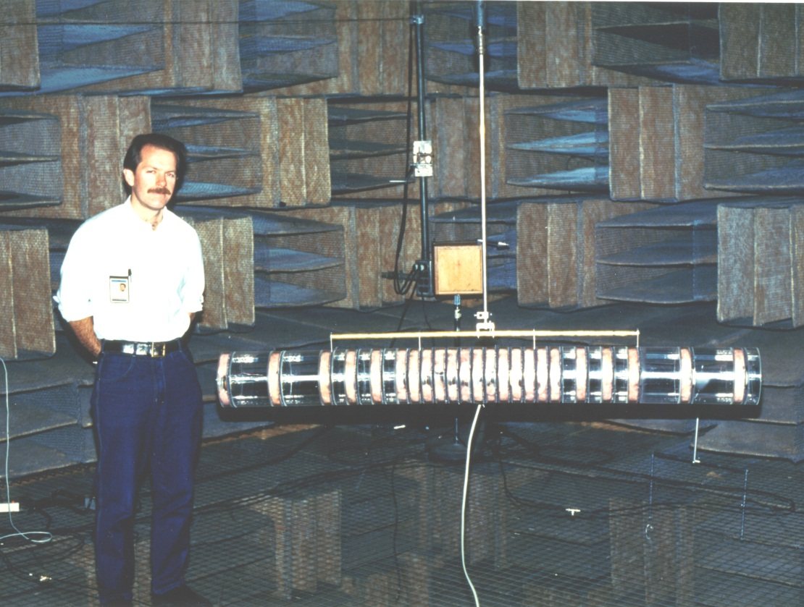
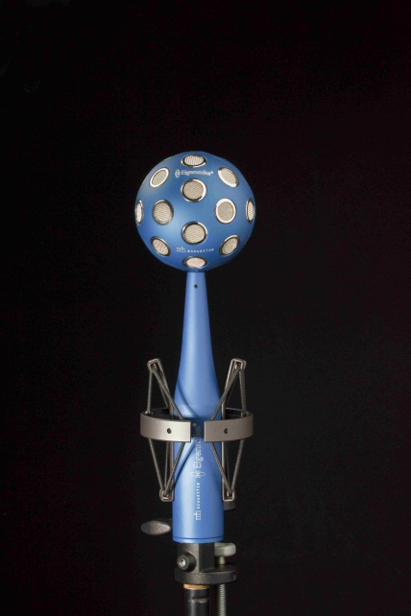
Some examples of where to go from here courtesy of Gary Elko and friends, I don’t have a single photograph of my own stuff:

Slide 44
Thank you, and GOOD NIGHT

