Slide 1
FFTs, Windows, and Circularity
J.D. (jj) Johnston
Factotum in Chief – Immersion Networks

Slide 2
First, two properties of the FFT
Circularity
Signal discontinuities

Slide 3
First, let’s review a very important property of the FFT, that being circularity.
When you apply an FFT, it assumes that the last sample in the FFT comes just before the first sample, in other words, the ends wrap around.
This causes a number of issues, including the need for windowing.
But first, let’s show an example.

Slide 4
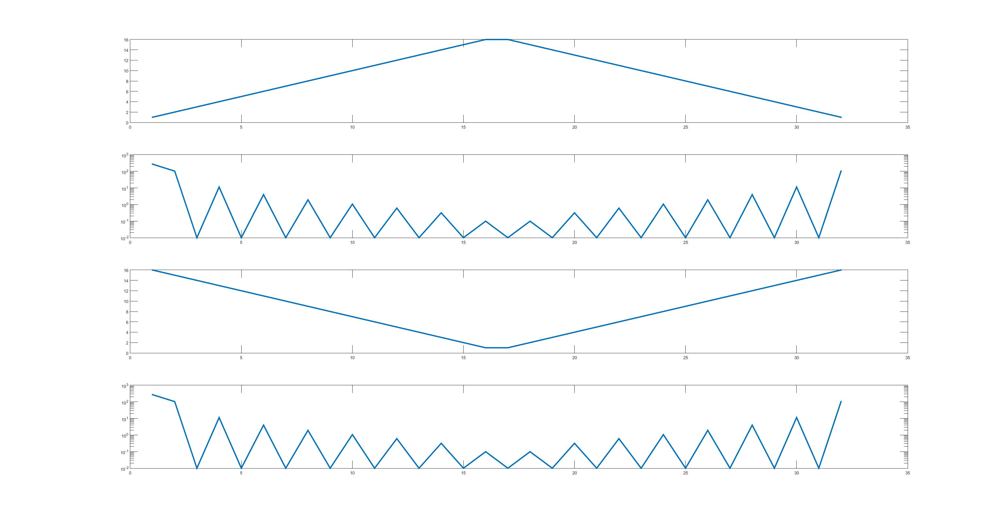
Signal
Amplitude Spectrum
Signal (shifted)
Amplitude Spectrum

Slide 5
Wait, what???
The signal was shifted. This means:
The only difference is in phase
I didn’t plot the phase
The delay was 16 samples, which works out to phi = t * w, where ‘t’ is the delay
Yeah. That simple.
The signal WRAPS AROUND!!!!
And thence we need windows.

Slide 6
Now: Discontinuities in Fourier Transforms
The kind of discontinuity in a signal defines how fast the spectrum falls off.
If there is a discontinuity in the signal, but only one (not a doublet) the spectrum falls off at 6dB/octave.
If there is a discontinuity in the derivative, 12dB/octave
If there is a doublet in the signal, the signal has a strong flat component
And so on. But what does this have to do with a window?

Slide 7
Time Waveform
Square Wave (1st derivative) – Blue
Triangular Wave (2nd Derivative – Red)
Corresponding amplitude Spectra

Slide 8
Back to the FFT and the Window
What happens when the end and the beginning of a window do not “match up”

Slide 9
Ok, FFT of 2 slightly different frequency sine waves
Remember, a sine wave has a ***LINE*** spectrum, right?
What if it’s not an integer number of cycles in the FFT length?
Oh, wait, then there’s a discontinuity. It won’t “blend” end to beginning.
Yep. That’s why we window!

Slide 10
Two sine waves
Resulting spectra

Slide 11
That discontinuity!
The discontinuity at the “end” (which is the same as any other point, since the FFT wraps around) causes a massive mis-estimation of the signal spectrum.
This, in a nutshell, is why you must window. Otherwise, signals at different frequencies are treated ***DIFFERENTLY*** and block lengths of FFT’s (or DFT’s) will confound the daylights out of what you are looking at.
Yes, the FFT is still lossless, phase included. But generally in this particular analysis, we’re looking for the signal spectrum, and we’re not doing such a good estimation!

Slide 12
Windows
There are many windows.
Rectangular (that’s what you get when you don’t window, since you really ARE windowing, but with a signal that’s just “chopped off” at both ends.
Triangular (zero at both ends, but not zero derivative)
Hann window (zero at both ends, first derivative also zero at both ends)
Windows handle the issue of discontinuity at the beginning and end of the block.

Slide 13
This brings us to another issue, time/frequency uncertainty
Your frequency estimation is only as good as your time window.
df * dt >= c
df is frequency resolution
dt is time resolution
c is determined by how “good” you want the estimation to be
All windows except for rectangular shorten the time duration of the signal, as they are smaller at the ends.
Windows therefore reduce the frequency precision, but treat all frequencies the same. (in general, there are specialty windows beyond rectangular)

Slide 14
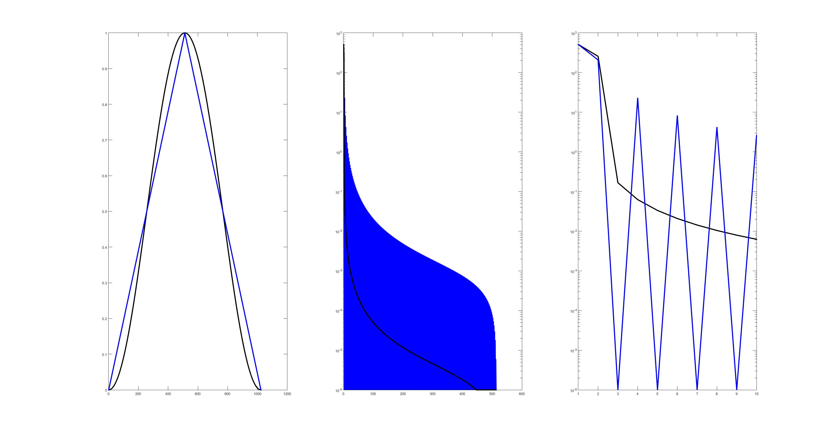
Some windows in common use:
Window
Spectrum of Window
First lines of window spectrum
Hann vs. Triangular (black vs. blue)

Slide 15
What do we see?
Triangular window is zero at the ends
Triangular window is ***NOT*** zero derivative at the ends
Hann window is zero and also in first derivative
And it rolls off faster, a lot faster.
The increase in frequency resolution isn’t much worth it, either.

Slide 16
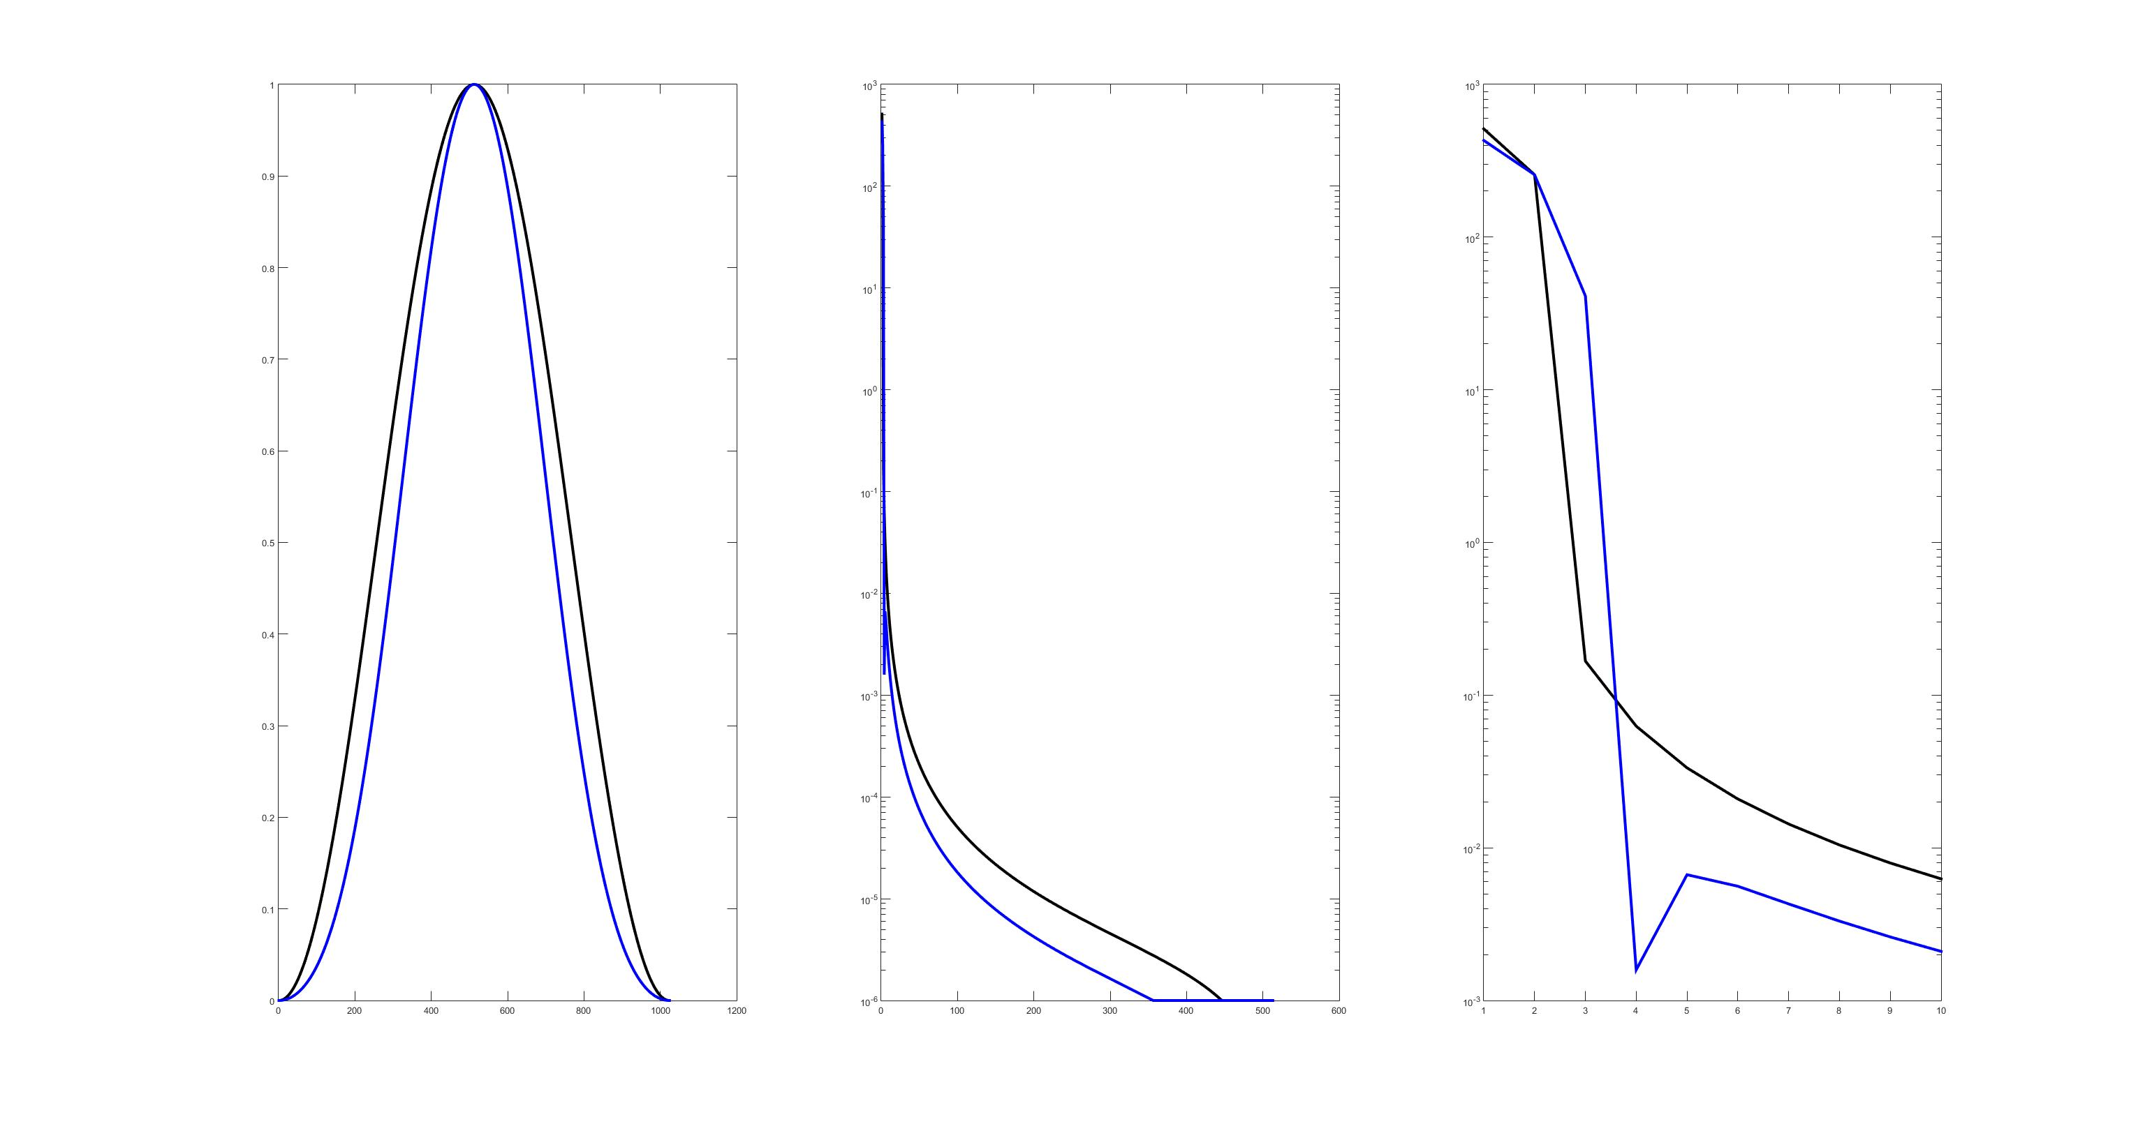
And another pair of windows:
Window
Spectrum of Window
First few lines of spectrum
This is Hann (black) vs. Blackman (blue)

Slide 17
So, always use a Hann window?
There are some operations, usually involving system measurements, where a window is only marginally necessary, because the signals are limited in time
However, noise can create problems by adding a discontinuity into this measurement
Adding a window can create ambiguities in measurement
There is no magical answer, understand what you measure.

Slide 18
But, WAIT, you just showed the frequency response of the window. What about the signal?
The “signal” simply modulates the window.
For a sine wave signal, it moves the peak away from DC to some other frequency
For a complex signal, it convolves the spectrum of the signal with the spectrum of the window.
That goes back to the “convolution theorem” discussed briefly in the “FFT Workshop” some years ago.
This makes the point that a window is nothing but a particular kind of low-pass filter, of course.

Slide 19
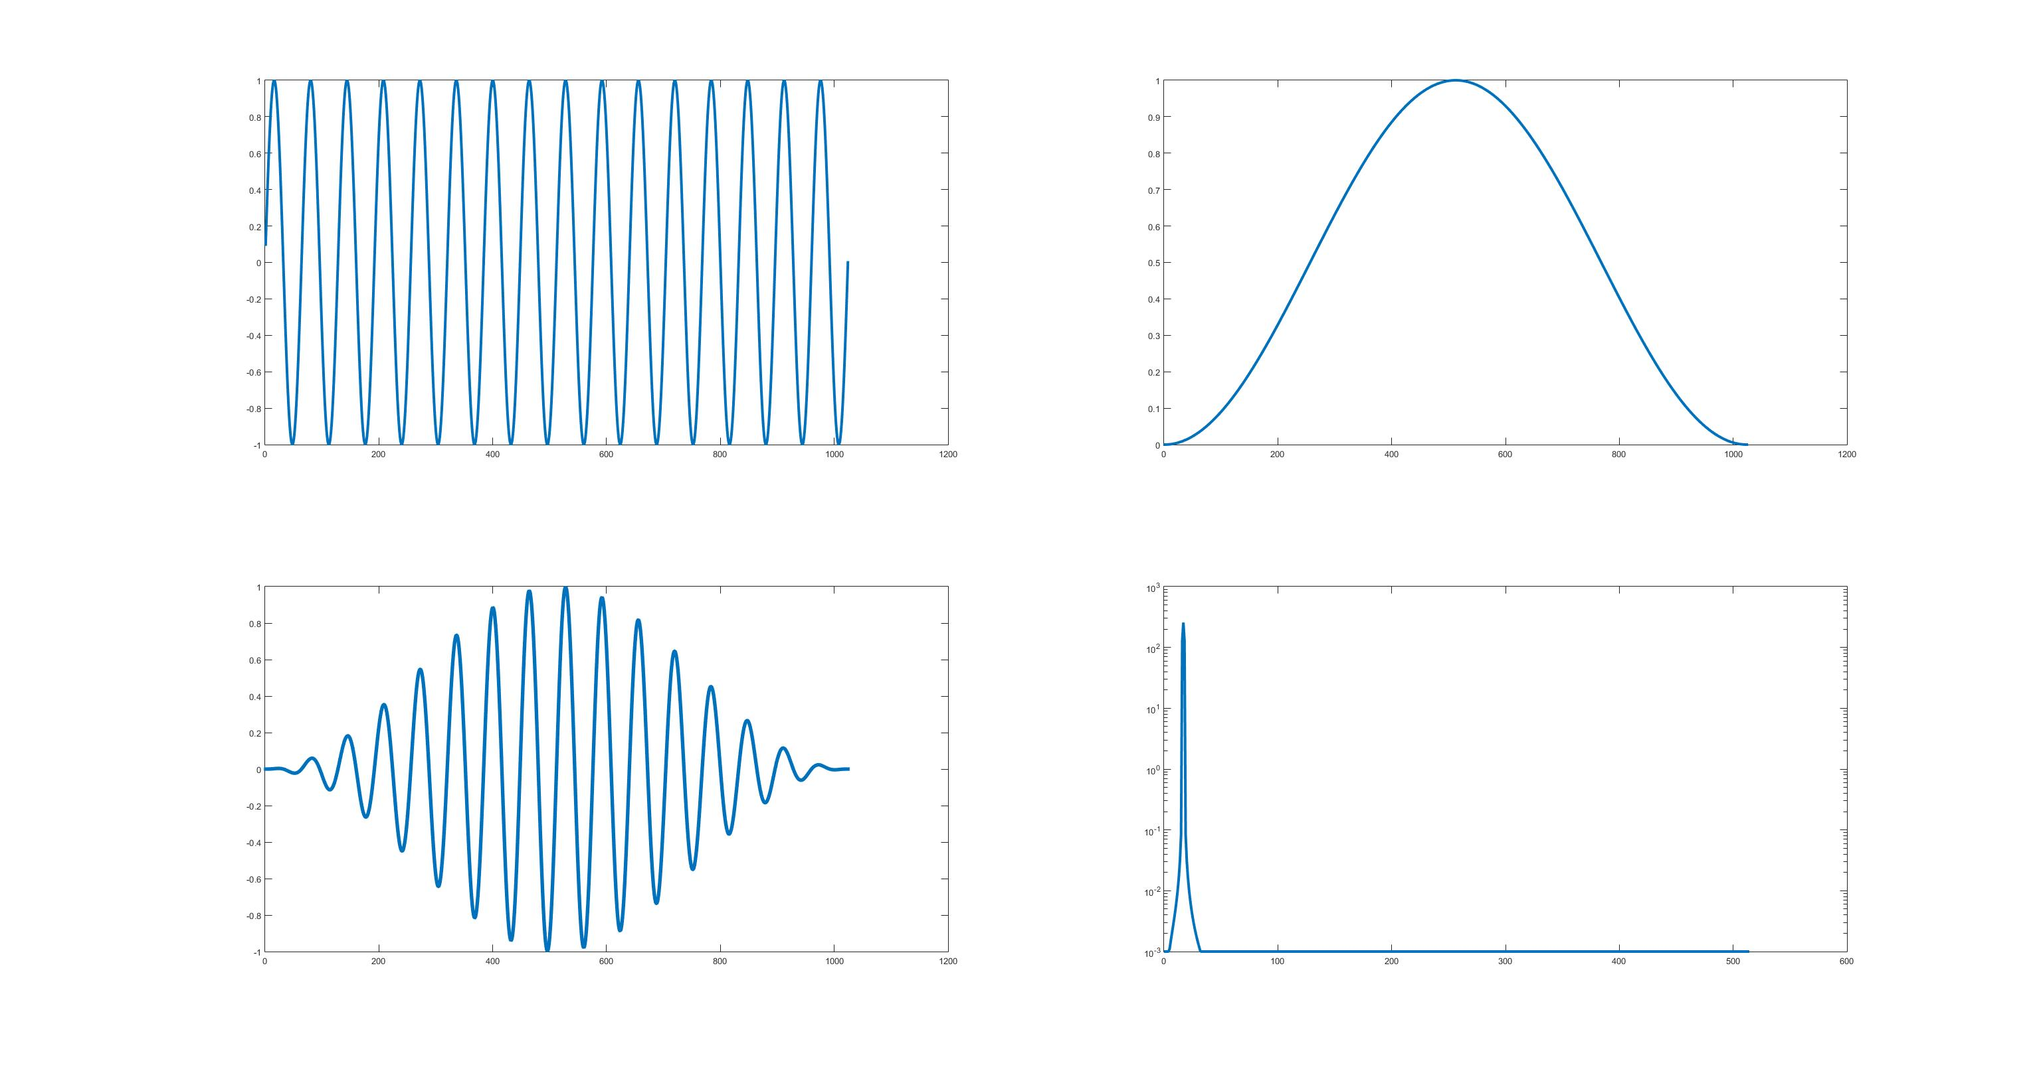
An example of a sine wave, windowed.
Sine wave
Window
Windowed Sine Wave
Resulting spectrum
Note peak shifted to sine wave
frequency.

Slide 20
Finally, some different windows characterized
Peak
shape
Full Spectra
Window
Black – Hann, Red – Blackman, Green – Kaiser (5), Blue -Nuttall

