Slide 1
Human Hearing 096
Part 1

Slide 2
Four Parts:
External acoustics
  HRTF’s/HRIR’s
  Interaural Time differences
Middle ear
  HP filter
  Level control
Cochlear analysis
  Modified transmission line filter
  Cochlear Filterband
  Compression Mechanisms
CNS
  Expectation
  Perceptual processes and losses

Slide 3
External Acoustics
Head Related Transfer functions.
  Sounds from any direction interacting with your head will be “filtered”
  This depends on:
    Head shape
    Head size
    Pinna shape
    Pinna location
  As you can see, these are therefore somewhat unique to a given individual.
  One learns their HRTF’s automatically by living with them
Interaural Time difference
  This is, strictly speaking, part of the HRTF but
  ITD’s can be manipulated independently of the frequency shaping due to the head/pinna

Slide 4
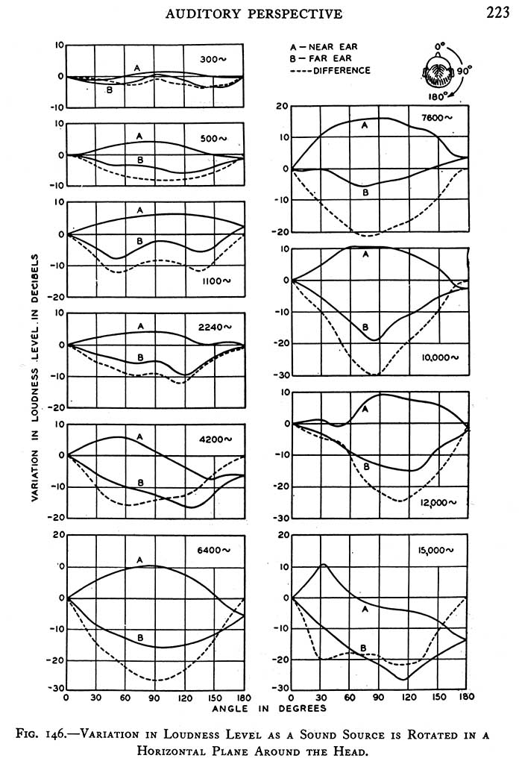
Some very old examples

Slide 5
Middle Ear
The middle ear is mostly an impedance transformer.
  It consists of the 3 bones and the ear drum. One can also include the ear canal, depending on whose text you’re reading.
It has a couple of other notable functions:
  It is a first order highpass filter operating at about 700Hz. That’s a big part of the low-frequency threshold increase
  Its acoustic impedance rises at high frequencies, which is a big part of the high-frequency threshold elevation. The diameter of the canal enters into this as well.
  It can decouple the eardrum from the cochlea
    If you’re doing that, it’s too damn loud!
  The ear canal provides a boost at one or two resonant points.

Slide 6
The “inner ear”
Ok, here’s where it gets complicated.
My drawings are terrible, forgive me.
First, a photo of the cochlea from the innertubes:

Slide 7
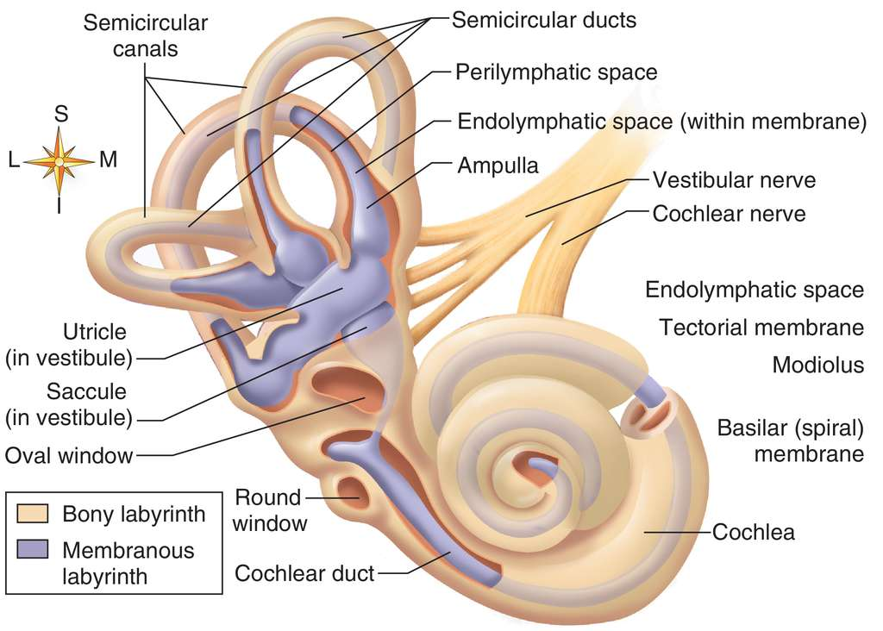

Slide 8
That’s kind of busy:
So, I’ll go back to that, but focus on
  The basilar membrane
  The oval window connects to the stapes, that’s where “sound goes in” via vibrations. These vibrations are minute.
  The round window lets the energy in the endolymph back out of the cochlea
Something you can’t tell from that drawing:
  The oval window and round window are on opposite sides of the organ of Corti
    The tectoral and basilar membranes are part of the organ of Corti.
    The basilar membrane and rossner’s membrane separate the scala timpani (space connected to the ear drum) from the scala vestibuli (space connected to the air behind the dear drum).
    The tectoral membrane extends from one side to the middle of the basilar membrane, inside the Scala Media (middle space)
The three spaces are filled by fluid, each slightly different
  The three spaces also have small electrical voltage differences.
  That probably matters, but don’t ask me how, today.

Slide 9
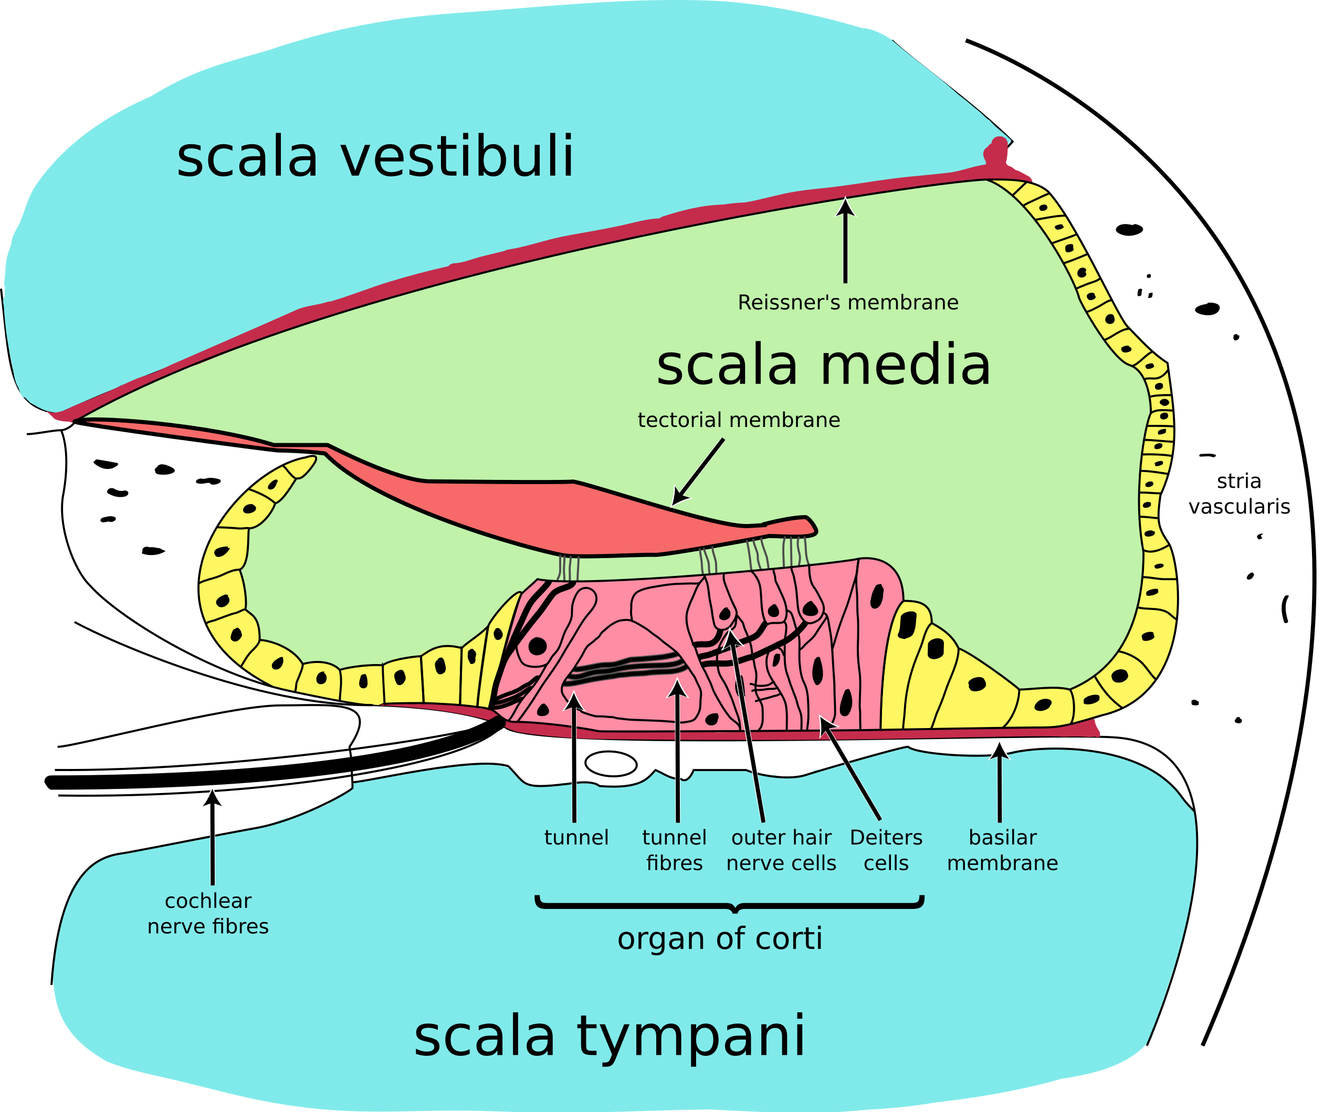
The organ of Corti

Slide 10
Something to remember
This is a tiny, tiny, think, delicate organ
It is now established that the inner hair cells do almost all of the detection
The outer hair cells provide “compression”.
Exactly how the compression works is the subject of rabid debate at the present.

Slide 11
So how this this all make us hear anything?
The setup creates a filterbank
  High frequencies at the input end
  Low frequencies at the far end
The system is a kind of biologically created, nonlinear, transmission line filterbank.
The outer hair cells change stiffness, and by doing so, changing membrane tunings.

Slide 12
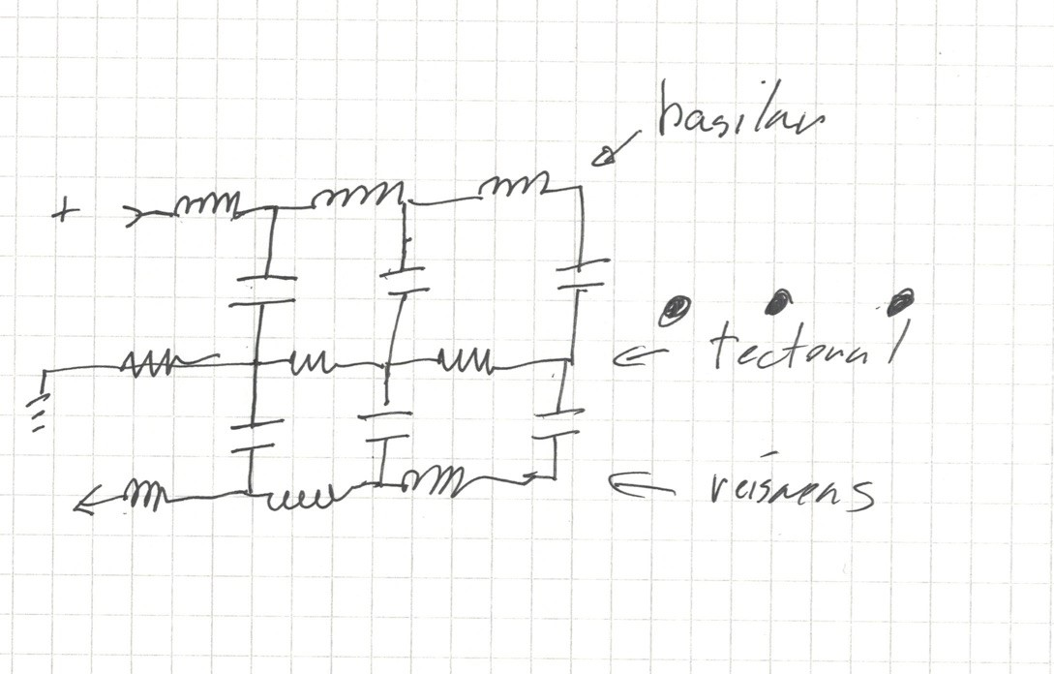
For the electrical engineer among us:
Current here is detection analog
From middle
ear
To air in
middle ear
Outer hair cell stiffness affects this ‘C’

Slide 13
No, that’s not exact. It’s much more messy than all that.
Everything is nonlinear
The detection is mixed between “all or nothing” and “level”. In addition, leading edges are favored.
Its delicate, and easy to overload.
None the less it creates a filter bank.

Slide 14
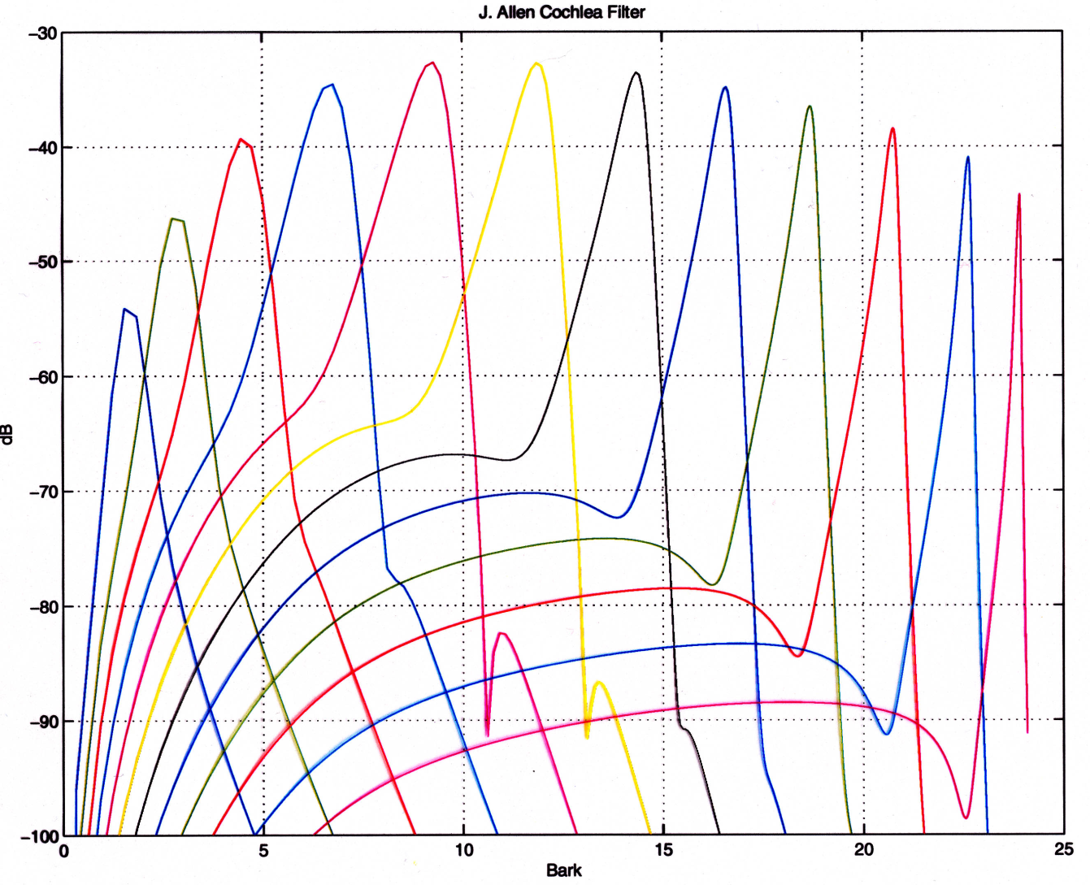
An example of some filters (no, not human)

Slide 15
How many filters are there?
There are about 2500 inner hair cell groups.
Each group, effectively, has a filter characteristic
Filters overlap, and overlap a lot
The “ERB’s” we use are an estimate of the filter bandwidths
The fact we conventionally use about 90 or so 1/3 ERB filters, each with a width of an ERB, is a computational issue.
Yes, there really are 2500 bands, overlapping enormously.

Slide 16
So, the first take-home:
The ear is a frequency analyzer.
The filters mean that there is actual mechanical separation of frequencies before the nerves are caused to fire.
The shape of these filters is reasonably well determined.
So, the first two rules of audio processing are:
  Don’t add new frequencies.
  Especially, don’t add new signal at far-removed frequencies from the original.

Slide 17
Compression inside one cochlear filter
The actual dynamic range of an inner hair cell is about 30dB.
The inner hair cells, when firing, depolarize the outer hair cells, the more firing of the inner hair cells, the more depolarization of the outer hair cells.
This reduces the sensitivity of the system substantially
Thence, the 30dB is mapped over about a 90dB range.
  (there’s actually more complication involving synapses, etc)

Slide 18
How does that work?
Well, both the basilar and tectoral membranes can be modelled as a peaky highpass filter.
  The exact response varies with level
  Nobody can quite assert exactly what that shape is, either.
The detectors (inner hair cells) fire on the difference between the two membranes.
  This leads to small changes in the membrane tunings making large changes in sensitivity.
  One example is shown in the next page. This is “for demonstration only”, the exact details are not established.

Slide 19
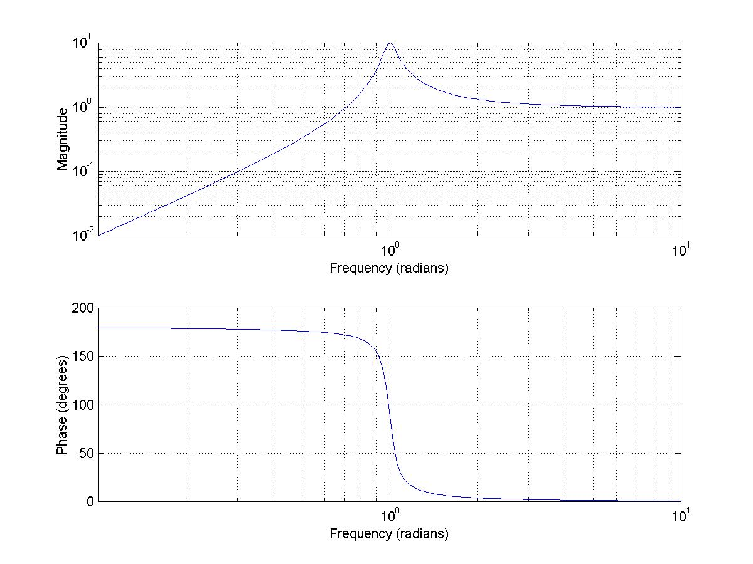

Slide 20
So? What happens, now, when we link two such resonances?
As you may (or may not) recall, linking two resonances splits the resonance into two modes, separated by a small amount of frequency.
Increasing the coupling makes the modes farther apart.
Depolarized outer hair cells are much less stiff, i.e. provide much less coupling.
So something of this sort goes on. Exactly what is undoubtedly much more complex.

Slide 21
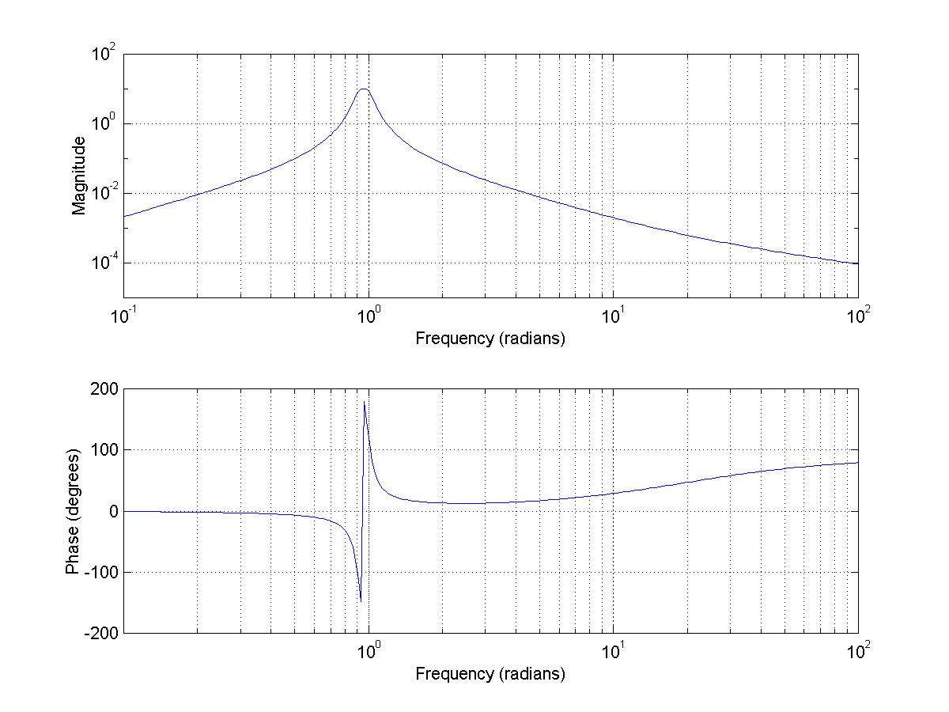
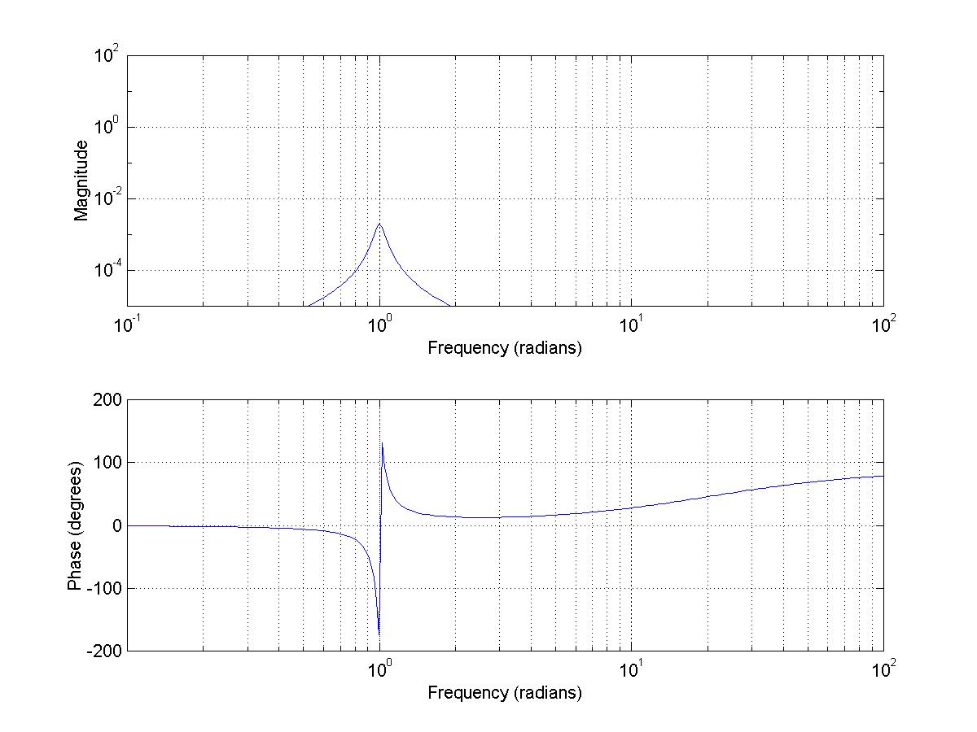
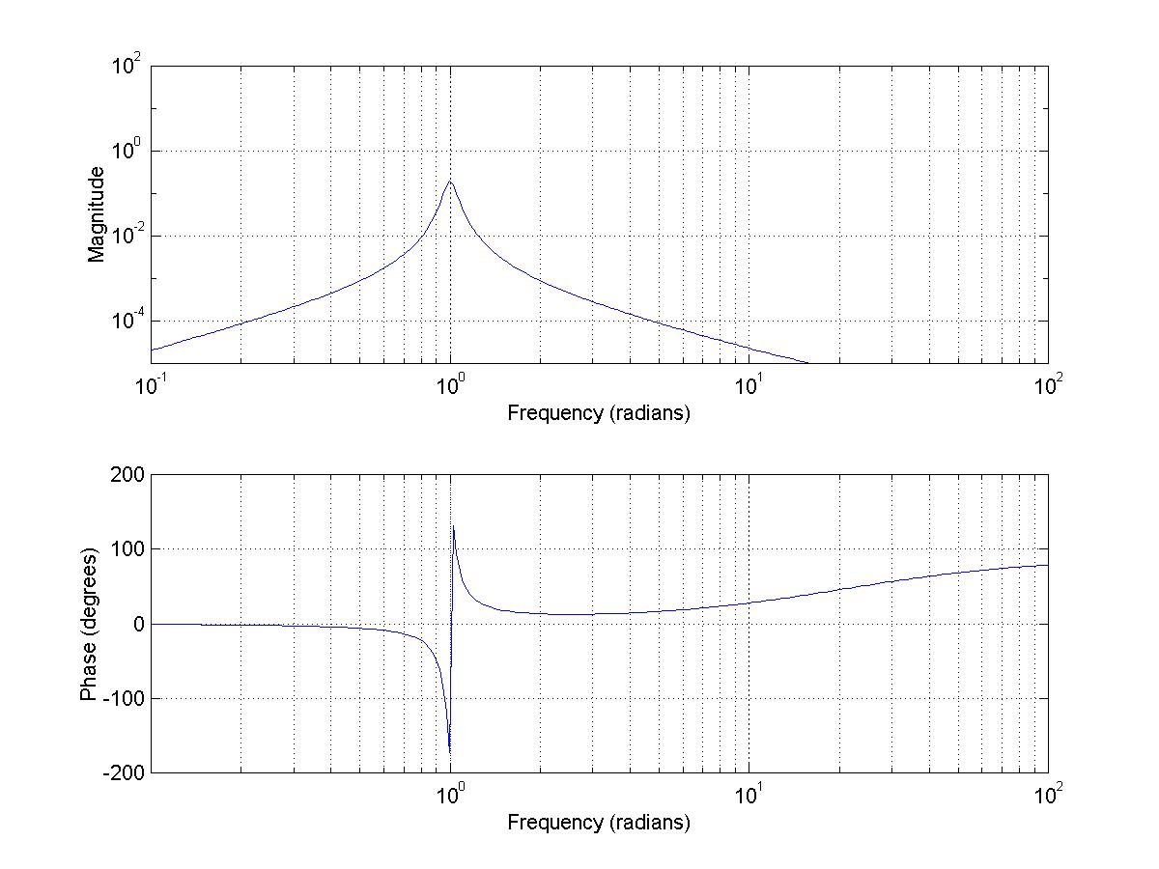
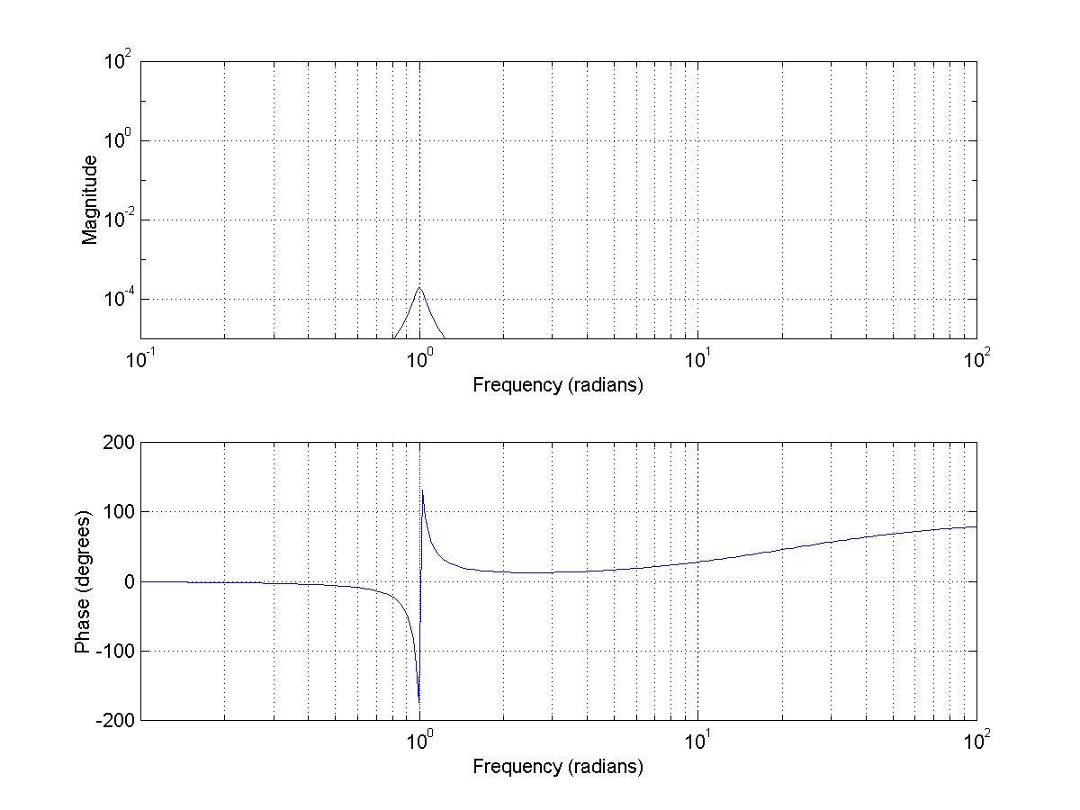
So, let’s look at the difference as the resonances split apart now. (numbers are relative offset)
1.1
1.00001
1.001
1.000001

Slide 22
Notice how that fast phase shift also provides information at low frequencies
At low frequencies the inner hair cells can fire synchronously on the “moving together” direction.
This means that there is a sharp change in firing time across the actual frequency of a tone.
Note also that the peak moves slightly with offset. This matches the drift of frequency sensation with level.
But yes, something more complicated is undoubtedly going on.

Slide 23
Loudness
First a definition.
Loudness is sensation level.
Intensity is analytic power level.
They are not the same thing.
Loudness is measured in phons or sones
Intensity is measured as power/volume
  SPL, or sound pressure level, measures one aspect of intensity
  The pressure level is in fact what’s most important to the ear

Slide 24
Loudness grows as a power of energy, inside one filter.
This is something like power ^ (1/3.32). This probably varies across the cochlea, but this generally suffices. This was used as the definition for ‘twice as loud’ being 10dB.
That number, in a given band, is the ‘partial loudness’ in that band
When adding loudness across bands, however, the power of 1/1.75 seems to balance the loudness of broadband noise vs. a tone.
So to determine total loudness, raise energy to the 1/1.75 power, sum, and then raise by the ratio of the two power laws, or 1/1.9 to scale the loudness to the definition of ‘twice as loud’

Slide 25
So, the point is:
Loudness and energy only scale when you don’t change the spectrum
When you change the spectrum, things can be surprising.
The next slide is a plot of bandwidth vs. loudness for a constant energy.
  It undoubtedly exaggerates at wide bandwidths, because the ends of the spectrum are probably falling below absolute thresholds.

Slide 26
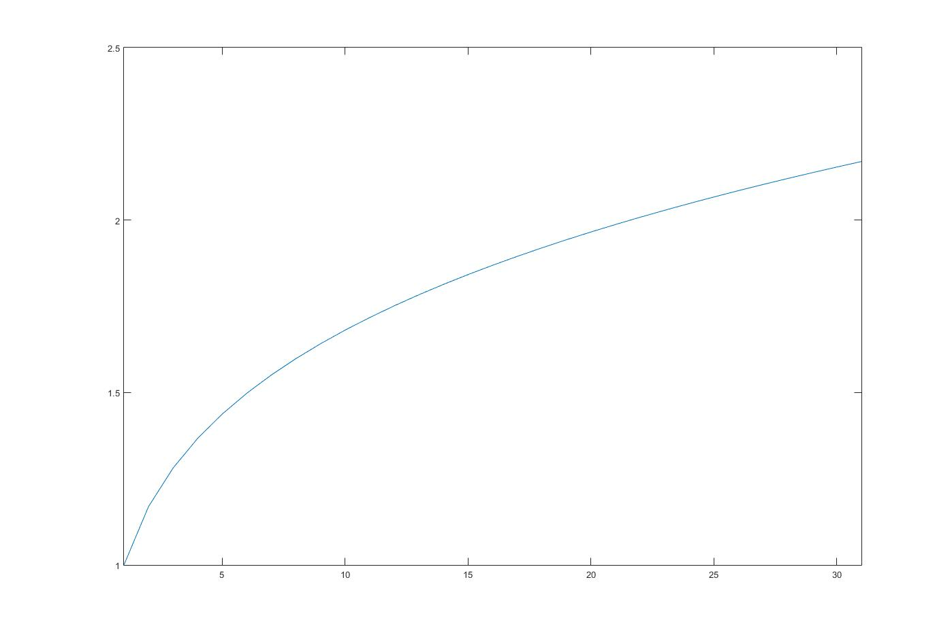
Equivalent
Loudness
Number of ERB’s of equal power bandwidth

Slide 27
Brain and Expectation
Mbits/second
Mbit/sec
Kb/sec
bit/sec
Loudness
“integration”
Feature
Analysis
Auditory
Object
Analysis
Cognitive and other Feedback

Slide 28
Yes that feedback is heavily influenced by everything.
What you see
What you feel
How you feel
What is the experimenter doing?

