Slide 1
NWAA Labs, Inc. : Old Problems, New Solutions: Architectural Acoustics in Flux Redux (Updated 2023)

Slide 2
1. Introduction: Ron Sauro President NWAA Labs, Inc.

Slide 3
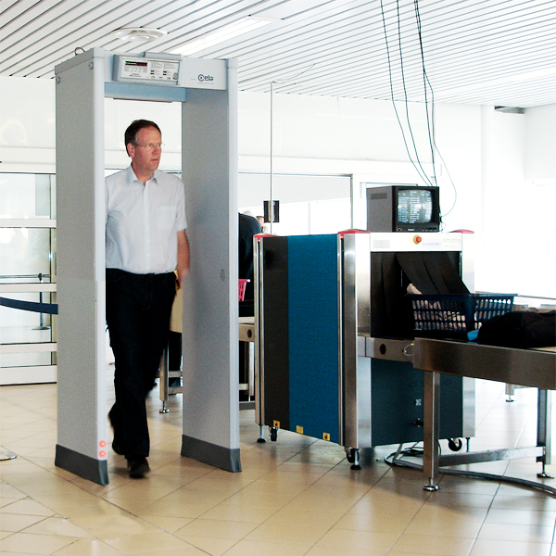
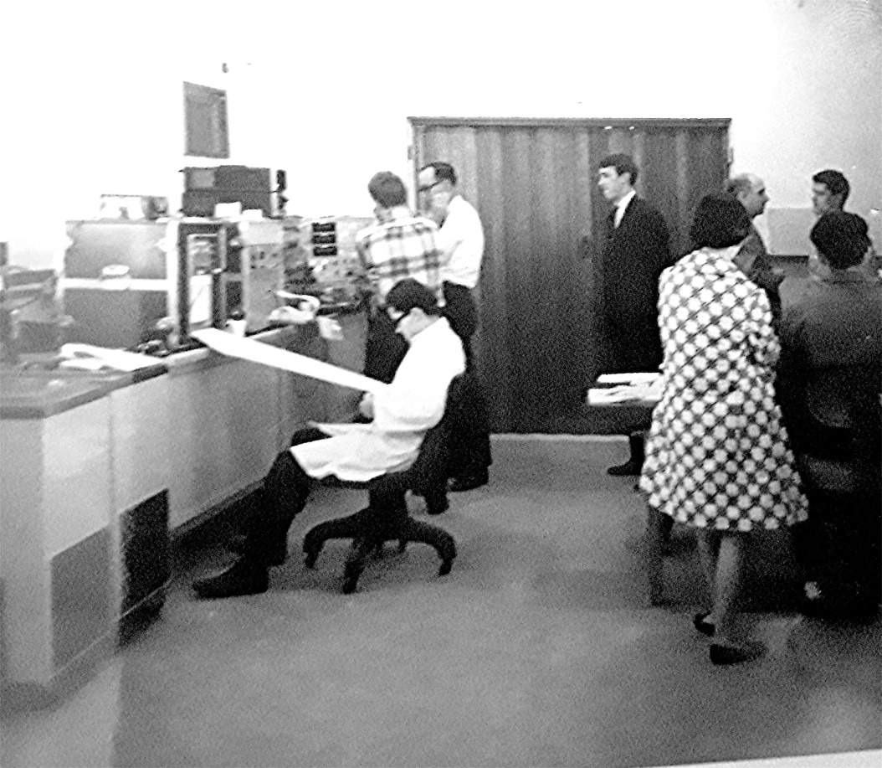
The Man Behind It
As a result of the first airline hijacking by D.B. Cooper, he is tasked with detecting guns being smuggled onto an aircraft. He invents the first “Metal Detector” used in airports.

Slide 4
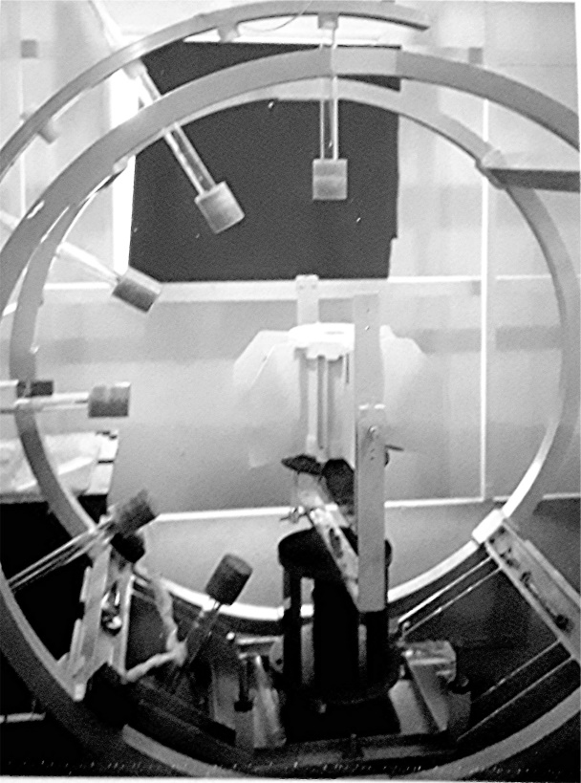
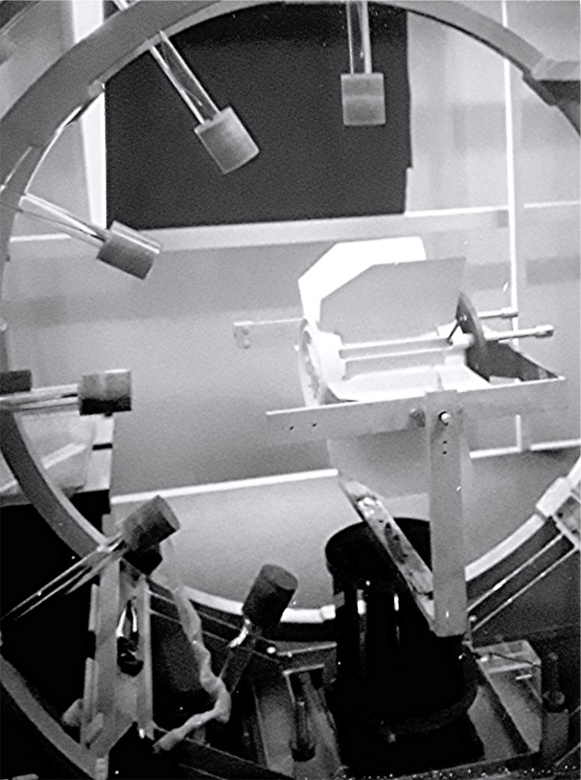
The Man Behind It
Ron then invents the test equipment needed to measure the magnetic signature of the miniature atomic reactors on space probes. This includes the first multi-channel, solid state magnetometer and multi position magnetometer mounting system. In addition, he designs the first solid state, multi channel, high speed, data acquisition system using a cassette storage medium.

Slide 5
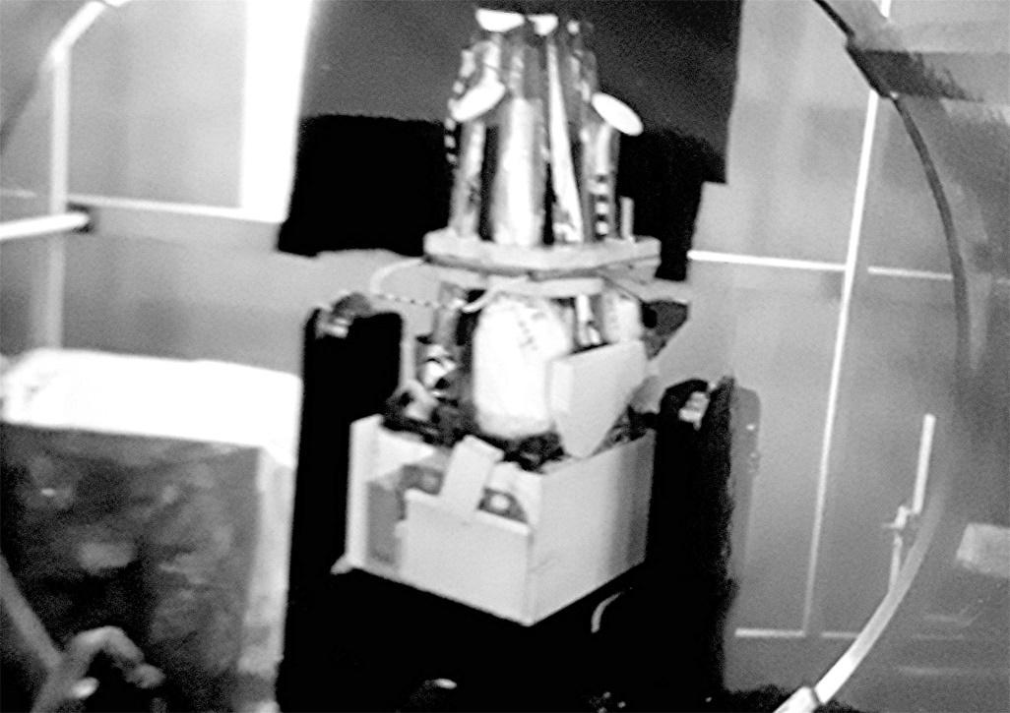
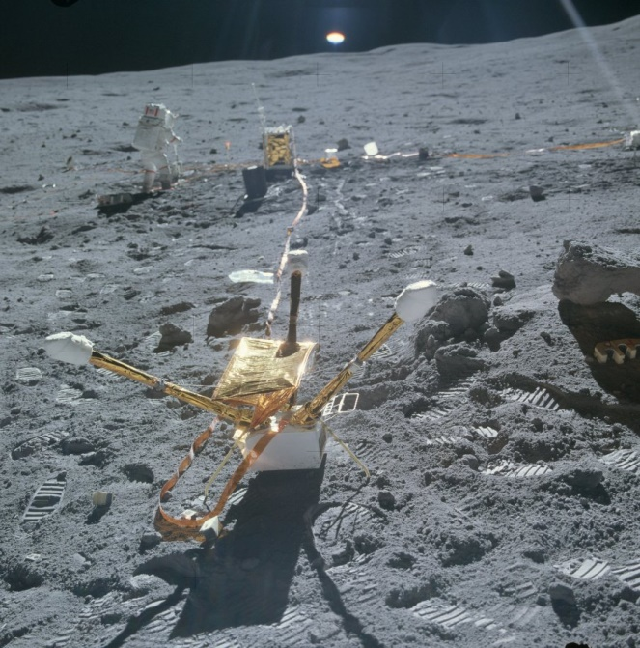
The Man Behind It
As a co-investigator, he designs multiple magnetics experiments for the Apollo, Viking, Pioneer, Voyager and the Cassini programs.

Slide 6
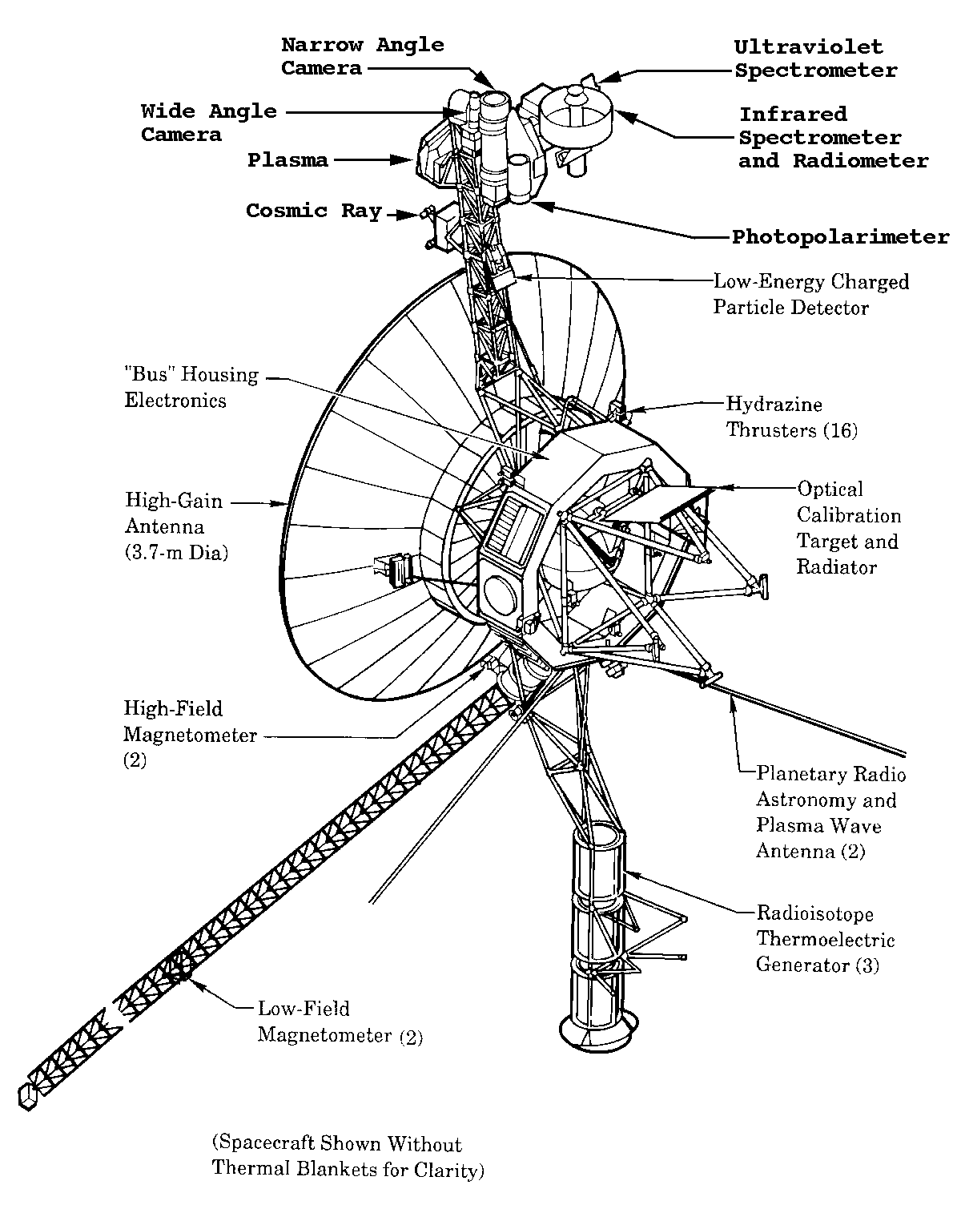
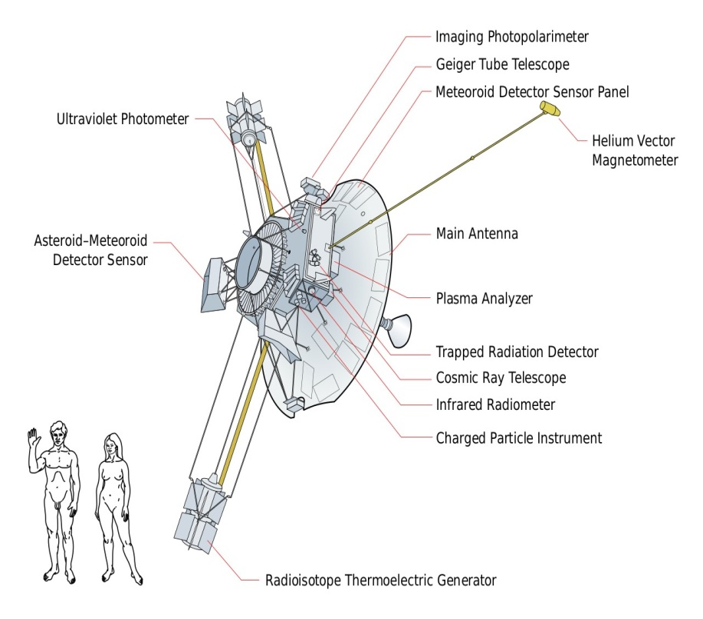
The Man Behind It
Pioneer 10-11
Voyager 1-2

Slide 7
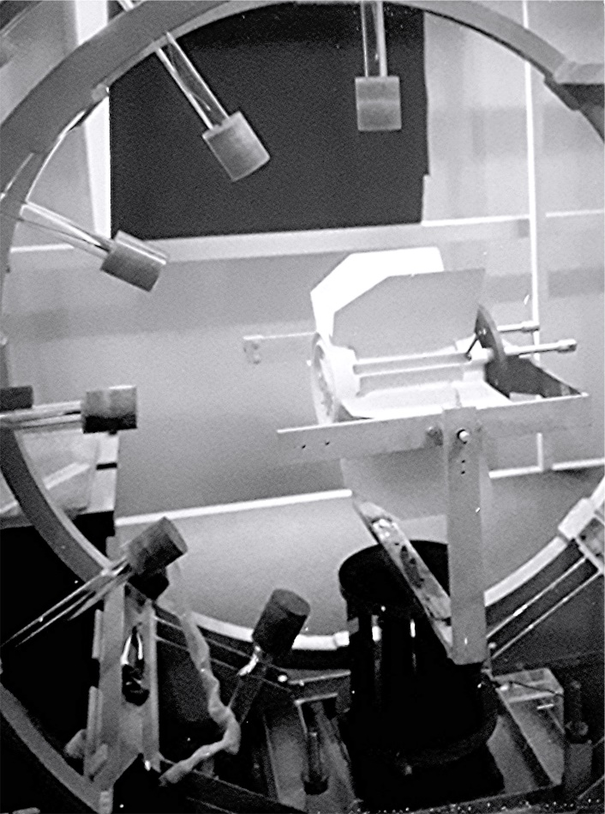
The Man Behind It
1968

Slide 8
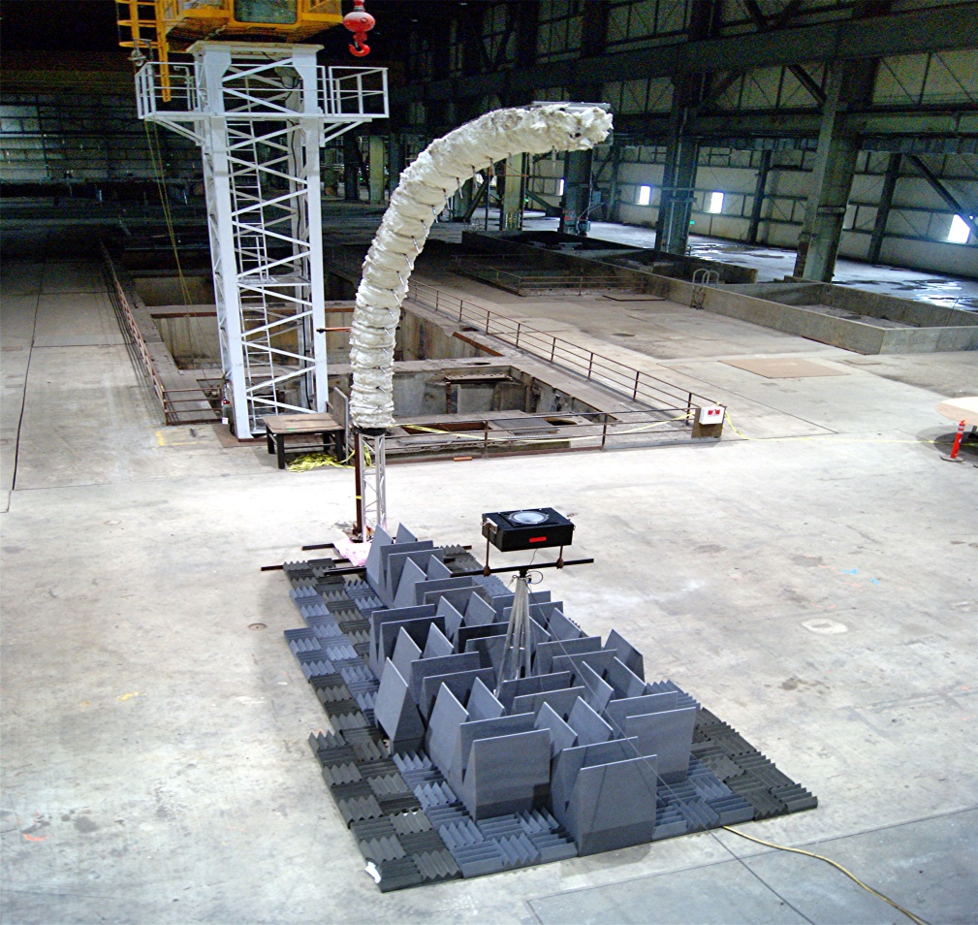
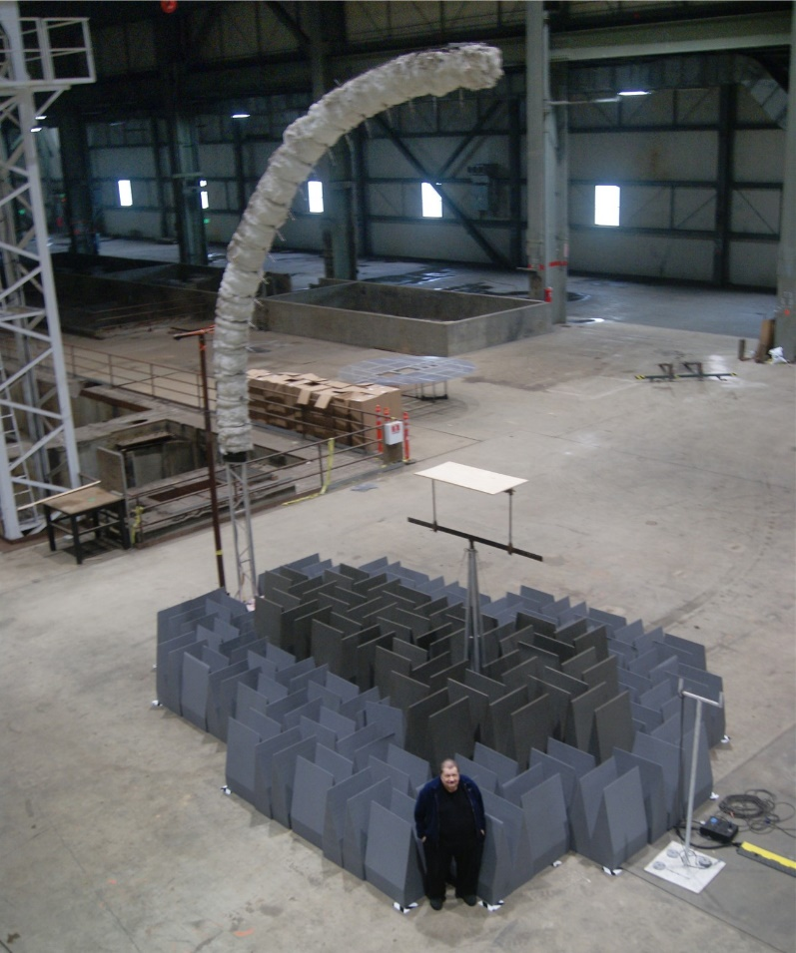
The Man Behind It
2020
CURRENT

Slide 9
2. Introduction: NWAA Labs, Inc. Facilities

Slide 10
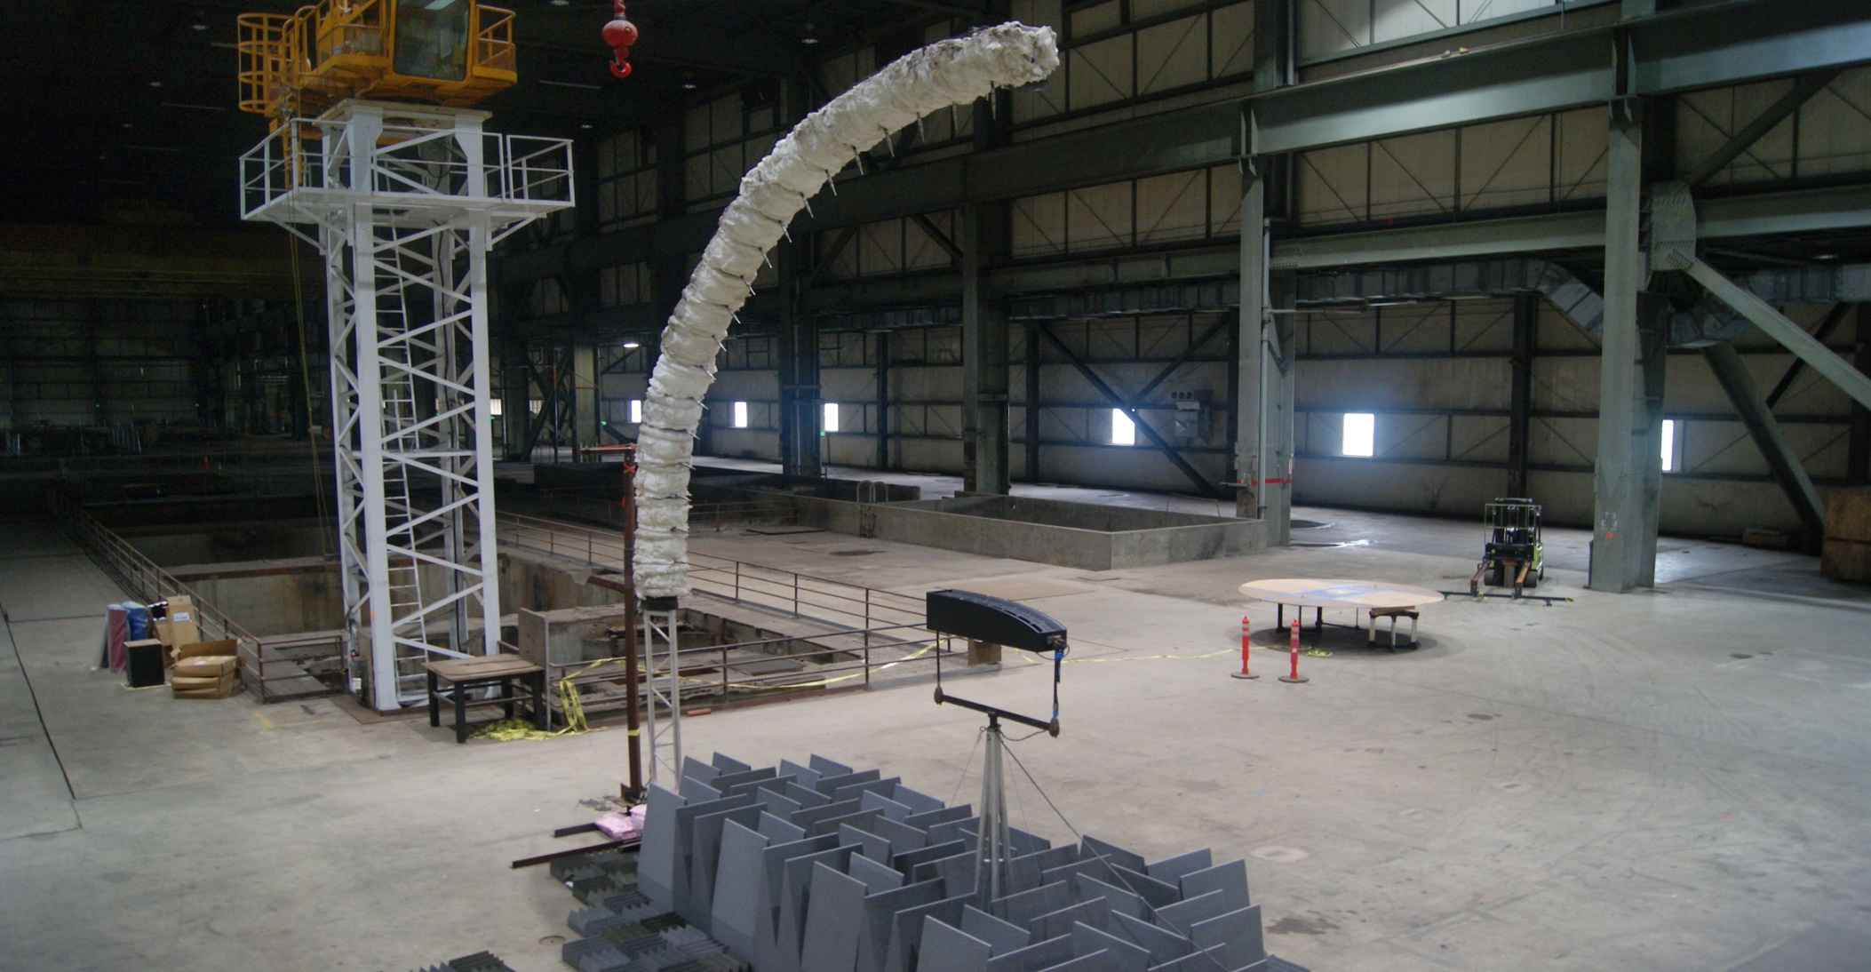
AES56 “MACH” Testing System
Multi Angle Computerized High Speed Testing System

Slide 11
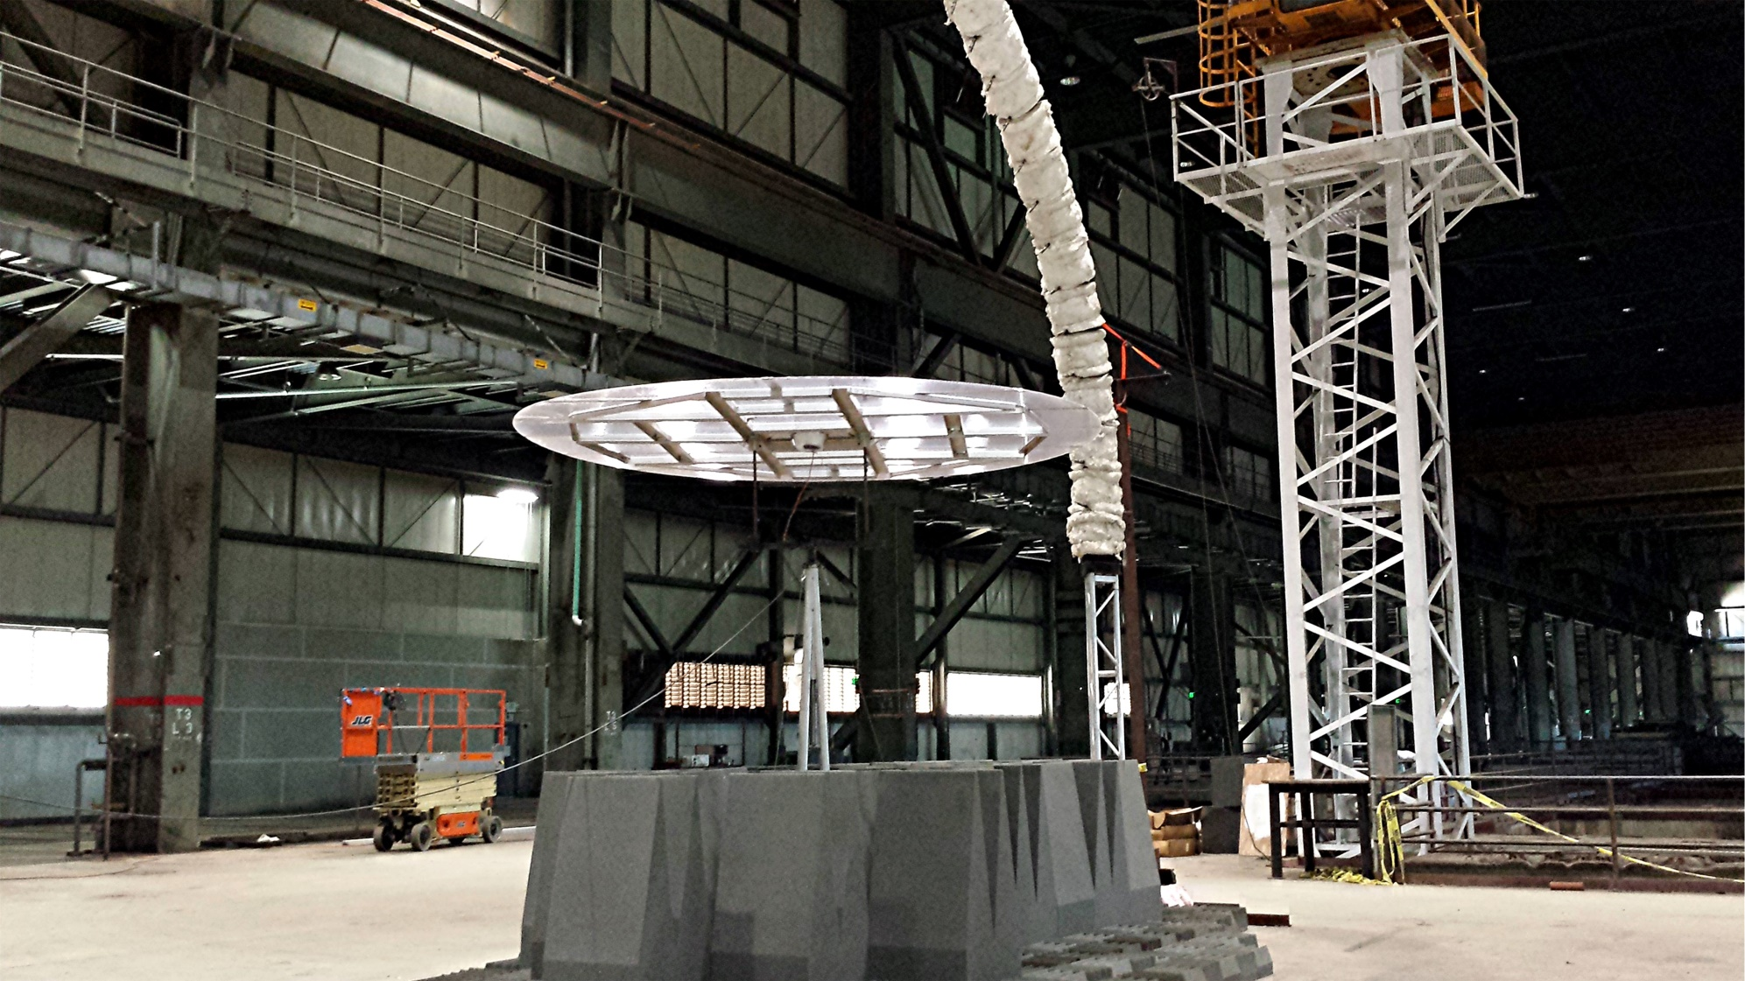
AES56 “MACH” Testing System
Multi Angle Computerized High Speed Testing System

Slide 12
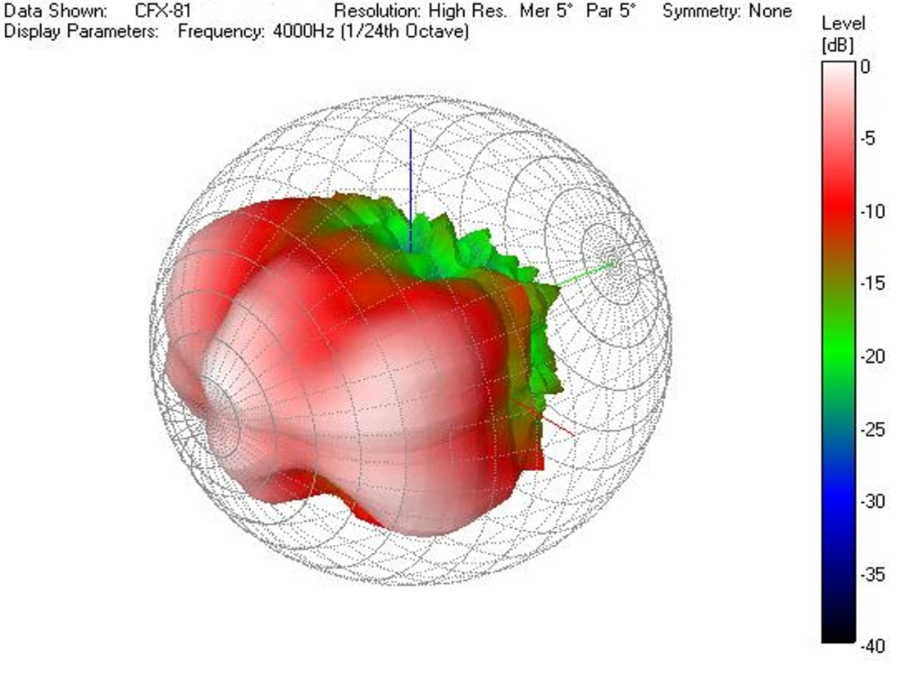
GLL Directivity Balloon.

Slide 13
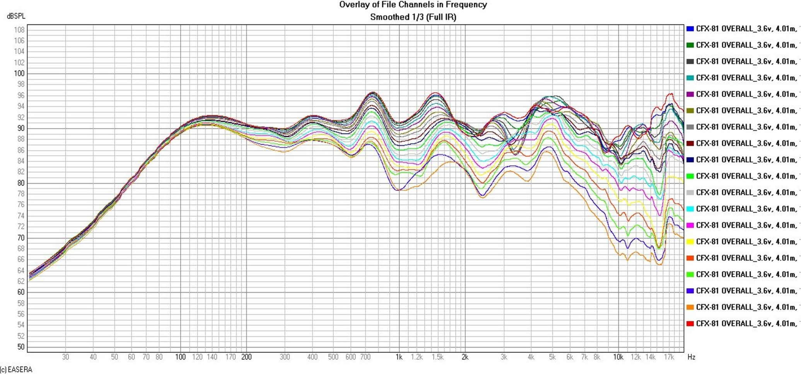
GLL Frequency Responses

Slide 14
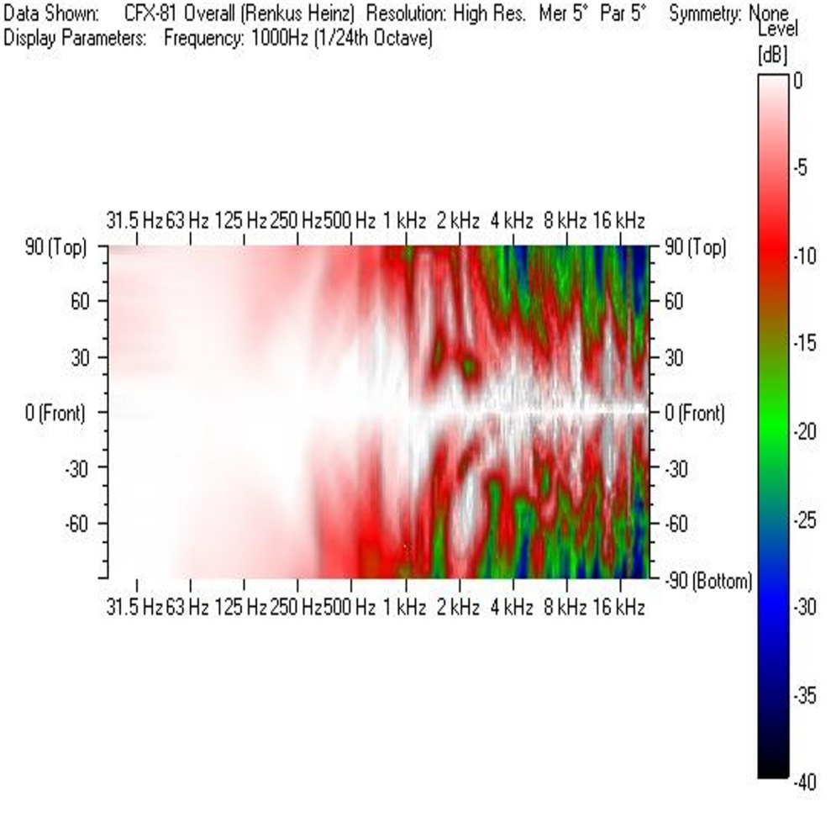
GLL Directivity Mapping
Point Source
GLL Simulation

Slide 15
NWAA Labs Experimental Diffusion and Scattering Test

Slide 16
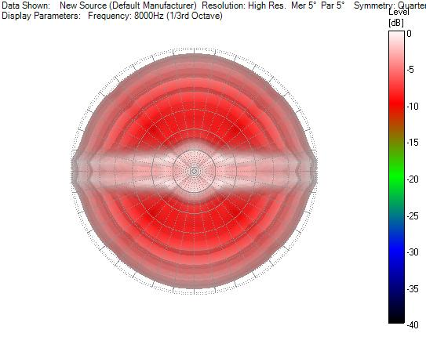
Cylindrical Model Actual Measurements

Slide 17
Cylindrical Model Simulation based on measurements

Slide 18
Reverb Rooms
The largest in the world
737 cu meters
The quietest non anechoic rooms in the world
-18dbA average from 25Hz to 10KHz
10 ft. by 12 ft. TL opening

Slide 19
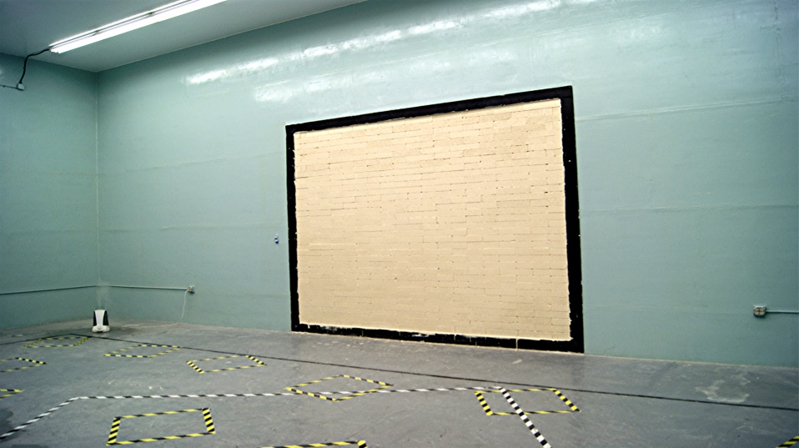
E-90/ISO-140 Transmission Loss
Walls
25-10kZHz

Slide 20
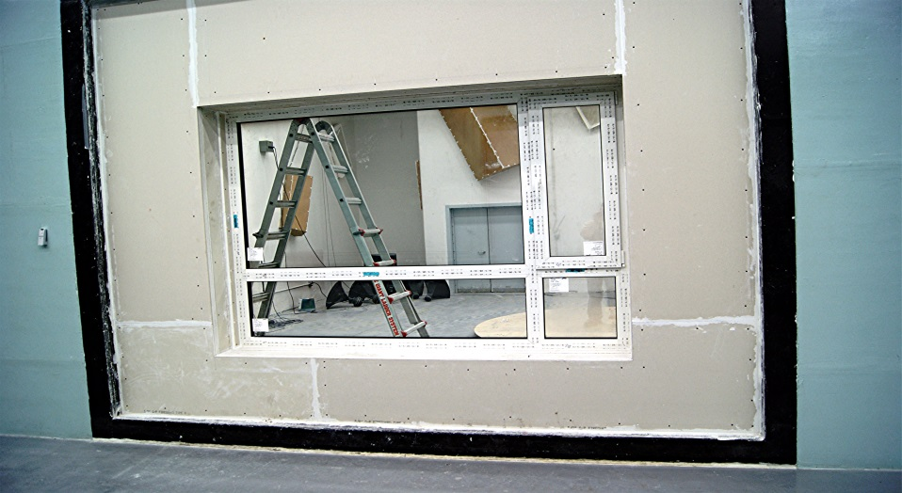
E-90/ISO-140 Transmission Loss
Windows
25-10kZHz

Slide 21
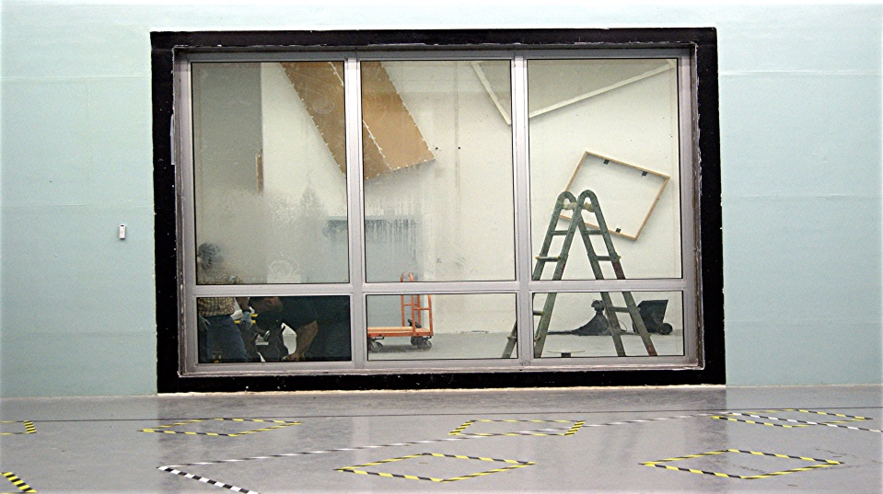
E-90/ISO-140 Transmission Loss
Curtain Walls
25-10kZHz

Slide 22
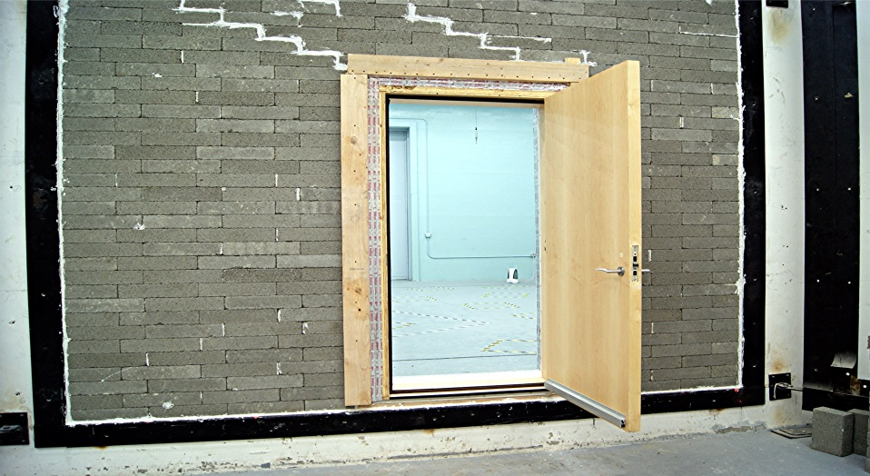
E-90/ISO-140 Transmission Loss
Doors
25-10kZHz

Slide 23
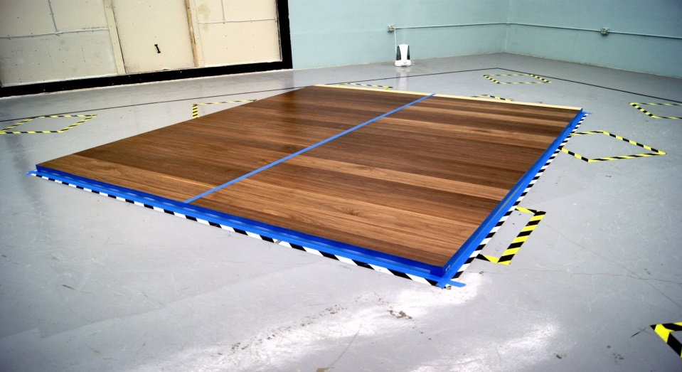
C-423/ISO-354 Absorption
A type Mount
25-10kZHz
Notes:
.5

Slide 24
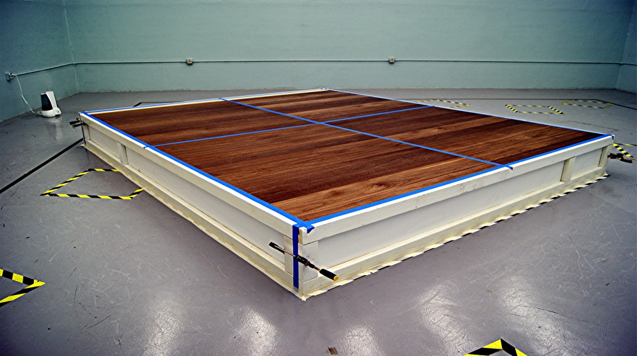
C-423/ISO-354 Absorption
Type E-400 Mount
25-10kZHz

Slide 25
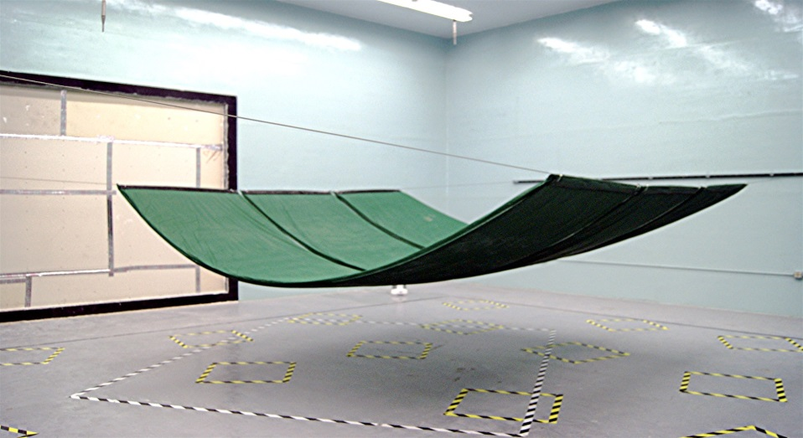
C-423/ISO-354 Absorption
Type M Mount
25-10kZHz

Slide 26
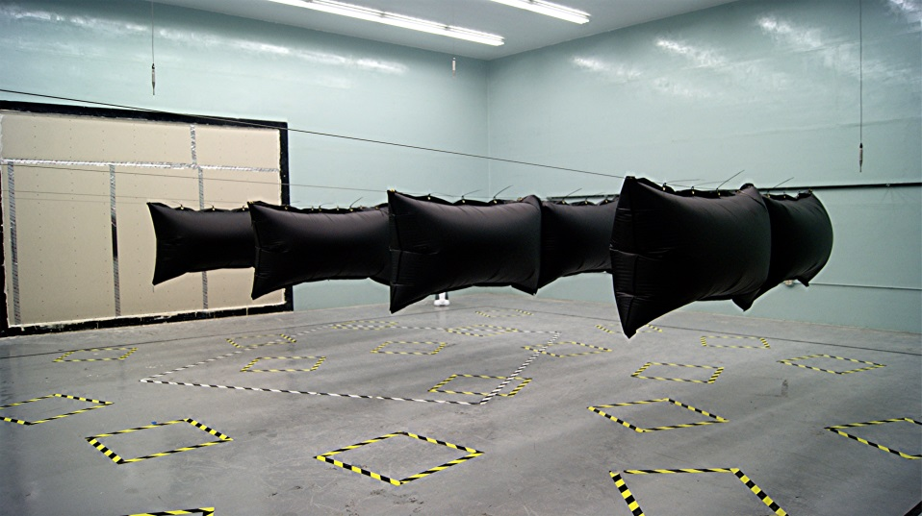
C-423/ISO-354 Absorption
Type J Mount
25-10kZHz

Slide 27
3. Introduction
Research and Discoveries
1. Absorption

Slide 28
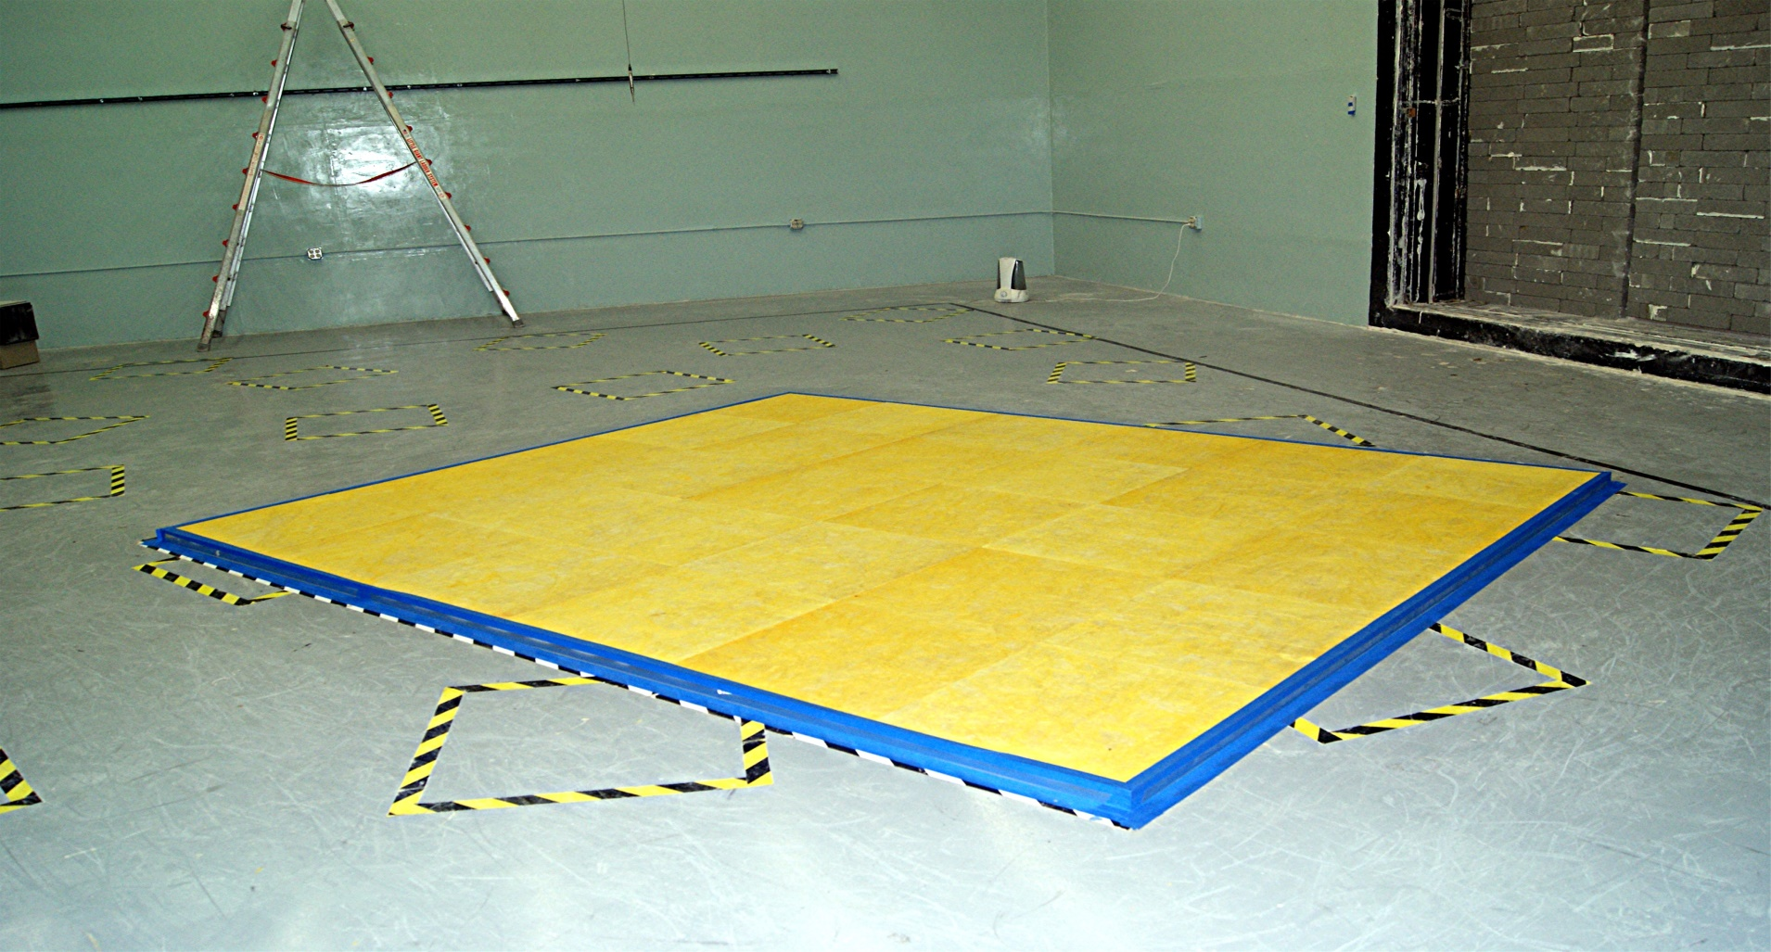
C-423/ISO-354 Absorption
Experimental A Mount Monolithic

Slide 29
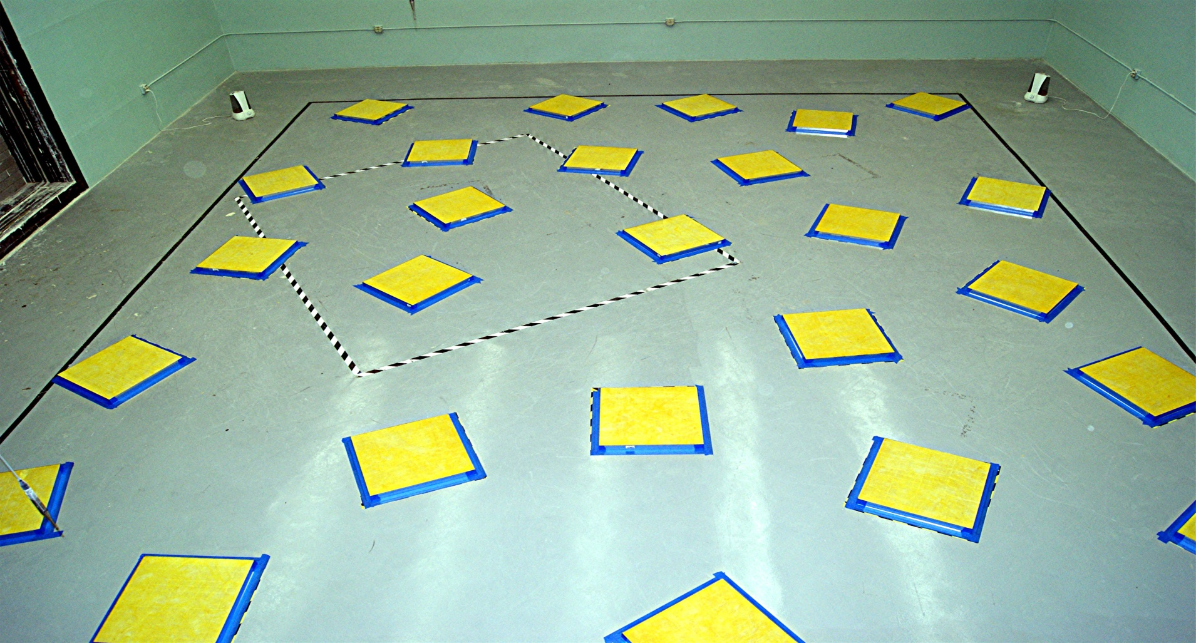
C-423/ISO-354 Absorption
Experimental A Mount Split

Slide 30
C-423/ISO-354 Absorption
Experimental Wall Mount

Slide 31
Topics of Discussion
Material vs Wall Construction
ASTM mounting Methods
Wall Structure Placement
Lack of data measured in recent time periods

Slide 32
Reverberation Room
A Type Mount

Slide 33
Proposed TL Mount
T Type Mount
Fill Wall

Slide 34
A mount vs TL Mount

Slide 35
A mount vs TL Mount

Slide 36
Conclusions
A Mount simulates a wall built over an exterior wall only
Interior wall adjoining another room should be measured using the TL mount
Modeling programs should include both types of data

Slide 37
Absorption Coefficients Pt1:
Is Area Enough?
NWAA Labs, Inc ©

Slide 38
Common Questions
Q: What is sound absorption?
A: It is the conversion of acoustic energy to thermal energy.
Q: What is the Absorption Coefficient?
A: Result of dividing the amount of absorption by the sample area

Slide 39
Differences in Standards
ASTM–C423 and ISO-354 require similar shaped samples and ISO-17497-1 requires a circular sample.
ASTM-C423, ISO-354 and ISO-17497-1 can use different methods of measuring the RT of the reverb room.
All use different areas.
All use different perimeters.
All provide different answers for absorption coefficients.

Slide 40
Experimental Tests
Measure recommended samples of the same material in the two prescribed ways.
Measured similar area samples in the two prescribed ways.
Measure perimeter lengths in the two prescribed ways.
Measure a non absorptive surface with same area and shapes as the above described tests.

Slide 41
IF NOT AREA WHAT ELSE?

Slide 42
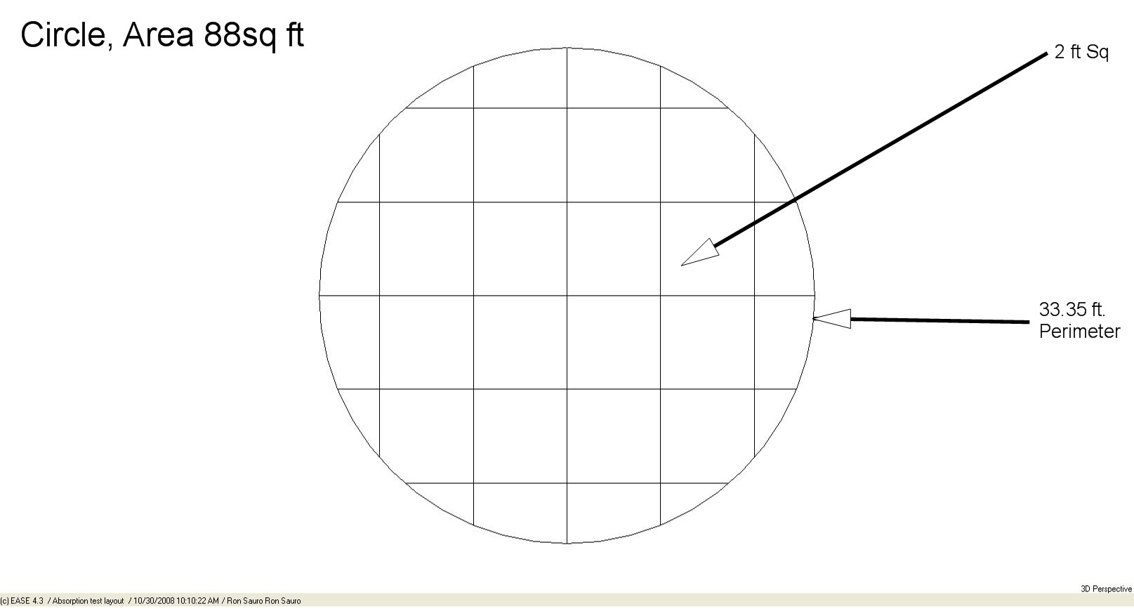
Circle with constant area

Slide 43
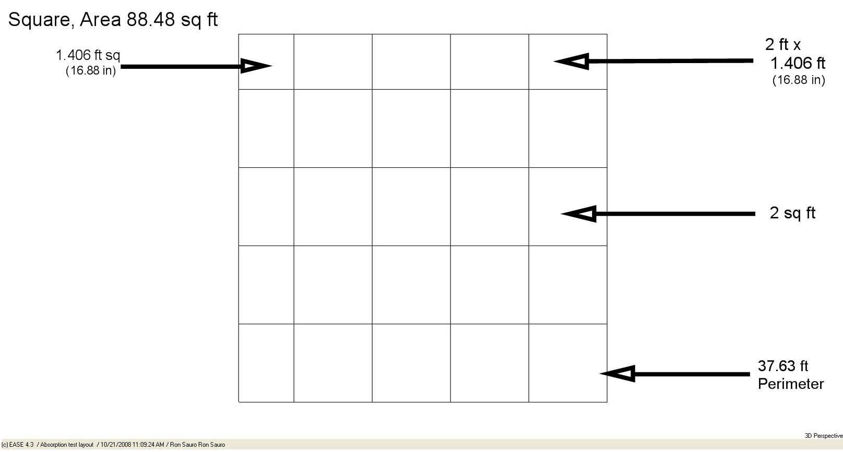
Square with constant area

Slide 44
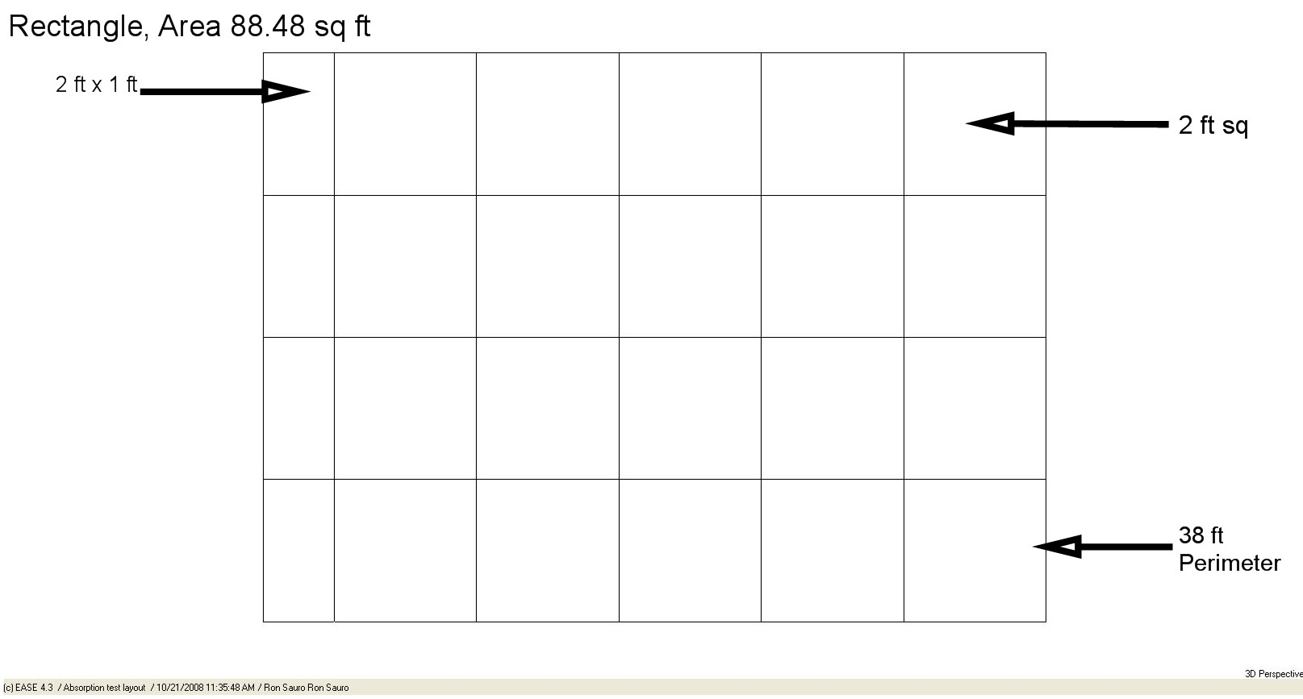
Rectangle Standard Area

Slide 45
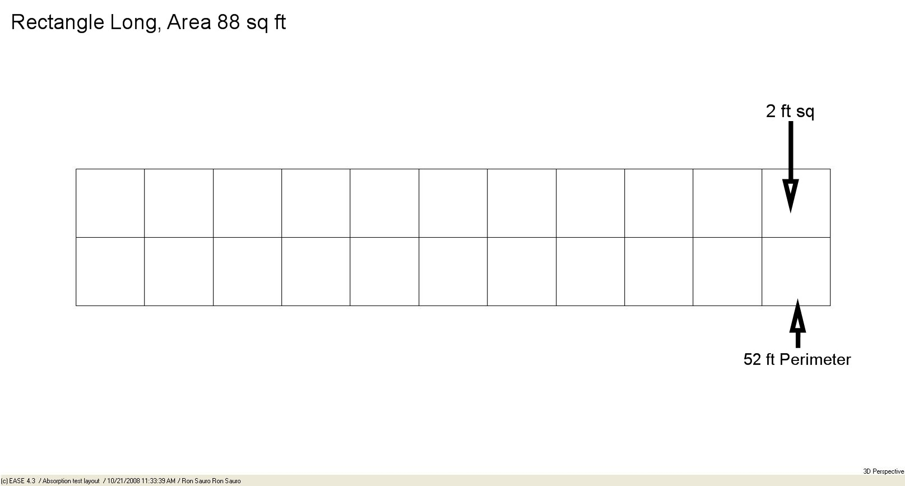
Rectangle Long Area

Slide 46
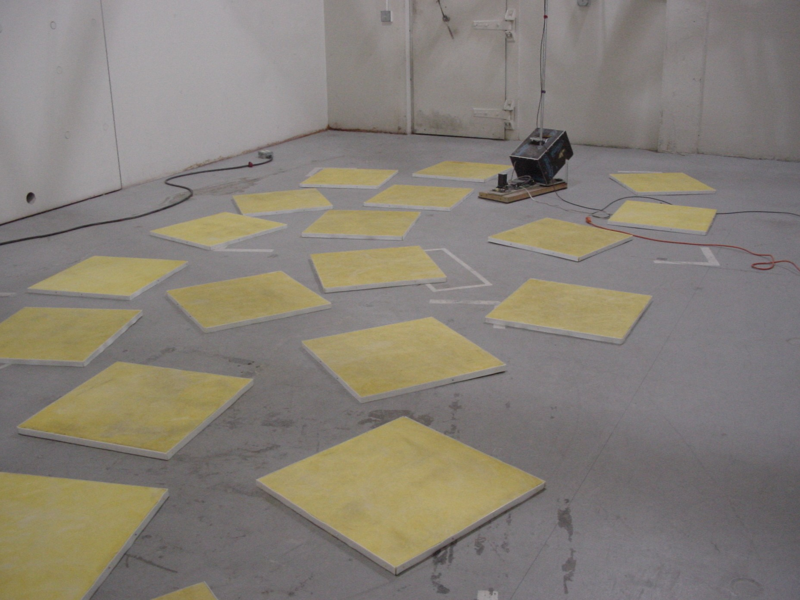
Scattered Pieces Area

Slide 47
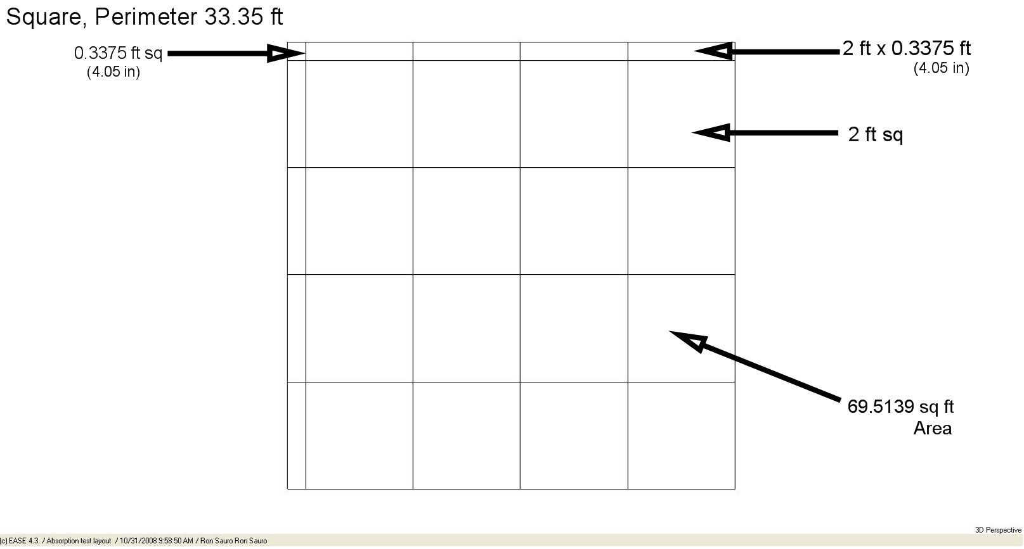
Square Perimeter

Slide 48
Rectangle Standard Perimeter

Slide 49
Rectangle Long Perimeter

Slide 50
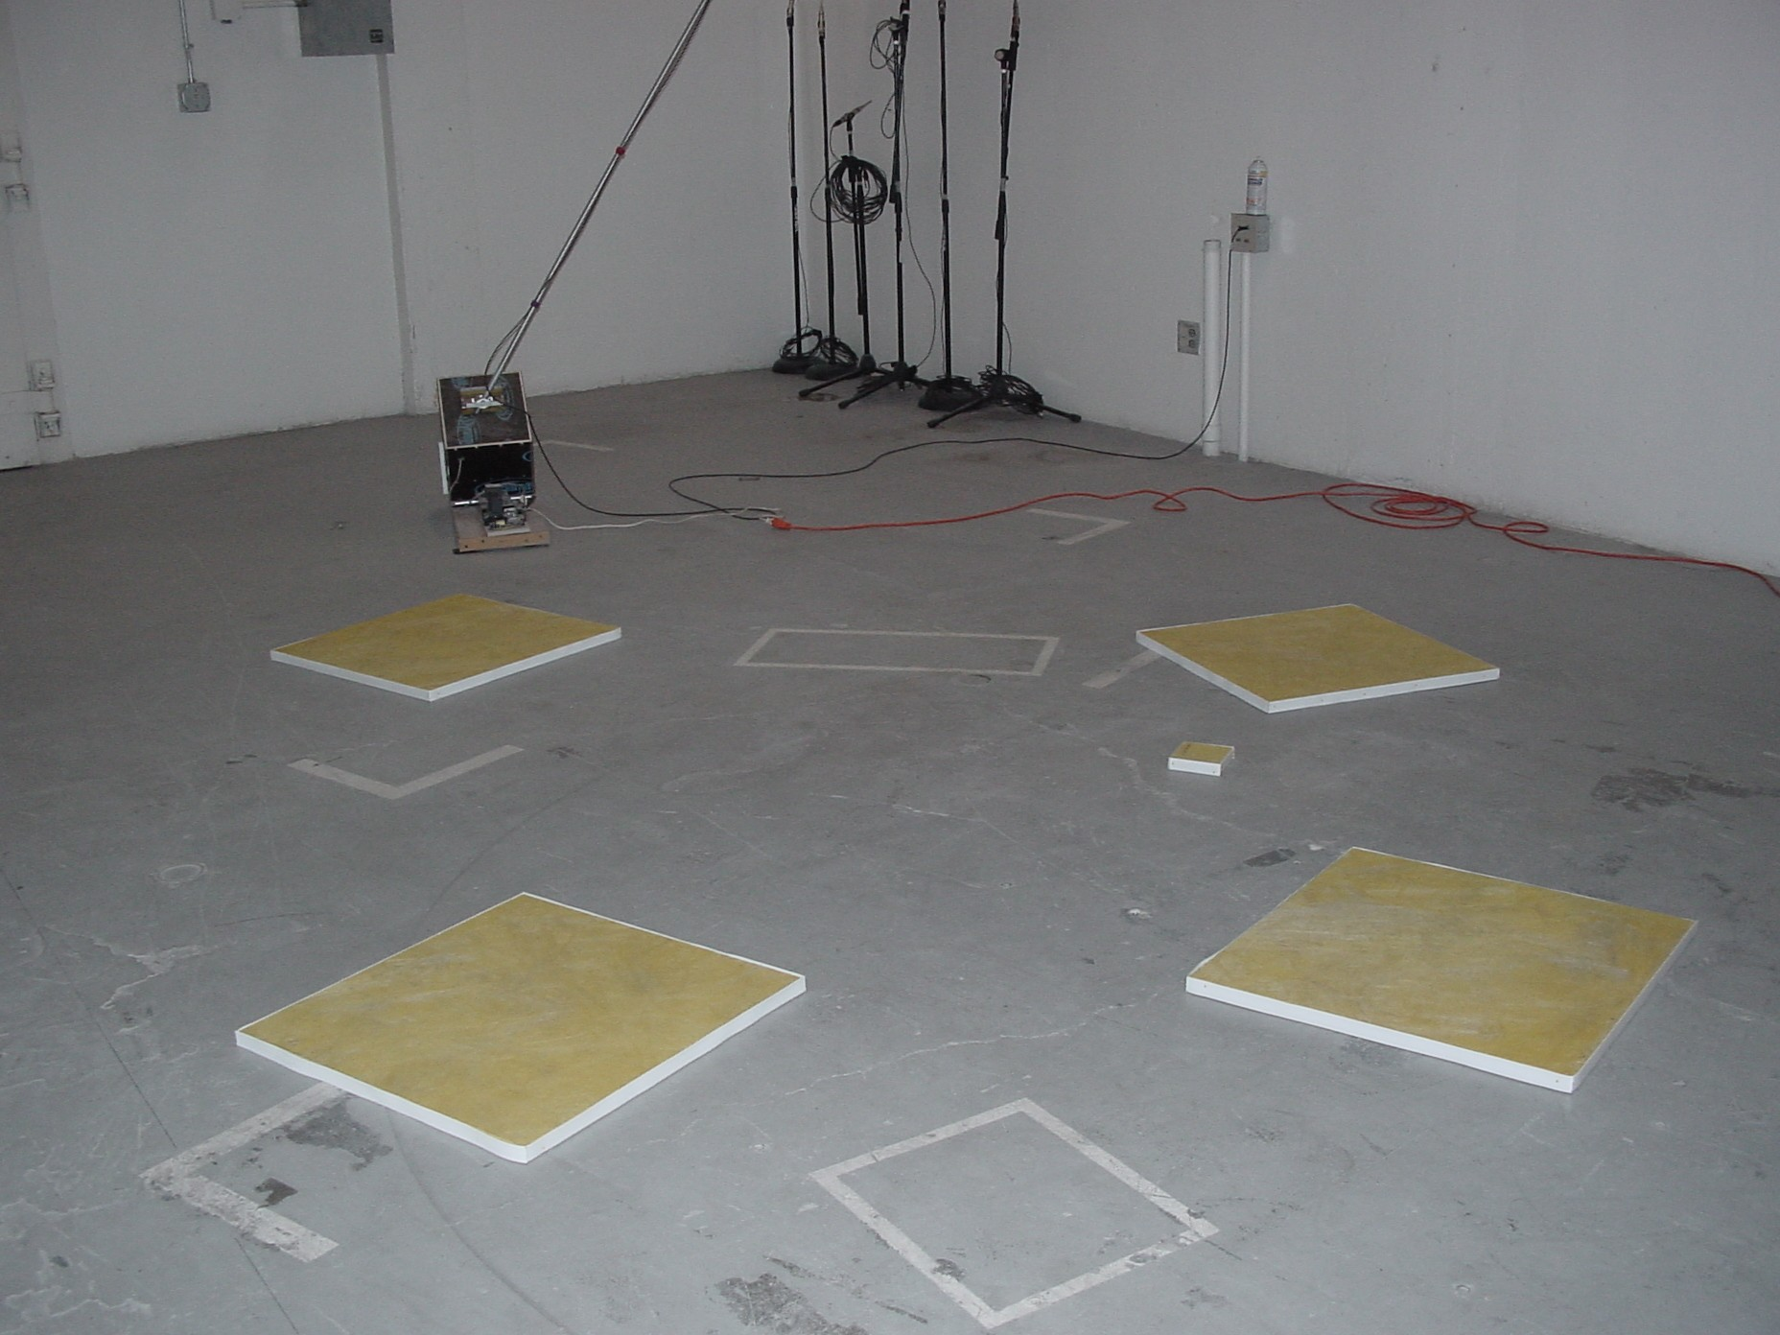
Scattered Pieces Perimeter

Slide 51
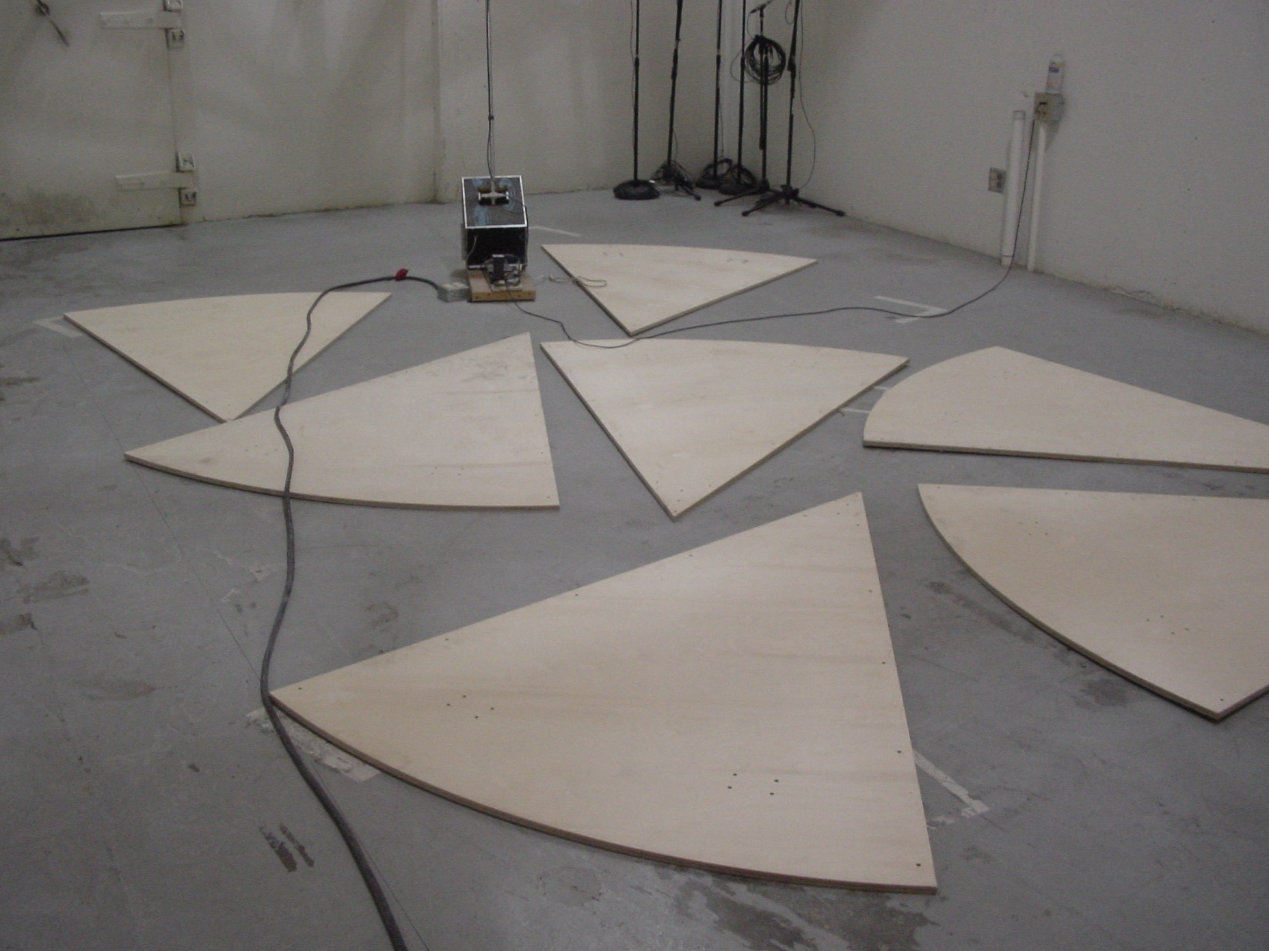
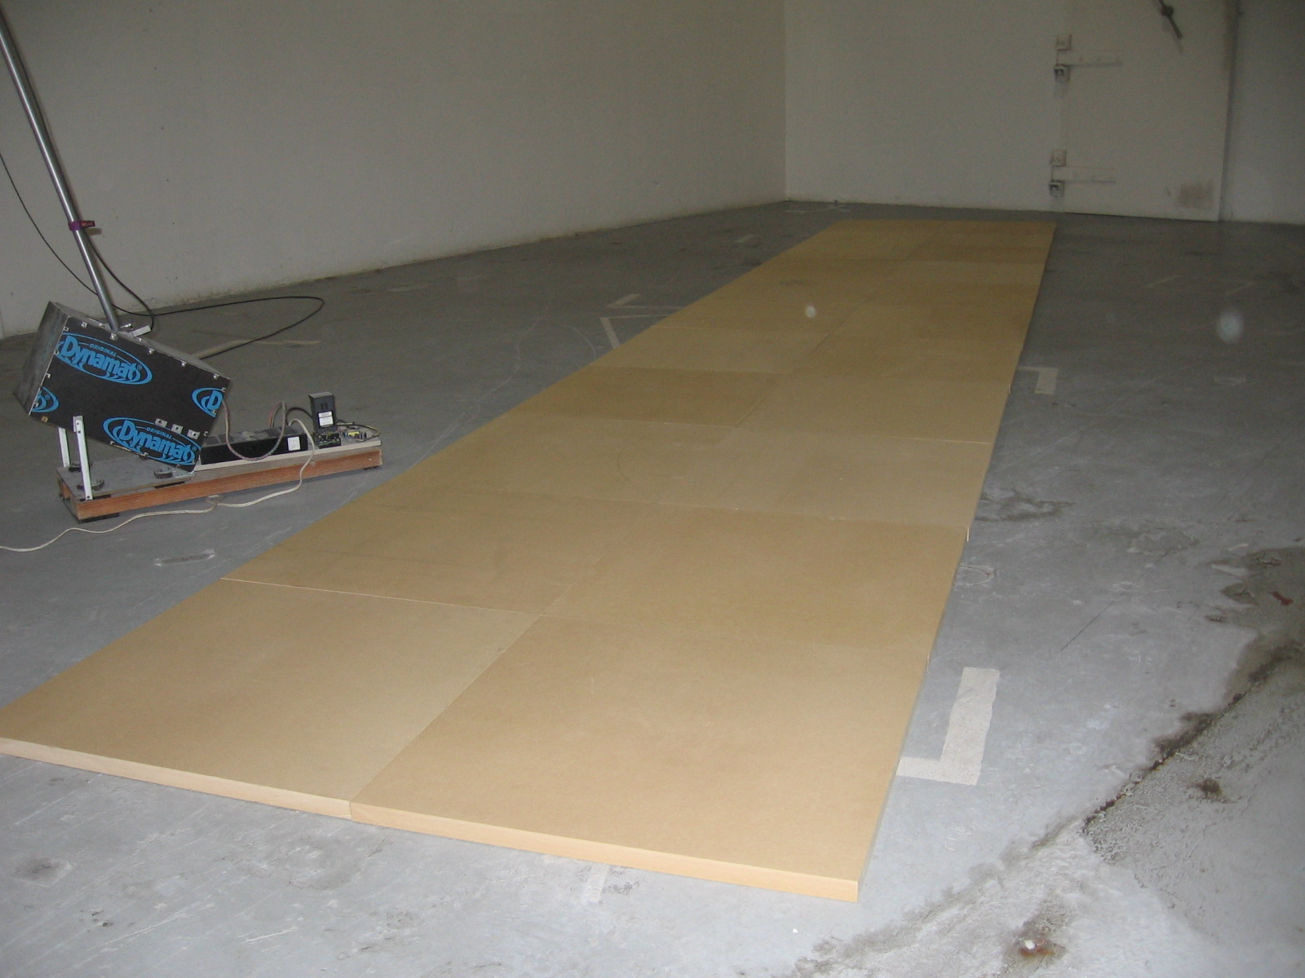
1” UHD HDF (sealed)

Slide 52
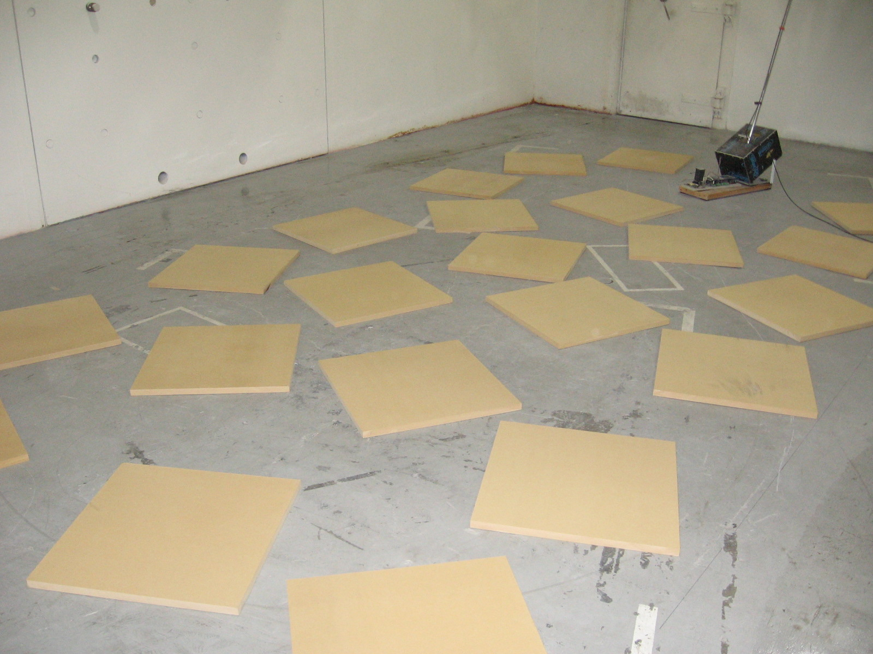
1” UHD HDF (sealed)

Slide 53
Absorption Coefficients Pt 2: Is the “Edge Effect” More Important than Expected?
NWAA Labs, Inc ©

Slide 54
Absorption
Types:
Flow resistance
Diaphragmatic resistance
Air resistance (resonance)

Slide 55
Friction

Slide 56
Diaphragm

Slide 57
Type Function
Flow resistance converts acoustic energy directly to heat created by the friction of air passing through different materials.
Diaphragmatic resistance converts the acoustic energy to heat based on the bending action causing molecular friction and air pressure changes in the volume of air trapped by the membrane.
Resonance converts acoustic energy to heat by alternate compression and decompression of a contained airspace with limited relief.

Slide 58
Absorption
Where:
A = sound absorption, m² or Sabins,
V = volume of reverberation room, m³ or ft³,
d = decay rate, dB/s, and
c = speed of sound (calculated in m/s or ft/s)

Slide 59
Speed of Sound
or
Where:
Tº_{C} and T°_{F} are temperature in degrees Celsius and degrees Fahrenheit, respectively

Slide 60
Absorption
Where:
A = absorption of the specimen, m² or Sabins,
A₁ = absorption of the empty reverberation chamber, m² or Sabins, and
A₂ = absorption of the reverberation room after the specimen has been installed, m² or Sabins.

Slide 61
Absorption Coefficient
Where:
α = absorption coefficient of the test specimen, dimensionless, Sabins / ft².
S = area of the test specimen, m² or ft², and
α₁ = absorption coefficient of the surface covered by the specimen

Slide 62
How is the Absorption Coefficient used?
where:
RT60 = time needed for the reverberation energy in the room to decay in level 60dB
k = the speed of sound that equals 0.161 when units of measurement are expressed in meters and 0.049 when units are expressed in feet.
V = the volume of the room
S_{α} = the total surface absorption of the room expressed in m ² or Sabins

Slide 63
Total Surface Absorption of a room
where:
S_{a} = the total surface absorption of the room expressed in m² or Sabins.
a₁ = the absorption coefficient associated with a given area S
S = the surface area of a single surface expressed in ft² or m²

Slide 64
Perimeter Length?
Does it make a difference?
If so, what difference does it make?

Slide 65
Constant Area Comparisons

Slide 66
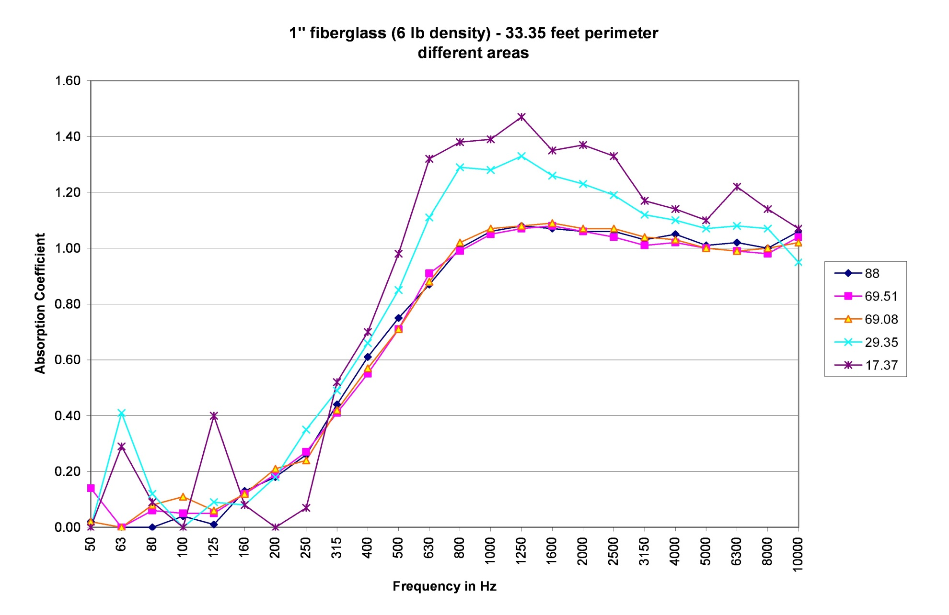
Constant Perimeter Comparisons

Slide 67
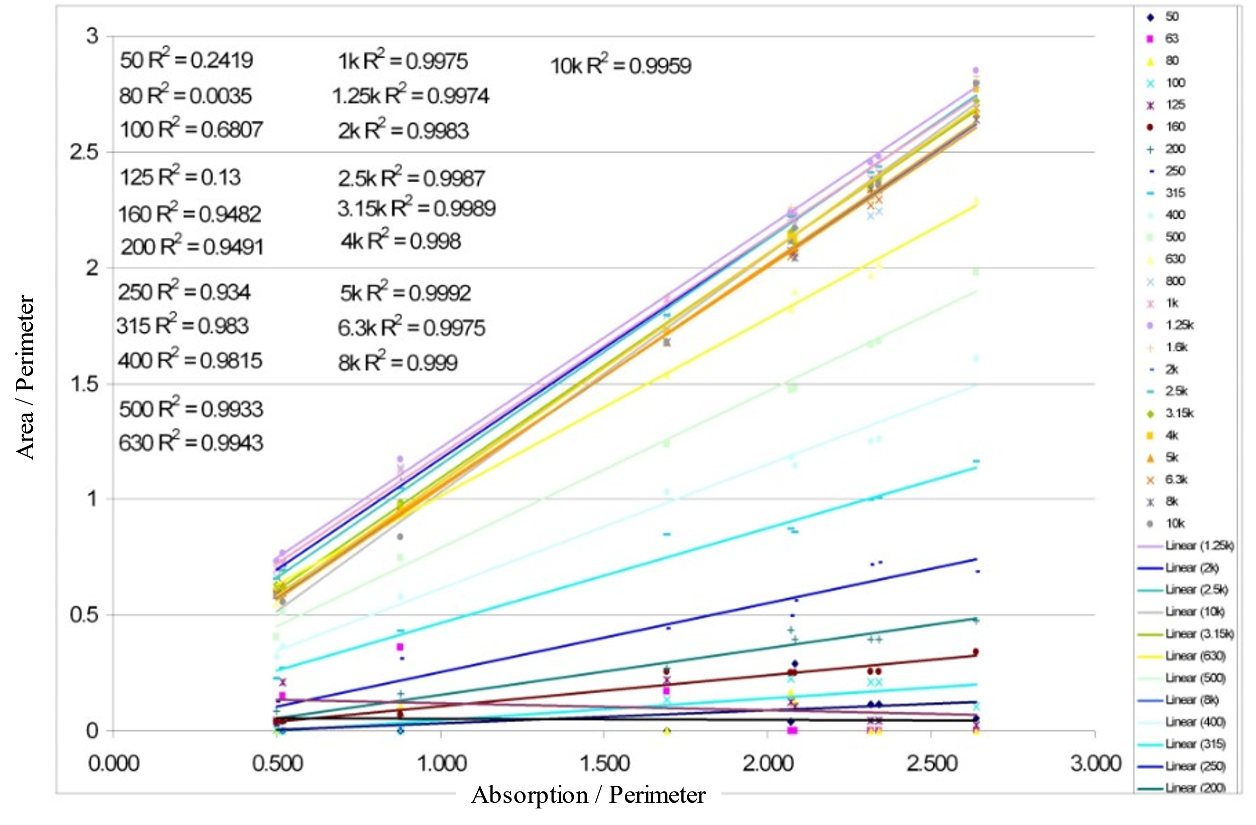
Data Correlations

Slide 68
Diffraction Effects?
A paper written by DeWitt and Burnside about the edge diffraction of radar waves showed that when radar waves are bent over the edge of a wedge by diffraction there is a heating effect on the air surrounding it transferring to the tip of the wedge. This author knows of nothing in physics that would restrict this effect from applying to acoustic energy as well. If this is the case then we would have to now include diffraction as a form of absorption and a type of absorber.

Slide 69
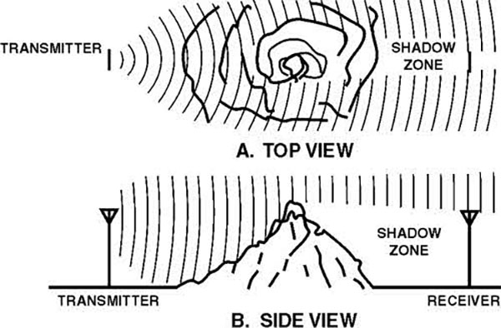
Diffraction Effects

Slide 70
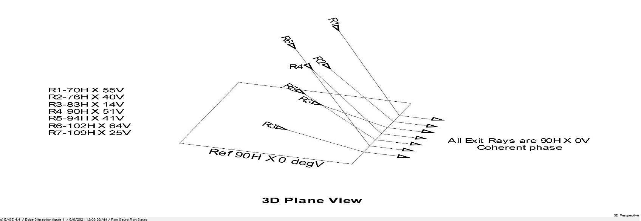
Diffraction Effects

Slide 71
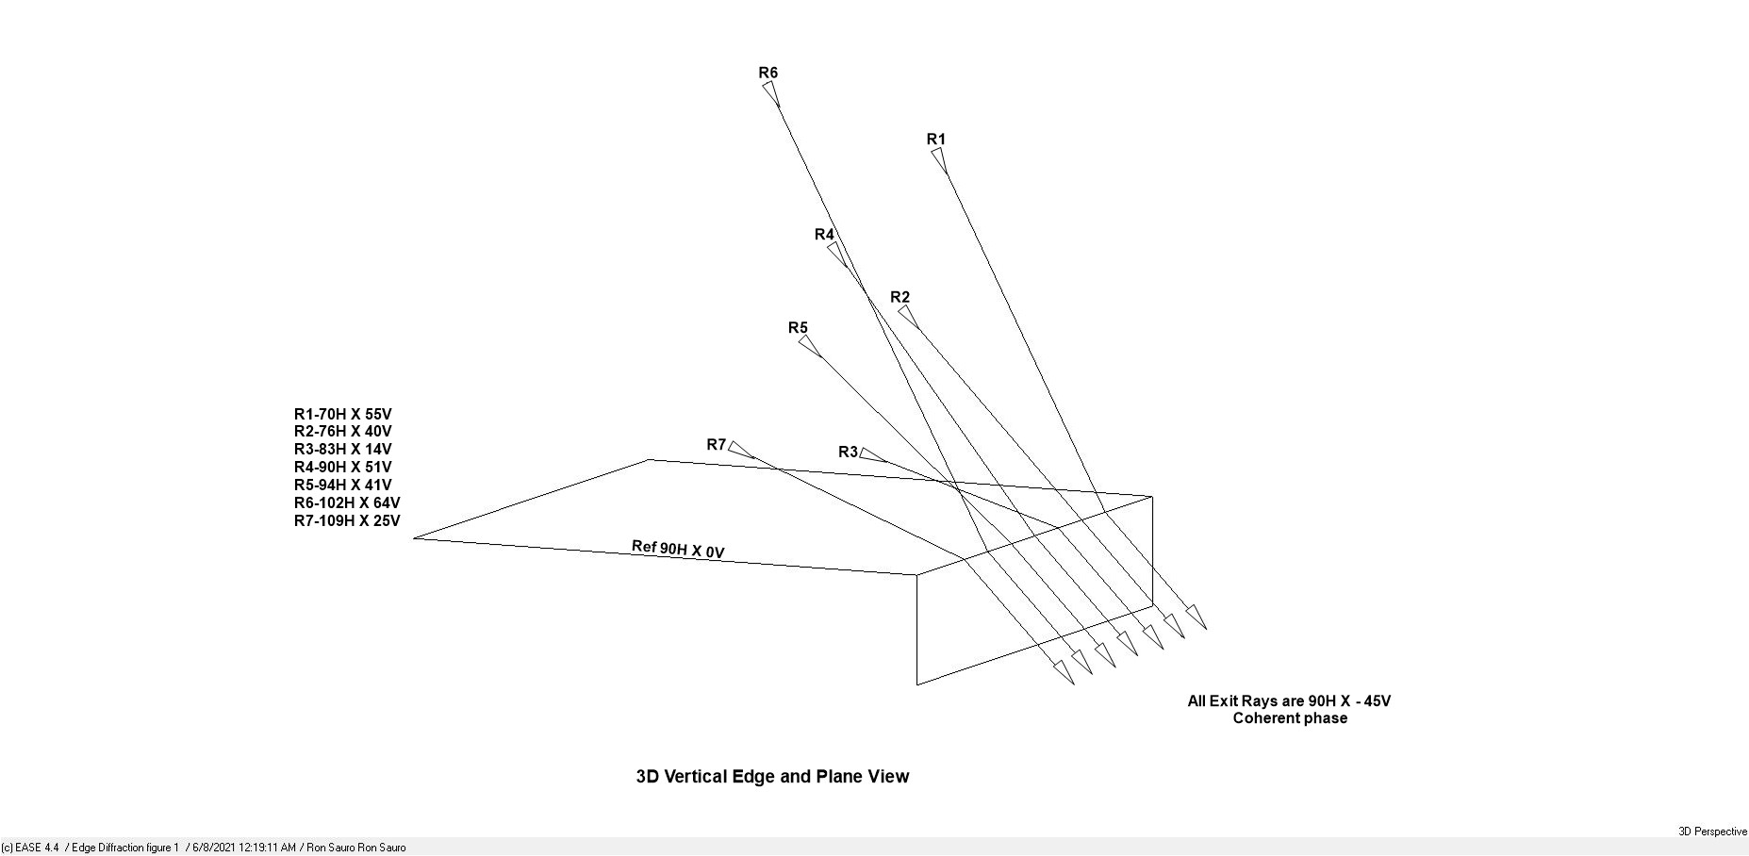
Diffraction Effects

Slide 72
Diffraction Effects?
Why does a circular sample have less absorption than a square of the same perimeter. It can be hypothesized that because diffraction has an absorptive function it might have a phase function as well. A square has four straight edges with each of the 4 edges going in 4 directions and any diffractions along that edge could have a common phase function and could be considered “coherent”. If they are “coherent”, then the energy contained could be additive.

Slide 73
Diffraction Effects?
A circle has an edge that is constantly changing direction and the diffractive energy could have different phase information and is not “coherent” and therefore may not be additive in its nature.

Slide 74
Conclusions
Is Area Enough?
Based on the results shown in this paper, it is believed that an area based “Absorption Coefficient” alone is not adequate to describe the total absorption of a surface.

Slide 75
Conclusions
Is “Edge Effect” More Important Than Expected?
It can be seen in the prior data that “Edge Effect” is much more important than previously thought. It can introduce considerably more absorption to a specimen than just a surface area based calculation would indicate.

Slide 76
Initial Equation in Basic Form
where:
A_{x} = absorption of the surface being calculated, m2 or Sabins.
A₁ = absorption of sample 1, m² or Sabins.
A₂ = absorption of sample 2, m² or Sabins.
S_{x} = area of surface being calculated, ft² or m²
S₁ = area of sample 1, ft² or m²
S₂ = area of sample 2, ft² or m²
P_{x} = perimeter of surface being calculated, ft or m
P₁ = perimeter of sample 1, ft or m
P₂ = perimeter of sample 2, ft or m
(f) = frequency of interest in calculation
NWAA Labs, Inc
2021 ISO July 29

Slide 77
Simplified Equation for Constant
where:
k_{ab} = absorption constant
A_{s} = absorption of scattered sample, m² or Sabins.
A_{m} = absorption of mono sample, m² or Sabins.
S_{s} = area of scattered sample, ft² or m²
S_{m} = area of mono sample, ft² or m²
P_{s} = perimeter of scattered sample, ft or m
P_{m} = perimeter of mono sample, ft or m
(f) = frequency of interest in prediction
NWAA Labs, Inc
2021 ISO July 29

Slide 78
Simplified Equation in Basic Form
where:
K_{ab} = absorption constant
A_{x} = absorption of the surface being predicted, m2 or Sabins.
A_{s} = absorption of scattered sample, m² or Sabins.
S_{x} = area of surface being predicted, ft² or m²
S_{m} = area of mono sample, ft² or m²
P_{x} = perimeter of surface being predicted, ft or m
P _{s} = perimeter of scattered sample, ft or m
P₂ = perimeter of mono sample, ft or m
(f) = frequency of interest in prediction
NWAA Labs, Inc
2021 ISO July 29

Slide 79
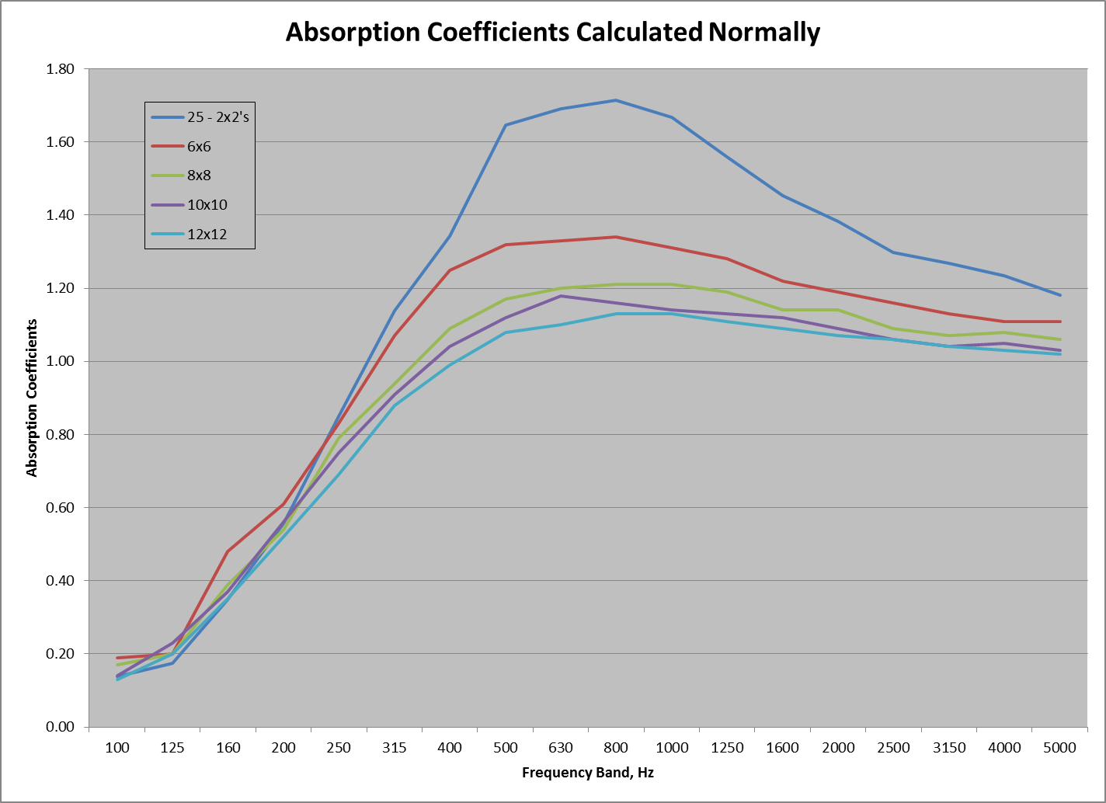
Bob Hallman tries to modify my method
so it does not need two measurements
These measurements are derived from ILS 898
NWAA Labs, Inc
2021 ISO July 29

Slide 80
Background
Sound Absorption is defined by a number that does not have units. They are called Sabins
The sound absorption coefficient is calculated by dividing the sound absorption by the area of the specimen.
Everyone knows that calculation is wrong.
The coefficient should not exceed 1, but it does sometimes and for some specimens, significantly.

Slide 81
Round Robin Results ILS-898
We will look at charts prepared by Ron Sauro on the absorption coefficients for the same material with different sized specimens.
The following graphs show our data for this experiment:

Slide 83
Three Proposed Solutions
There are now three proposed solutions to this problem:
Bob Hallman has proposed an alternative to absorption coefficients based on multiple measurements with different perimeter to area ratio configurations.
ISO TC43/SC2/WG30 has a proposal based on Thomasson’s paper.
Bob has a proposal similar to the ISO proposal.

Slide 84
ISO TC43/SC2/WG30 Proposal
Bob deals with this in more detail later, but:
Defines a virtual area that is the footprint plus a wavelength related area associated with the perimeter.
Is being proposed as a way to predict the absorption of various sample sizes and geometries rather than a change to the absorption coefficients.

Slide 85
Bobs Proposed Solution
Is empirically derived
Identifies an area associated with the perimeter that is wavelength dependent.
Uses this area to predict the total absorption of specimen with a different geometry than what was tested.
Requires the C423 Absorption coefficients and the geometry of the specimen tested.
Does not require multiple measurements of a specimen.
As with the ISO proposal, does not replace the absorption coefficients, but provides a way to predict the absorption of various specimen sizes and geometries.

Slide 86
Bobs Proposed Solution, Continued
Initial hypothesis: There is a wavelength related area associated with the perimeter that needs to be considered when predicting absorption.
First assumption: The perimeter area is that area of the specimen that is within ½ wavelength of an edge.
Second assumption: The area associated with the perimeter is just as effective in absorbing sound as the area associated with the footprint. This assumption is false, but we will get to that later.

Slide 87
Basis for Comparing Calculations
Bob wanted to avoid any verbiage that would undermine the C423 defined absorption coefficient.
To compare results and calculations, in all cases predict the total absorption of an 8’ x 9’ specimen which is the size recommended by C423. We will get into why it is 8’ x 9’ later.

Slide 88
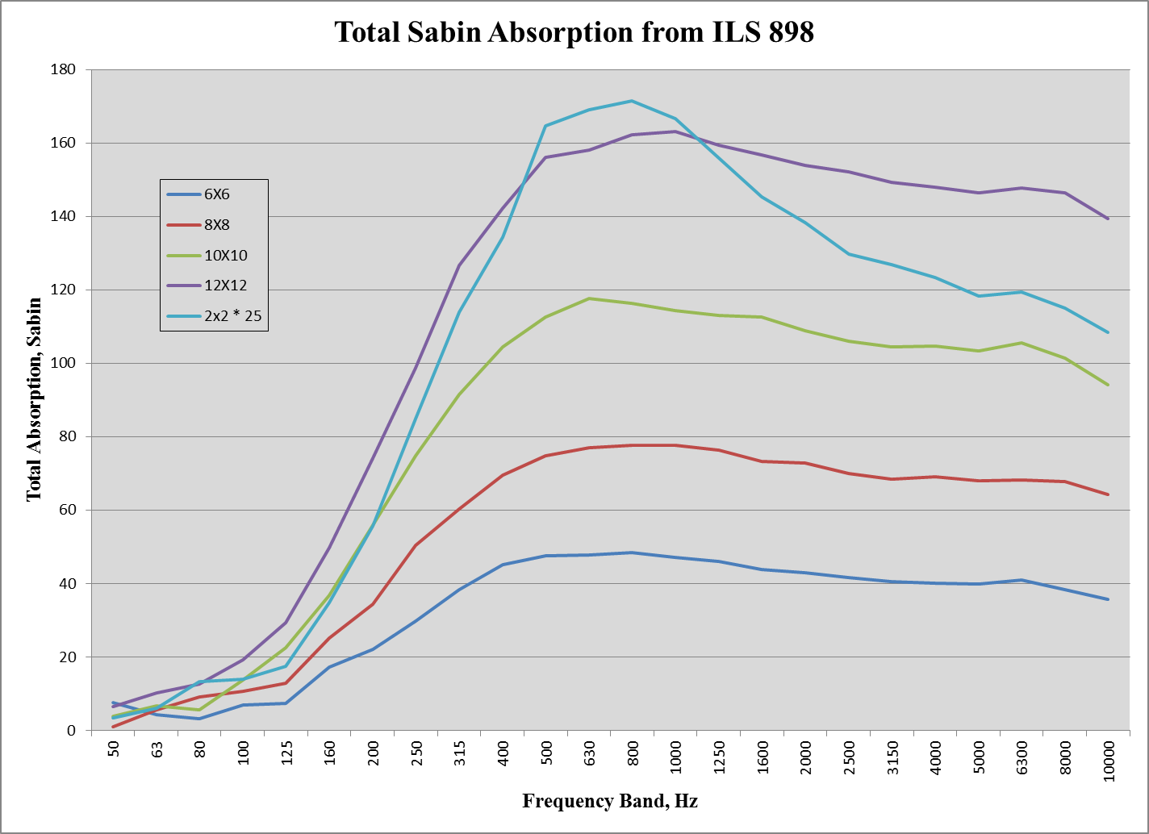

Slide 89
Separated Specimens
Based on two tests that Bob did with specimens separated by various distances:
The distance between specimens has an effect on the absorption of the set of specimens that is wavelength dependent.
At the mid frequencies, where the size of the individual specimens is close to the wavelength, the effect is significant for separations of at least 2’.
The results from ILS 898 Test 2 where the instructions were to place 25 2’x2’ specimens at least 1’ apart, was flawed as 1’ separation was insufficient in the mid frequencies.

Slide 90
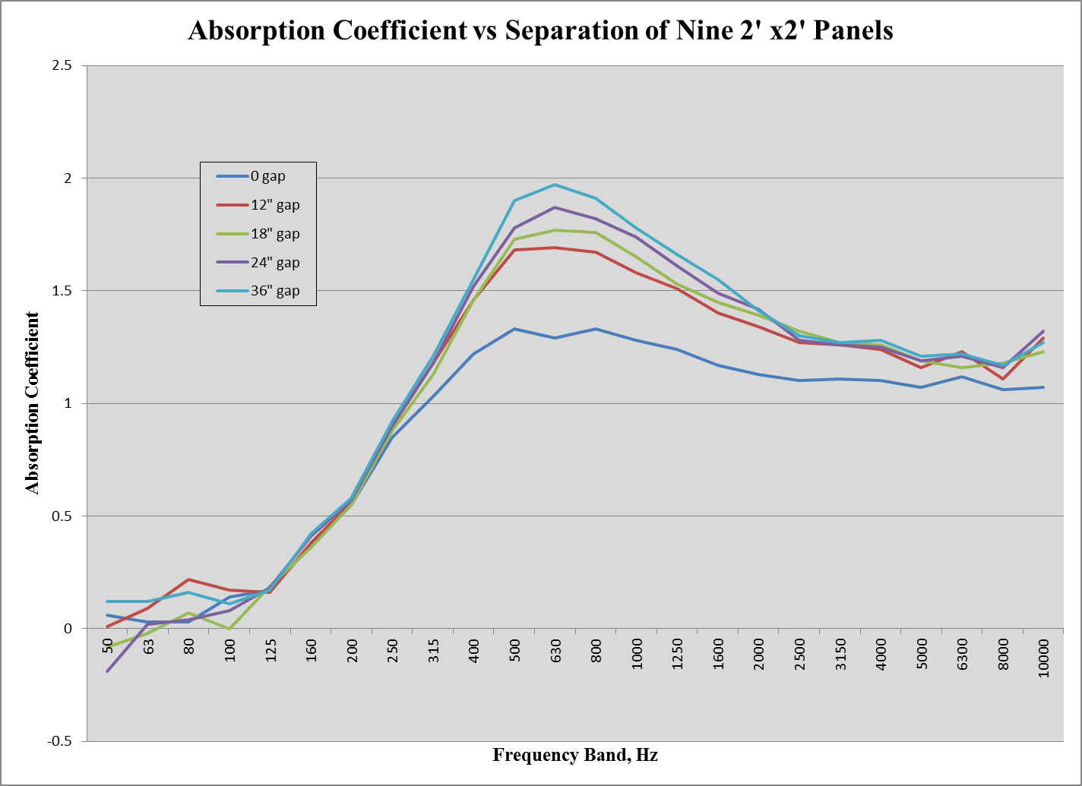

Slide 91
Separated Specimens
As a result, on all subsequent charts, the data for the 25 2’x2’ panels will be omitted.

Slide 92
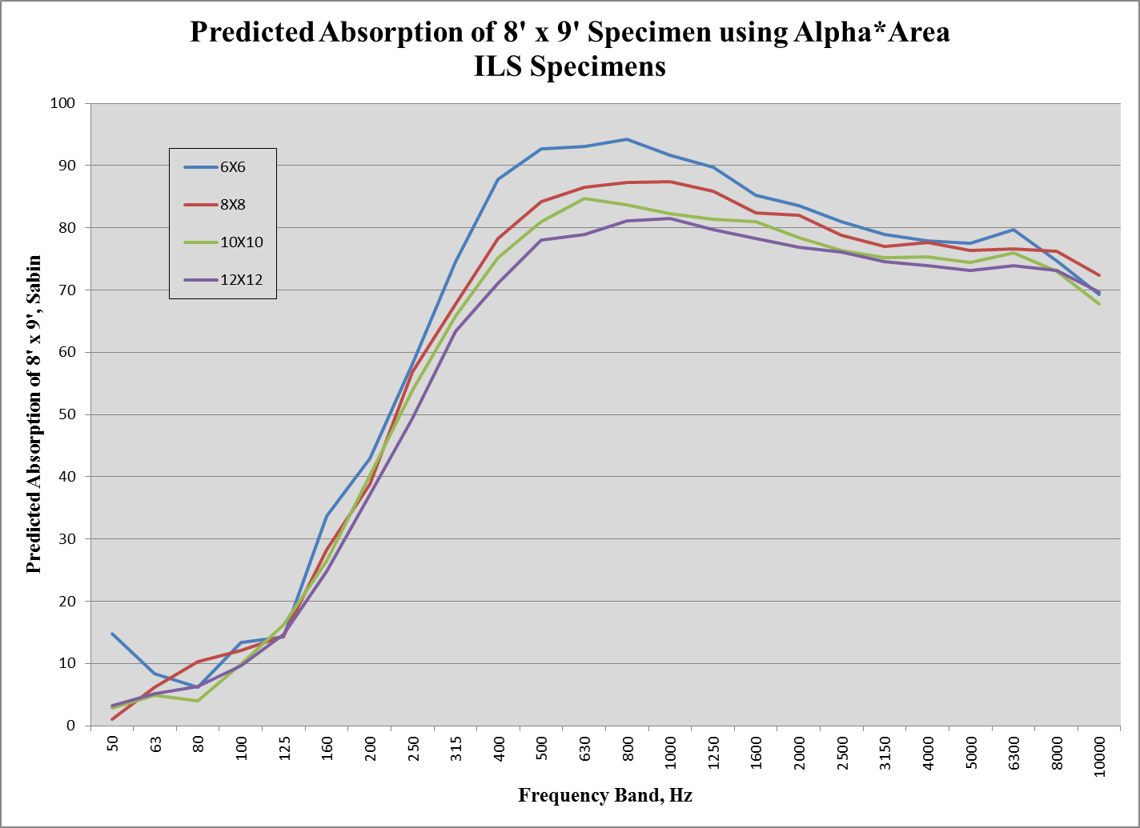

Slide 93
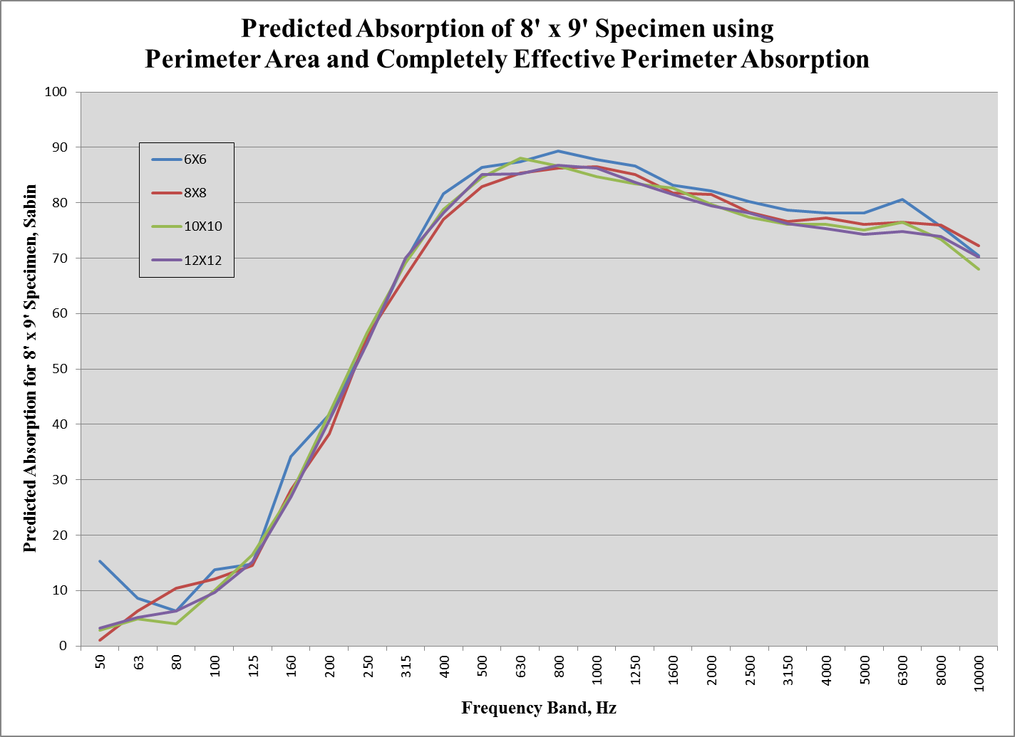

Slide 94
Prediction 1
This looks really good.
However, lets look at a different specimen, one not so absorptive.
Here are the same charts for a mineral fiber based specimen with an NRC of 0.55 or 0.60 depending on the specimen size:

Slide 95
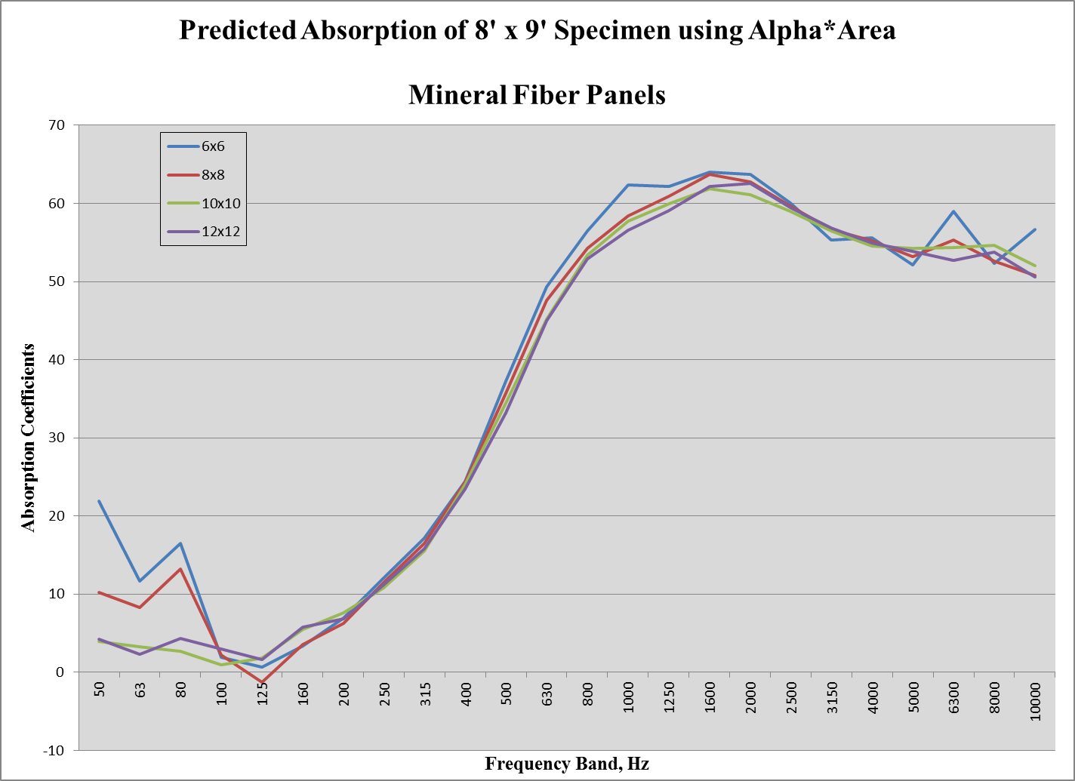

Slide 96
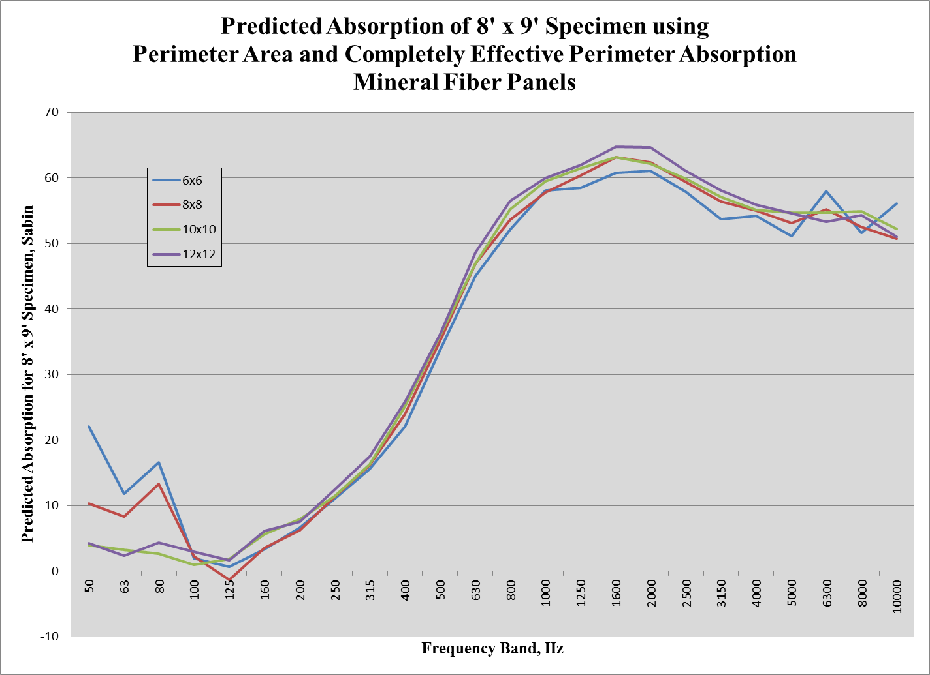

Slide 97
Perimeter Area Effectiveness
First, note that the perimeter area effect is not as significant for products that are not high in absorption.
Second, the perimeter area correction over corrects in this case.

Slide 98
Hypothesis Refined
Since it is obvious that the edge effect is not as significant for absorbers with lower absorption coefficients, lets refine the prediction using that observation.
The following predictions use a derivative of the absorption coefficient to modify the effectiveness of the perimeter area

Slide 99
Refined Prediction
The first chart is the prediction for an 8’ x 9’ mineral fiber absorber:

Slide 100
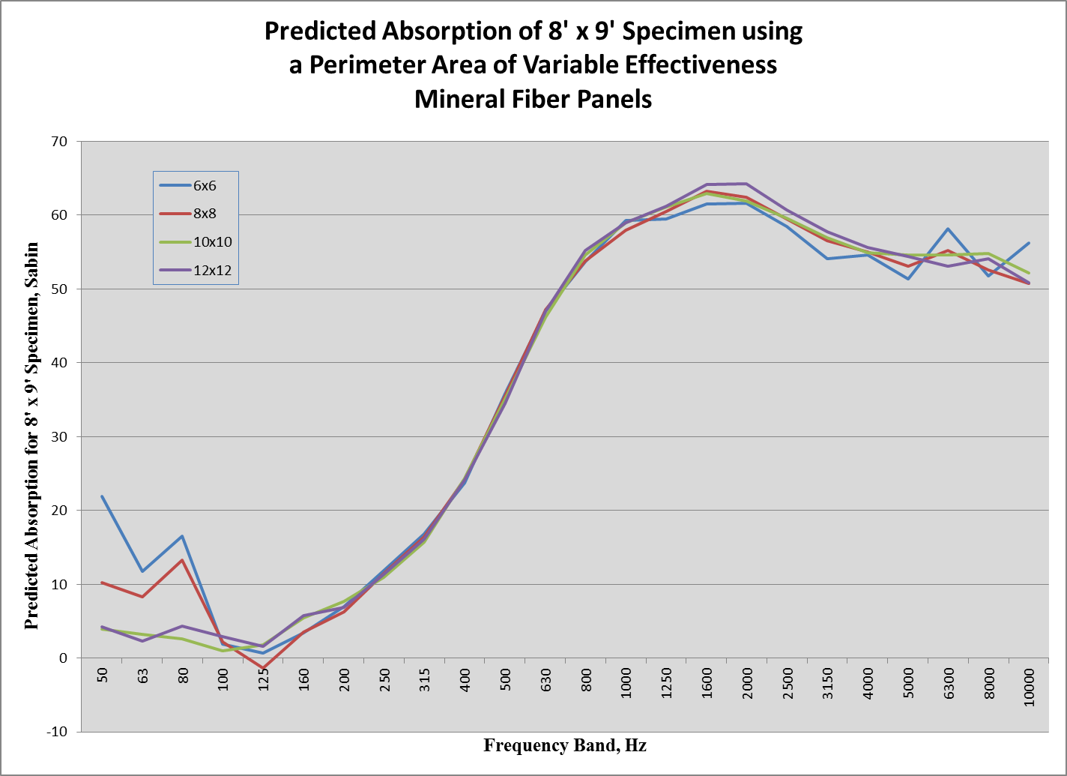

Slide 102
ISO Prediction
The following is a comparison with the method proposed in ISO 354.
The virtual area is the area of the footprint plus an area along each edge ƛ/4 wide.
The primary difference is at low frequencies where the virtual area exceeds two times the footprint.
The following chart show the predictions using the proposed ISO method.

Slide 105
How do the Predictions Compare
Calculated standard deviation of absorption at each frequency, from each specimen size and overlaid curves for each prediction method.

Slide 109
Statistical Conclusions
Statistically:
My refined prediction did better for the ILS fiberglass specimens over most of the frequency band. And did better in the mid frequency range for the mineral fiber specimen.
The Alpha*Area method was the best for the mineral fiber specimen at high frequencies.
Note that I have not addressed Ron Sauro’s method yet.

Slide 110
Comparison with Ron Sauro’s Method
Do not believe the “Separated” data should be used due to the effect of separation distance.
Used the slope from 6’ x 6’ and 12’ x 12’ measurements to test Ron’s method.
Graphs of the ILS specimen and the mineral fiber Specimen follow.

Slide 114
Comments on “Tuning Fork”
The two prediction methods yield similar, but not identical results.
Ron’s results were calculated using the scattered specimen data which may have artifacts of the separation distance.
The proximity of one part of the “fork” to another part of the “fork” may have complicated the situation.

Slide 115
Summary
The Hallman refined method:
Seems to closely replicate Sauro’s method without the need to test multiple specimens.
Appears to do a better job than the proposed ISO method of eliminating the difference associated with variations in sample size.
None of the methods completely explain the effects of separation between panels.
The absorption of the tested specimens at low frequencies is too low to test the predictions.

Slide 116
Recommendations
Do not change the C423 technique for determining absorption coefficients.
Prepare a guide document for predicting the absorption of specimens with different geometric configurations.

Slide 117
Recommendations, continued
Continue research on:
Thicker specimens to evaluate the predictions at lower frequencies
E mounted specimens
The effect of nearby absorbers
Extending predictions to specimens that have both sides exposed to the sound field.

Slide 118
Absorption
We know that the configuration of an absorber
affects the absorption from previous presentation but
what effect does the spacing between these unit have
on the absorption and what is the effect of the orientation
of the absorber have on the absorption.

Slide 119
Absorption Experiments
We designed a series of experiments to test these questions.
First we tested the spacing differences between 2 ft by 2 ft
pieces compared to a monolithic specimen. The spacing
varied from 6 inches in both directions to 24 inches in both
direction with edges parallel to each other and the walls.
(See following four slides)

Slide 120
Absorption
Monolithic
6 inch spacing

Slide 121
Absorption
12 inch spacing
18 inch spacing

Slide 122
Absorption
24 inch spacing

Slide 123
Absorption
Spacing comparisons

Slide 124
Absorption
24 inch aligned
24 inch unaligned

Slide 125
Absorption
24 inch unaligned

Slide 126
Absorption
18 inch aligned
18 inch unaligned

Slide 127
Absorption
18 inch unaligned

Slide 128
Absorption
12 inch aligned
12 inch unaligned

Slide 129
Absorption
12 inch unaligned

Slide 130
Absorption
Edge Effect Algorithm
For the i^{th} of n rectangular panels of absorptive material of length $l$ and width $w$:
Calculate the area related to each edge of the panel, $S_{j}$ where j = 1 to 4, (since there are 4 edges to each panel):
$S_{j}=α\int_{−λ}^{λ}{f\left(x,u\right)dx}$
Where:
$x$ is the distance from the edge
$u$ is the length of the edge, either $l$ or $w$ depending on the edge
If $x$ is within an absorptive panel $f\left(x,w\right)=0$

Slide 131
Absorption
Edge Effect Algorithm (continued)
If $x$ is not within an absorptive panel:
$f\left(x,w\right)=max⁡(\frac{w}{2},w−λ)(λ−\left|x\right|)/λ$
$α$ is the absorption coefficient obtained by dividing the measured absorption by the physical area
Calculate the Total Effective Area for the i^{th} panel:
$S_{t,i}=l∗w+ min⁡(l∗w,\sum_{j=1}^{4}{S_{j}})$
Sum the Total Effective Area for each absorptive panel in the array to obtain the total Effective Area of the array of panels, $S_{t}$
$S_{t}= \sum_{i=1}^{n}{S_{t,i}}$
To predict the absorption of a different array of like panels, calculate the total Effective Area of the target array, $S_{t}^{′}$ in the same way as $S_{t}$
Obtain the predicted absorption by$A_{p}^{′}= α \frac{S_{t}^{′}}{S_{t}}$

Slide 132
Absorption

Slide 134
A coefficient is not a percentage!!!! 0.9 absorption coefficient is NOT 90% absorption!!

Slide 136
A coefficient is not a percentage!!!! 0.9 absorption coefficient is NOT 90% absorption!!

Slide 137
Absorption
Myth: Acoustics is a “settled” branch of physics
Fact: There is fundamental research going
on today and new facts are being written daily
that are as basic as Sabines work

Slide 138
Absorption
Myth: We can measure absorption
Fact: We cannot measure absorption directly

Slide 139
Absorption
Myth: We can measure absorption
Fact: We cannot measure absorption directly.
We measure the differences in the reverberation
time in a reverberation room and use that
to determine the amount of absorption needed in
the room to effect that change.

Slide 140
Absorption
Myth: Baffles have twice as much absorption
when both sides are exposed to the room
Fact: Baffles measured have an average of
1.2-1.3 times more absorption when hung in a room

Slide 141
Absorption
Myth: Baffles have effect
depending on their arrangement.
i.e. Parallel, Boxed, Herring bone and others.
Fact: None of these makes any significant
difference to the absorption of a room.
The spacing between individual units can
be used to increase the real absorption of the units

Slide 142
Absorption
Myth: Wall mounted panels that are spaced
off of the walls will increase their low frequency
absorption as the space behind increases.
Fact: This is only partially true. The low frequency
absorption only increases when the spacing from the wall
does not exceed 1 inch. The effect disappears after 1 inch.
This only applies to unimpeded airspace.

Slide 143
Absorption
Myth: BIG ONE!! Absorption is controlled
by the size (area) of the absorber.
a = A/S or A=a * S
Fact: This is not true at all.
Previous presentations have shown this to be the case.
The ratio of perimeter length to the area
and spacing between units are the controlling factors.

Slide 144
NWAA Labs Experimental Diffusion and Scattering Test

Slide 145
Diffusion: (Better Ways of measuring it, displaying the data and using it in Room Simulations)

Slide 146
A 4d world being crammed into a 2d box for 3d acousticians
ISO 17497-1, ISO17497-2
6.3.2 Structural depth of test sample
The measurement method is intended for surface roughness. Thus, the results are only reliable if the structural depth is sufficiently small compared to the size of the test sample. The structural depth should be h < d/16, where d is the diameter of the turntable.

Slide 147
A 4d world being crammed into a 2d box for 3d acousticians
ISO 17497-1, ISO17497-2
Not applicable to geometric reflectors or to seating areas or large surface constructions that have surfaces sufficiently large enough to specularly reflect energy at needed frequencies.

Slide 148
A Pyramidal

Slide 149
What do you see and use more of?
Question?
or

Slide 150
What can we learn from this 2d view?
Question 2A?
We can look at both horizontal and vertical directivity polars of that frequency.
We can see directly the attenuation of energy along that polar of that frequency.

Slide 151
What can we learn from this 3d view?
Question 2B?
We can look at all angles of directivity of that frequency.
We can see directly the attenuation of energy along any angle of directivity of that frequency.

Slide 152
Measuring system for speakers

Slide 153
A diffuser is a
speaker
without a
voice coil

Slide 154
Measuring system for diffusers

Slide 155
Conclusions
What you have seen today is the results of a preliminary standard that has been written at ASTM and is based on the AES 56 standard used to measure directivity balloons for speakers and other sound sources.
As of last week at least 12 manufacturers have had their diffusers measured using this method and have data available and ready.
The simulation programs are NOT directly ready for this but can be made to work with this data using work arounds
We hope this will change in the near future and will allow basic diffusion to be used in simulation programs in a better way than just coefficients that tell us very little.

Slide 156
Thank You for your
time and attention

