Slide 1
BEFORE WE START
PLEASE GO TO https://we.tl/t-VwIbzGCh94 AND PICK UP THE ZIP FILE.
Unpack it.
This will give you a set of files that I intend to demonstrate masking with.
These can not be made into .mp3 or other encoded formats without risking loss of the intended masking phenomena.
Please listen in headphones.
Use the file named “nbnoise.wav” to set a comfortable, not excessive listening level.

Slide 2
What’s this about “masking”
James D. (jj) Johnston
Chief Scientist, Immersion Networks
Redmond, Wa

Slide 3
Please note:
The meeting notice suggested that you might want to go back and review the talk about “Hearing 096” first.
This really isn’t optional, the frequency analysis that occurs on the cochlea is key to understanding masking.
If you haven’t, remember that the ear is a kind of time/frequency analyzer. This is a key point.

Slide 4
What is masking?
In order to get there, we must carefully define loudness, and the term “partial loudness”
Loudness is expressed in sensory terms.
Intensity (spl, etc) is not Loudness.
There are multiple talks on loudness, as well, at the meeting recap site.

Slide 5
Partial Loudness
Loudness refers to the sensory level across all frequencies.
Partial loudness refers to a vector of contributions to the total loudness across frequency.
It is a function of both time and frequency, and is generally approximated in 1/3 ERB (see the hearing talk for the definition of an ERB) steps across frequency, for any given time instant.

Slide 6
Some things to remember
First, an ERB is effectively the bandwidth of a filter.
The signal it filters excites a particular region of the cochlea.
The inner hair cell on the cochlea is the detector that excites (among other things) the auditory nerve.
The SNR of the inner hair cell is about 30dB.
This 30dB range gets mapped across 90+dB via cochlear mechanics and the outer hair cells.
This 30dB number is strongly related to masking issues.

Slide 7
Now, imagine we have a measurement of partial loudness over a time interval. MASKING occurs when the partial and total loudnesses DO NOT CHANGE when things are added to, or removed from, the original signal. In short, it is a loudness (and partial loudness) change of ZERO for some amount of signal change. The SNR of the inner hair cell is one limit. There are others.

Slide 8
Please listen to these files from the downloaded zip archive now:
nbnoise.wav
Vs.
nbnoisesin.wav
Vs.
nbnoisesins.wav
Please listen to these three, in headphones, without changing your listening level. Use the first file to set a reasonable level.
Compare nbnoise.wav and nbnoisesin.wav Then compare nbnoise.wav to nbnoisesins.wav

Slide 9
The Power Spectra
nbnoise
nbnoisesin
nbnoisesins
Full size jpg’s will be on the site.

Slide 10
So, what did you hear?
Nbnoise vs nbnoise+sin
Most likely nothing at all.
This exhibits masking.
Nbnoise vs. nbnoise+sin2
Come on, anyone could hear that!
That’s not masked, for sure.
The masker is narrow band noise in one ERB around500 H.z
There is a sine wave in both examples, just at different frequencies. The two sine waves have the same level.
The level of the noise and sine are unchanged, only the frequency of the sine wave is varied. This is a very important point, masking happens primarily inside one ERB.
The first example puts the tone in the middle of the ERB constituting the narrowband noise.
The second puts the tone an octave lower.

Slide 11
So, what’s the point?
Well, that’s two signals of identical “SNR”
One masks the sine wave completely
The other one doesn’t even come close
This, in addition to demonstrating masking, makes it perfectly clear that masking is frequency dependent.

Slide 12
Masking principle 1:
Masking is frequency based. Frequencies near each other in an ERB scale interact.
But there’s more. Masking spreads UPWARD in frequency. There is some masking up to 2-3 ERB’s above the masking signal. Not much, but enough to be important for perceptual coders.
Masking does NOT spread downward to any substantial extent. Once you get a half ERB below the masker, masking is mostly gone.
Hence the difference in the two files with a sine wave added.

Slide 13
Which means, of course
If two signals have substantially different frequency spectra
They won’t mask each other unless the level difference is enormous.
BUT this does not mean two signals with similar spectra will interact and have some parts masked.
Second principle of masking:
There is simultaneous masking (both signals present at the same time), which is the strongest case.
There is postmasking, where the masker comes first, followed by the masked signal. This is a much smaller effect, and often tricky to take advantage of.
There is premasking, where the masker comes after the masked signal. For all useful purposes, this does not exist. This is where the dread ‘pre-echo’ comes from.

Slide 14
So, now, the first two rules of masking
To interact and have masking, you must have similar spectra from the two signals.
There must be enough level difference to provide masking.
The two signals must be closely time aligned. WAIT, the first THREE rule of masking are …

Slide 15
So, then, 30 dB down inside an ERB, with no pre-echo, in simultaneous situations and you’re good?
Well, maybe, but you often need much less than 30dB.
The next demo:
Tmn.wav
Nmt.wav
Again, use headphones.
The first file is a tone (sine wave) masking noise. The noise level is 15dB.
The second one is noise masking tone, same difference.
Note nmt.wav is the same file as nbnoisesin.wav You can use nbnoise.wav to compare. The noise in the tone masking noise file is kind of obvious by itself.

Slide 16
The spectra
Noise masking tone
Tone (not) masking noise

Slide 17
Masking signal characteristics
There are some classical results we can mention:
Tone Masking noise, noise contained within +- ½ ERB of the tone.
30dB SNR suffices.
Noise masking tone, same rules for bandwidth.
5.5 to 7.5 dB SNR
Noise masking noise, same rules, two different noise sources
Again 5.5 dB, give or take
Noise masking noise, signal noise source. (i.e. gain change)
3.5 dB SNR or so (i.e. the difference level is the “error”)

Slide 18
Right, so noise is simple, tones are simple, right?
Well, no, human speech comes in somewhere in the middle, as do many instruments and most everything else.
The real definition of “Tone” means that the signal envelope within the ERB is constant
The real definition of “noise” means that the signal envelope within the ERB varies substantially (remembering WITHIN THE ERB)
So, no, it’s not so simple, and this is way, way far way from a 1 hour talk. Not going there today. Obviously if you’re trying to find out if one of your vocals is going to be masked, you’re not going to calculate this, so use 15dB, give or take, for a decent guess.

Slide 19
So the four rules of masking:
To interact and have masking, you must have similar spectra from the two signals
There must be enough level difference
The two signals must be closely time aligned
The time domain structure of the signal inside each ERB matters a great deal.
Approximations are required
Wait, the FIVE rules of masking are
(see above)
And then there’s stereo unmasking.

Slide 20
Stereo? What?
So far we’ve talked about a monophonic signal. Now, we’ll talk about a stereo signal.
This is, in fact, the origin of a great deal of the “Suzanne Vega Problem”.
If signal and noise are in phase in the two channels, this devolves to the monophonic situation.
Of course, then there’s the case where the signal does not fit that description.

Slide 21
The “Suzanne Vega Problem”
There are two parts.
The simple one is that it is simply a demanding signal, and requires lots of bits per channel
The other problem, when put through two independent codecs, is that the signal is almost monophonic, but the CODEC NOISE is independent in the two channels.
Which brings us to the issue of “Binaural Masking Level Depression”, which is to say that the ear, especially below 1000Hz, is sensitive to differences in the waveform.
This also means that the ear is sensitive to the ENVELOPE shape above 2kHz
Between those two frequencies, it’s a bit of one, a bit of the other, and often less sensitive.

Slide 22
Wait, what is this Binaural thing, now?
As I said in the last slide, when you have a signal in two ears, there are several issues.
The first is that differences in arrival time or wave shape at low frequencies can lead to imaging effect.
This is used in stereo all the time, of course
The problem arises when two signals are moved spatially in a way that UNMASKS one that, perhaps, you would prefer was masked.
This can also “unhide” an instrument you want to hear.
The second is that the same effect happens at higher frequencies, but responding primarily to the onset of the envelope of the waveform.

Slide 23
Wait? What? What does that even mean.
Now there are two more wave files to listen to. These are identical, I think, to the ones in the AES codec listening disc, because they came from me. ☺
Listen to “inphase.wav”
Listen to “outphase.wav”
They don’t sound the same, do they?

Slide 24
So, then, what’s going on?
In both signals, the masker is a noise masker. It is the same in both cases, the same exact values.
In “inphase” the masked signal is a sine wave, IN PHASE in the two channels.
In “outphase” the not-so-masked signal is the same sine wave, but inverted in one channel.
The power spectrum of the two files is identical.
In the first case, the sine wave is undetectable if you compare it to the noise alone
In the second case, it’s nothing like undetectable, but it doesn’t sound much like a sine wave, either.
There is “BMLD” in a nutshell. For more words, look in Brian Moore’s book on hearing.

Slide 25
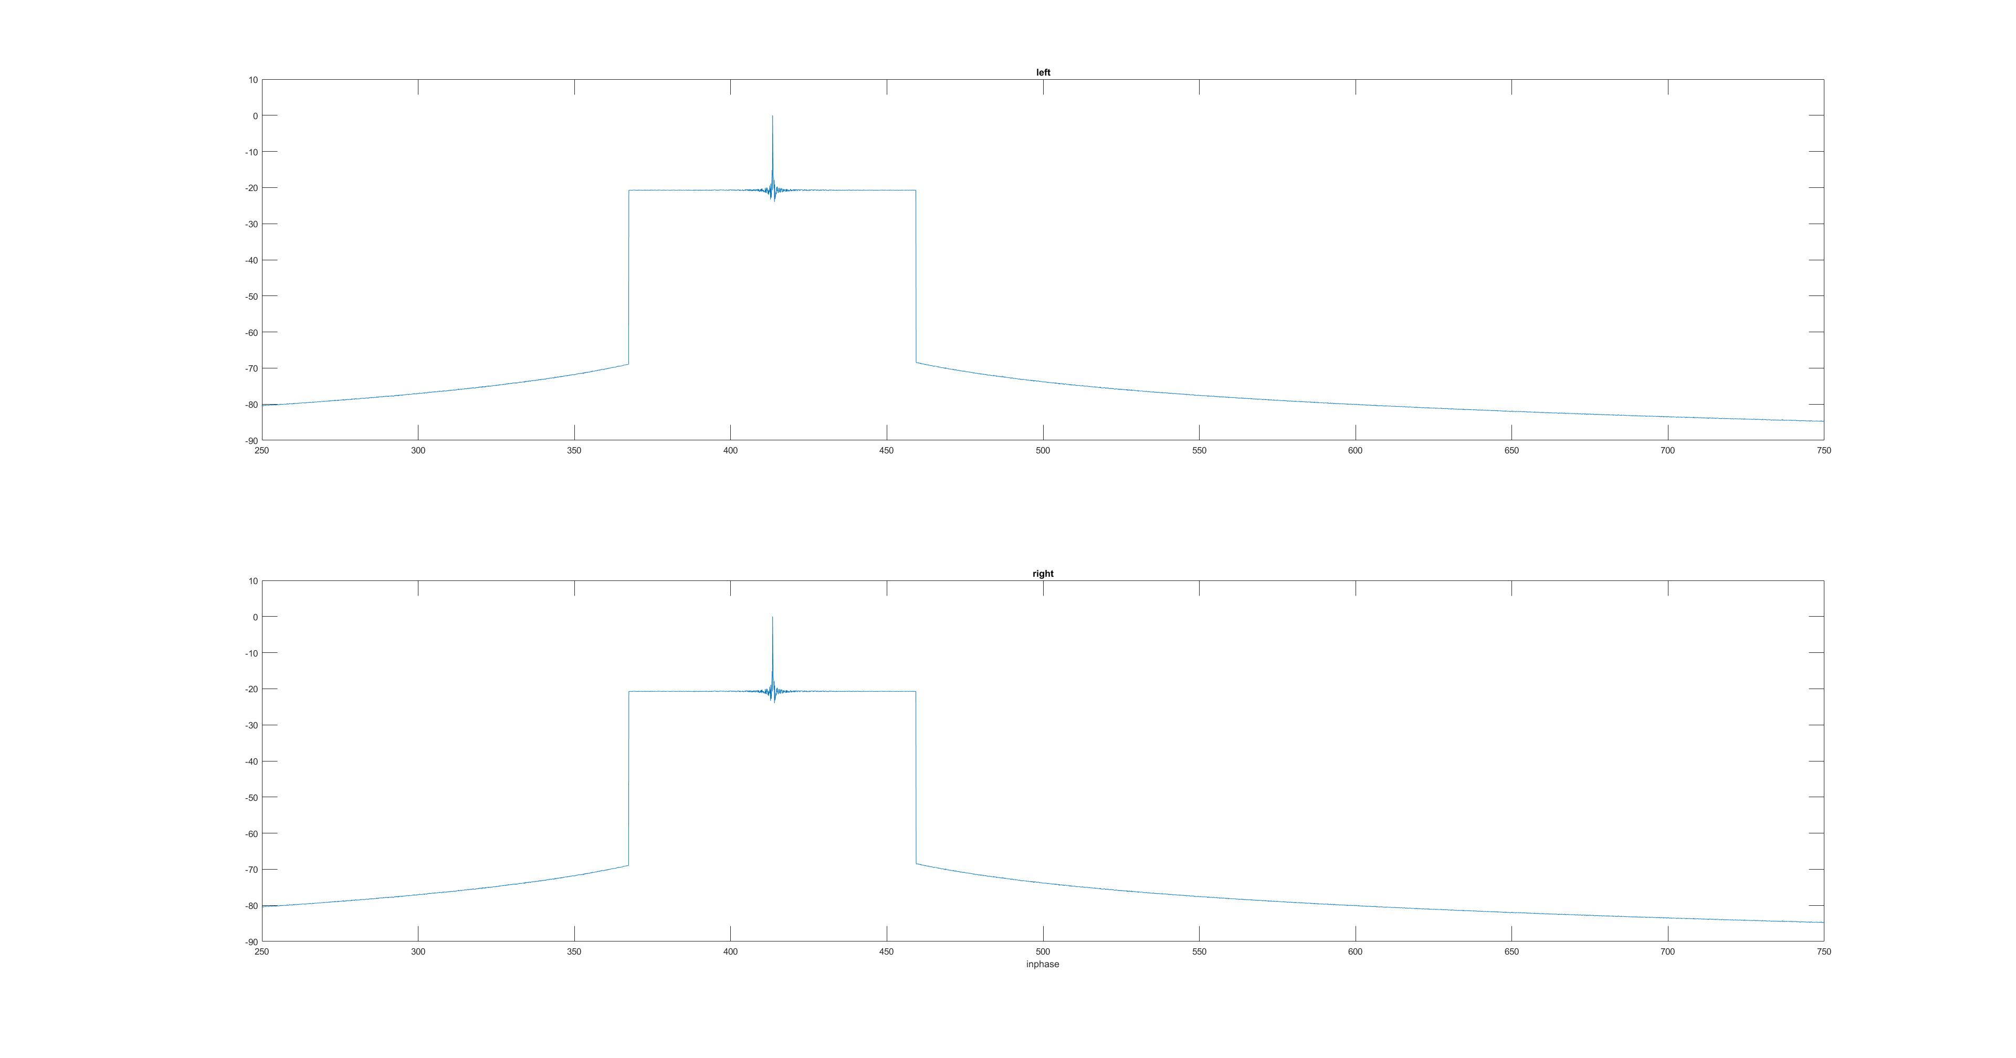
Left and right spectra
inphase

Slide 26
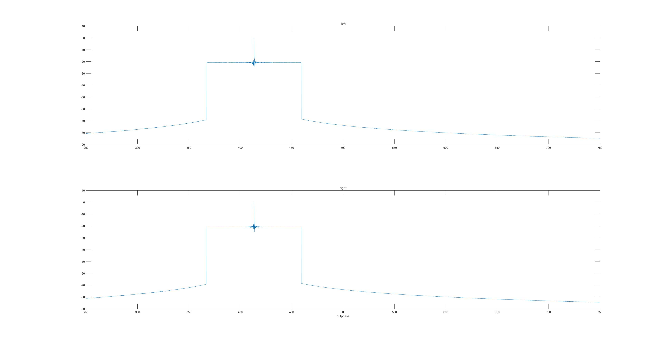
Left and Right Spectra
Outphase
Yes, the power spectra are identical to arithmetic error level

Slide 27
All those hard to see and read plots
Will be on the meeting recap page along with the .pptx deck.
There, they’ll be in 4k glory, and you will be able to read them

Slide 28
The effects of BMLD
BMLD can move a signal that is indetectable at 6dB SNR (while in phase in both channels and a common masker) to detectable at close to 30dB when the masked signal is NOT in phase in the two channels.
You will most often hear this only in a very dry room, or in headphones, and it’s much easier to hear in headphones.

Slide 29
So, finally, the five rules of masking:
To interact and have masking, you must have similar spectra from the two signals
There must be a level difference
The two signals must be closely time aligned.
The structure of the signal inside each ERB matters a great deal. Approximations are required
You have to pay attention to both masker and masked signal phase in stereo. Either being out of phase interaurally leads to detectable imaging issues, SOMETIMES. Of course, it’s envelope match at high frequencies.
And of course, the SIXTH rule of masking: If any ERB isn’t masked, the signal isn’t masked.

Slide 30
Some practical takeaway idea
Similar spectra may mask or be masked
Similar time domain behavior in an ERB (or multiple ERB’s) may be masked
Different time structure in two signals may prevent masking.
Even a hint from one or 2 ERB’s in time structure can cause effects similar to BMLD
That’s beyond the bounds of a basic tutorial.

Slide 31
Questions?

