Slide 1
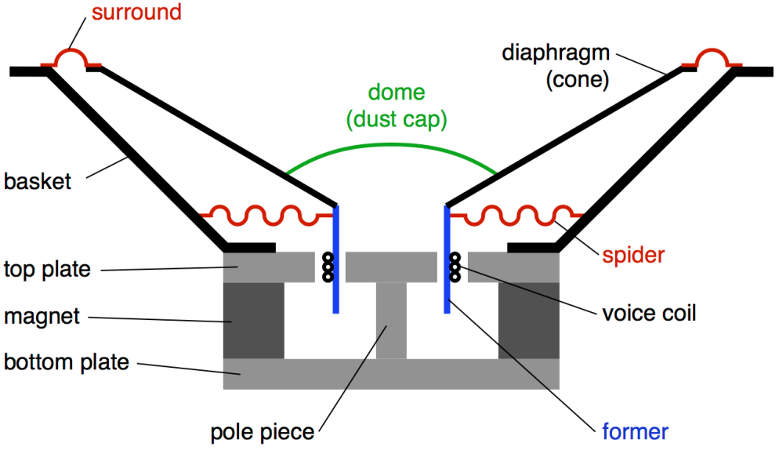
Impedance Of Loudspeakers
Dana Olson
Show some plots of impedance curves
perhaps even measure one actively live
Then he'll talk about what these curves mean,
how they are used and
What effect a 4 ohm vs 8 ohm speaker has on amplifier performance.

Slide 2
Loudspeaker Impedance, Z
What is it?
How is it measured?
Why does Z matter?
Reactance in a speaker
Understanding Example Measurements
How can it affect amplifier performance
Passive Crossovers and Resonance Artifacts

Slide 3
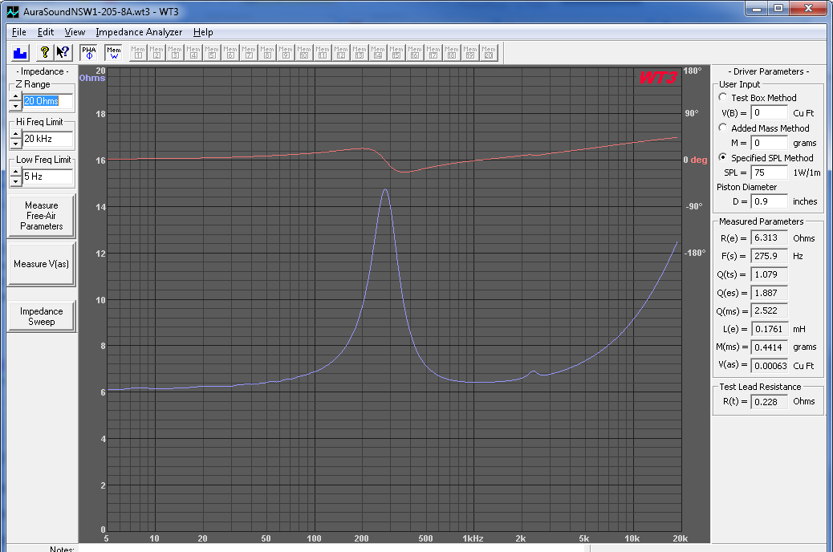
What is it?
Frequency dependent opposition (resistance + reactance) to the flow of charge (current) through the motor coil of a loudspeaker.

Slide 4
LIMP User Manual

Slide 5
Can that be derived from R=V/I?
Notation change U for V, Z for R
Z(f) = U / I Impedance = Volt/Current
I speaker = I resistor … when in series.
I = U/R
Ur = U1 – U2
I = (U1 – U2) / R 1/I = R / (U1 – U2)
Z(f) = U/I = U2 * R / (U1 – U2)

Slide 6
Demonstration (LIMP user manual)

Slide 7
Why does Z matter?
P = k* a Sound Pressure = k * Acceleration.
a = F / m Acceleration = Force/Mass
F = B * L * i Force = Magnet * Wire L * Current
i = v / z Current = Voltage / Impedance
Voltage output amplifiers rely on the speakers impedance to perform the voltage to current conversion.

Slide 8
Why does Z matter?
When driven by a fixed voltage, a variation in impedance with frequency will cause a variation in sound pressure with frequency.
Current Drive (trans conductance amplifier)
Passive crossover template filters assume constant input and output impedance.
Amplifier Distortion depends on speaker impedance.

Slide 9
Reactance in a speaker? Periodic storage and release of energy.
Electrically
Energy Stored in Electric Field in Capacitors
Energy Stored in Magnetic Field in Inductors
Transformer (coil – steel – eddy currents)
Electromechanically; Linear motor coupled to mechanically resonant structure
Kinetic energy of a moving mass
Potential energy of a deformed spring
(In ported systems an added spring and mass are formed using volumes of air)

Slide 10
Speakerlab 10” Woofer GW1038R

Slide 11
JBL 1” Dome Tweeter Ti053

Slide 12
What’s it look like

Slide 13
Speakerlab 12” Active Hybrid Radiator

Slide 15
Sealed Box Woofer

Slide 16
Ported Box Woofer

Slide 17
Amplifier Performance 8 ohm vs 4 ohm speakers
Douglas Self: Audio Power Amplifier Design Handbook

Slide 18
Amplifier Performance 8 ohm vs 4 ohm speakers

Slide 19
Drop in transistor gain (Beta) with increasing load current.

Slide 20
Beta varies with amp output voltage

Slide 21
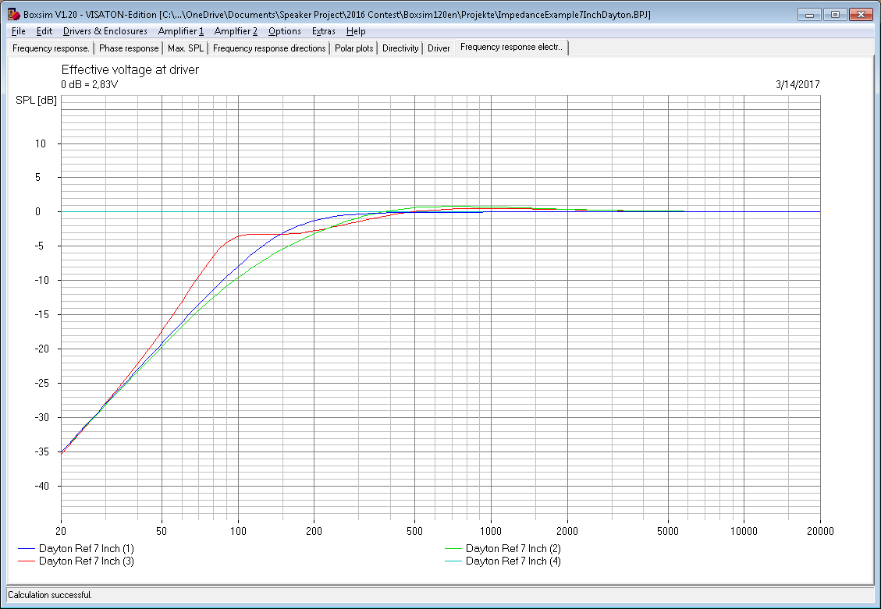
Driver Impedance Variation Effect On Passive Crossover
Z variation with frequency dorks up X over.

Slide 22
Resonance Compensation

Slide 24
Advanced Loudspeaker Modeling Knud Thorborg

Slide 25
From LIMP
Voice coil inductance (LE) was usually specified as inductive component of driver impedance at 1 kHz. In modern instrumentation that model is abandoned, and voice coil is treated as “lossy” inductor whose impedance ZLE depends on frequency. Physically, ZLE represents the input impedance of the "transformer" whose secondary winding is the pole piece. Eddy currents in the pole piece give rise to primary circuit resistance.

Slide 26
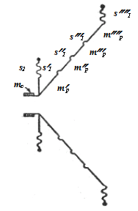
Mismatch from model shows influence of “parasitic” elements.

Slide 27
References
Douglas Self: Audio Power Amplifier Design Handbook, Focal Press, www.douglas-self.com
http://www.leedh-acoustic.com Nearly ideal drivers, No Surround, No Spring, No Steel
Esa Merilainen: Current-Driving Of Loudspeakers

Slide 28
Software
ARTALABS, Ivo Mateljan: Arta; Limp Measurement Software
WT3 (woofer tester 3) www.partsexpress.com
Knud Thorborg: Scan-Speak “semi-inductor” model.
http://www.scan-speak.dk/?page_id=496
VISATRON: Boxsim V1.20 (Crossover design)

