Slide 1
What the (&^(@# Is an FFT?
James D. (jj) Johnston
Independent audio and electroacoustics consultant

Slide 2
ATTENTION- THERE IS ONE RULE!
If you have a question
ASK!

Slide 3
First a term:
Time domain
The “time domain” is a waveform, such as comes from your microphone, goes into your loudspeaker, or is encoded in some fashion in a recorder. It contains a value that represents the amplitude of something (here we presume audio) as a function of time.
We will get to “frequency domain” in a minute or 30…

Slide 4
Why the time domain?
Our ears work by doing a very unusual kind of time/frequency analysis of the pressure at the eardrum. The pressure at the ear drum is a function of pressure vs. time, ergo it is in the time domain.

Slide 5
So, why would we care about anything else?
The ear converts the time domain pressure into a set of signals, each of which constitutes a filtered version of the time domain signal, where the filtering provides frequency selectivity.
In other words, the ear uses a lossy, unusual kind of time/frequency analysis.

Slide 6
Time/frequency analysis – whaaaaaaaaaaaaa?
By filtering the time domain signal into many overlapping channels of time domain signal, the ear creates frequency separation, ergo providing resolution not just in time, but also in frequency.
Note that the ear does NOT do an FFT, or anything of the sort.

Slide 7
Time-frequency analysis
There is something to be recalled here:
The narrower the bandwidth of the filter, the worse (i.e. wider) the time resolution of a filter
The wider the bandwidth of the filter, the better (i.e. narrower) the time resolution of a filter
Later, we shall see why, but for now, suffice it to say that
Bandwidth * time_resolution >= c (c = 1 or c = .5 depending on situation)

Slide 8
This matters why?
The ear does not have constant filter bandwidth with frequency:
At low frequencies, the filter bandwidth is approximately 70 Hz
At high frequencies, it’s approximately ¼ octave.

Slide 9
A table of Band Edges
2536
3017
3589
4269
5077
6038
7181
8540
10157
12079
14365
17084
20317
24162
20
90
161
232
303
374
445
530
631
751
894
1064
1266
1506
1792
2132
Remember there are many overlapping filters and that this list is one set of bands edge to edge

Slide 10
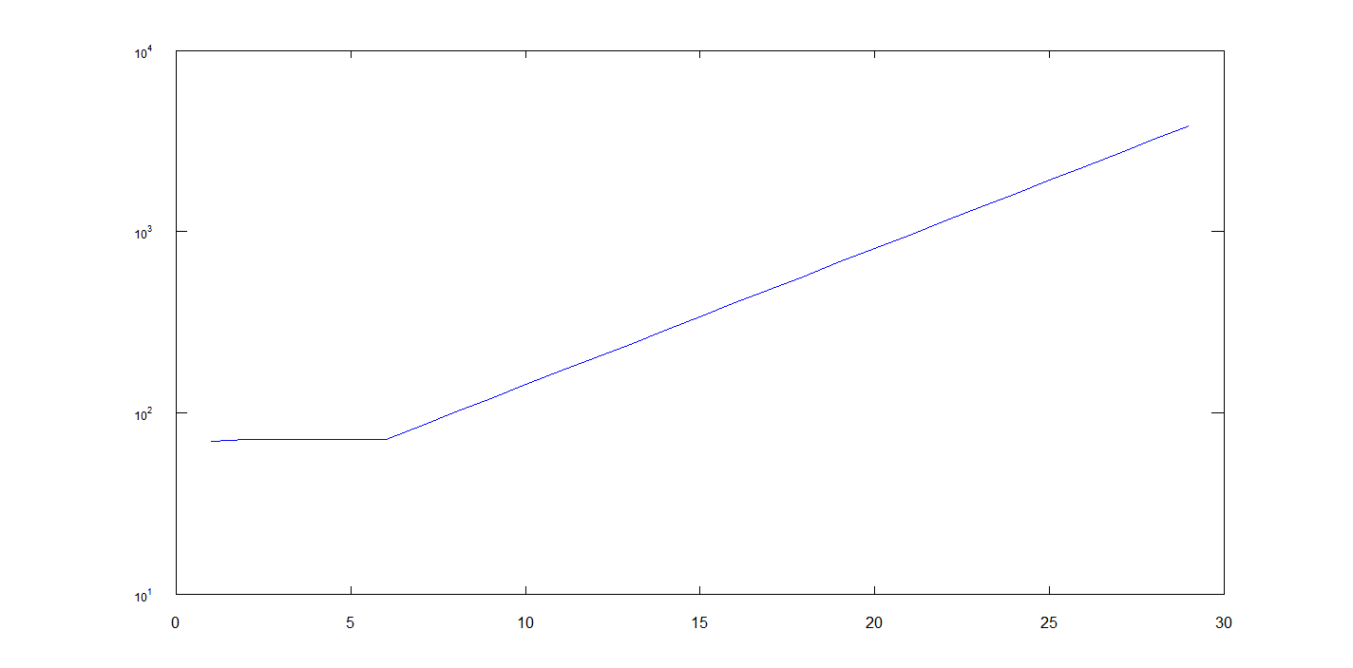
Vertical Scale is bandwidth in Hz
Horizontal scale is band number
(for integer number bands)
Bandwidth vs. band number

Slide 11
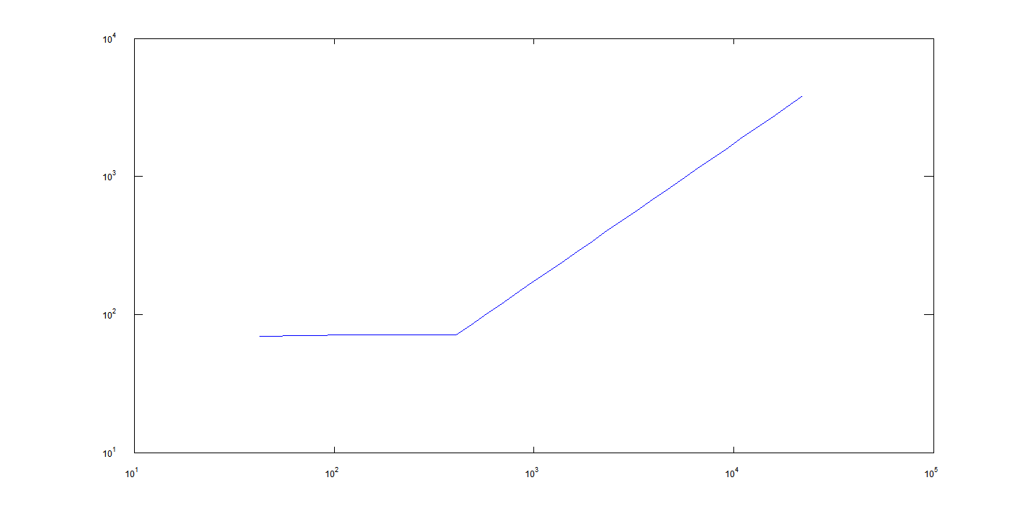
Vertical Scale is bandwidth
Horizontal Scale is center Frequency of band

Slide 12
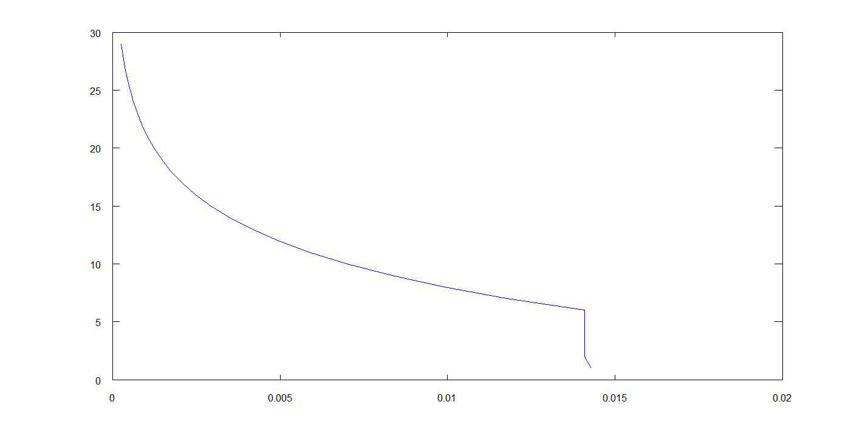
But, now, time resolution:

Slide 13
My point?
When you filter a signal, you also set a minimum time resolution (minimum in seconds, milliseconds, etc)
This leads to time-frequency analysis, where you analyze a section of a signal, and thus get a given time resolution and frequency resolution.

Slide 14
Why we care about frequency in audio
That’s simple, the ear is frequency selective.
But the ear uses a very peculiar, lossy kind of time/frequency analysis.
Still, we can learn a lot from other kinds of time/frequency analysis

Slide 15
What is an FFT?
FFT means
Fast
Fourier
Transform
Needless to say, the next question is:
So, what the (*&( is a Fourier transform?

Slide 16
NO MATH!
A Fourier transform has several forms:
It can convert an unsampled, time-domain waveform into a transform that analysis the entire signal in terms of frequency and phase
It can convert a sampled, time-domain signal of any particular length into frequency and phase, via real and imaginary spectra

Slide 17
A bit of Formalism
It is conventional to express a spectrum with a capital letter, i.e. X(w).
It is conventional to express the time domain version of the signal with a small letter, i.e. x(t)
Both of the signals contain exactly, precisely the same information, it’s just in a different form.

Slide 18
The FFT
I am absolutely not going to explain how to do an FFT. There are many good implementations out there, get one and use it.
The FFT uses lengths that are more constrained than “any length” which a Fourier transform or “discrete fourier transform” (DFT) can implement.
But as a result, it is substantially faster.
And that’s why we use it.

Slide 19
How much faster, did you say?
Length | FLOP for DFT | FLOP for FFT
16 | 16*16=256 | 16*4*4=256
32 | 32*32=1,024 | 32*5*4=640
64 | 64*64=4,096 | 64*6*4=1,536
…
1024 | 1,048,576 | 40,960
8192 | 67,108,864 | 425,984
32768 | 1,073,741,824 | 1,966,080
I think that makes the point pretty well, yes?

Slide 20
To explain a bit more:
A DFT is simply an n^2 process. The number of operations is the square of the length, for any length.
An fft of length n=2^m is a process that takes n*m “butterflies", each of which takes 4 operations, give or take.

Slide 21
Ok, that’s how fast it is. But what does it do?
Ok, now we’re going to talk about a variety of issues surrounding the FFT in particular, but that also apply to the DFT and Fourier Transform. We will talk about:
Windowing vs. Frequency resolution
Properties of the Transform
After the second break, we’ll use that pesky “convolution theorem” a lot.

Slide 22
First, what is it, Strictly Speaking
For the math-aware, it is an orthonormal transformation.
This means that:
The input and output contain exactly the same information
It is exactly reversible
It obeys that “convolution theorem”
Its projected space is called the “Frequency domain”
There are many “frequency domains”.

Slide 23
What it is NOT
An FFT does not calculate a power spectrum
But of course you can calculate one from the FFT of a signal.
An FFT is not a filterbank
If you do block by block FFT, there is no frequency meaning to the joints between FFT’s.
An FFT does not have some “measurement error”, it is a precise, exact mathematical function.

Slide 24
You may hear “FFT’s are not valid”
Yes, they are. Period.
A (continuous time, continuous frequency) Fourier Transform may not be valid if (and only if)
It has infinite energy in the input signal AND
It has infinite slope in the input signal
But you can’t create either one of those in the real world, so unless we’re talking about strictly mathematical issues, the Fourier Transform works.
Always.
An FFT, by using an input consisting of samples that obey the sampling theorem, is valid. That’s part of being an orthonormal transform.
Of course, you can still misuse it. You can also misuse a toothpick.

Slide 25
Ok, now, the “Frequency Domain”
By now you have probably caught it, there is no one “Frequency domain” beyond a single Fourier Transform (fft, dft, etc).
For a given transform, the frequency domain is defined as a complex spectrum from an FFT.
For something that does successive FFT’s, like a waterfall plot, spectrogram, etc, the proper term is:
TIME/Frequency domain.

Slide 26
Some properties of an FFT
An FFT turns 2^n samples of time domain complex signal into 2^n complex numbers.
Rarely (i.e. never) do we have complex input in most audio processing (although we can not completely rule that out for specialized things I won’t go into right now)
For real input, the FFT has the same output, BUT
You have 2 real, and 2^(n-1)-1 complex samples that are unique.
The other samples are either zero (for the two real points) or complex conjugate of the 2^(n-1) complex samples.

Slide 27
H U H ? ? ? ? ? ?
If I do an FFT on a 32 sample signal consisting of 1, 2, 3, 4, … 32 I get:
528.000 + 0.000i (note zero imaginary part)
-16.000 + 162.451i , -16.000 + 80.437i, -16.000 + 52.745i, -16.000 + 38.627i
-16.000 + 29.934i, -16.000 + 23.946i, -16.000 + 19.496i, -16.000 + 16.000i
-16.000 + 13.131i, -16.000 + 10.691i , -16.000 + 8.552i , -16.000 + 6.627i
-16.000 + 4.854i, -16.000 + 3.183i, -16.000 + 1.576i
-16.000 + 0.000i (note zero imaginary part)
-16.000 - 1.576i, -16.000 - 3.183i, -16.000 - 4.854i, -16.000 - 6.627i
-16.000 - 8.552i, -16.000 - 10.691i, -16.000 - 13.131i, -16.000 - 16.000i
-16.000 - 19.496i, -16.000 - 23.946i, -16.000 - 29.934i, -16.000 - 38.627i
-16.000 - 52.745i, -16.000 - 80.437i, -16.000 - 162.451i
Note that each of the identically colored pairs (and all pairs, mirrored about the middle, real, value) is of the form x +- y i, where the sign of the imaginary part is opposite for the first vs. second value. This change of sign in the imaginary part is called the “complex conjugate”.

Slide 28
In a nutshell:
N values in
N values out
But all but 2 of them are complex numbers
That means N/2 -1 complex numbers.
That’s where “phase” comes from.

Slide 29
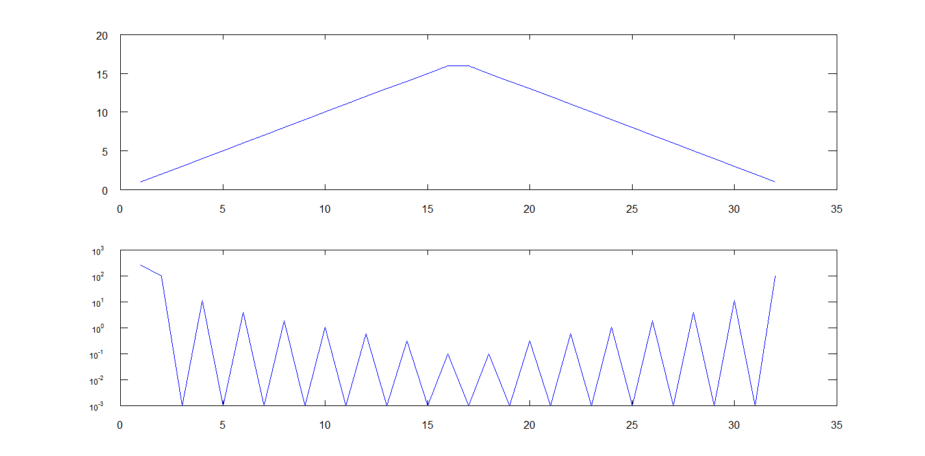
Some other properties, symmetric input:
X(t)
Abs(X(w))

Slide 30
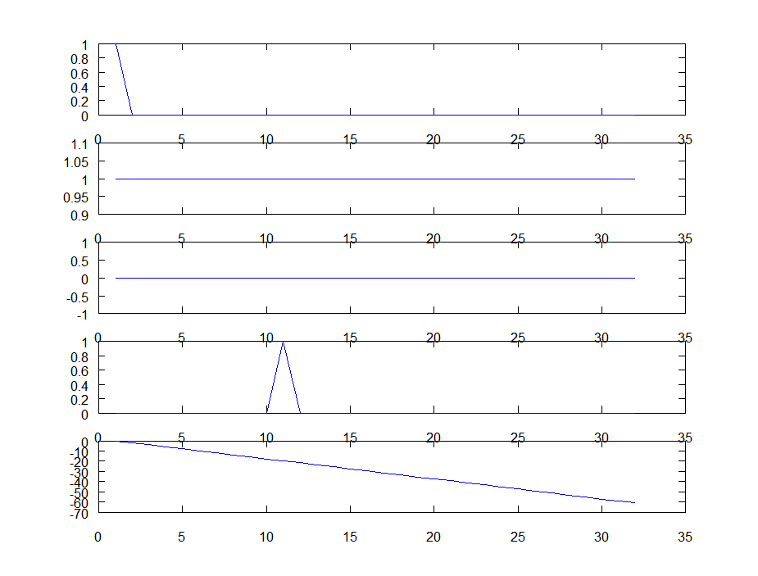
The meaning of phase:
x1
Amplitude of fft for either x1 or x2
Phase of x1
x2
Phase of x2

Slide 31
Phase shift vs. time delay
Phase shift (in radians) = 2* pi * f * t;
A constant delay means phase shift is a line

Slide 32
This “real signal” thing:
It means that we only use the first half of the transform.
This is sometimes called a real to complex FFT
If you do it that way, you save 40% of the processing.
When we display the spectrum, we only display the first half (plus 1 for fs/2).
The other half will always be mirrored. Always.

Slide 33
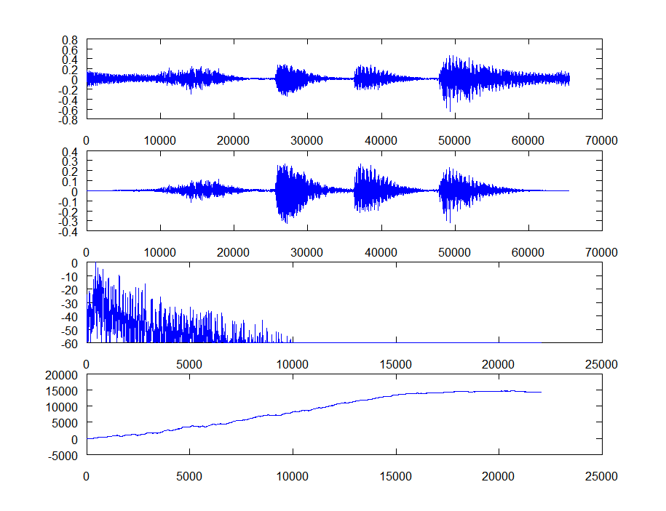
An example of real data
Sample of Ragtime Piano
Windowed Sample
Spectrum in dB,
Normalized to peak
Phase

Slide 34
Windowed? Wait. Whazzis?
An FFT is “circular”, as far as it is concerned, the signal is continuous from the END to the beginning of the input data.
If it’s not, you get artifacts from the discontinuity
These artifacts are also called the “Rectangular Window”
So you use a window to ensure that both ends of the data are zero. That way, no discontinuity.

Slide 35
What do you use for a window, then?
There are many many’s of choices.
Hann (sometimes mistakenly called Hanning)window. Dr. von Hann might object.
Hamming window
Kaiser window(s)
Blackmun window
…

Slide 36
What window to use?
I use a Hann window, almost exclusively.
Why? Well, a window is nothing more or less than a lowpass filter. It’s back to that convolution theorem, but we probably don’t want to discuss that today. If we do, maybe at break?

Slide 37
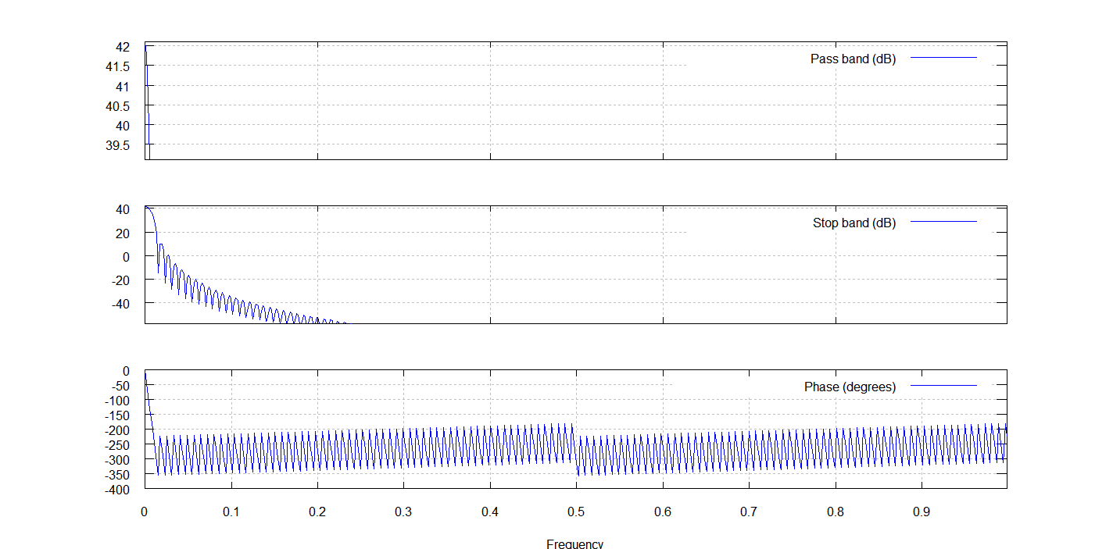
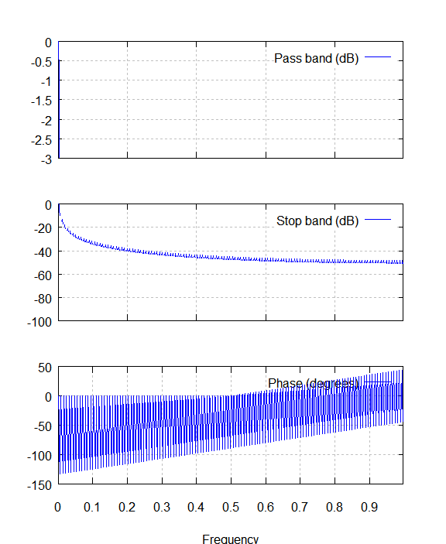
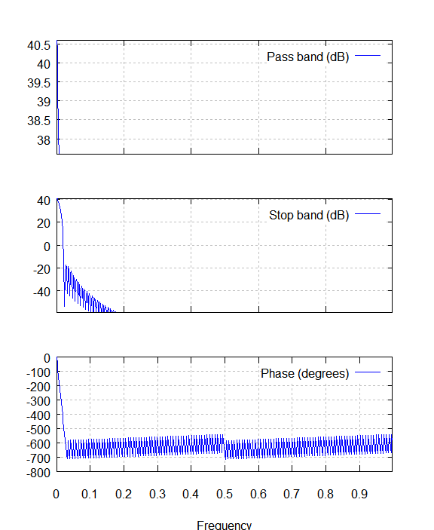
Some window functions:
Hann
Rectangular
Blackman
Note narrower
passband
Note wider
passband
Note better rejection
Note awful far-frequency
rejection

Slide 38
Yes, it’s true
All windows are a tradeoff between the width of the passband (i.e. the maximum) and the amount of far-frequency rejection
A Hann window is very simple, and is a very good intermediate choice, with good far-frequency rejection, and not too much broadening of the peak.

Slide 39
When do you window?
The conventional answer is “always”.
But all generalities are false
If you’re trying to calculate a spectrum, you ought to window.
If you’re capturing a room response, maybe, maybe not.

Slide 40
Ok, bio-break here.
Questions are welcome, of course.

Slide 41
Doing a spectrum in Octave The setup:
clear all
close all
fclose all
len=2^12;
fs=44100;
wind=hann(len); # make the hann window
slen=len/2; # the shift length, i.e. 1/2 overlap.
x=wavread('01jt.wav'); # or you can specify any other wave file, of course.
whos # shows the form of the file, n samples by 2 channels
flen=length(x); # gets the length of the file in samples
nblk=floor(flen*2/len)-1 # might clip the end of the file
nonzeroblocks=0;
lenspec=len/2+1; # length of the spectrum
sumspec(1:lenspec,1:2)=0; # to keep overall power spectrum

Slide 42
The work:
for ii = 1:1:nblk
work=x( ((ii-1)*slen +1):((ii+1)*slen) , 1:2); # pick one block of data
work(1:len,1)=work(1:len,1) .* wind; # window left channel
work(1:len,2)=work(1:len,2) .* wind; # ditto right channel
ss=sum(sum(abs(work))) # is there any energy here?
if ss > 1/32768 # if it's smaller than that there is no signal.
nonzeroblocks=nonzeroblocks+1;
workt=fft(work); # take the transform
ps=workt(1:lenspec,1:2) .* conj(workt(1:lenspec,1:2));
sumspec=sumspec + ps; # keep overall power spec sum.
psmax=max(max(ps)); # find overall maximum
ps=ps/psmax; #normalize to peak for presentation
ps=max(ps,.00000000001); # put in minimum energy to avoid stuff
ps=log10(ps)*10; # dB spectrum.
subplot(2,1,1);
plot(work);
subplot(2,1,2)
plot(ps);
end
fflush(stdout); # this slows things down but makes sure
# we see the output from the program
junk=input('hit cr'); # paces it so humans can interact
end

Slide 43
Yes, I know that’s a touch more than you bargained for…
But the actual file is available at:
http://www.aes.org/sections/pnw/scripts/
You can run it on your computer, by uploading octave, for free.

Slide 44
Something else you can do with Octave that is occasionally instructing:
clear all
close all
clc
fname='01.wav'
x=wavread(fname);
x=round(x*32768);
len=length(x)
his=histc(x(:,1),-32768:32767); % channel 1
his=his+histc(x(:,2),-32768:32767); %channel 2
tot=sum(his);
his=his/tot;
his=max(his, .000000000001);
xax=-32768:32767;
semilogy(xax,his);
axis([-40000 40000 1e-10 1e-1]);

Slide 45
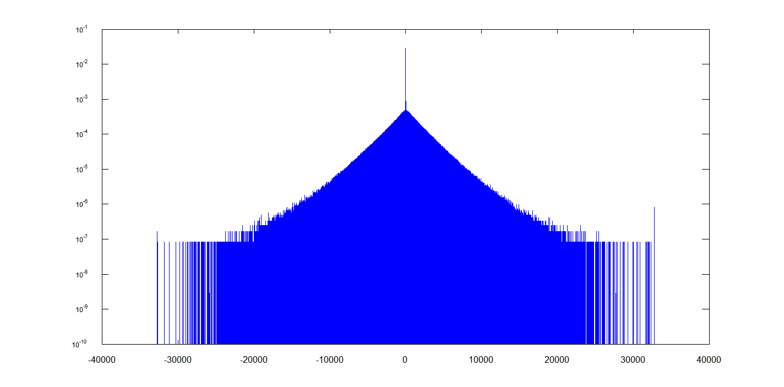
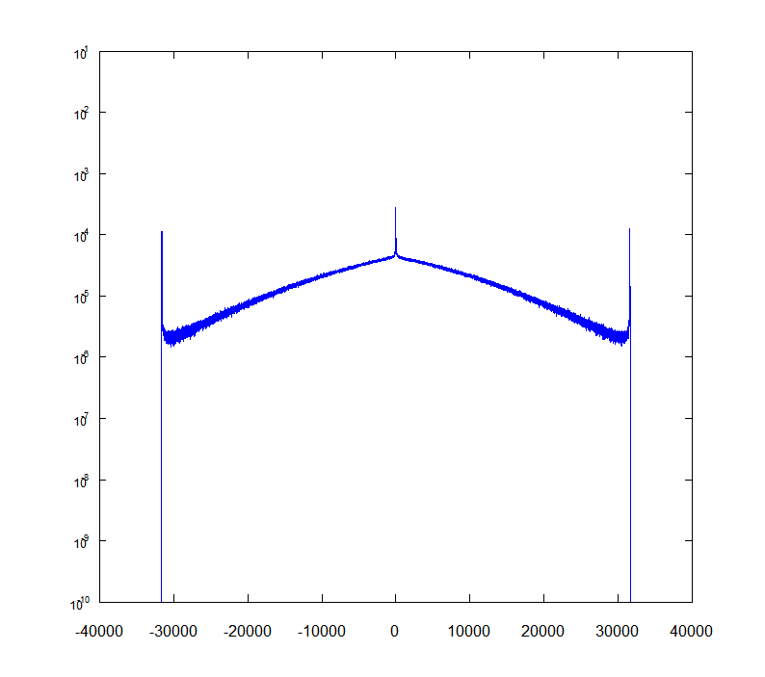
What does that get you?
Level Histogram of Ragtime Piano
Level Histogram of Modern Loud Production
Clippity-clip!!
Missing Codes

Slide 46
Now it gets complicated:
We will take a probe signal designed by using lots and lots of allpass filters (i.e. filters that affect phase, but do not change spectrum) on an impulse (which has all frequencies).
The result is not quite perfect, because we truncate the ends, but it looks like the next slide here.
The way to generate this is the .m file “allpass.m”

Slide 47
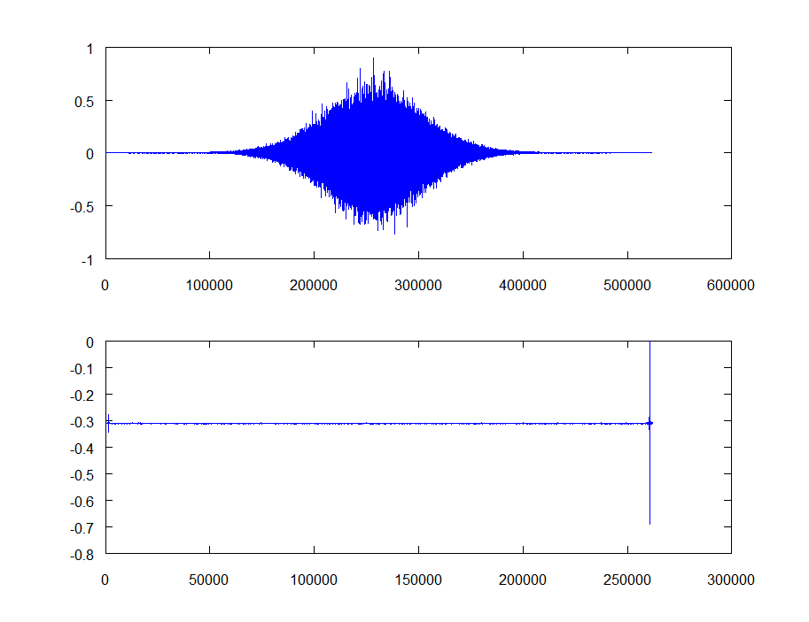
Time Waveform
Power spectrum in dB

Slide 48
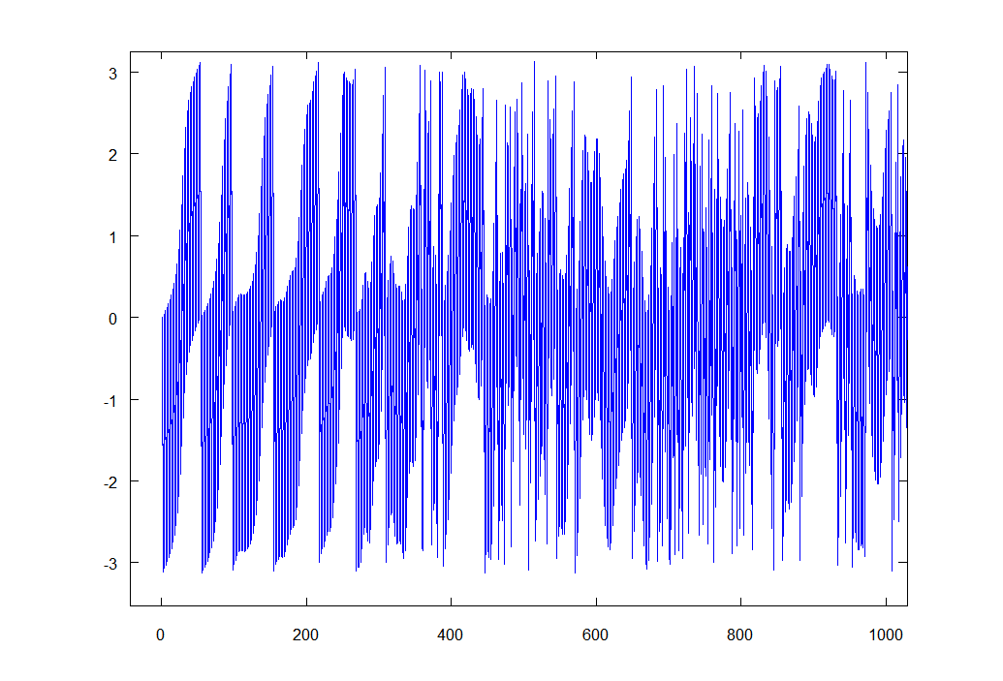
Pretty flat, eh? Now look at the phase!
And that is only the first 1000 points of a 512K transform!

Slide 49
The message?
Wild divergence in phase, created by an allpass filter, spreads out the signal from a single sample to many, many, many samples.
This increases the energy of the signal after normalization.
But, it probably makes figuring out when it started hard, right?
Wrong.

Slide 50
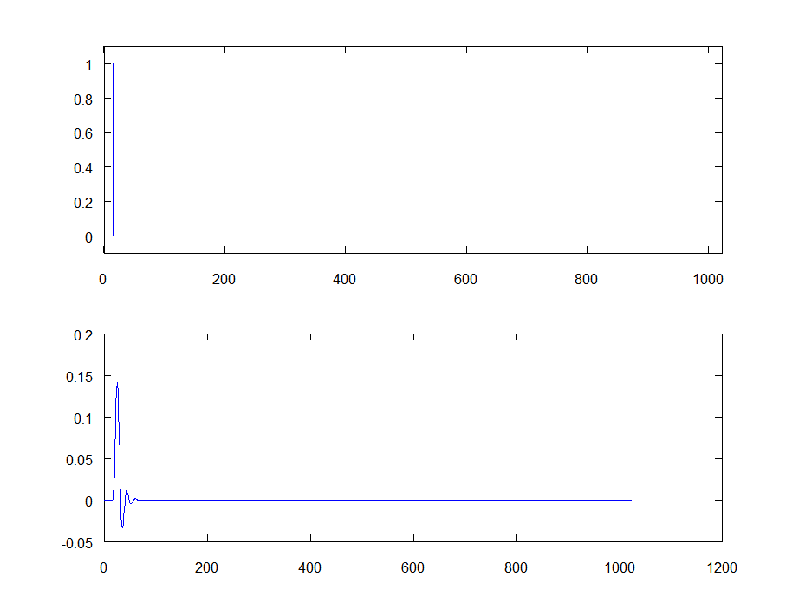
First, let us calculate the impulse response of a nice, simple, 5th order Butter worth filter directly.
Input to filter
Output from filter

Slide 51
So, why don’t we just do that all the time?
First, the input signal is very low energy, it has maximum amplitude, but only for one sample.
If we have any noise in the process, it will swamp the measurement signal
There is no way to control other noise that may come from outside (i.e. in an acoustic setting)
Many things (including circuits and loudspeaker drivers, microphones, etc) do not handle impulses very linearly.
So the measurements contain more distortion than information.

Slide 52
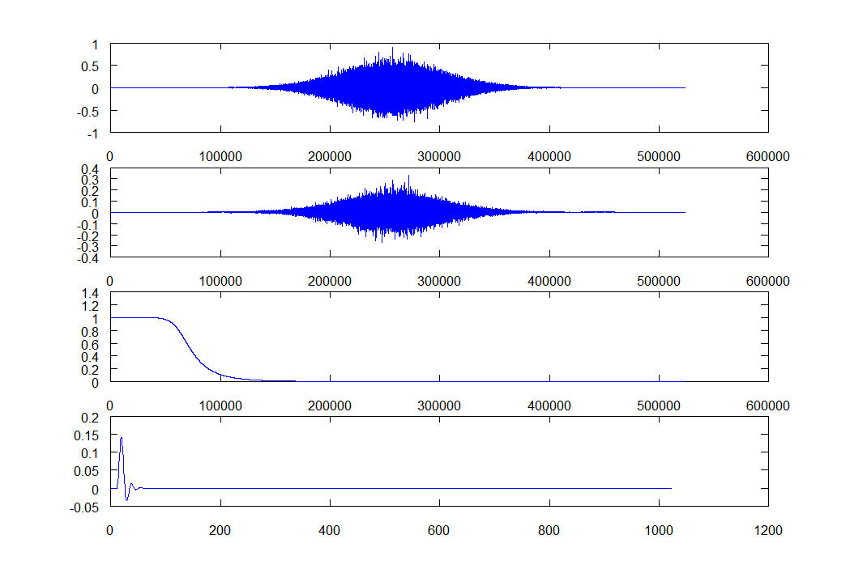
Let’s use our probe signal, then.
Probe Signal
Filtered Probe
Amplitude of Transform of FP divided by transform of PS
Inverse transform of the division of FPT/PST – Impulse Response

Slide 53
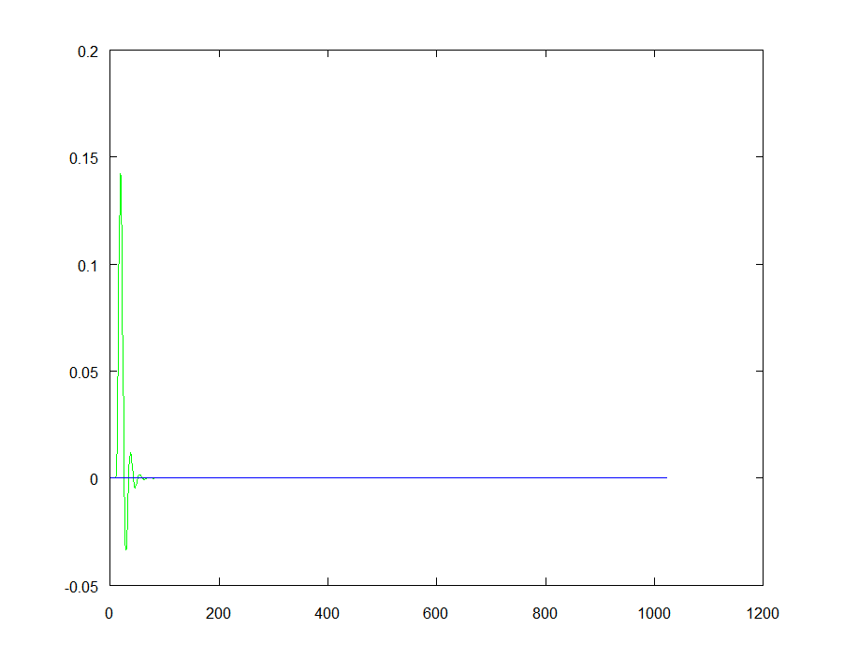
Let’s Compare the Two
Red (obscured by green) is FFT method
Green (covering red) is direct filtering
Blue (maximum absolute value of 2e-13) is difference
That, as they say, is “exact enough”, and the error
is strictly calculation error and rounding

Slide 54
Ok, where’s the magic wand?
Well, it’s the convolution theorem.
When you convolve things in the time domain (which is what filters do), you MULTIPLY them in the frequency domain.
When you DIVIDE things in the frequency domain, you DECONVOLVE things in the time domain.
In other words, we removed all of that wild phase shift, and got our impulse response.

Slide 55
That works both ways:
When you MULTIPLY things in the time domain, you CONVOLVE them in the frequency domain.
That’s what a window does to an FFT
The rectangular window is just another window in that respect, and not a very nice one in the frequency domain
Rarely do we deconvolve frequency domain signals by dividing in the time domain, however, the time domain has a tendency to have zeros, which is a bit inconvenient.

Slide 56
?Zeros?
If what you’re trying to deconvolve by has any zeros, you’ve lost information forever
And deconvolution can never ever be exact.
There are ways to kind of, sort of, handle this. Sometimes you have to do that.
I prefer not to do that, ever, if I can avoid lossy least-mean-squares minimizations

Slide 57
So, “fast convolution”
Well, first, let us recall a few things:
When you convolve two sequences, of length “m” and “n”, you wind up with a sequence of length “m+n-1”.
In may cases, doing two forward transforms, a complex multiply, and an inverse transform, which works out to 12 log2(m+n-1), beats the heck out of m*n.
That’s not the subject for today, so enough!

Slide 58
The point of all this:
By using transforms, you can do some really convenient things that would be a pain in the time domain.
After this break (10 minutes, please) we’ll talk about (insert fanfare) the Analytic Envelope.

Slide 59
Ok, good, but how do I measure time delay?
First, a drylab example:
We’ll take a signal, delay it by some number of samples, and add a filter to that, so we have both frequency shaping and time delay.
We take that, do the same thing we did with the filter above, and look at the results.
Then we use the “analytic envelope” and we see something else.
Guess which one works best?

Slide 60
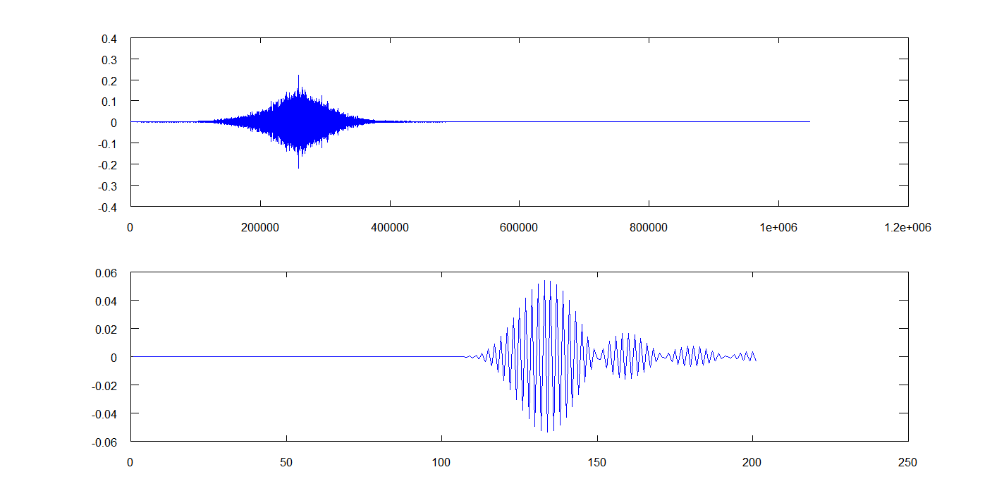
First, get the impulse response
Filtered Probe
Resulting Impulse Response

Slide 61
Ok, where is the overall delay in that?
Well, that raises several things:
The delay isn’t constant with frequency
The impulse response confuses the issue of delay
The sampling rate makes all of that even worse?
What we need is both the signal and its quadrature component, right?
Yep. But, no, Virginia, I am not going to explain Hilbert Spaces. I’m just going to do it.

Slide 62
So, what’s the “analytic envelope”
It’s the absolute value (i.e. sqrt(real^2 + imag^2) of the inverse transform of the POSITIVE FREQUENCY CONTENT of the signal
I.e. we zero the second half of the complex spectrum, that part that is always the complex conjugate. Remember that?
Then we take the ifft
Then we calculate the absolute value

Slide 63
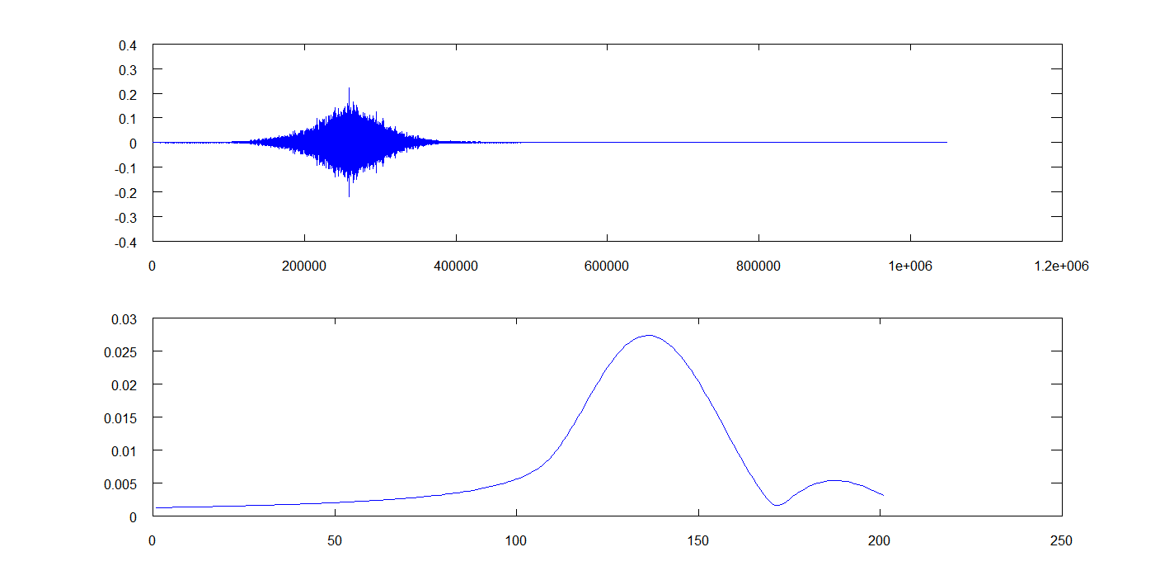
Now What?
The Analytic Envelope

Slide 64
Ok, two things, you ask:
The first is that the signal should start at “100” on the plot
But the filter adds delay.
And then that second bump
The filter delay as a function of frequency is rather extreme for this filter

Slide 65
So, let’s put this all together:
We can calculate the frequency response of a system very accurately, using long-term signals that are not sweeps, and that can be analyzed without using swept-filter methods
We can calculate system delays.

Slide 66
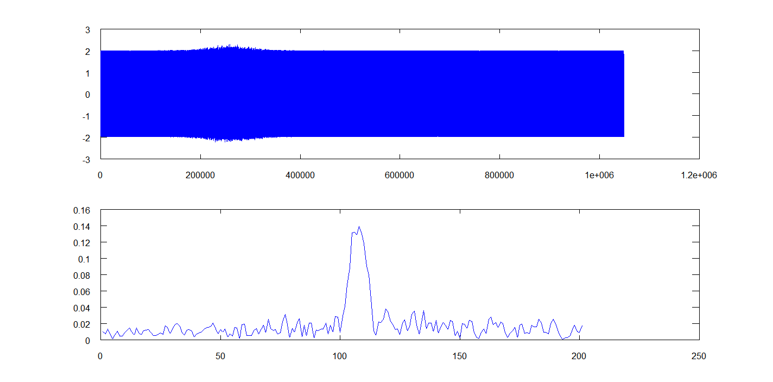
Now, let’s add some noise:
is -32.5 dB
Filtered Probe plus lots of noise
And the analytic envelope
Not too bad for a signal that’s less than 1000th of the noise energy, eh?

Slide 67
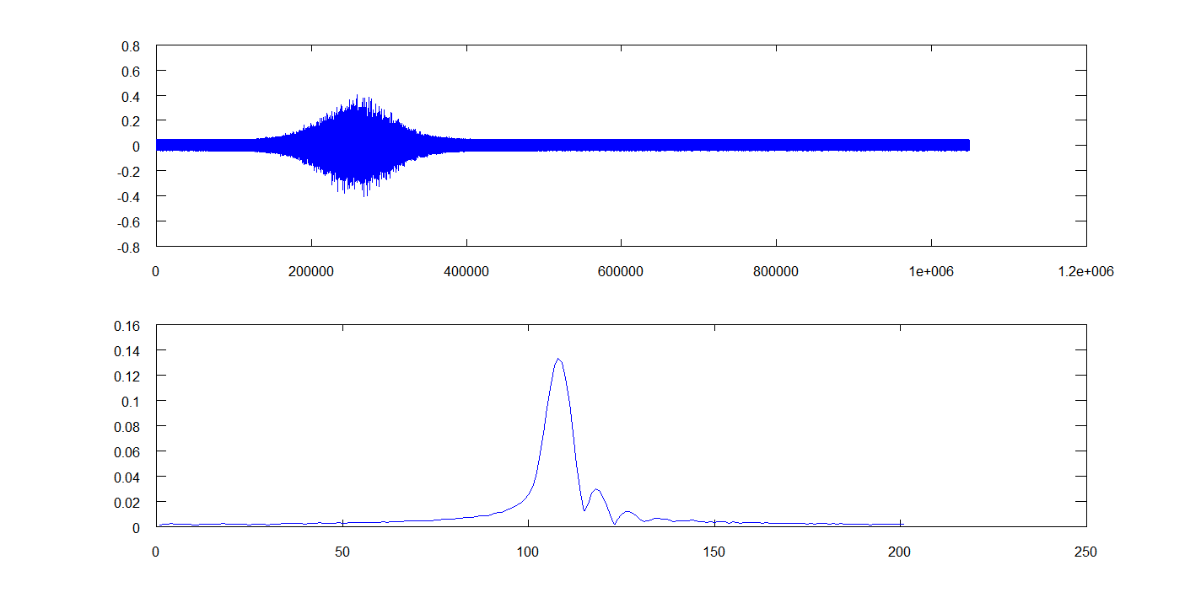
Ok, let’s be reasonable:
Zero dB SNR

Slide 68
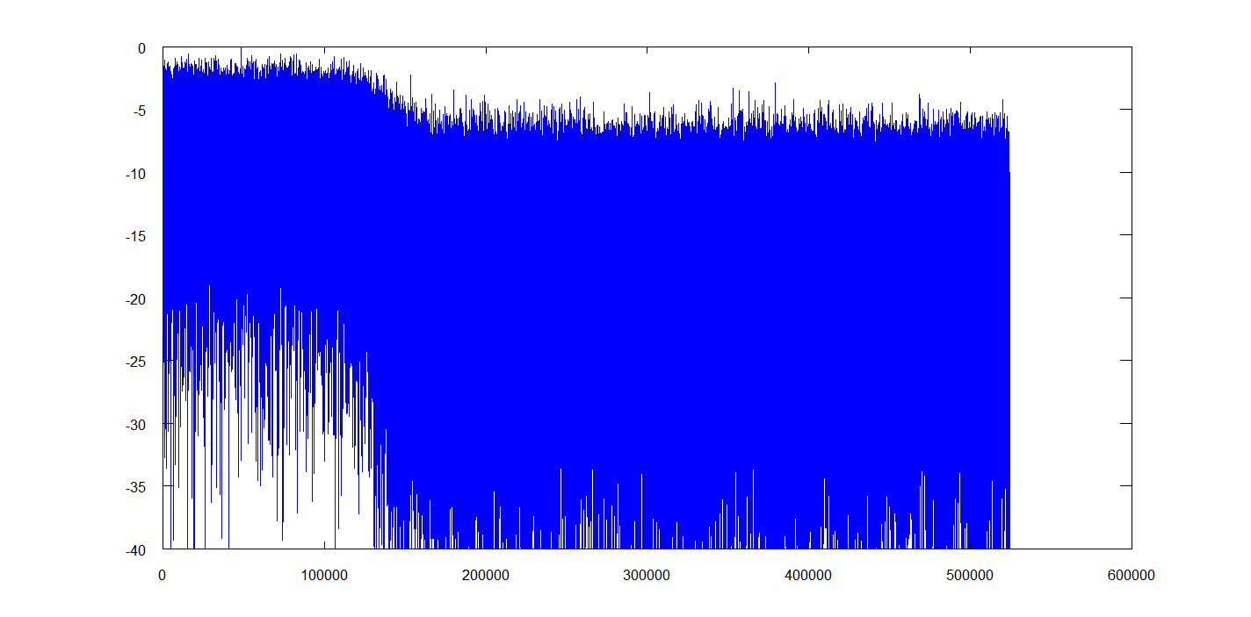
The point?
Synchronous detection works like a champ.
But what does the frequency response look like with all that noise?

Slide 69
What that says is simple:
In order to measure the room response, you need more probe (signal) energy than the noise level in the room at that frequency:
At least 10dB more is a good idea
This is most often a problem at low frequencies
But speakers are pretty powerful, too.

Slide 70
It does make a point, though:
If you use a probe signal that does not reach the room noise level at some frequency, you won’t ever gather any information at that frequency.
The various “two input” analyzers suffer from this particular issue, because the probe signal is the music that’s playing.

Slide 71
How do they work, now?
They work much like the synchronous detection shown above, but using the music signal as a probe signal.
Due to their lack of control over the probe signal, they must carefully calculate (or at least one hopes so) how meaningful a measurement is at any given frequency.

Slide 72
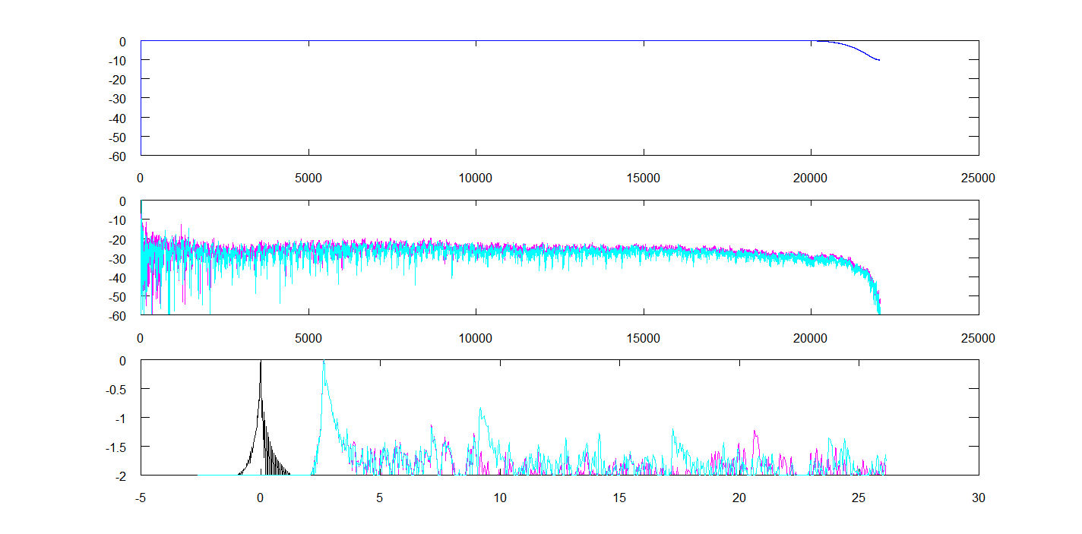
A result in Dan’s Basement:
Reference Frequency Response (loop back)
Magenta: with 10’ to back wall from mic
Cyan: with 3’ to a large sheet of plywood.
Wood plus
plywood
Envelopes, as above.
Back wall

Slide 73
A word about Smoothing Spectrum:
That’s roughly the same as shortening the analysis length.
Let’s plot one of the spectra in the previous plot on a shorter vs. longer analysis length:

Slide 74
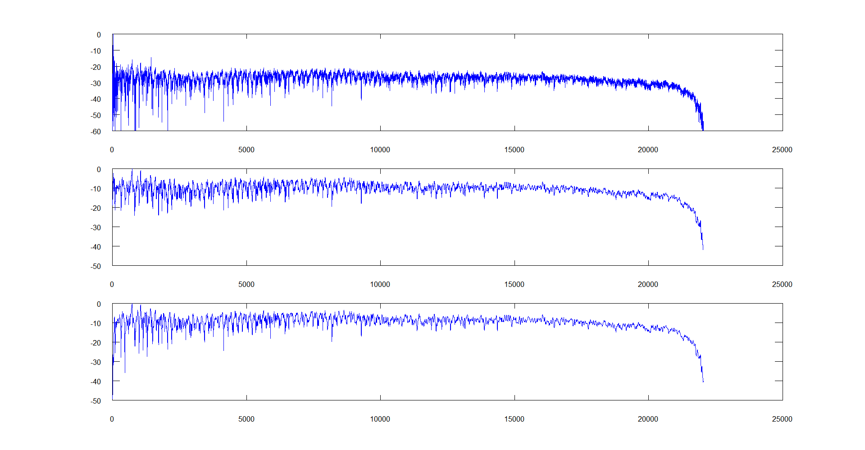
High resolution frequency response
Filtered Amplitude Response at 256 line smoothing
128th length analysis

Slide 75
So?
The factor of 2 is expected.
The shorter FFT provides the same resolution.
As you may recall from the beginning of the talk, we need different time resolution at different frequencies
i.e. this, by itself, does not provide an auditorily germane frequency response measurement, although it’s an accurate one.

Slide 76
Now for some measurements using real input:
This power point deck ends here, now you get to watch actual octave processing in action.
I’ll try to do some step by step and plot the steps so you can see how this all plays out.
I will also try to have some scripts you can refer to afterwards.

