Slide 1
Pacific Northwest Audio Engineering Society Presentation The Transparent One and Audio Entrepreneurship
Rick Kernen – CEO, Vanatoo
Gary Gesellchen – CTO, Vanatoo
Introduction
AES Associate Member, attend several meetings/year
Mike and Rick tried a set of Transparent Ones at Opus 4 Studios
We offered to speak at meeting
No sales pitch!
Cover the Product Design and the Why’s & How’s of the Business

Slide 2
Overview
Journey is better when you know where your headed
Conversation, not Lecture – Ask Questions!
Reality was spaghetti – Roughly chronological view of Vanatoo
Background on us and Vanatoo
Entrepreneurship – Our experience
The Design Cycle
The Manufacturing Cycle (with China)
Distribution and Sales Channels
Marketing and the Future
Break
How about a Little Night Music?

Slide 3
Background
Rick Kernen – CEO, Electrical Engineer
Gary Gesellchen – CTO, Mechanical Engineer
20⁺ Years at Tally (Mannesmann Tally, TallyGenicom)
Rick was VP of R&D, Gary was Engineering Director
$500M in products with our fingerprints
Private Equity “Investment” Ownership by 2007
We are Innovators!
Take summer off, regroup in fall
Decide if there is a business opportunity

Slide 4
Business Opportunity (2007 Landscape)
Market disruptions spell Opportunity
Music is almost 100% digital
Legal downloads arrive – iTunes hits 1 billion
Streaming and Internet Radio are making inroads
Downloaded/Streamed music is locked to computers or portables
802.11 Wi-Fi is becoming common in households
Class D amps start gaining acceptance in Hi-Fi market
Bose and others make small cool/doable
The iPhone is introduced
There is enough disruption to create Opportunity!

Slide 5
Opportunity – But Where to Play?
Service or Product?
Reseller or Custom?
Build or Buy?
Play to our Strengths – Speakers, Electronics, Networking
Play to Needs – Get music off computer, into room
Wireless Powered Speaker!
Market needs it
We have know-how
We love this stuff!
Uh-Oh, now we’re Entrepreneurs!

Slide 6
Entrepreneurship (Our Version)
If you hang your shingle out, you’re an Entrepreneur
Here are some questions to answer:
What do you want to do?
Why do you want to do it?
Is there a market?
Do you believe in yourself?
Can you live with failure (economically, emotionally)?
Sole Proprietorship or larger Partnership?
Do you believe in your Partner(s)?
Are you going to be BIG or small?
Whose money are you going to spend?

Slide 7
Entrepreneurship (Cont’d)
Do Your Homework:
Read Business and Startup Books/Articles
Identify and Know your Competition
Identify and Know your Customer
What / Why / How they Buy
Research options for reaching your Customer
Online / Retail / Distribution Channels
How will your customer find you?
Know your costs
Know your budget
Leave your comfort zone – No such thing as “Not My Job!”
Personal advice is plentiful. Listen, but make your own decisions!

Slide 8
Entrepreneurship (Cont’d)
Corporate Structure:
Don’t skimp on the Legal Stuff!
Don’t take anything on faith – Put it in Writing
Don’t agree to anything you can’t live with
Vanatoo Specifics:
LLC with Washington State
Detailed Partnership Agreement
Understanding of Division of Labor
Largely a “Virtual Company”, meaning we contract others as needed

Slide 9
The Design Cycle
Market Research:
Reports are expensive – Summaries and Reports of Reports
Everybody wants “Wireless”, Don’t agree what it means!
Men still like the idea of a big system
Women don’t want it taking over the space
Bass Sells
Make it Small with Big Bass!
Is Sound Quality an Afterthought?
We were told: “If it doesn’t suck, you’re golden”
Important to Us, our Customers, our Marketing Message
Going to be better than “doesn’t suck”!

Slide 10
The Design Cycle (Cont’d)
The Wireless Quest:
Wireless Chipsets – Proprietary, Point-to-Point
Bluetooth – Not quite “HSAA” (Hardly Sucks At All!)
UPnP/DLNA
Avega
Apple AirPlay
No Good Choice – Let User Choose!
External solution can follow device selection
Newer systems will work – Obsolete Proof Design
Everybody Wins!
Oh, you have 8 seconds to explain this?

Slide 11
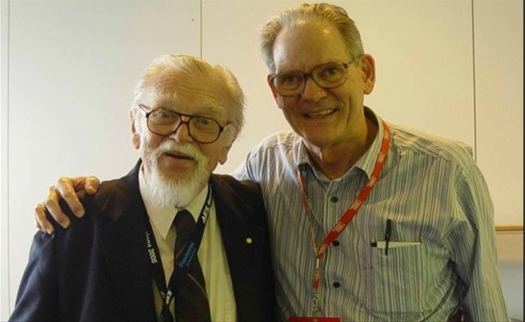
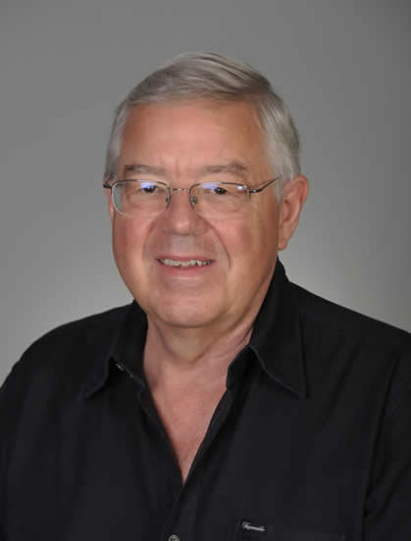
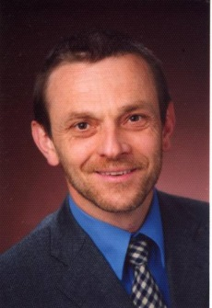
The Design Cycle (Cont’d)
Speaker Design:
Design Goals
No “BBC Curve”
Flat to below 50Hz
Reasonable playback volume in anticipated usage
As small as practicable
Leverage The Experts
Neville Thiele & Richard Small
Floyd Toole
Wolfgang Klippel

Slide 12
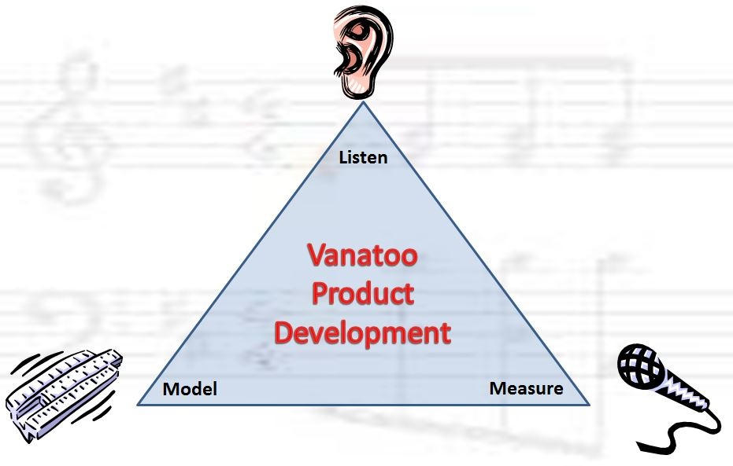
The Design Cycle (Cont’d)

Slide 13
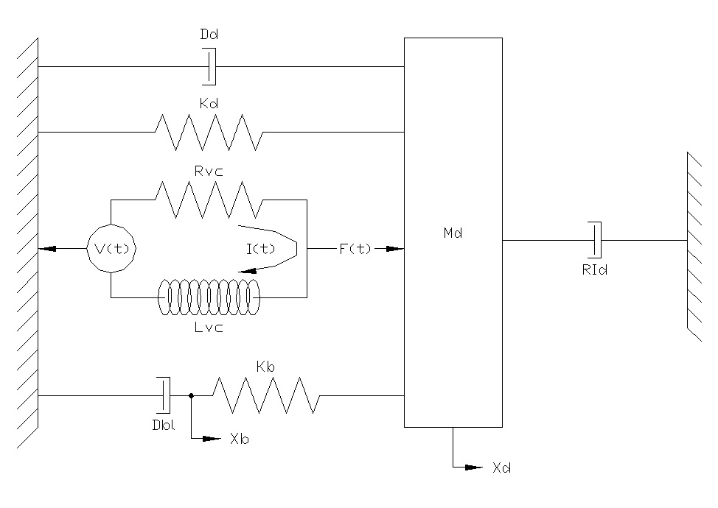
The Design Cycle (Cont’d)
Sealed System Model

Slide 14
The Design Cycle (Cont’d)
Settled on ~ “6th Order Alignment”
Flat to below 50Hz
Controls Out of Band Displacement
Settled on ~3 liter box, 5 ¼ Woofer, PR
Had it Working by “Prototype 10”
Measured Right, Not good enough sound (midrange)
Back to the Model!
Nonlinear analysis pointed to Le(x) as biggest culprit
Licensed “XBL” woofer patent
Here come 5 more prototype rounds!
Measured Right, Sounded Right!

Slide 15
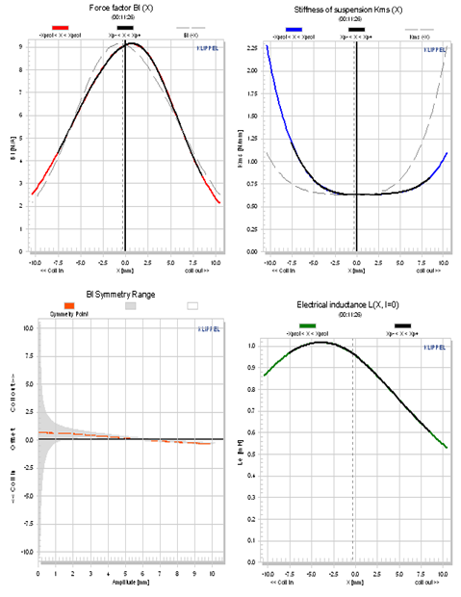
The Design Cycle (Cont’d)
Pre - XBL Woofer Klippel Measurement (not Production!)

Slide 16
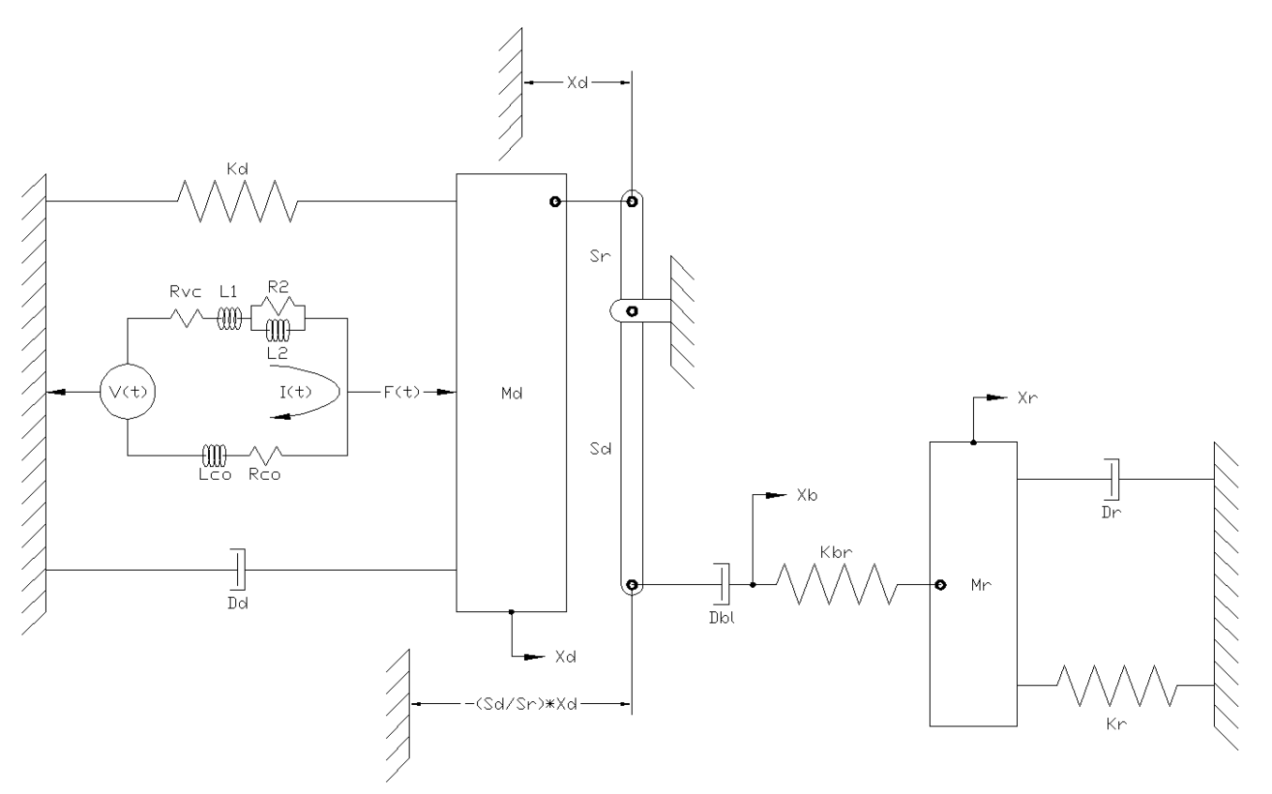
The Design Cycle (Cont’d)
Passive Radiator System Model

Slide 17
The Design Cycle (Cont’d)
Electronics Design:
Listened to different Class D Amps
Not all sounded alike
D2Audio most like reference system (NAD/Adcom)
D2Audio also has great Features, Tools
Digital domain internals at 48KHz/24Bits
Direct digital input
Integrated DSP
Canvas programming front-end
Analog Input a Given – Required an ADC!
USB Input Desired – Required USB to S/PDIF converter

Slide 18
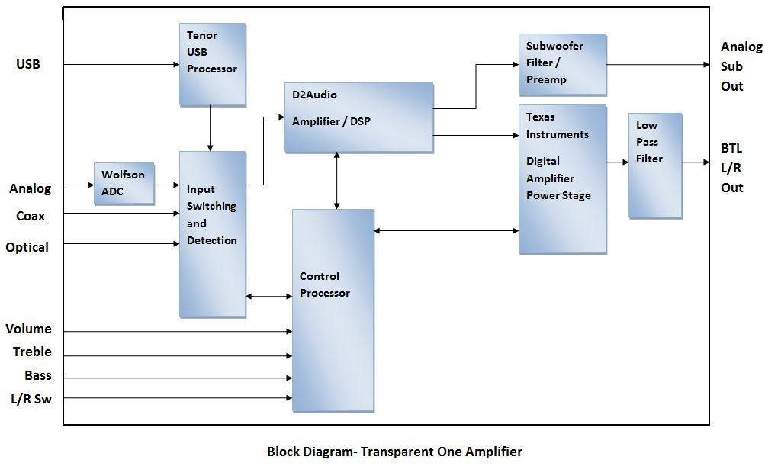
The Design Cycle (Cont’d)

Slide 19
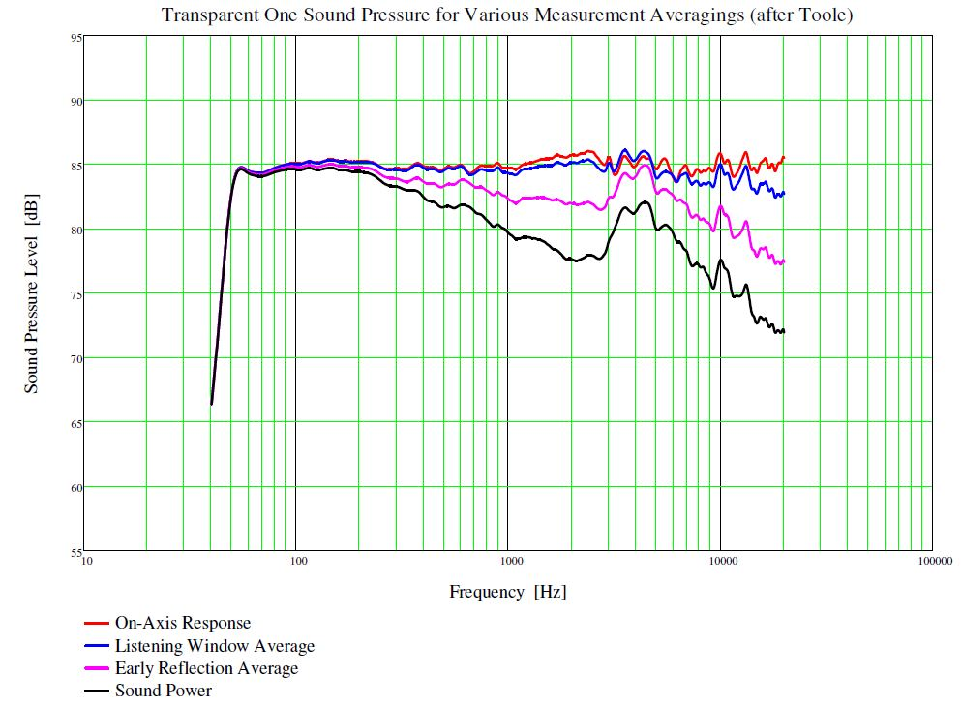
The Design Cycle (Cont’d)

Slide 20
The Manufacturing Cycle
Vendor Selection:
Started with detailed Product Specification
Asked for quote from Misco
Loudspeaker Industry Sourcebook
Driver Design and Production
Box Factory
Electronics Design and Production
US Office
Short List of 3-4 Companies
Received detailed quotes from Philippines and China
Chinese Company won our Evaluation
So, now we’re doing business in China!

Slide 21
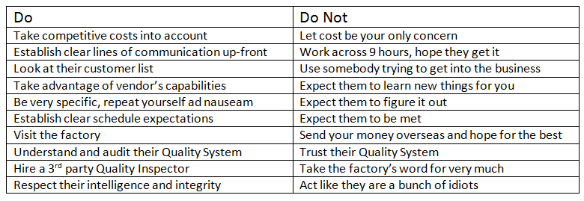
The Manufacturing Cycle (Cont’d)
Suggested China Do’s and Don’ts

Slide 22
The Manufacturing Cycle (Cont’d)
Chinese Manufacturer was integral part of Design Cycle
We owned Features, Performance, Final Decisions
Wanted them to own quality of drivers and electronics
Very much an iterative process:
They did not understand the design we wanted
They do not use speaker models
Kept trying to steer us toward “normal” designs
Build – Test – Iterate cycle continued for ~18 months
Electronics went in circles for extended periods
Ended-Up Better than original specifications
Hired 3rd Party Inspection
Coordinated International Shipping

Slide 23
Distribution and Sales Channels
Retail or Online?
Need to know at the outset
Not much retail “shelf space” for audio
Deep pockets required for mass market
Technical nature not a fit for “Big Box” stores
Audio is/has gone online – Our competition is already there
Direct Sales are a Better Value for Customer
Online Sales
Sell from Vanatoo.com and Amazon.com
Use Amazon as catalog – Coast/Coast coverage 24/7!
Use FBA as Warehouse and Fulfillment Partner

Slide 24
Distribution and Sales Channels (Cont’d)
Establish Retailer Network
Enhances online-only credibility of an unknown entity
Enhances visibility (joint promotion)
Drives Sales
Self-Distribution required
Wash/Ore reception has been good at “Stereo Stores”
California, Here We Come!

Slide 25
Marketing and Our Future
The Engineer’s View of Sales & Marketing

Slide 26
Marketing and Our Future (Cont’d)
Our Plan
Build High Quality Website (clean, professional, informative)
Establish Coast-Coast Availability (Amazon)
Influence Customers thru Professional Reviews
Get Customer Reviews (Amazon, our Website)
Participate in Social Media
Facebook/ Twitter / Forums
Buy Advertising
Print / Online / Pay-Per-Click
Attend “Audio Shows”
RMAF / THE Show

Slide 27
Marketing and Our Future (Cont’d)
Results to Date
Product Quality and Reliability have been Very Good
Website gets mostly good feedback
8 Professional Reviews – No Payola!
Editor’s Choice – Best Buy 2013 – 4.5/5.0 Mice
24 Customer Reviews on Amazon
23 five Stars, 1 Four Stars
Social Media does not come naturally to us!
Paid Advertising has been Limited/Spotty
Print / Email Opt-In / AdWords

Slide 28
Marketing and Our Future (Cont’d)
Results to Date
Sales are the Only Metric!
Low/Mid/High Projections in Business Plan
Currently running to Mid Projection after 8 Months
Cash Is KING
Cash Flow is Positive
Allowing us to ramp-up Promotion in 2013

Slide 29
Marketing and Our Future (Cont’d)
Vanatoo Future
Offer Turn-Key Wireless Bundles
Considering Value-Add Peripherals
Vanatoo Custom / 3rd Party
Ramping-Up SEO for better Search Listings
More Effort on Social Media Marketing
Additional Powered Speaker Products
Smaller / Larger / Hipper
Integrated Wireless is the Future – When Standardized
Add Marketing/Sales Partner to Vanatoo?

Slide 30
Thank You!
Rick Kernen – CEO, Vanatoo
Gary Gesellchen – CTO, Vanatoo

