Slide 1
Hearing 101
James D. Johnston
Independent Consultant

Slide 2
The Schedule:
What does your middle/inner ear do with the sound that gets to it?
What does your head do to the sound before it gets to the eardrum?
What happens when you have 2 ears instead of 1?
What does acoustics present to the two ears? And what part of that matters?

Slide 3
The Middle Ear
Think of it as having two parts
  A high pass filter, 6dB/octave, with a knee at about 700Hz.
  A transformer, to convert the impedance of air to the impedance of the inner ear.

Slide 4
The high-pass filter
It’s quite important.
A cloud, going overhead, and causing the temporary drop in air pressure from a good sized thunderstorm, creates a change in air pressure equal to some 160dB SPL or so.
Inside the eye of a hurricane, the pressure change is much larger, on the order of 10%, which is above 174dB SPL.
BUT these all occur at very, very low frequencies. The HP effect of the eardrum, coupled with the air-releasing function of the Eustachian tubes, prevents damage in such circumstances.
(we won’t discuss tornados, they present other difficulties)

Slide 5
The “transformer”
It works just like any other impedance matching transformer, of course it’s mechanical, not electronic.
There is also some protection built into the middle ear, but we won’t discuss it BECAUSE YOU SHOULD NOT BE LISTENING AT THAT KIND OF LEVEL, EVER!

Slide 6
The Inner Ear
The inner ear consists of several parts, but we will only talk about the cochlea, which is the part involved in ordinary hearing.
  Ordinary? WHAT?
    At very high levels, a number of other sensations, skin, chest, gut, and so on, are known to happen.
    These are not usually the kinds of levels and frequencies we use, unless we’re making a disaster movie about plate tectonics, or blowing up a giant blue tree.

Slide 7
So what does it do?
The cochlea has three basic functions:
  Frequency filtering
  Some kind of compression mechanism
  Detection of sound
Now, two important definitions:
  LOUDNESS -> The sensation level of a sound.
  INTENSITY -> SPL, sound energy, etc. Something you can directly measure from the waveform.

Slide 8
Loudness is not Intensity.
Intensity is not loudness.
That’s a different tutorial, but a few points to be made:
  If you increase the energy of a signal by putting in gain, the increase in loudness, in general, will grow at the 1/1.75 power of the gain (in ratio terms) or about 1/3.5 power of the energy ratio.
    This means a gain of 1.4, or 3dB, causes an increase in loudness of about 1.414^(1/1.75) or 1.21
  If you put energy into a different part of the spectrum, they do not mutually compress.
    If we have a sine wave of energy 1, and we add another sine wave of energy 1, far enough away in frequency, the loudness will approximately DOUBLE
Loudness and intensity are only loosely related.

Slide 9
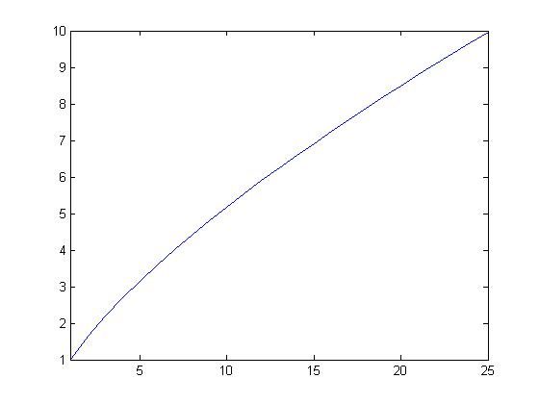
A graphical example
Relative
Loudness
Number of bands
In this slide, the vertical axis is the relative loudness, with the single-band loudness set to ‘1’ for simplicity. The curve shows the relative loudness when the same amount of ENERGY is split over ‘n’ bands, from 1 to 25. The numbers for over 15 bands are probably an overestimate, but that is signal dependent.

Slide 10
But why is that?
The ear is a biomechanical frequency analyzer.
  It consists of many, many highly overlapping filters.
  At low frequencies, these filters are 60Hz or so wide.
  At high frequencies, these filters are a bit less than ¼ octave wide, give or take.
  The crossover point is around 600Hz to 1 kHz.

Slide 11
How does that work?
Inside the cochlea, there are several membranes. Two of them are called the basilar and tectorial membranes.
There are two kinds of modified hair cells that go between them
  One kind are motion detectors (inner hair cell)
  The other kind change their properties when they are discharged (outer hair cell)

Slide 12
The basilar membrane stretches from entrance of the cochlea to the apex.
  At the entrance end, it is very tight
  At the apex, it is under much less tension
  At the entrance, there is little fluid (which is heavy) between the entrance and the basilar membrane – So high frequencies pass through.
  At the apex, there is a lot of fluid, the membrane is loose, so low frequencies pass through.
It’s a travelling wave filter, made out of biological tissues.

Slide 13
What happens?
High frequencies are detected near the entrance.
Low frequencies at the apex
Mid frequencies, obviously, part way down the membrane.
The next slide shows approximations for some of these filters. Note the horizontal scale is the “Bark” scale, which was the original attempt to describe the filter bandwidths. It’s not quite right, and now we use something called “ERB’s”.

Slide 14
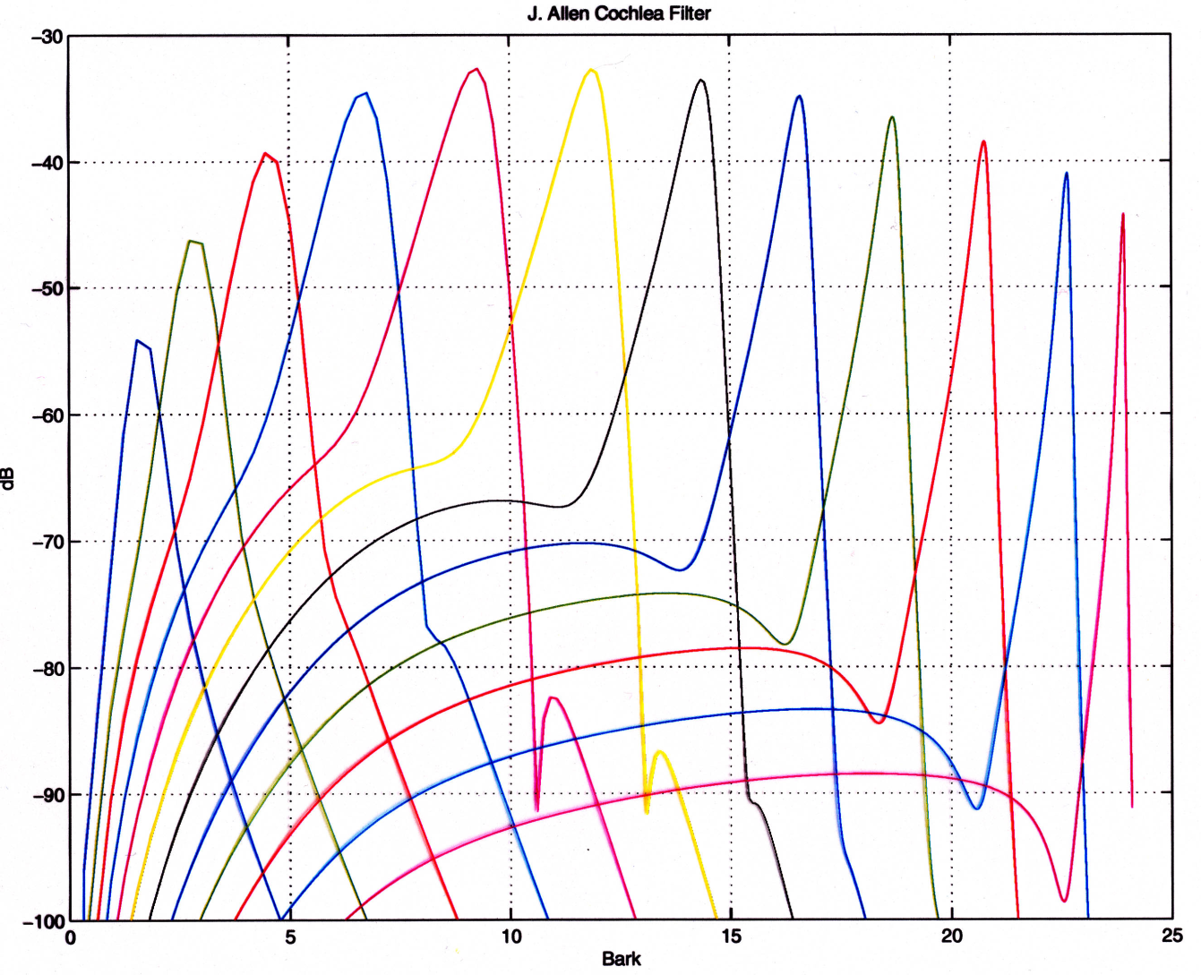
J. Allen Cochlea Filters

Slide 15
One point along the Membranes:
Tectoral
Membrane
Outer
Hair
Cells
Inner
Hair
Cell
Basilar Membrane

Slide 16
What does that mean?
The inner hair cells fire when they are bent. This is what causes us to hear.
The outer hair cells
  one faction of psychophysicists argues that they tune the relationship between the two membranes.
  another faction argues that they act as amplifiers.
I am not going to take a position on all that, I am going to describe a way to model the results that seems to well describe the measured phenomenon.

Slide 17
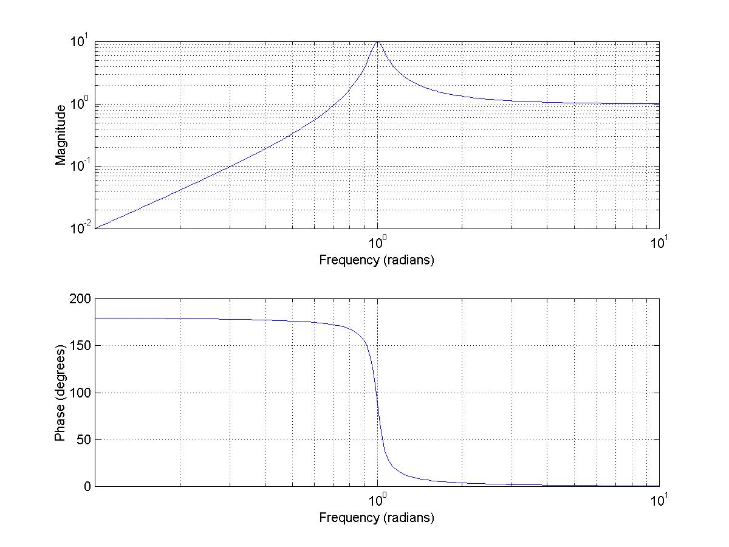
Example HP filter
(This filter is synthetic, NOT real)

Slide 18
Features of a HP filter
At the frequency where the amplitude is greatest, the phase is changing rapidly.
  This means that two filters, slightly offset in frequency, will show a large difference between the two center frequencies, providing a very big difference in that region.
When two nearly-identical filters are coupled, their resonances “split” into two peaks, slightly offset in frequency.
As the coupling decreases, the two resonances move back toward the same point.

Slide 19
What do the inner hair cells see?
They see the DIFFERENCE between the two high pass filters, if the first idea on the previous page is right.
We’ll run with that, because the model works.
This does not mean that the model represents the actual physics. That’s not settled yet.
So, what happens when you split the resonance due to coupling between the two membranes?

Slide 20
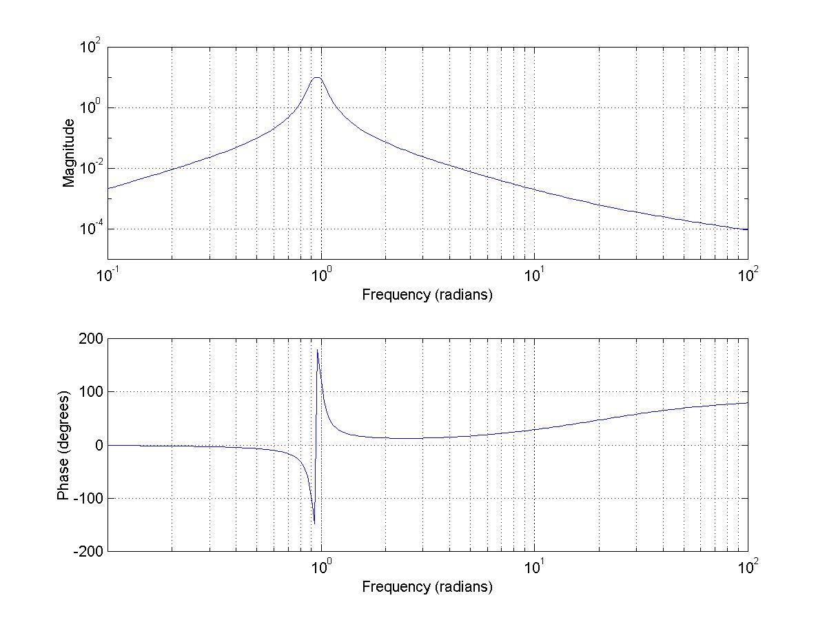
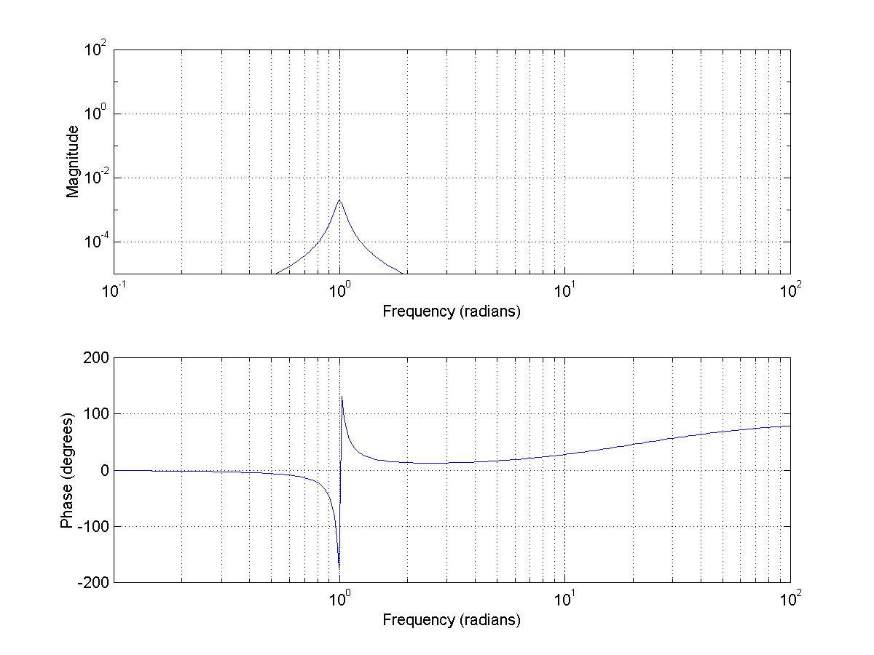
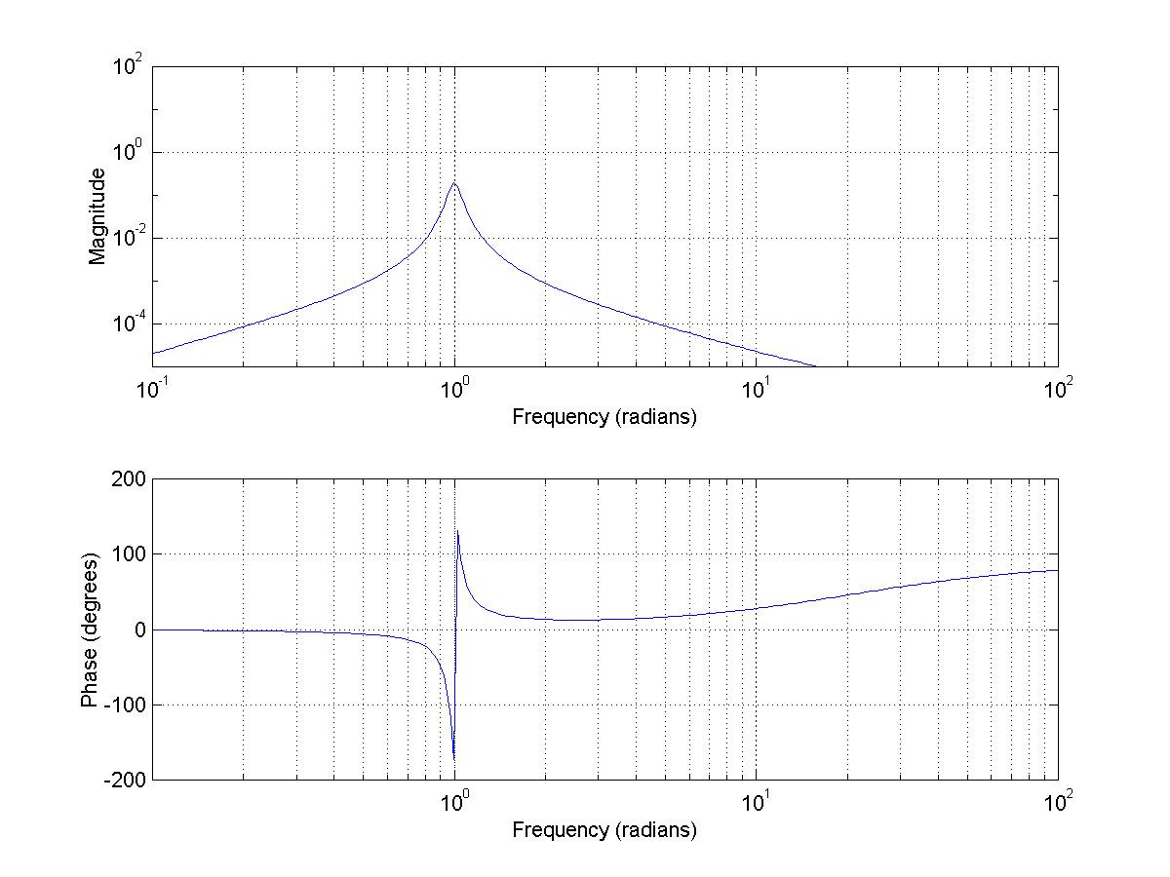
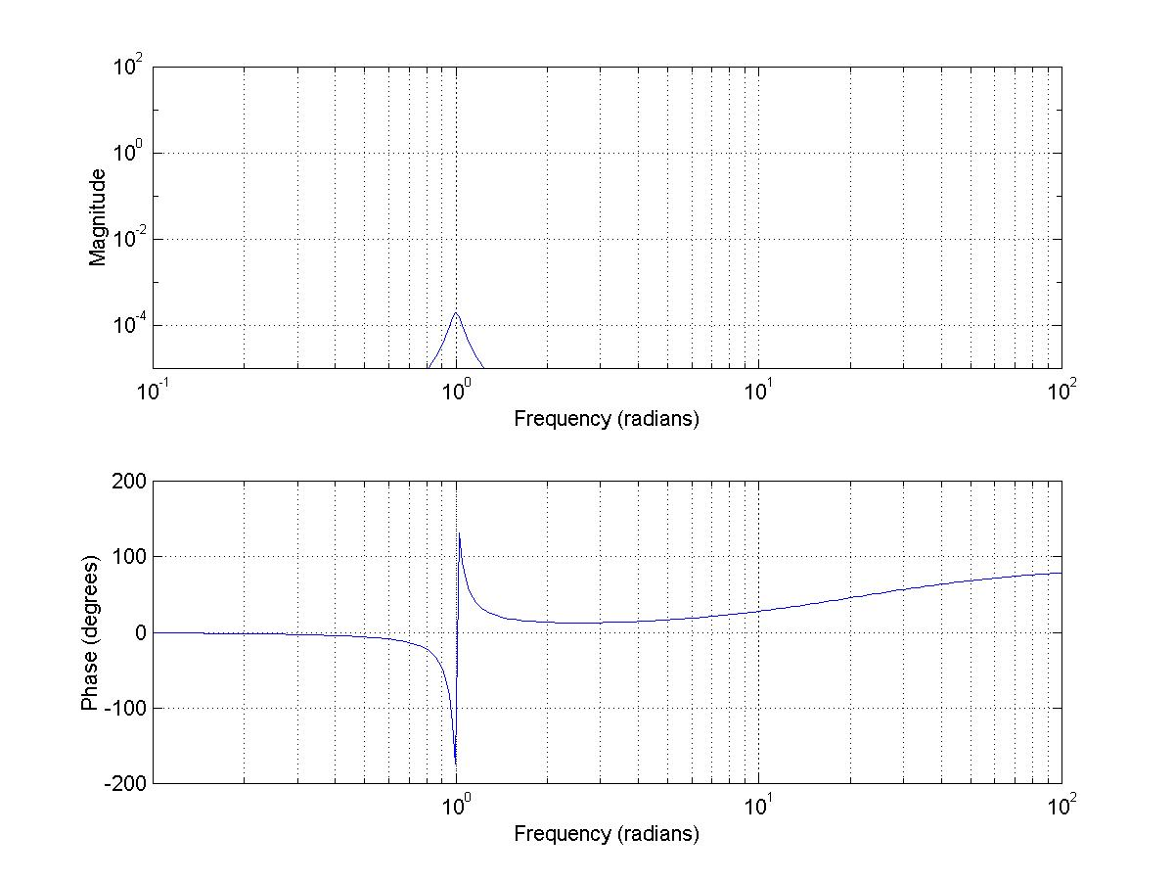
Filter split vs. Frequency Response
Offset 1.1
Offset 1.00001
Offset 1.001
Offset 1.000001

Slide 21
The exact magnitude and shape of those
curves are under a great deal of discussion and
examination, but it seems clear that, in fact, the
depolarization of the outer hair cells creates the
compression exhibited in the difference between
applied intensity (the external power) and the
internal loudness (the actual sensation level
experienced by the listener).
There is at least 60dB (more likely 90) of compression available. Fortunately, the shape of the resulting curve does not change very much, except at the tails, between the compressed and uncompressed state, leading to a set of filter functions known as the cochlear filters.

Slide 22
The detectors:
  Interestingly the detectors themselves have about a 30dB dynamic range, not a 90dB or 120dB range.
  The loudness compression maps this 30 dB to the full range of reasonably functional human hearing.
  This mapping results in some interesting things, for instance, masking.
    If a second signal is present in an ERB, and is more than 30dB down, it is below the detection threshold.
    If the signal in an ERB has a rough envelope, the interactions result in masking threshold as little as 5dB below the energy in that ERB.
  Masking is, in fact, what all perceptual coders utilize.
    That means MP3, AAC, AC3, etc.

Slide 23
A quick masking demo
I will play 3 signals, an original and then two signals with 13.6dB SNR. I am not telling you the order. You must figure out which is which.

Slide 24
A word about those filters:
When you have high frequency resolution (i.e. at low frequencies in this case) you have bad time resolution (speaking relatively)
When you have bad frequency resolution (i.e. at high frequencies) you have better time resolution.
The point? The time resolution of the ear varies quite a bit with frequency, over something like a 30:1 or 40:1 range, due to the cochlear filters and the loudness integration system.
This is a headache for lossy compression algorithms, but that’s a different talk.
This also means that you have to be aware of these varying time scales.

Slide 25
And about what gets detected…
At low frequencies, the leading edge of the filtered signal itself (membranes approaching each other) is detected. (under 500Hz)
At high frequencies, the leading edge of the ENVELOPE is detected. (over 2kHz or so)
At mid frequencies, the two mechanisms conflict.
Remember this when we get to binaural hearing.

Slide 26
We’re almost done with part 1.
Now we’ll explain why knowing this might be useful.

Slide 27
So, what does all that mean to you guys?
The first thing it means is that everything, yes everything, has to be considered from the point of view of the somewhat odd time/frequency analysis that the cochlea provides.
Effects do not strongly couple between parts of the membranes that do not respond to the same frequencies.
So, many things work differently for signals close in frequency vs. signals removed from each other in frequency.

Slide 28
Monaural Phase Detection
Many papers have cited the original work on the 60Hz vs. 7000Hz phase experiment.
  Obviously, these two frequencies are far, far apart on the cochlea. They just don’t interact. Not even slightly.
  Since they don’t interact, it’s not too surprising that phase doesn’t matter.
If, however, the two signals strongly interact at some point on the basilar membrane, yes, phase can matter.
  It takes quite a bit of phase shift in terms of degrees/octave, but digital is good at that.
  Physical acoustics is pretty good at that, too.
The point? Phase shift that varies gradually with frequency is not much of an issue. Rapid changes in phase, on the other hand, very much do matter with the right input signal.

Slide 29
Well, the compression doesn’t happen instantly.
  This means that the leading edge of a waveform will be louder than that which follows, in terms of instantaneous loudness. So we get a leading edge detector. This has been called the “precedence effect” among other things. It’s very important later when we talk about binaural hearing.
But, remember, loudness, as opposed to instantaneous loudness, is something that is summed for up to 200 milliseconds, give or take, by the central nervous system.

Slide 30
And the loudness thing.
If you make a signal more broadband, it will be louder for the same amount of energy
In many cases, even clipping, which can ONLY reduce the total energy if you don’t change the gain, will still greatly increase loudness.
This goes into a different panel discussion, early this morning, related to Radio Processing.

Slide 31
A Term to Remember:
Partial Loudness
  Partial loudnesses are a vector, representing the contribution to total loudness from each inner hair cell.
  In a very real way, partial loudnesses are what goes from the inner ear to the brain.
  What you hear is the result of the partial loudnesses.
    Not the waveform
    Not the FFT
    Not partial intensities (i.e. the filtered ERB-wide signals)
    Cochlear compression is key to many hearing effects.

Slide 32
One more thing
Remember that bit about the filter time resolution and coding?
  Pre-echo is really bad. Before an attack, you can hear injected noise nearly down to the noise floor of the listening setup.
  Codec filterbanks, in order to be constant-delay (i.e. linear-phase) must have pre-echo.
  Pre-echo can start the compression on the basilar membrane before the signal arrives. This reduces the loudness of the transient. Not good.
Not only that, pre-echo has some nasty consequences in imaging. More on that later.

Slide 33
What does your head do?
There is an enormous amount of detail one could go into here, but let us simplify.
The “HRTF” or “HRIR” (Head Related Transfer Function and Head Related Impulse Response), both of which include precisely the same information, can be measured, for a given head, from any given angle or distance.

Slide 34
This isn’t a tutorial on HRTF’s, so…
These result in two things that can be measured:
  Interaural time differences, which may vary across frequency (ITD’s)
  Interaural level differences, which will vary substantially across frequency (ILD’s)

Slide 35
But
Once size does not fit all.
  Especially on midline (i.e. center)
  Differences in fit can be interpreted in several ways, depending on the individual.

Slide 36
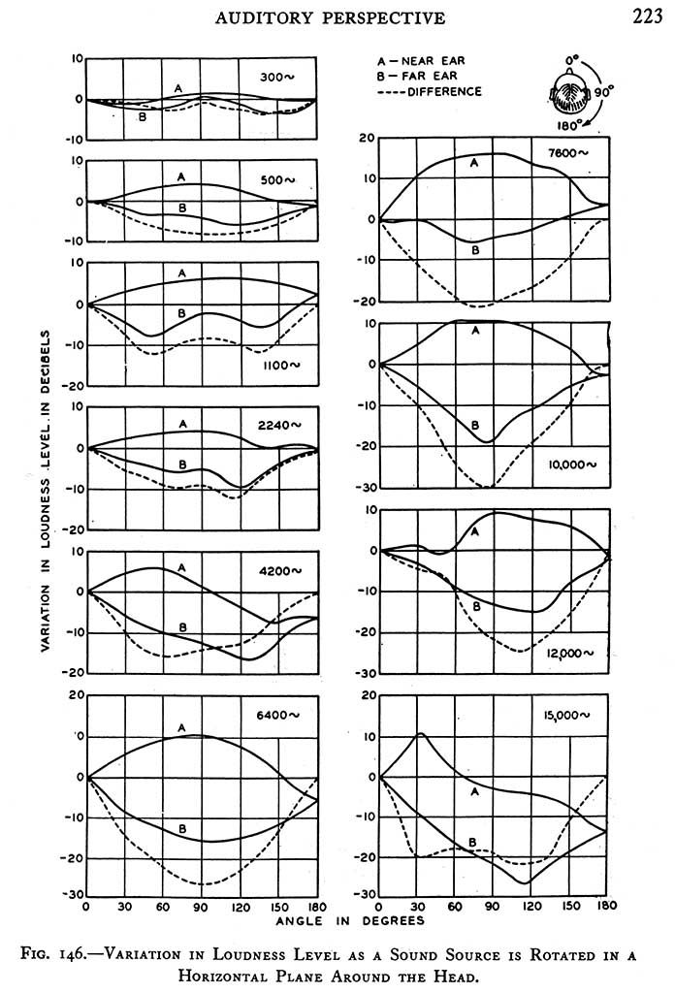
Some very, very old data on ILD:

Slide 37
There is much more data on this subject
Much of the data is contradictory, or strongly individualized, or generalized to the point where it works “ok” for “most people”.
  Unfortunately, that’s the nature of the problem.
Much data is proprietary, etc., as well.
Just remember, ILD, ITD vary with frequency. That is the point.

Slide 38
Externalization (i.e. inside the head vs. outside the head)
For signals off midline, it’s not so hard, because the spectra at the two ears doesn’t match that well.
For spectra ON midline, externalization depends on hearing YOUR OWN differences between your own left and right ear HRTF’s.
  That’s why center-channel virtualization is so prone to failure.

Slide 39
HRTF’s vs. Stereo
A stereo signal, sent to two speakers at symmetric angles (let’s use the standard setup), sends two signals to each ear.
If the signals are duplicated in the two channels, i.e. center signal, the two HRTF’s interfere
  This means you have a dip in the actual frequency response in the midrange for center images.
  Remember that midrange boost you use for vocalists?
  This dip also obscures some of the distance cues for central images.

Slide 40
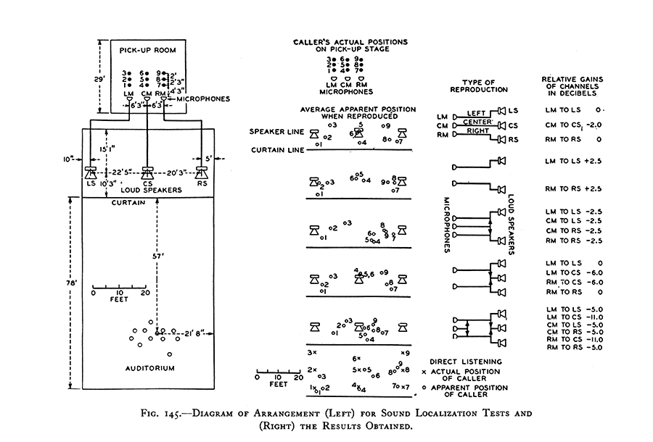
Some very old, very well tested results:

Slide 41
In other words:
The center speaker is essential for getting depth cues right.
  Exactly how you handle the center channel isn’t clear, but there is no doubt that you need it.
  Fortunately, this also increases the sweet spot for the stereo soundstage.
The center microphone is absolutely necessary, too.
What this does not mean is “dialog center” – That is a different solution to a different problem in cinema. It is the WRONG solution for the home.

Slide 42
Limits to Hearing
Due to the fact that the eardrum is a HP filter, we don’t hear much below 40Hz, and nothing to speak of (due to auditory as opposed to body sensation) below 20Hz.
Above 15kHz, the eardrum/middle ear system is also creating a low pass filter. While some energy does get through:
  All of the signal above 15kHz or so is detected at the very entrance to the cochlea
  This is why there is little pitch perception there
  This gets damaged very quickly in the modern world ☹
  20kHz is in fact a good estimate for the average human in their teens or above
  25kHz can be detected by some children, but that goes away with growing up (and getting bigger).

Slide 43
Level sensitivity:
The minimum level detectable by the completely unimpaired human is on the order of 10^-10 atmospheres. (Just below 0dB SPL)
TOO *&(*& LOUD is on the order of 10^-5 atmospheres. (just below 100dB SPL)
The noise level at your eardrum, due to the fact that air is made of molecules, is circa 6dB SPL to 8dB SPL. The reason you don’t hear it is because the filters in your ear make the levels too low. At the ear canal resonance, a dB or two too low. Yes, you can almost hear the noise of the atoms in the air. The right microphone easily can.

Slide 44
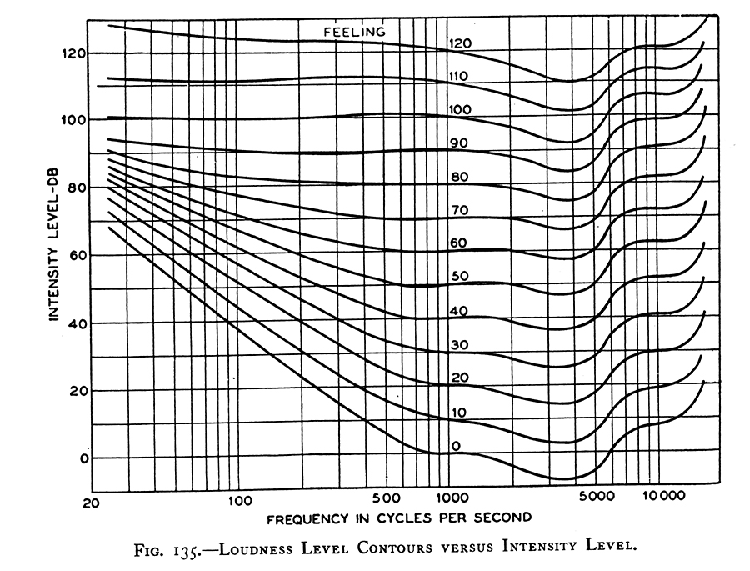
More old results, well taken:

Slide 45
BIOBREAK
Please Return in 5 minutes.
I will leave time at the end for Q/A and we can do more in the hallway afterwards.

Slide 46
Yo, JJ, we have 2 ears!
Yes, yes, and that’s very important. You didn’t have to shout! ☺
There are several things to consider:
  Interaural Time Difference (itd)
  Interaural Level Difference (ild)
Both of these can vary with frequency. Remember that. It is very important.

Slide 47
A point about ITD’s
Remember the “leading edge” comments? That’s very important here.
  This is how we can localize a speaker or sound source in a live environment.
  Leading edges from the SOURCE always get there first, if there’s nothing in the road (which is the usual case).
  And we can detect the leading edges of ITD’s very, very well, thank you.

Slide 48
How well?
Remember that bit about how the detectors fire, and how they sometimes have two conflicting firing effects?
  That means that below 500Hz, a 1 ERB wide Gaussian pulse will have a delay sensitivity (binaurally) around 2 samples at 44K sampling rate, of course that increases rapidly below 100Hz or so.
  At 1000 Hz, the result is more like 5 samples.
  At 2000 Hz, it’s back down to 2 samples, or better.
  A broadband pulse can get down, listener depending, to between 5 and 10 microseconds, using pulses generated digitally for rendering in a 44/16 system.

Slide 49
How well in reverberation?
The early reverberation comes later, and as a result is greatly reduced in loudness compared to the direct sound.
That means that we localize leading edges and transients very, very well.
Above 2 kHz, there is little, if any, localization information in a sine wave. Try it some time, it just isn’t easy to do. Reverberation only makes it worse.
  BUT add some modulation, and now the localization is easy.

Slide 50
So, what can we make out with two ears.
Well, first, everyone knows that ITD can create a very strong directional sensation, in the “cone of confusion”, i.e. at a more or less fixed angle to centerline (centerline meaning the angle to the plane of the perpendicular bisector to the line between your ears)
This is called the ‘cone of confusion’ because anywhere on that ‘almost’ cone can be the source of a given average ITD.

Slide 51
But I can tell front from back!
Well, yes, you can, most of the time!
  Difference in ILD between the ears (for any signal) and in spectrum (for a known signal) can help to sort out the “cone of confusion”, and off-center, they do so very, very well.
    But there are also small differences in ITD with frequency, it would appear we might use those, too. Research is indicated here.
  Differences in ILD don’t work nearly as well on the centerline.
    Well, that’s because there isn’t much ‘D’ in the ILD. You have approximately (but not quite, that’s important too) the same spectrum at the two ears. So the basic information for ILD is mostly missing.
    In such cases, we usually assume front or back.
      Knowing the spectrum to expect helps a lot here.
      That’s why a person with a bad head cold can cause front/back reversal. The high frequencies are missing.
      Front/back reversal is worst on centerline, and near it. There are a couple of other places that can create a problem as well.

Slide 52
What else can we do with two ears?
We can use HRTF’s to sense direction, even when ITD’s are messed up, say by a diffuse radiator.
We can use ILD’s to sense direction, with things like panpots.
  But not always, and sometimes images will be quite unstable.
  “Stereo” panpots can create both ILD and some ITD, the interaction is “interesting”.

Slide 53
Why I hate Panpots
Panpots add an ILD via two speakers. This does, to some extent, create some ITD due to HRTF’s, BUT
  The ITD and ILD do not necessarily agree.
    So you get image shift, tearing, etc., unless you’re at L, R, or Center
  You need to be splat-on in the middle of the listening position, or the precedence effect will ruin things.

Slide 54
But, some tests used delay panning, and that didn’t work.
You need both delay and gain panning
  The gain needs to be consonant with the delay used
  The delay needs to be in the right range, i.e. ITD range. Using a delay of over a millisecond or so will just confuse the auditory system, which does not usually get those kinds of delays.
It will work, and you will get at least somewhat better sweet spot in 2-channel
YOU DO MUCH BETTER IN 3 FRONT CHANNELS WHEN YOU USE ITD/ILD PANNING, and you get a much wider listening area.

Slide 55
All of this ITD discussion is, however, assuming something important:
In all of this, considering first arrival, we are assuming that the ITD’s are consistent across at least a half-dozen, give or take, ERB’s in each ear, and the SAME ERB’s in the two ears.
What happens when there is no consistency?
  Well, that’s the next topic, but first some words on acoustics

Slide 56
Pre-echo vs. ITD
Due to the way that filterbanks work, the noise in a signal is reflected about the leading half (and the trailing half, but that’s not pre-echo) of the analysis window.
  This means that the channel that comes LATER in the original signal has the EARLIER pre-echo.
  This can rather confuse ITD’s if pre-echoes are too big.

Slide 57
What does acoustics (meaning real hall acoustics) put into this system?
It puts in a variety of leading edges from the direct signal.
It puts in a bunch of early reflections that cause frequency shaping, loudness changes, and that can cause articulation or localization problems if they are too strong.
There is a long, diffuse tail, in a good hall.
  Note, I’m not talking about a bad hall hall hall hall hall here.

Slide 58
An important Term
Critical distance:
  The critical distance in a hall is the position where the direct energy is equal to all of the reflected (i.e. delayed) energy.
  In most any hall, you’re WAY beyond a critical distance.
  Leading edges still allow you to localize things via ITD and ILD, to surprisingly low rations of direct to diffuse signal.
  A demo of that won’t work in this room ☹

Slide 59
Diffuse? What’s that?
A diffuse signal is a signal that has been reflected enough times to have extremely complicated phase shifts, frequency response details, and envelope variations.
  This is what a good concert hall is very, very much supposed to do.
  This leads to what creates a diffuse sensation very directly.

Slide 60
When a signal does not have leading edges that are coincident across a band of frequencies in one ear, and there is no coincidence with a similar band of frequencies in the other ear, we get a diffuse, i.e. “surround” sensation.
This is, among other things, why you all have reverbs that have the same T60 profile, but different details, for your stereo production. This creates a diffuse sensation, due to the difference in the two reverb details.
You can’t hear the details for the most part, but you can hear if a coincidence happens.

Slide 61
So, to summarize this whole talk:
The ear is a frequency analyzer with a highly variable time/frequency resolution as you move from low to high frequencies.
The ear emphasizes the leading edges of signals.
The ear only has at most a 30dB SNR at any given frequency, but:
  This can be autoranged over 90dB.
  The ear, outside of an ERB, can be very frequency selective, so signals at far removed frequencies do not interact.

Slide 62
Two ears:
Use ITD and ILD, along with HRTF’s, to disambiguation direction.
When HRTF’s don’t help, the ear can compare the timbre of direct to diffuse to analyze front/back. Sometimes this works. Sometimes you get tricked.
Provide diffuse sensation as well as direct.

Slide 63
And:
Everything goes through the frequency analysis system unless you’re talking about high-level skin sensation or gut/chest sensation.
When you think about what you’re doing, remember the idea of ERB’s, or even Critical Bands. Either will help you out.

Slide 64
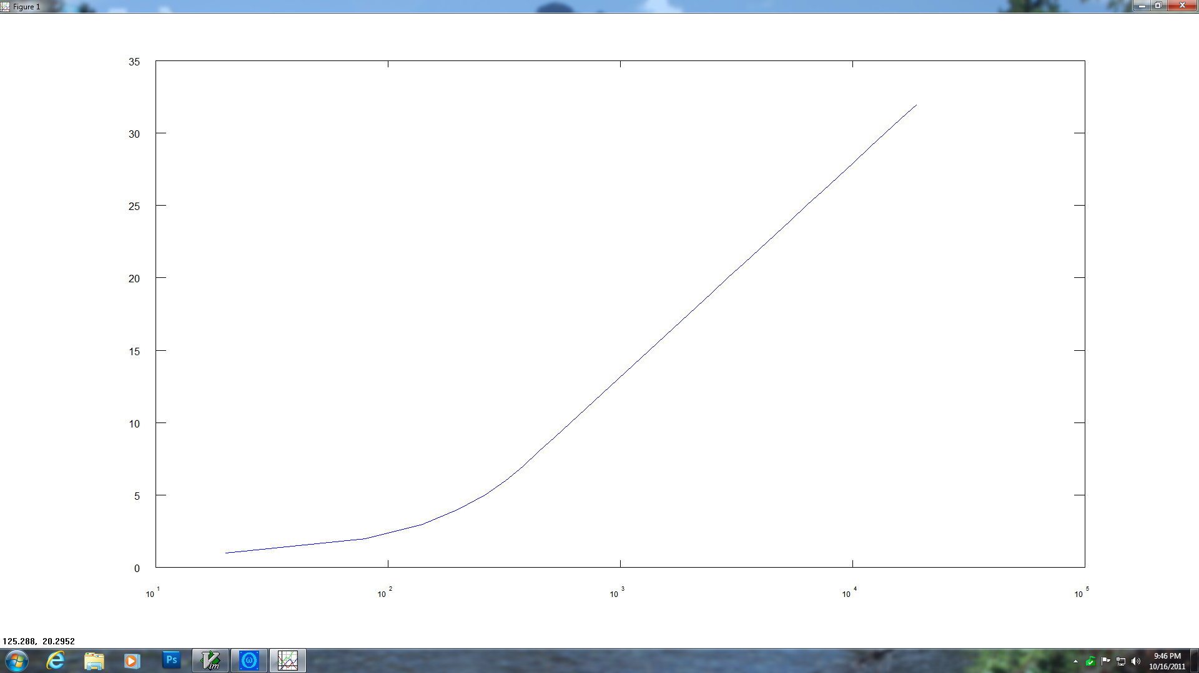
ERB (vertical scale)
Vs
Frequency (horizontal scale

Slide 65
If you don’t have a better table, this isn’t bad. It’s not great, either.
ERB 1.000000 = 20.000000 Hz
ERB 2.000000 = 80.000000 Hz
ERB 3.000000 = 140.000000 Hz
ERB 4.000000 = 200.000000 Hz
ERB 5.000000 = 260.000000 Hz
ERB 6.000000 = 320.000000 Hz
ERB 7.000000 = 380.000000 Hz
ERB 8.000000 = 445.000000 Hz
ERB 9.000000 = 521.000000 Hz
ERB 10.000000 = 609.000000 Hz
ERB 11.000000 = 712.000000 Hz
ERB 12.000000 = 833.000000 Hz
ERB 13.000000 = 974.000000 Hz
ERB 14.000000 = 1139.000000 Hz
ERB 15.000000 = 1332.000000 Hz
ERB 16.000000 = 1557.000000 Hz
ERB 17.000000 = 1820.000000 Hz
ERB 18.000000 = 2128.000000 Hz
ERB 19.000000 = 2488.000000 Hz
ERB 20.000000 = 2908.000000 Hz
ERB 21.000000 = 3399.000000 Hz
ERB 22.000000 = 3973.000000 Hz
ERB 23.000000 = 4644.000000 Hz
ERB 24.000000 = 5428.000000 Hz
ERB 25.000000 = 6345.000000 Hz
ERB 26.000000 = 7416.000000 Hz
ERB 27.000000 = 8668.000000 Hz
ERB 28.000000 = 10131.000000 Hz
ERB 29.000000 = 11841.000000 Hz
ERB 30.000000 = 13840.000000 Hz
ERB 31.000000 = 16176.000000 Hz
ERB 32.000000 = 18907.000000 Hz

Slide 66
Questions?
(until you get bored or we get thrown out of the room)

