Slide 1
“Make it loud” and Other Disasters
J.D. Johnston
Chief Scientist, Immersion

Slide 2
First, a reminder of some technical issues:
Digital clipping aliases all out of band harmonics down into the passband.
This means that NONE of them “go away” like happens in an analog system
This is an extremely inharmonic process. You can create new frequencies far, far from the originals.
DAC’s do not always respond to “full scale” signals like one would hope they do. Intersample overs create “interesting” sounds.
Any full-scale signal put through a codec is going to create MORE clipping.

Slide 3
A few more issues
Quantizer issues
Missing codes
Dithering omitted
Overcompression*
No loudness range
Near Flat spectrum
*In this talk “compression” means level compression. “Coding” is bit rate reduction.

Slide 4
What’s this about clipping and aliasing?
We take a 6.7kHz sine wave
We clip it at ¼ the maximum peak.
Look what happens!
Original
Original
Spectrum
Clipped
Original
Clipped
Spectrum

Slide 5
So, what does this sound like.
I’ll play original
I’ll play clipped
Tell me what you think.
N.B. Turn level down, please!
Note, also, that even though the second clip has much less power, it sounds as loud, and a touch unpleasant.

Slide 6
Moral of the story:
If you are going to distort your signal, you must oversample enough that the aliases do not land back in the passband.
Then do your distortion.
Then downsample (properly)
For a highest distortion order of ‘n’, you must oversample by ceiling( (n+1)/2)
Or else.

Slide 7
Intersample overs
If you have two successive clipped values (both negative or positive) the waveform encoded is larger than the +-1 many people expect.
Many (not all) DAC’s fail miserably at this test, and do “stuff”.
Bob Smith will show you real measurements of real DAC’s that are best described as “what the actual *(&(*(*&( ?” So don’t do that, ok?

Slide 8
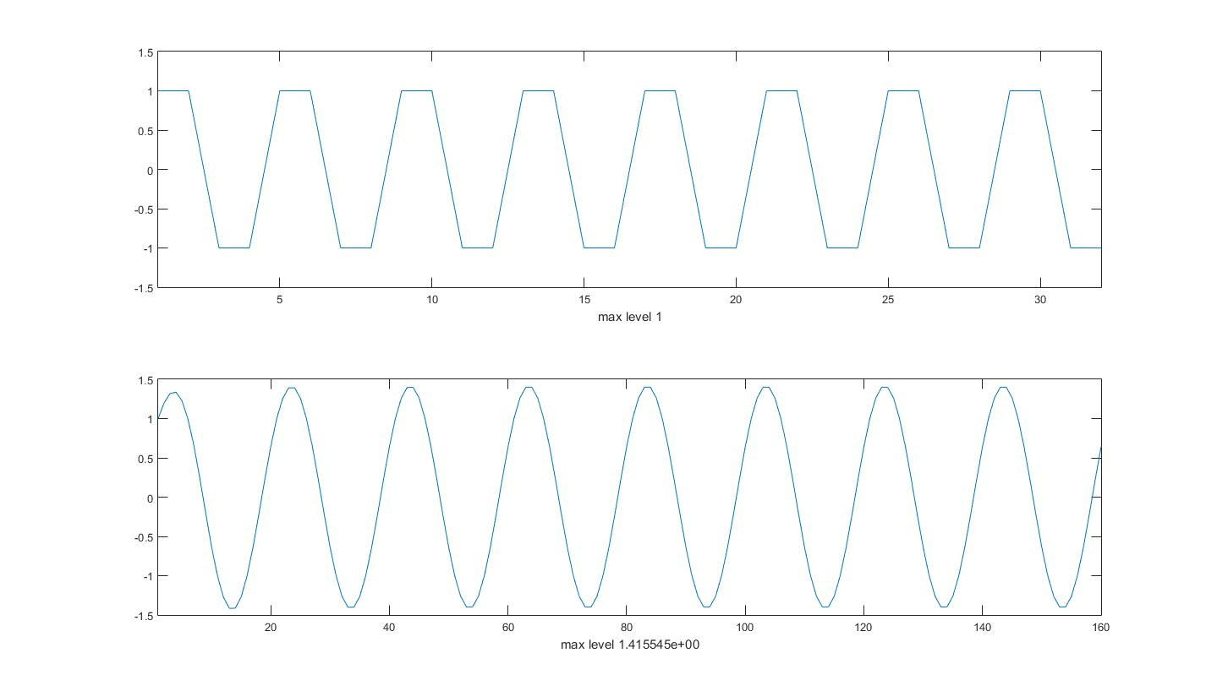
The classic, trivial example (but hardly the only one)
DAC
Input
Data
Output Waveform

Slide 9
Yeah, so what?
In some DAC’s the oversampling arithmetic fails, and “stuff” comes out. It’s hard to characterize this, but if you hear a “crunch” on intersample overs, that might be your problem.
In some DAC’s the output amplifier will clip. If you hear an obvious clip, that’s probably what went wrong.
In some DAC’s, the output amplifier will go temporarily unstable. This again is more of an unpleasant “crunch”.
Some do it right. You CAN NOT count on that in the real world.
The “so what” is “you didn’t want your track to sound like that, right?”

Slide 10
Ok, now let’s add in processing.
EQ, compensation, etc, can easily create both clipping and intersample overs. For instance, a highpass filter at 10Hz can create intersample overs on powerful bass signals by changing the relationship of the harmonics. Yeah, I have had that happen, in frightening proportions.
Perceptual coding OF ANY KIND will spread the amplitude of all samples, resulting in clipping, intersample overs, and the like. This is an unavoidable consequence of a codec.
Yes, of course, codec makers add protection for this. That does, of course, change the overall system gain. It is, however, the right answer.
Soft clipping can nerf most of this, but let’s not do that if we don’t have to do that.
Less sophisticated coding can do even worse things.
Note: Lossless coding does not have this problem, but:
You may find your bit rate higher than you wanted
Internal signals in the lossy codec will be larger than expected.
The guts of the lossless codec must account for this. I assume they do, I haven’t seen one fail. Yet.

Slide 11
What else might this do?
In addition to breaking DAC’s that are insufficiently protected (which seems to be quite a few of them):
It raises the bit rate for a codec, lossless, lossy, or otherwise.
Clipping the input makes for more harmonics, and more bits.
It makes it LOUD!
That doesn’t necessarily mean “good”.

Slide 12
Another real life example.
I will now play two clips.
One is clipped.
One is not.
Do you really want to make your music sound like that? Seriously!

Slide 13
Now, on to some measurements. I’m going to put up a bunch of graphs. Each one has 3 plots.
The first plot shows two things:
In red, the histogram of the actual levels on the track
In blue, the histogram of the 5x oversampled track.
The second plot is a histogram of the results of a reasonably good loudness (not intensity) model.
The third plot is a histogram of the Spectral Flatness Measure. The more negative this number, the lower the encoding bit rate, in general. Zero means white noise. A sine wave would be extremely negative.

Slide 14
Histogram?
Each histogram shows the probability of a given datum falling into a particular histogram bin. The histogram is calculated over an entire track, and then each individual datum is counted, after being separated into bins.
For the first plot, each bin is one discrete 16 bit level.
For the second and third, the bins are one ‘unit’ apart, either in loudness or dB.
Because there are not 65536 pixels width, in the first plot, both the highest and lowest in a given bin are plotted, which accounts for the line thickness.
This can be revealing, for instance, when some bins do not occur.
This can also reveal processing issues.
Peaks at the ends near +-1 are clipping. You’ll see. Just you wait!

Slide 15
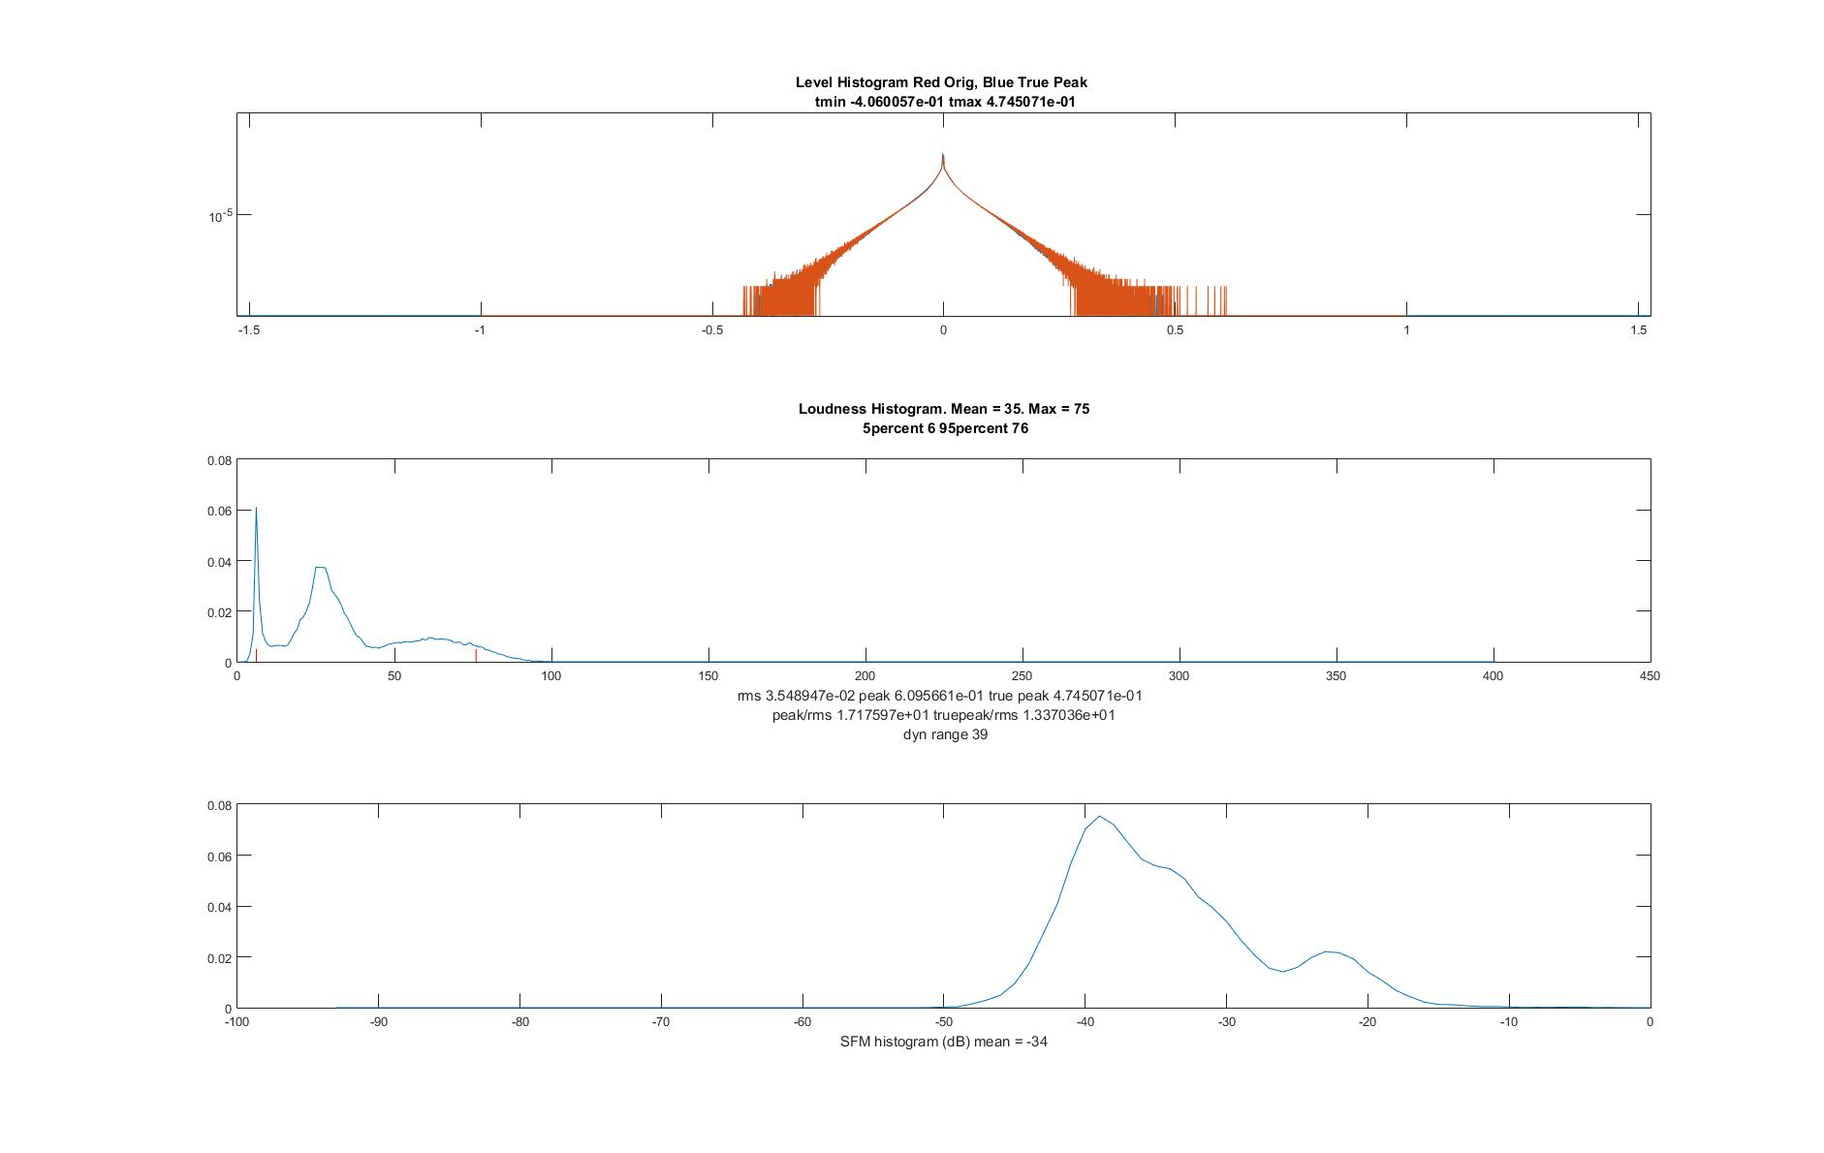
A low-level, well made recording, first:

Slide 16
Some things to notice:
Absolutely no overload. This looks to be recorded too low, but is part of a suite, where this is the quiet part. No clipping. No intersample issues.
The ADC and conversion show a few missing codes, as one would expect from probability, near max and min, but nothing exceptional.
Despite low loudness, ratio of 5% to 95% loudness is pretty large, leading to quite some dynamic range.
The signal is fairly predictable (from SFM)

Slide 17
A low level recording NOT so well done:

Slide 18
Things to notice:
Nope, no clipping.
Peak level unnecessarily low
Missing codes in ADC/processing chain, alternatively, no dithering after large gain increase (low recording level).
It turns out every odd level is missing in this recording.
Maybe there was no alternative here, but it’s not good practice.

Slide 19
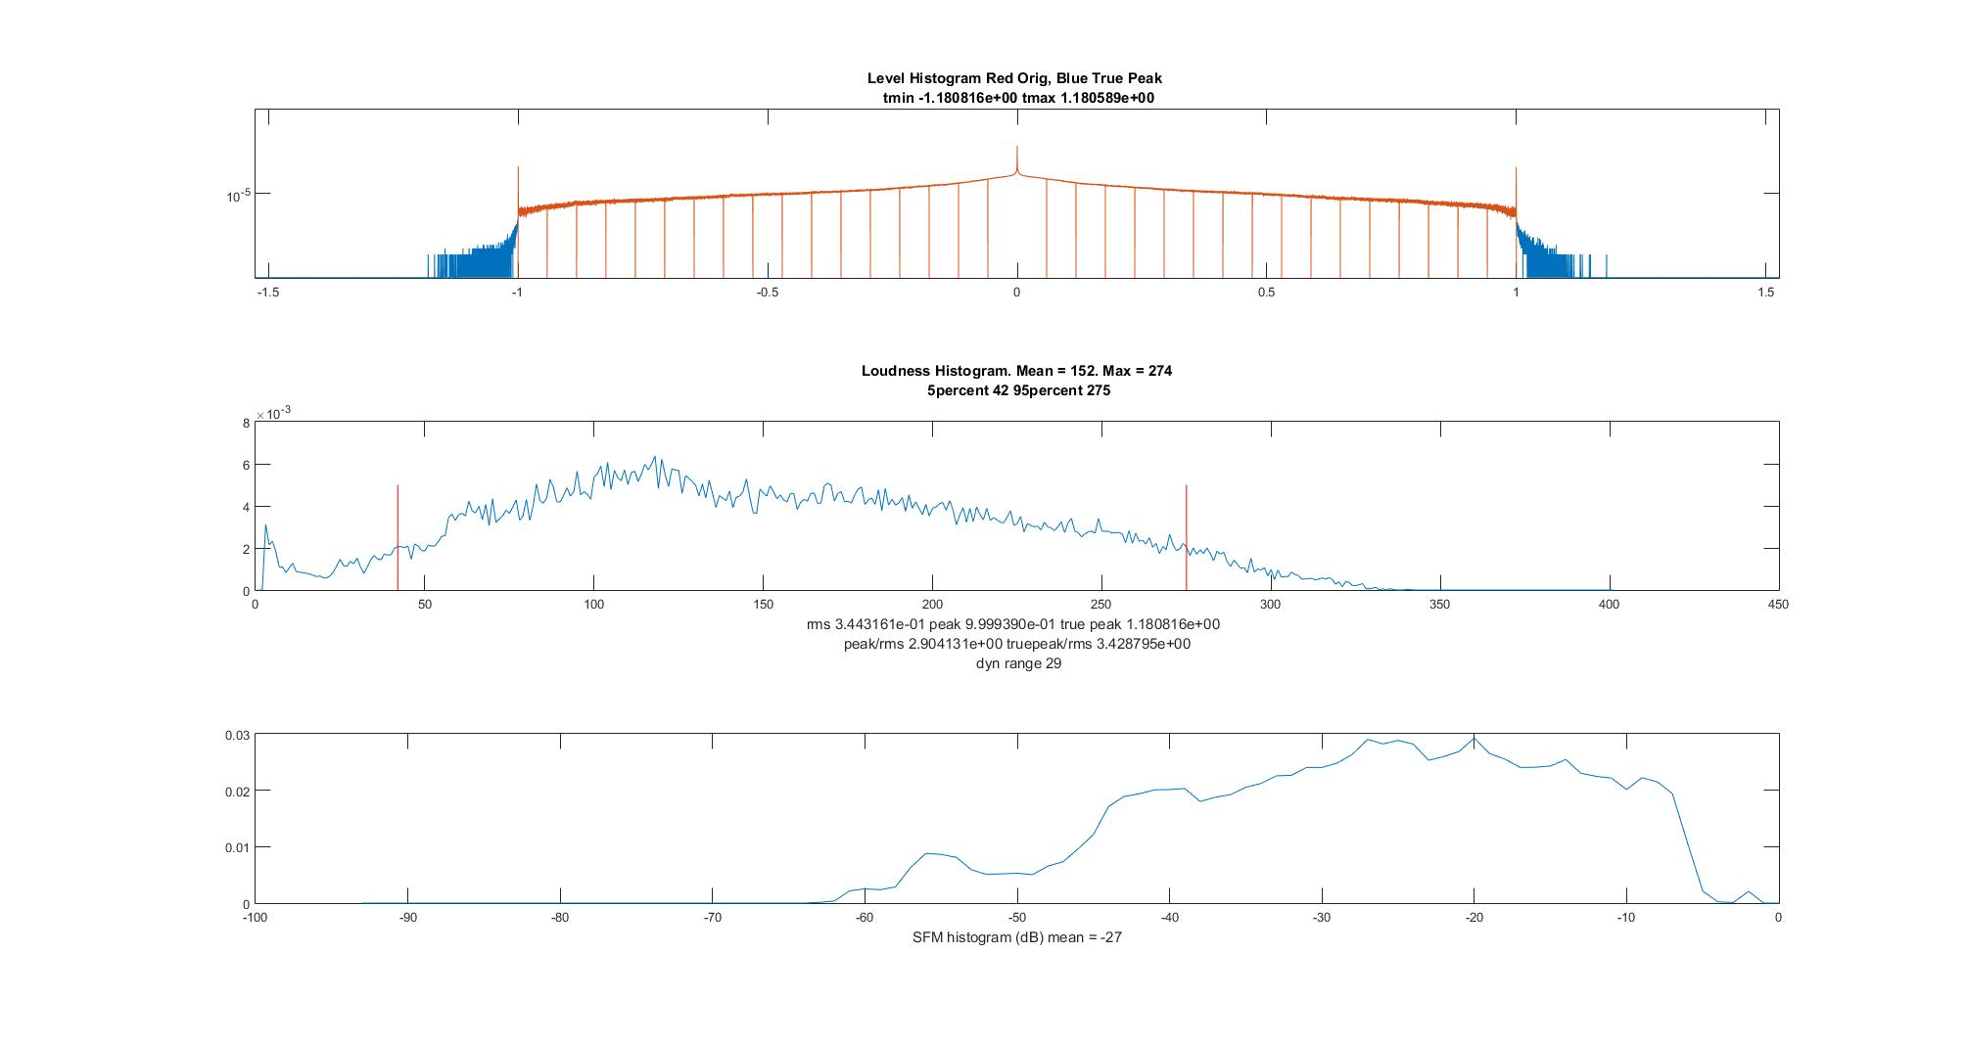
Now, a very different example. There will be a quiz on this one. ☺

Slide 20
The good news, first:
There’s still some dynamic range, due to the changes in spectrum, but look at the peak/rms ratio.
On to the bad news.

Slide 21
And the bad news:
First, the original (not oversampled) has been adjusted with a very small ratio gain change WITH NO DITHERING!
That’s what those weird zeros in the red plot at the top show.
It’s clipped. A lot. I won’t use the appropriate (but also inappropriate) adjectives here. See those “rails” at +- 1? Yep. Clipped.
The intersample overs are frankly breathtaking. Yes, this would be the track we found some ‘interesting’ DAC performance with.
Bass is not supposed to have a high-frequency ‘chirp’ or ‘crunch’.
It’s necessary to nerf this by 3dB to put it through all DAC’s.
Why, WHY WHY WHY?

Slide 22
Another exercise in intersample overs:

Slide 23
Something a bit unique:
^ Yes, they did that!

Slide 24
Did you see that?
They clipped the PCM data substantially.
It is clipped well inside the +-1 range.
It is clipped so that there are NO INTERSAMPLE OVERS
So, somebody was in fact looking at intersample overs.
The result is a question of art. It is what it is. Note that there are both loud and quiet parts of this (heavy metal, yes!) track. There are dynamics.

Slide 25
Something very, very old:

Slide 26
That’s what one might expect from a very old track. This particular track was cut when I was 4 years old. Needless to say it was mono, on mag tape.

Slide 27
Something completely different:

Slide 28
Different, indeed.
Look at the clipping.
Look at the clipping, again. Second and third most common levels are –max and +max.
They are clipped well inside max range.
There are no intersample overs to speak of.
So why?
I don’t know. It is what it is.
Also, the missing codes are a bit much.

Slide 29
And here, I don’t quite know what to say.

Slide 30
Finally, a massive total over a very large corpus I can’t mention:

Slide 31
And then there’s Lossy Codecs
Your stuff is going to go through lossy codecs
Give it at least 1dB, better 3dB for the codec to work
Clipping at the codec input will raise the codec rate or lower the codec quality.
KEEP IT DOWN!

Slide 32
The moral of the story:
There are some substantial whoppers out there in terms of production.
There are several ways of dealing with intersample overs.
Any time you approach max or min too closely, you’re going to create massive difficulties for downstream processing from codecs to equalizers to volume controls.

Slide 33
So, I assume that when you produce something, you want it to sound just the same when the listener gets it, right?
Do not insist on getting to +- max. Give yourself a 3dB pad
Check your intersample overs
Make sure you don’t have missing codes, faulty dithering, etc.
Look at your peak/rms and loudness ratios
Remember, loud is only good when it actually sounds good.

