Slide 1
Acoustic Measurement Systems 101
Bob Smith
Principal Scientist, Acoustic Systems Physio-Control

Slide 2
Agenda
Overview of an Acoustic Measurement System
System Calibration
Microphones
Measurement System Comparisons
Dedicated Hardware vs. Computer + SW
Audio Interfaces
Example real world use
Demonstrations

Slide 3
Input Overview

Slide 4
Output Overview

Slide 5
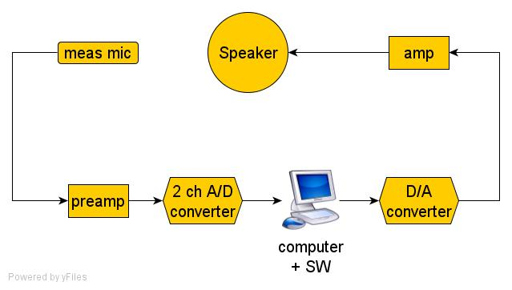
1 Channel System

Slide 6
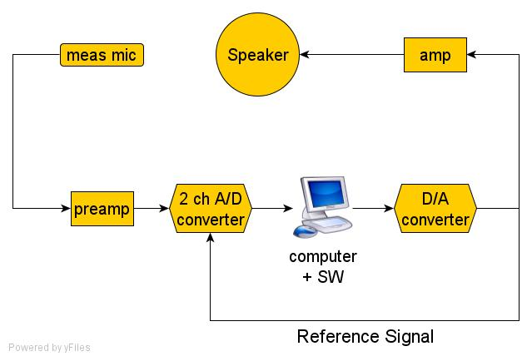
2 Channel System

Slide 7
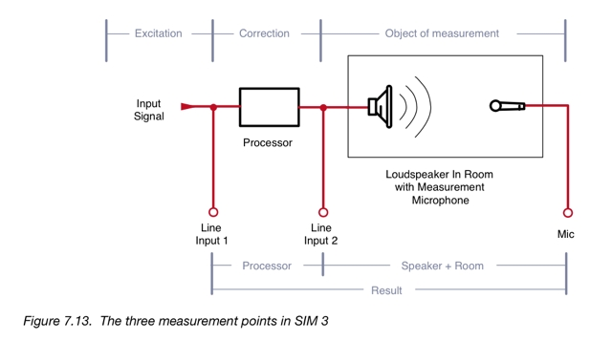
3 Channel System

Slide 8
System Calibration
Microphone mV/Pa
Gain staging between mic and digital domain
Digital domain 0dBFS representation
How many mV / Pa at microphone = ?? dBFS in digital domain
Mic calibrator (level only)
Bruel & Kjaer 4231 Type 1 NIST traceable ~ $2K
Landtek ND9 – not traceable ~ $120

Slide 9
System Calibration
If the mv/Pa is known for a measurement mic the following can be used in place of a mic calibrator to get close to calibrated SPL levels:
Signal generator (even an iPod will work)
AC voltmeter with a mV scale
Set the sig gen for 1 KHz (or use 1 KHz wavefile)
Connect sig gen to voltmeter and adjust output such that the voltmeter reads the same mV as the mic mV/Pa
Now connect the sig gen output between Pins 2 & 3 of the audio I/O mic preamp input (P48 off!) and adjust the preamp gain for the dBFS representation desired

Slide 10
Gain Staging: -0.05 dBFS no clipping

Slide 11
Gain Staging: 0 dBFS clipping

Slide 12
Gain Staging: -2 dBFS inter-stage clipping

Slide 13
System Cal: 94 dBSPL = -16 dBFS

Slide 14
Measurement Microphones
Bruel & Kjaer, ACO Pacific, Microtech Gefell, DPA
Josephson, Earthworks, LinearX
Beyerdynamic MM1, Audix TM1
Dayton EMM-6, Nady CM-100, The B word
DIY Panasonic wm61a

Slide 15
Measurement Microphones
Frequency Response Accuracy
Off axis performance (how omni is omni?)
Self Noise
Dynamic Range
Maximum SPL

Slide 16
DPA 4006 Polar Response

Slide 17
 |  |  | dB A | mV/Pa | mV/Pa | Hz - Hz | dB | dB | $
mfg | model | type | self noise | sensitivity | measured | freq resp | tol +/- | max SPL | price | notes
ACO+Josephson | 7046+C617 | ext | 12 | 67 | 70.9 | 2-20K | 2.0 | 145 | 2,000
Audix | TM-1 | pre | 28 | 6.5 |  | 20-25K | 2 | 130 | 300
Beyerdynamic | MM-1 | pre | 28 | 15 | 14.9 | 50-16K | 1.5 | 128 | 200
dbx | M2 | pre | NS | 7 | 6.46 | 20-20K | NS | NS | 100
Behringer | ECM-8000 | pre | NS | NS | 10 ~ 14 | 15-20K | 2.5 | NS | 50 | unbal
Nady | CM-100 | pre | NS | 10 | 9.18 | 20-20K | NS | 120 | 50 | unbal
Dayton | EMM-6 | pre | 24 ? | 10 | 8.99 | 18-20K | NS | 127 | 50 | unbal
Earthworks | M-30 | pre | 27 | 8 |  | 9-27K | 1.0 | 150 | 650
Earthworks | M-50 | pre | 22 | 30 |  | 3-50K | 1.0 | 142 | 1,300
DPA | 4003 | pre | 15 | 40 |  | 10-20K | 2.0 | 135 | 1,925
DPA | 4006 | pre | 15 | 10 |  | 10-20K | 2.0 | 124 | 1,925
Sennheiser | MKH-20 | ext | 10 | 25 |  | 12-20K | 2.0 | 135 | 1,200
Schoeps | CMC6+MK2 | ext | 11 | 15 |  | 20-20K | 0.5 | 130 | 1,800
Josephson | C550H | pre | 26 | 10 | 9.85 | 20-20K | 2.0 | 135 | 400
Josephson | 606+KA11N | ext | 15 | 15 |  | 20-20K | 2.0 | 140 | 1,280 | NA

Slide 18
Microphone Calibration
Reciprocity – primary standard method
IEC 61094-2, edition 2
Free Field Comparison
IEC 61094-5, edition 1
Pistonphone
typically 250 Hz, 114 or 124 dBSPL
Electronic Sound Calibrator
typically 1000 Hz, 94, 104, 114 or 124 dBSPL

Slide 19
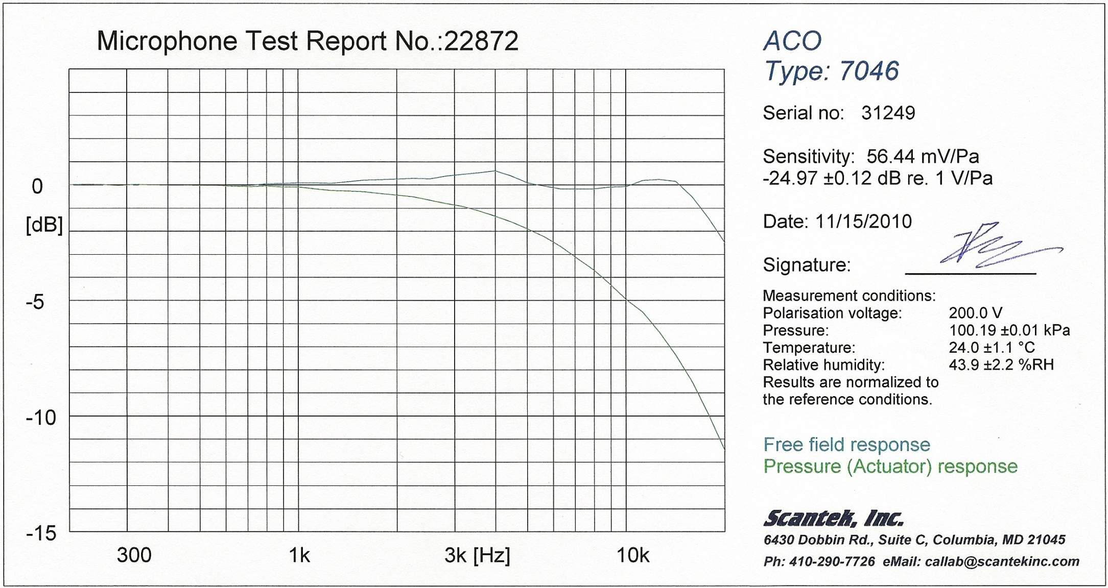
Reference Mic 1

Slide 20
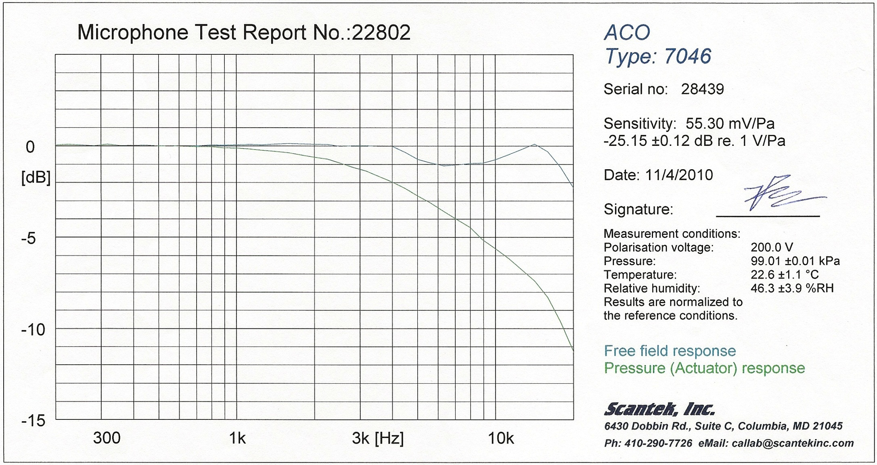
Reference Mic 2

Slide 21
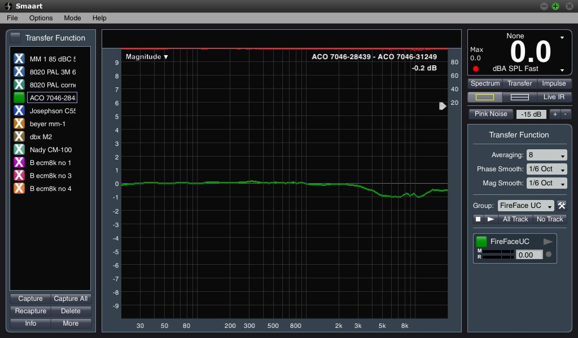
Free Field Comparison Calibration

Slide 22
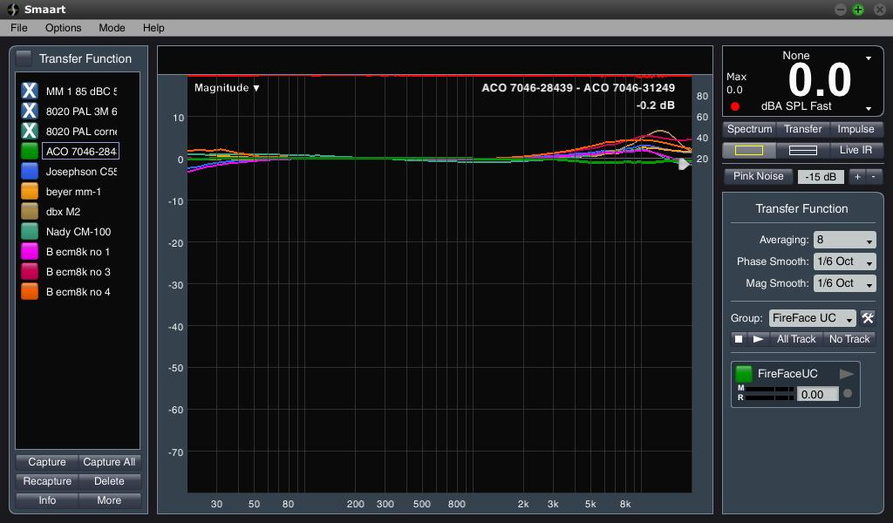
Measurement Mics Compared

Slide 23
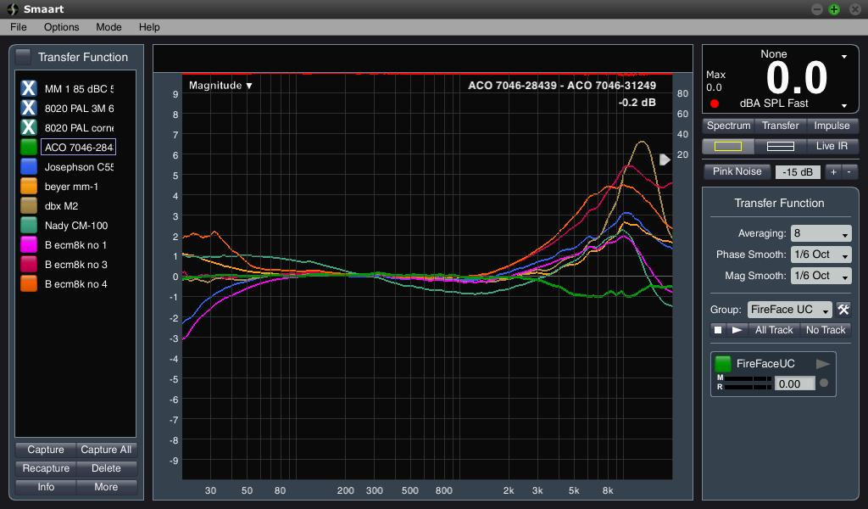
Measurement Mics Compared

Slide 24
ACO 7046-28439

Slide 25
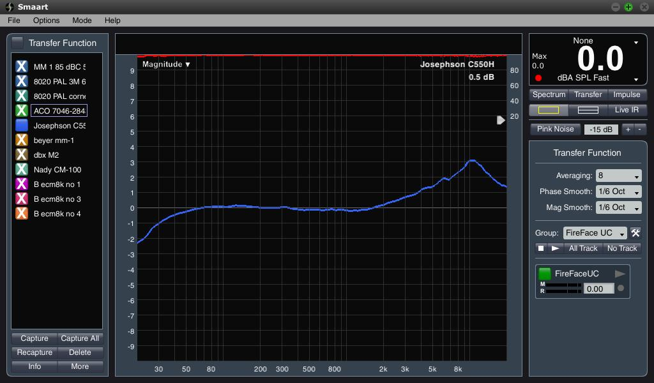
Josephson C550H-5938

Slide 26
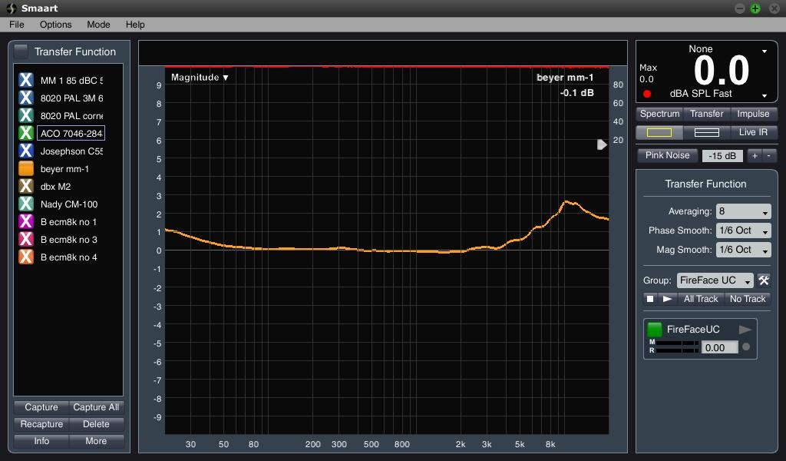
Beyerdynamic MM1-2267

Slide 27
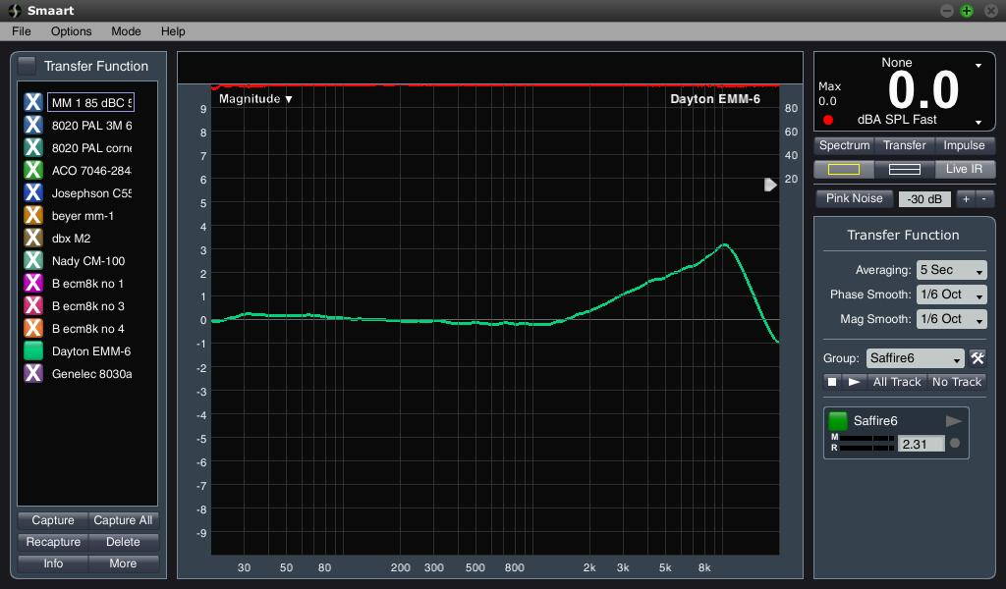
Dayton EMM6-2372

Slide 28
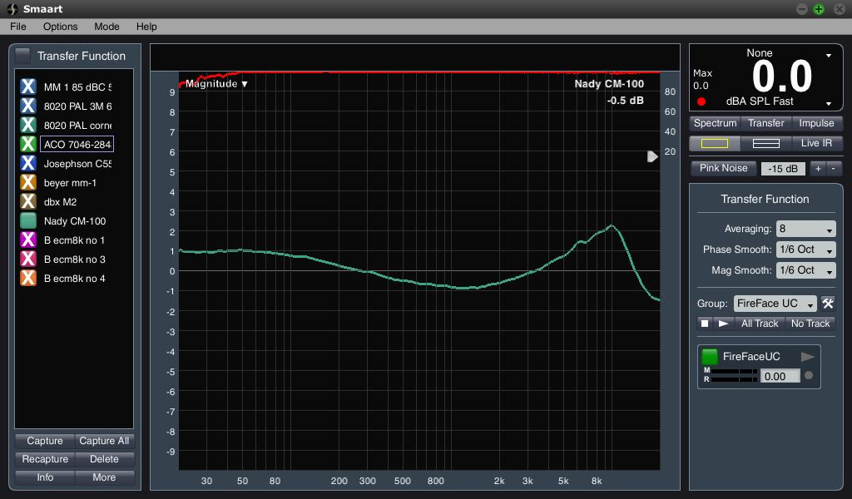
Nady CM-100

Slide 29
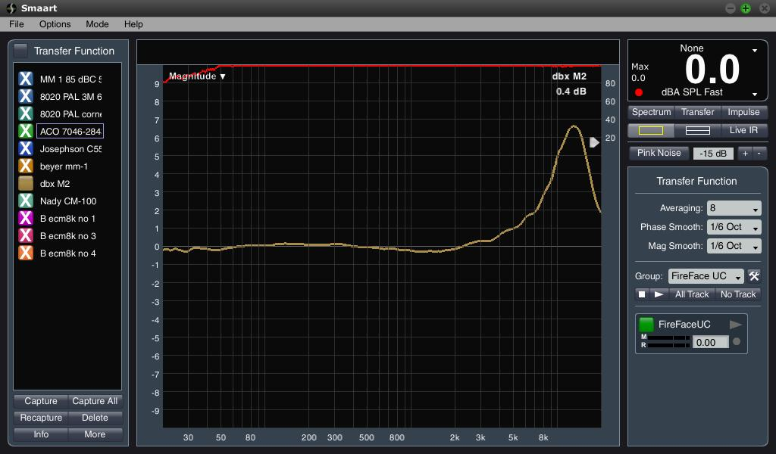
dbx M2

Slide 30
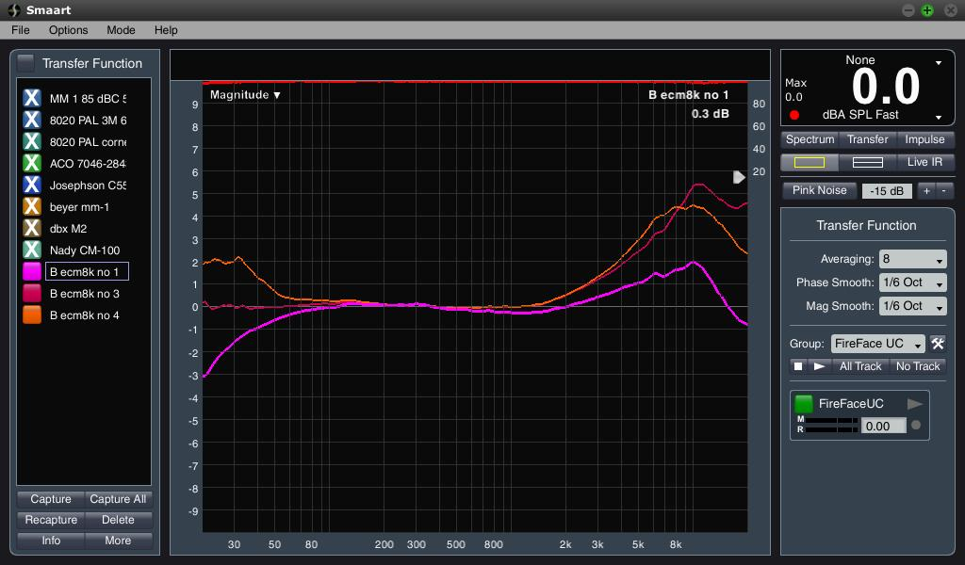
The B company ECM8000 3 mics

Slide 31
Measurement Systems
Bruel & Kjaer, NT Instruments, Meyer SIM, Audio Precision, Rohde & Schwarz
CLIO, LinearX, DRA MLSSA
EASERA, Smaart, Praxis
Omnimic, TrueRTA, ETF5
Room EQ Wizard, Speaker Workshop

Slide 32
Dedicated HW vs. Computer + SW
Purpose Specific Imbedded OS instead of Win7, Lion or Linix
System crashes, BSOD occurrence minimized
Dedicated controls for rapid feature access
Minimal or no system integration
System calibration
Can be more $$$

Slide 33
Rohde & Schwarz UPV

Slide 34
Audio Precision SYS-2722

Slide 35
Measurement Systems
Bruel & Kjaer, NT Instruments, Meyer SIM, Audio Precision, Rohde & Schwarz
Purpose built imbedded OS / hybrid with host OS
Turnkey
High Accuracy
Calibrated
Comprehensive
$5K to $50K

Slide 36
Measurement Systems
CLIO, LinearX, DRA MLSSA
Hybrid embedded OS / computer host OS
Minor integration
High Accuracy
Calibrated
Comprehensive
$2K to $10K

Slide 37
Measurement Systems
EASERA, Smaart, Praxis
Host OS
Moderate integration
Accuracy depends on quality of audio interface
Can be calibrated
EASERA comprehensive, Smaart more focused
$800 to $1K except EASERA
$800 to $5K EASERA depending on configuration

Slide 38
Measurement Systems
Omnimic, TrueRTA, ETF5
Host OS
More complex integration except Omnimic
Accuracy depends on quality of audio interface
Can be calibrated
Omnimic is a unique system
Useful feature sets
Free to $300

Slide 39
Measurement Systems
Room EQ Wizard, Speaker Workshop
Host OS
DIY integration
Accuracy depends on quality of audio interface
Can be calibrated
Useful feature sets
Free

Slide 40
Audio Interfaces
Computer Interface
Firewire 400 & 800
USB 1.1, 2, 3
Computer internal bus
OS drivers

Slide 41
Audio Interfaces - Examples
RME Fireface UC $1300
MOTU UltraLite-mk3 $550 (FW + USB)
M-Audio Fast Track Pro $200
Lexicon I-Onix U22 $250
Focusrite Scarlett 2i2 $150
Mackie Onyx Blackjack $150
Tascam US-100 $100

Slide 42
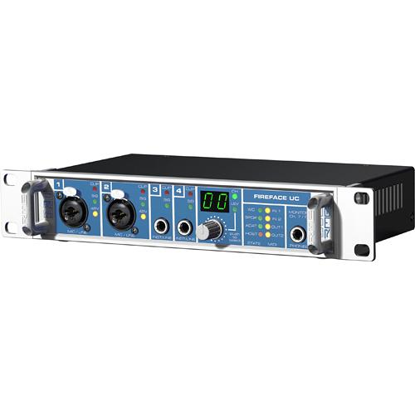
RME Fireface UC (USB)

Slide 43
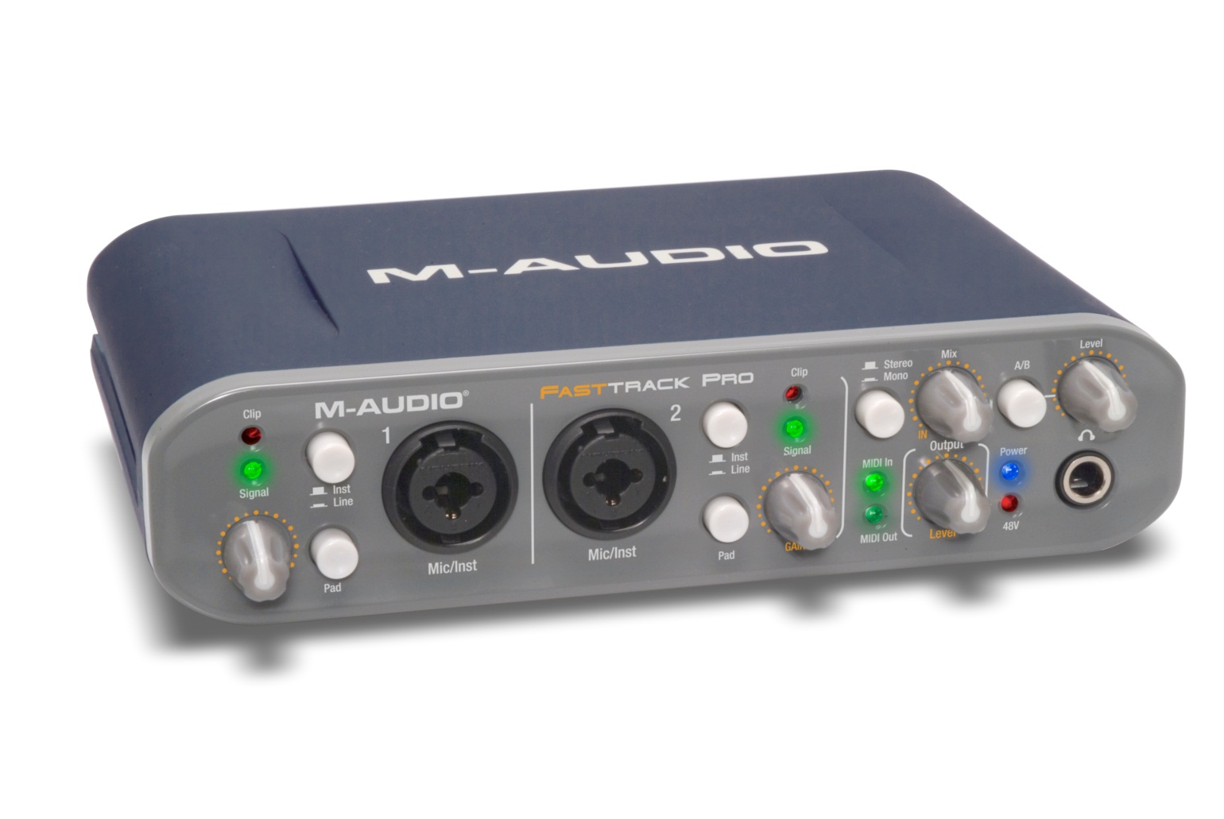
M-Audio Fast Track Pro

Slide 44
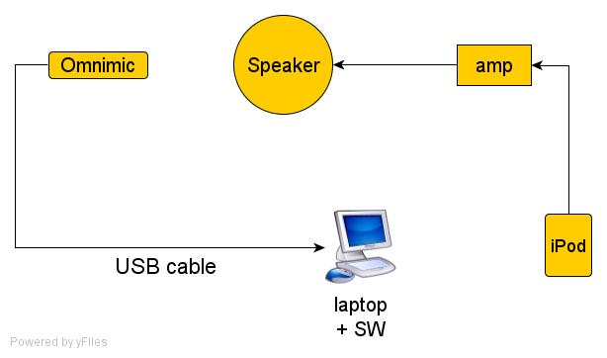
1 Channel System Example

Slide 45
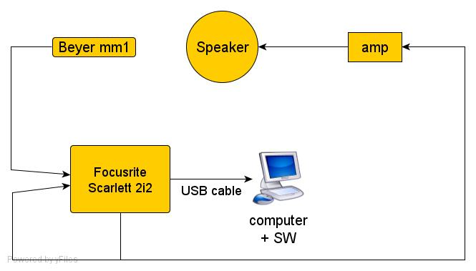
2 Channel System Example

Slide 46
Useful Integration Tools
dpc latency checker
deferred procedure calls timed
Microsoft rattv3
time spent in ISR, deferred procedure calls and timer dpc
Centrance ASIO latency checker

Slide 47
Real World Measurements
Speaker frequency response
Measurement system comparison
Microphone comparison
Acoustic door performance

Slide 49
Genelec 8030a – ACO 7046 mic

Slide 50
Genelec 8030a – ACO 7046 mic

Slide 51
Genelec 8030a – Dayton EMM6 mic

Slide 52
Genelec 8030a – 7046 - EMM6 mics

Slide 53
Acoustic Door Gasket Sound Leak

Slide 54
Acoustic Door Gasket Seal Improved

Slide 55
Demonstrations
Meyer SIM
SmaartLive v7
Speaker measurement – nominal
Speaker measurement – contaminated
Delay measurement
Omnimic – time permitting
Room EQ Wizard – time permitting

Slide 56
Links to Mfgs mentioned
Measurement Microphones:
http://www.bksv.com/Products/TransducersConditioning/AcousticTransducers/Microphones.aspx
http://www.acopacific.com/micdetal.html
http://www.acopacific.com/chart.html
http://www.microtechgefell.de/index.php/en/measuring-equipment/sound--noise
http://www.dpamicrophones.com/en/products.aspx?c=Catalog&category=234
http://www.josephson.com/pdf/srs5.pdf
http://www.earthworksaudio.com/our-microphones/m-series/
http://www.linearx.com/products/microphones/m51/M51_1.htm
http://north-america.beyerdynamic.com/shop/ct/conference-technology/product-line/microphones/special-microphones/mm-1.html
http://www.audixusa.com/docs/products/TM1.shtml
http://www.daytonaudio.com/index.php/emm-6-electret-measurement-microphone.html
http://www.nady.com/cm100.html
http://www.behringer.com/EN/Products/ECM8000.aspx

Slide 57
Links to Mfgs mentioned
DIY wm61a measurement mic:
http://www.johncon.com/john/wm61a/
http://www.linkwitzlab.com/sys_test.htm
http://www.speakerbuilder.net/web_files/Articles/diymic/diymicmain.htm
Microphone Calibration Service:
http://www.scantekinc.com/
Microphone Field Calibrators (SPL level):
http://www.bksv.com/products/telecomaudiosolutions/electroacousticsaccessories/soundcalibratortype4231.aspx
http://01640c0.netsolhost.com/fieldcali.htm
http://www.acopacific.com/splcali.html
http://www.ebay.com/sch/i.html?_from=R40&_trksid=m570.l2736&_nkw=nd9+calibrator
Audio Interfaces:
http://www.rme-audio.de/en_products_fireface_uc.php
http://www.motu.com/products/motuaudio/ultralite-mk3
http://www.m-audio.com/products/en_us/FastTrackPro.html
http://www.focusrite.com/products/audio_interfaces/scarlett_2i2/
http://www.mackie.com/products/onyxblackjack/
http://tascam.com/product/us-100/

Slide 58
Links to Mfgs mentioned
Acoustic Measurement Systems:
http://www.bksv.com/
http://www.nti-audio.com/
http://www.meyersound.com/
http://ap.com/
http://www.rohde-schwarz.us/en/products/test_and_measurement/audio/audio_products/
http://www.audiomatica.com/clio10/home1.htm
http://www.linearx.com/
http://www.mlssa.com/
http://www.renkus-heinz.com/easera/index.html
http://www.rationalacoustics.com/
http://www.libinst.com/
http://www.parts-express.com/pe/showdetl.cfm?Partnumber=390-790
http://www.trueaudio.com/
http://www.etfacoustic.com/
http://www.hometheatershack.com/roomeq/
http://www.audua.com/
http://www.purebits.com/
http://www.sigview.com/

Slide 59
Links to Useful Integration Tools
Useful Integration Tools:
http://www.thesycon.de/deu/latency_check.shtml
http://msdn.microsoft.com/en-us/windows/hardware/gg487354
http://msdn.microsoft.com/en-us/windows/hardware/gg487334
http://centrance.com/downloads/ltu/

